Slide 1
Smart Salary Classification using Ensemble & Traditional Machine Learning Models on UCI Census Data
CAPSTONE PROJECT
Presented By:
Pattapu Chohitha
Seshadri Rao Gudlavalleru Engineering College
Computer Science Engineering

Slide 2
OUTLINE
Problem Statement
System Development Approach (Technology Used)
Algorithm & Deployment (Step by Step Procedure)
Result
Conclusion
Future Scope(Optional)
References

Slide 3
Problem Statement
Employee salary prediction is a crucial aspect of workforce analytics, where compensation is influenced by factors like age, education level, work class, marital status, and job occupation. Manual processing of such high-dimensional data can be inefficient and inconsistent. This project utilizes the UCI Adult Census Income dataset to develop a robust classification system using multiple machine learning algorithms such as Logistic Regression, Decision Trees, Random Forests, SVM, KNN, and Gradient Boosting. The goal is to accurately predict whether an individual's income exceeds $50K per year, enabling fair and automated salary classification and HR decision-making.

Slide 4
System Approach
🔧 System Requirements: ▪ Python 3.9+ ▪ Jupyter Notebook / VS Code / Google Collab ▪ UCI Adult Census Income Dataset ▪ Basic computational setup (4GB+ RAM)
📚 Libraries Used: ▪ pandas – for data manipulation ▪ numpy – for numerical operations ▪ scikit-learn – for ML algorithms (LogisticRegression, DecisionTree, RandomForest, SVM, KNN, GradientBoosting) ▪ matplotlib – for visualization and outlier detection ▪ joblib – for saving and loading trained models

Slide 5
Algorithm & Deployment
Load and clean the UCI Adult Census Income dataset.
Replace missing values and filter outliers using boxplots.
Encode categorical variables using Label Encoding.
Select relevant features like age, education, occupation, relationship, etc.
Train multiple models: Logistic Regression, Decision Tree, Random Forest, SVM, KNN, and Gradient Boosting.
Evaluate all models using accuracy, confusion matrix, and classification report.
Compare performance to identify the best classifier.
Save the final model using joblib.
Predict salary class (<=50K or >50K) for new employee input.

Slide 6
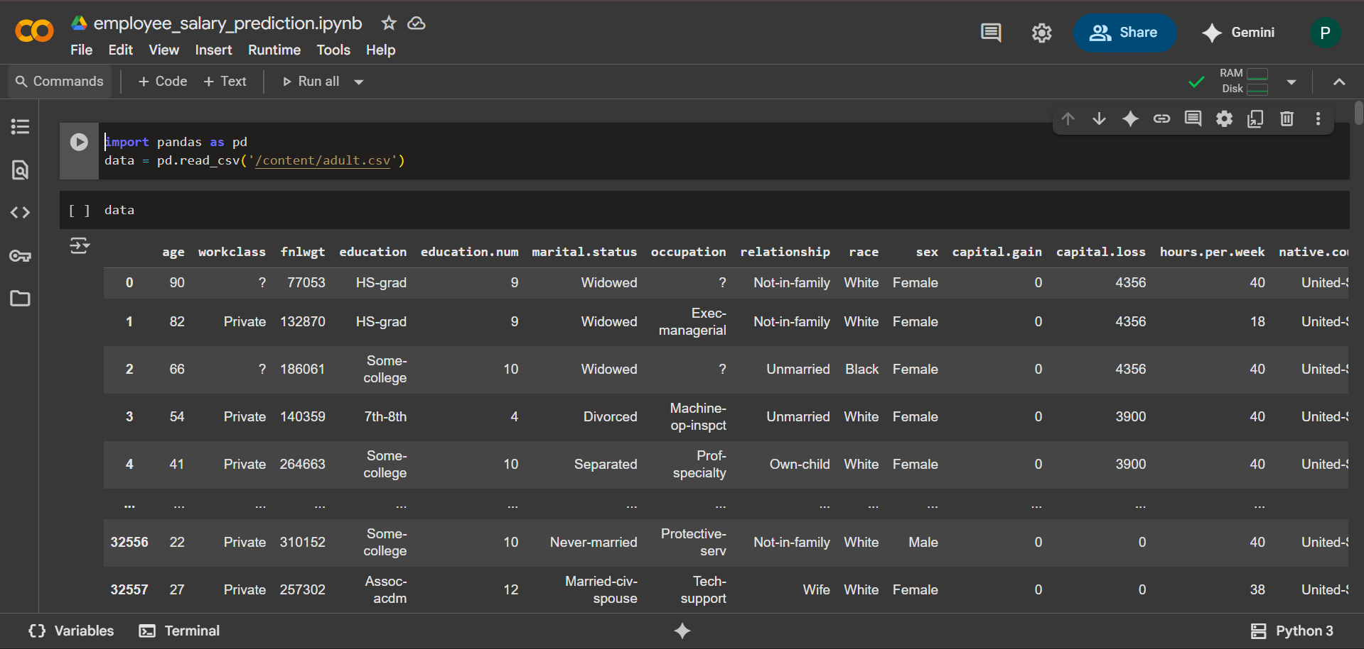
Result

Slide 7
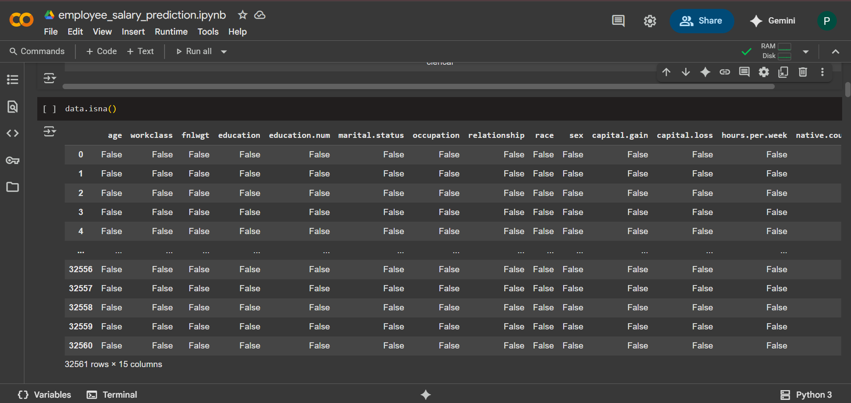
Data Cleaning – Identifying Null or Missing Values

Slide 8
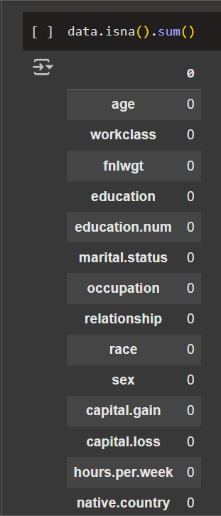
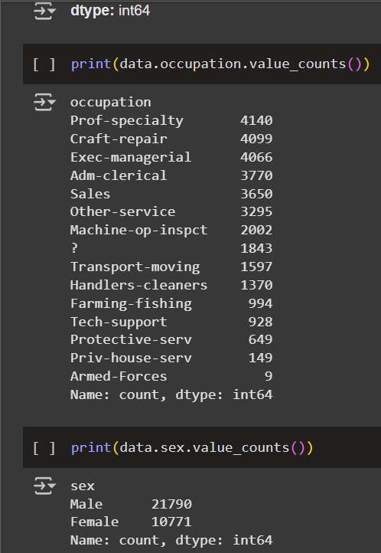
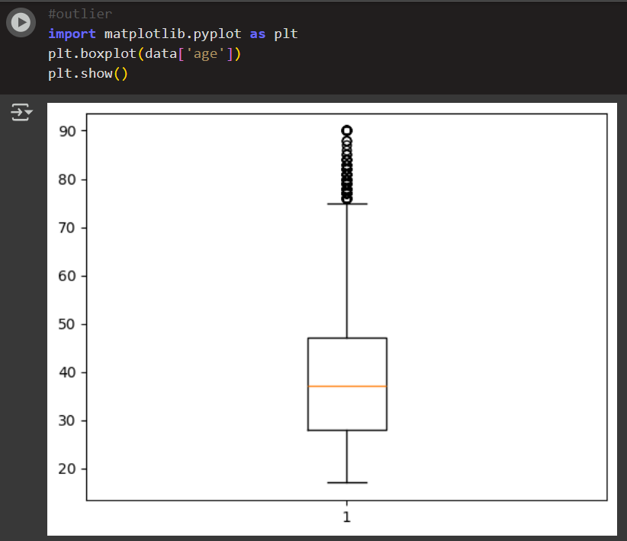
Data Visualization – Outlier Detection using Boxplots

Slide 9
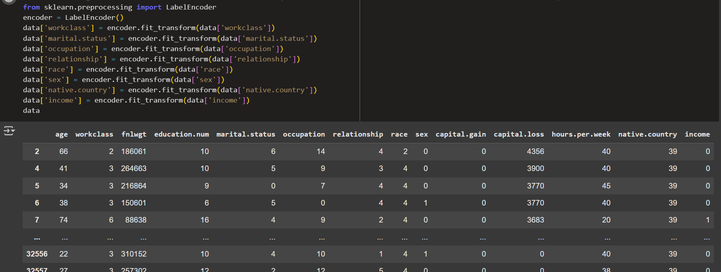
Categorical Feature Encoding using Label Encoder

Slide 10
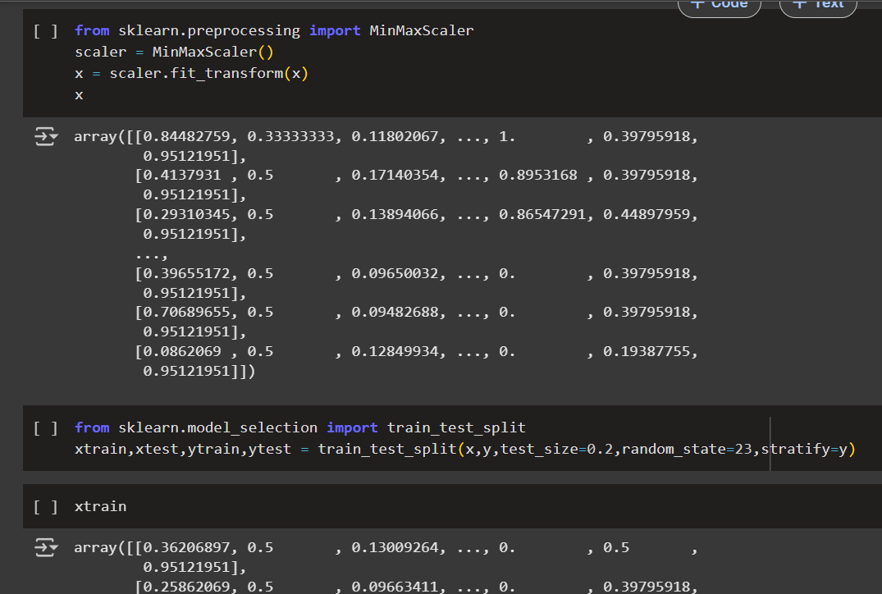
Data Normalization – Preparing Features for Training

Slide 11
TRAINING MULTIPLE CLASSIFIERS WITH STANDARDIZED FEATURES
results = {}
for name, model in models.items():
pipe = Pipeline([
('scaler', StandardScaler()),
('model', model)
])
pipe.fit(X_train, y_train)
y_pred = pipe.predict(X_test)
acc = accuracy_score(y_test, y_pred)
results[name] = acc
print(f"{name} Accuracy: {acc:.4f}")
print(classification_report(y_test, y_pred))
from sklearn.metrics import accuracy_score, classification_report
from sklearn.linear_model import LogisticRegression
from sklearn.ensemble import RandomForestClassifier, GradientBoostingClassifier
from sklearn.neighbors import KNeighborsClassifier
from sklearn.svm import SVC
from sklearn.preprocessing import StandardScaler, OneHotEncoder
X_train, X_test, y_train, y_test = train_test_split(x, y, test_size=0.2, random_state=42)
models = {
"LogisticRegression": LogisticRegression(),
"RandomForest": RandomForestClassifier(),
"KNN": KNeighborsClassifier(),
"SVM": SVC(),
"GradientBoosting": GradientBoostingClassifier()
from sklearn.pipeline import Pipeline
from sklearn.model_selection import train_test_split
}
results = {}
for name, model in models.items():
pipe = Pipeline([
('scaler', StandardScaler()),
('model', model)
])
pipe.fit(X_train, y_train)
y_pred = pipe.predict(X_test)
acc = accuracy_score(y_test, y_pred)
results[name] = acc
print(f"{name} Accuracy: {acc:.4f}")
print(classification_report(y_test, y_pred))

Slide 12
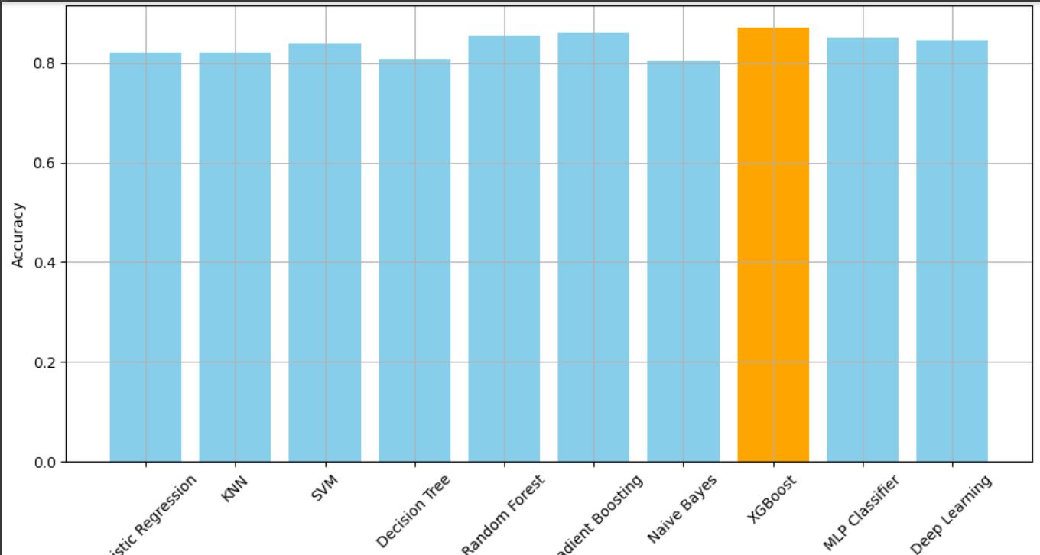
Model Accuracy Comparision

Slide 13
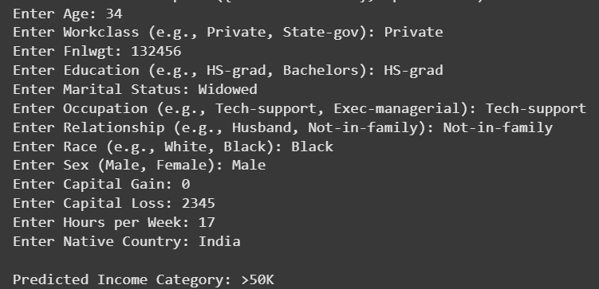
Output
Github Link : https://github.com/PattapuChohitha/smart-salary-prediction-ml-classifiers

Slide 14
Conclusion
The project successfully demonstrated the use of machine learning techniques for income classification using the UCI Adult Census Income dataset. Multiple models were implemented, including Logistic Regression, Decision Tree, Random Forest, SVM, KNN, and Gradient Boosting. Among these, ensemble models like Random Forest and Gradient Boosting delivered higher accuracy compared to traditional classifiers.
The solution proved effective in handling real-world categorical data through label encoding and in identifying relevant patterns for income prediction. The use of evaluation metrics like accuracy and confusion matrix helped compare model performances objectively.
Challenges included dealing with missing values, class imbalance, and categorical data preprocessing. Improvements can be made by tuning hyperparameters, applying feature selection, or deploying the best model as a web application for real-time use.

Slide 15
Future scope
▪ Implement hyperparameter tuning (GridSearchCV or RandomizedSearchCV) to improve model performance. ▪ Use ensemble techniques like XGBoost or LightGBM for better prediction accuracy. ▪ Deploy the best-performing model as a web application using Flask or Streamlit. ▪ Integrate with HR systems for real-time salary classification and decision-making. ▪ Apply explainable AI tools (e.g., SHAP or LIME) to interpret model predictions. ▪ Extend the dataset with new demographic or job market attributes for broader insights.

Slide 16
References
UCI Machine Learning Repository – Adult Dataset 🔗 https://archive.ics.uci.edu/ml/datasets/adult
Kaggle – Adult Census Income Dataset 🔗 https://www.kaggle.com/datasets/uciml/adult-census-income
Scikit-learn Documentation – Machine Learning in Python 🔗 https://scikit-learn.org/stable/
Matplotlib Documentation – Visualization in Python 🔗 https://matplotlib.org/stable/contents.html
Joblib – Persistence and Model Serialization 🔗 https://joblib.readthedocs.io/en/latest/
Géron, A. (2019). Hands-On Machine Learning with Scikit-Learn, Keras, and TensorFlow (2nd ed.). O’Reilly Media.

Slide 17
THANK YOU

