Slide 1
Group 04 Presentation
‘Ungrading’ simulator

Slide 2
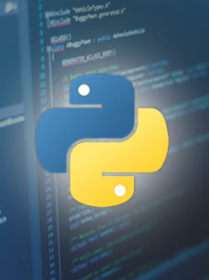


Project software architecture
Benjamin McGregor

Slide 3

Python
Our program was written in Python.
We chose this language due to its flexibility and our previous experience with it.
It has many useful libraries and is easier to use than more syntactically complex languages like Java or C++.
Allowed us to use a mix of OOP and functional programming.

Slide 4
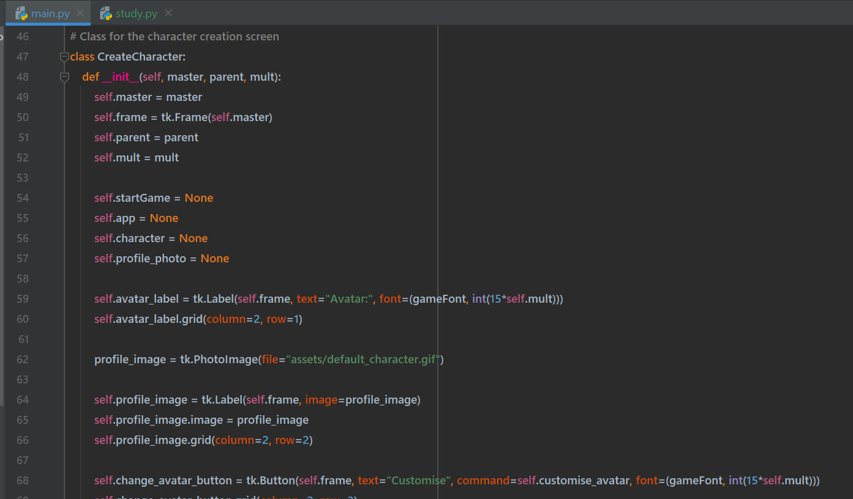
Python – usage
All aspects of simulator written using Python code.
We used OOP for the main file, with the code for the main screens, setup and in-game mechanics.
We used functional programming for modular aspects like the grade calculator and avatar customisation
This also allowed us to work on different parts of the simulator separately with minimal code conflicts.

Slide 5
tkinter
The Python Tkinter library was used for all of our interfaces.
We chose it due to its adaptability and the previous experience of members.
It also can be easily used with an object-oriented approach, which made our code extremely modular and organised.
We wanted to use a totally offline simulator with simple installation, so used a Tkinter-based GUI instead of something like a webapp.

Slide 6
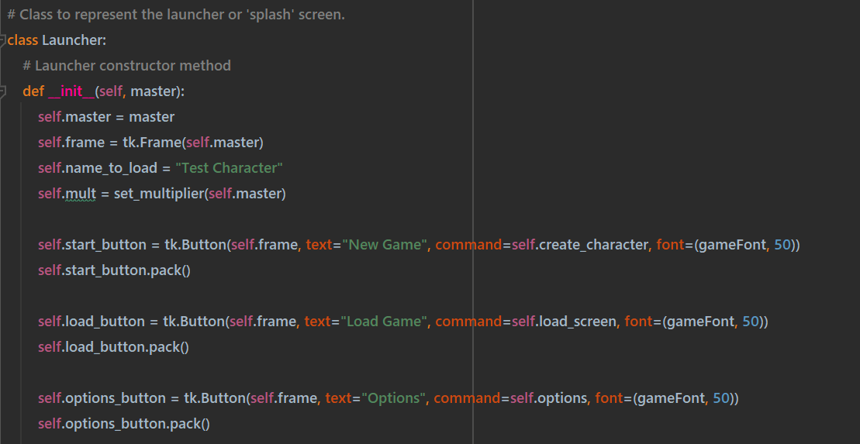
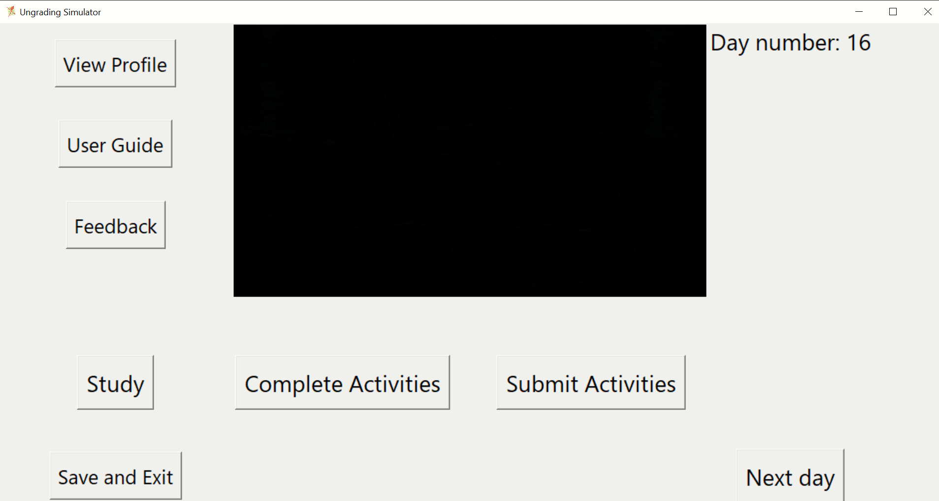
Tkinter - usage
We used Tkinter in the main file to create class-based screens that instantiated other screen objects as the user navigated the simulator.
For some other features we used it in a functional way to create screens and then send the outputs back to the main file.
We used various Tkinter features to create varying types of display with several types of widgets and layout managers.

Slide 7

SQLite3
For all of our databases we used the sqlite3 Python library.
We chose this due to our previous experience with SQL and the flexibility and mobility.
It is included with the standard python installation.
Allows the use of standard SQL statements to operate on and create databases.
Creates simple .db files that can be easily created and managed.

Slide 8
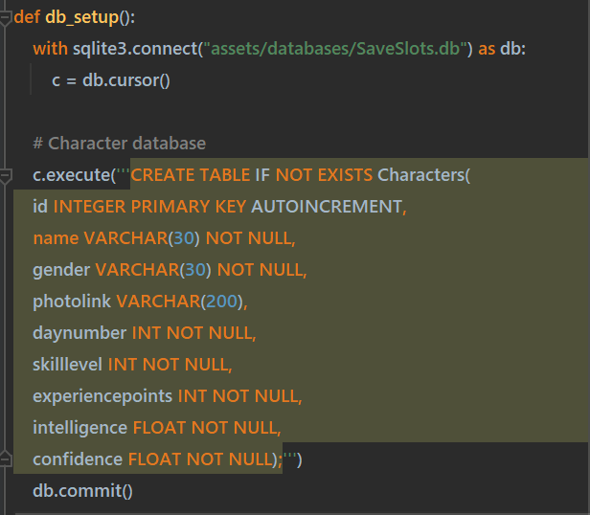
SQLite3 - Usage
We used sqlite3 databases for character data, activities, feedback and topics.
This allowed us to create a dynamic saving/loading feature where character details are automatically saved and then can be loaded again at any time.
SQL statements were used to fetch character data for the final score calculation and all of the character information that could be viewed in the game.

Slide 9
DIFFERENT METHODS OF COMMUNICATION
Bilal Patel
GROUP CHAT (Worked very well)
- Any questions were answered quickly e.g what kind of format should we use?
All key information from the client/group meetings were messaged onto the group so all group members were informed.
Primary source of communication – reminders for client meetings, meeting location and attendance.
WEEKLY STANDUPS
– These standups took place on a wednesday
Worked well as we were in person therefore communication was a lot easier.
Easier to see progress and if everybody is on track (Live demos)
TEAMS MEETING (least effective)
- This method was used when some group members were unable to attend in person
= Effective as we were still able to communicate key information so we could progress, progression wasnt halted.
Sometimes we would have technical issues which caused inconvenience.

Slide 10


Something non-technical that you learned during the project Amrit pal Singh
Group work allows a group member to give their viewpoints.
Planning phase is really important for a group project.
Face-to-face meetings are more effective compared to virtual meetings.
Estimating the time frame and weight for the task is an important aspect.

Slide 11
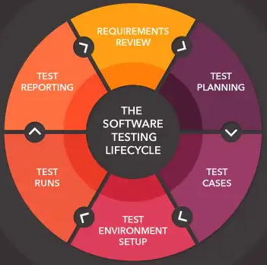

Something non-technical that you learned during the project Amrit pal Singh
Precise testing should be conducted for every feature implemented.
Regular meetings and planning are an essential part of a group project.
Scrum Master should know the strengths of everyone to give work accordingly.

Slide 12
Taking it Further
Ellie Palmer, Group 04-C

Slide 13
Possibilities for Expansion:
Details and fine-tuning for authenticity
Evaluating previous features to include or rework into project
Work on debugging any possible problems that could arise after release
Before any other additions, user feedback must be taken into consideration throughout the implementation process

Slide 14
User Feedback
Can be used for finding bugs and learning where to improve
Bug reporting feature or contact information
Design features that are needing the most improvement will be improved first
Features to pick and add to will be decided primarily based on user feedback

Slide 15
Examples of features to implement:
Pixel art of different places across campus that display according to the user’s activity, e.g. the Library for studying.
Description of the simulator and designer information (such as contact details) on the splash screen.
Choice of using colours or grayscale themes to assist people with optical or other disabilities.

Slide 16
Overview of the purpose of the project.

Slide 17
Why was the project carried out?
What is the aim of the project?

Slide 18

Why was the project carried out?
No prior experience
Awareness
Uncertainty
Image reference

Slide 19

What is the aim of the project?
Experience
Clear Understanding
Encourage ungrading approach
Image reference

