Slide 1

PatternAgents
Open Source Design Patterns for Electronic Systems
Tom Moxon
@PatternAgents
Notes:
This Document is only provided under a Non-Disclosure Agreement (NDA).

Slide 2
Beacons for Bees
Applying Geo-Location to
Wild and Domestic Bee Hives

Slide 3
Agenda
Honey Bees / Colony Collapse Disorder
Hardware for Beehives
The Physical Web
Beacons
Proximity Beacon API
Hardware for Beacons
Beacon Reference Designs
Source: @PatternAgents

Slide 4
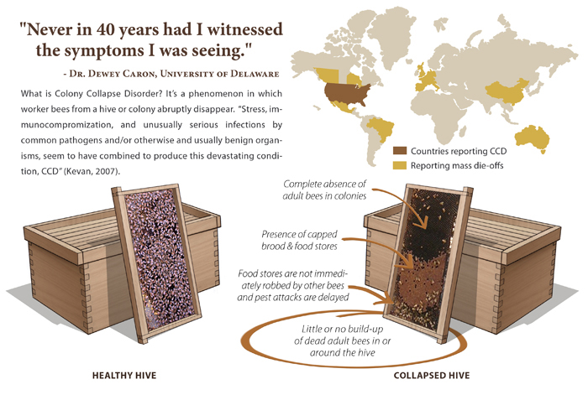
Honey Bee CCD
Graphics by Tony Linka

Slide 5
Suspected CCD Causes
There are many causes that have been attributed to
Honey Bee Colony Collapse Disorder (CCD), including :
Wild Habit Destruction
Mono Crop (single crops lack diverse food supplies)
Neonicotinoids and general pesticide overuse
Mites and other parasites
Fungal, Viral, or other infections (Nosema, IAPV)
General Climate Change Issues
Source: USDA

Slide 6
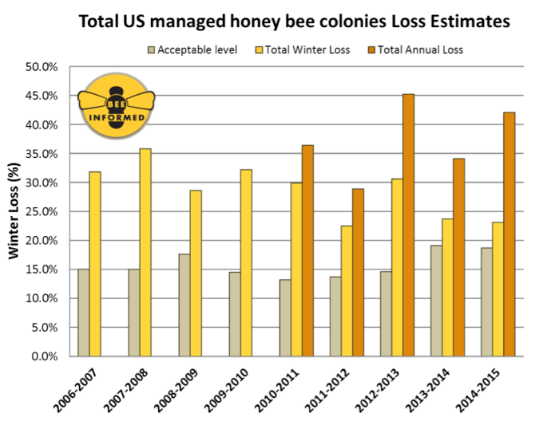
U.S. Honey Bee Surveys
Source: USDA

Slide 7
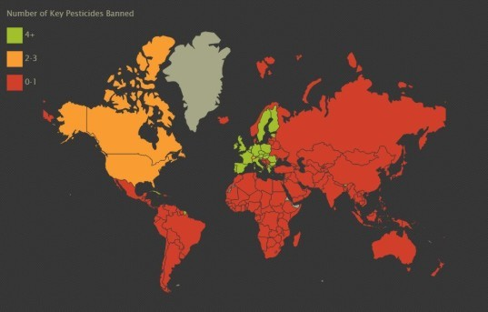
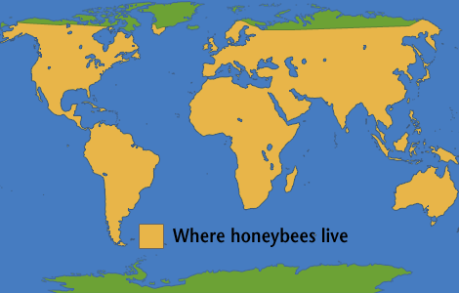
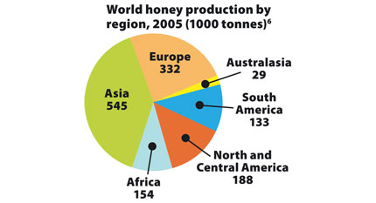
Worldwide Impact
Source: National Geographic

Slide 8
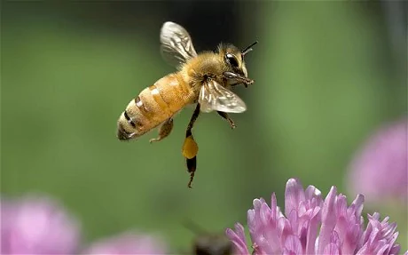
How can we help the Bees?
Plant Bee Friendly Wildflowers (increase biodiversity)
Reduce your use of pesticides (companion crops, etc.)
Raise Awareness of the plight of Honeybees
Consider your own backyard Hive
Locate, measure, and monitor wild Hives (little data)
Source: Univ. Minn/St. Paul

Slide 9
Hardware for Bees
Working with Hives and Bees

Slide 10
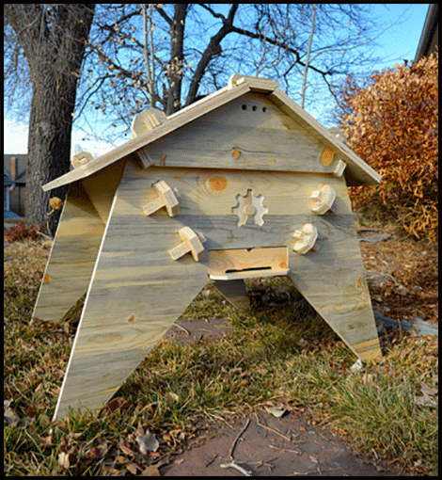
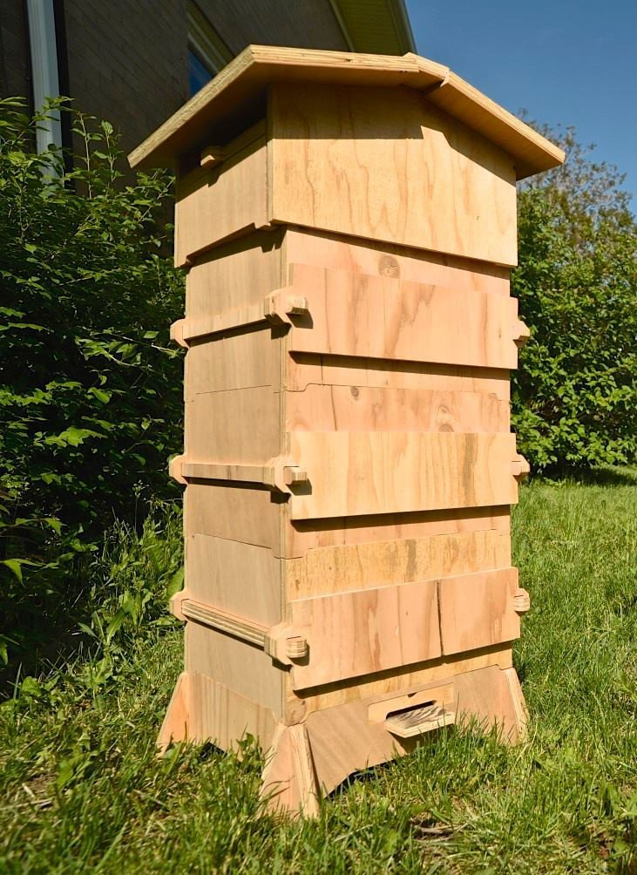
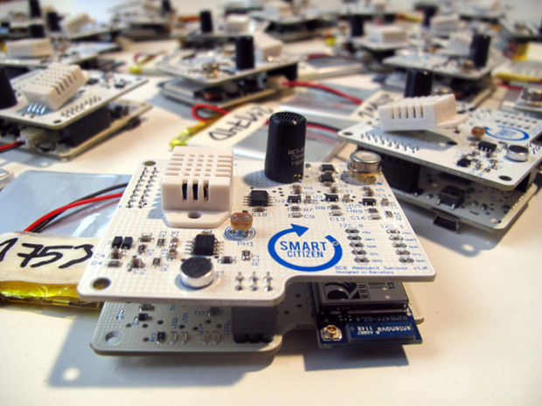
Open Source Beehives
Smart Citizen Sensors
Colorado Top Bar Hive
Efforts like Open Source Beehives have been providing easy to build kits and sensors packages for DIY beekeepers
Barcelona Warre Hive
Source: OpenSourceBeehives

Slide 11
Materials for Hives
Bees are very picky about what goes into the hive
Organic materials (wood, bamboo, paper, etc.)
FR4 (printed circuit board materials) and conformal coating of FR4 are not welcomed by the bees
(out gassing and aging of materials is a problem)
3-D Printing should use undyed, Poly Lactic Acid (PLA) materials, a corn based, biodegradable, plastic that the bees will generally accept into the hive
Source: @PatternAgents

Slide 12
Maintenance for Hives
Bees may coat circuits, wires, and sensors with propolis, if they don't like the materials
If you can coat circuits, wires, and sensors in bee's wax after final test, then the bees will tend to leave them alone
If you can't coat it in bee's wax, consider a laser cut wooden or bamboo box, and seal the box edges and openings with bee's wax
Replaceable covers for in-hive sensors, paper/gauze
Source: @PatternAgents

Slide 13
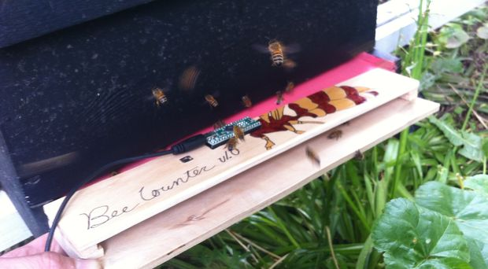
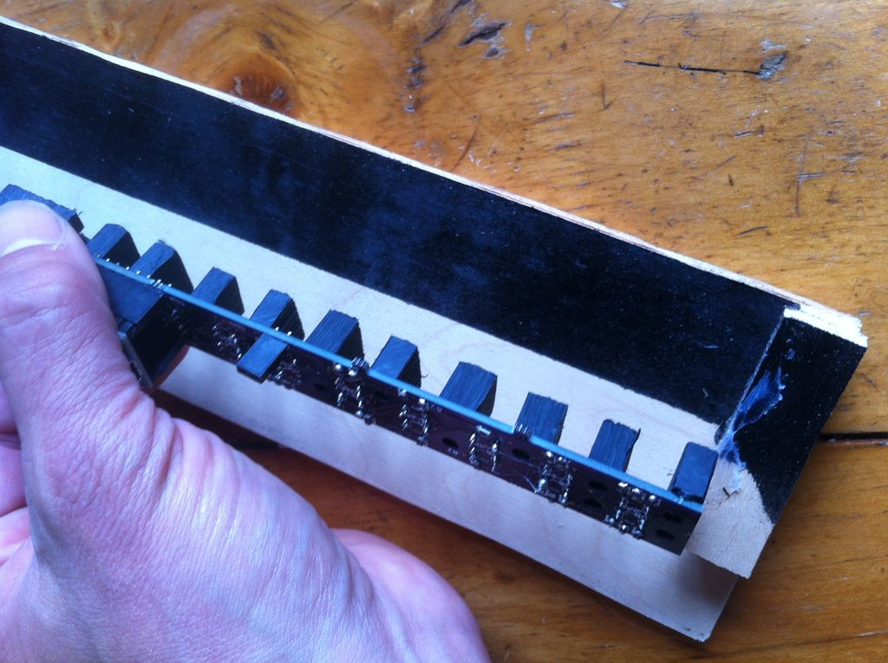
Local Efforts – Bee Counting
Open Source design for optical counter
http://www.instructables.com/id/Honey-Bee-Counter/
Source: Tom Hudson, PE

Slide 14
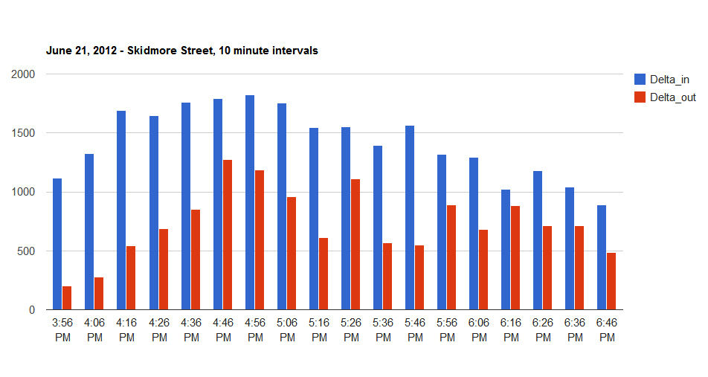
Bee Counting
Source: Tom Hudson, PE

Slide 15

Varroa Mite Infestation
Graphics by Tony Linka

Slide 16
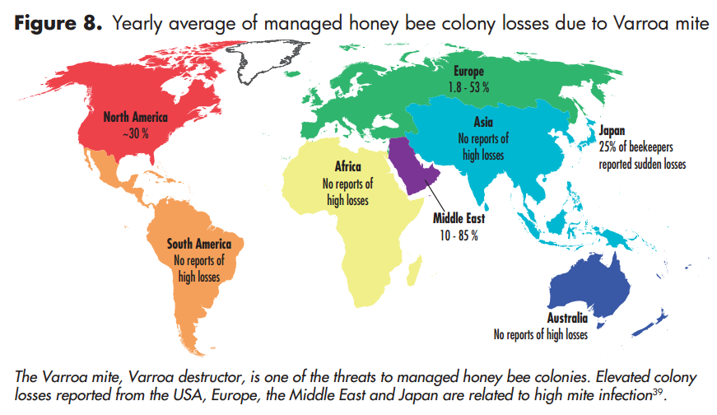
Varroa Mite Losses
Source : UNEP, 2008

Slide 17
Controlling Varroa Mites
Killing the Mites without killing the Bees is difficult
Better to interrupt their life-cycle by sterilization
Elevated Temperatures in select areas of the hive
Existing & patented solutions not working well...
(brute force, difficult to implement, genetic impact)
Source: Univ. Minn/St. Paul

Slide 18
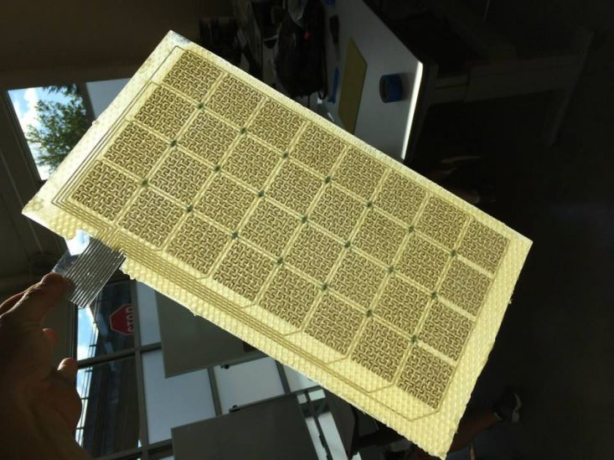

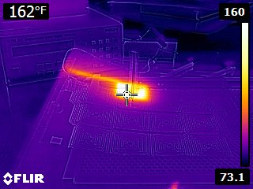
Circuit Boards for the Bees
Eltopia has been developing and testing new control methods for Varroa Mite and other pests
Source: Eltopia

Slide 19
Hive Monitoring Resources
Intelligent Beehives
Open Energy Monitor
HiveTool
Colonymonitoring.com
Hackerbee
Honey Bee Counter
Luke Aldridge Rice
Intelligent Beehives at Yale
Arnia
Source: the Internets

Slide 20

The Physical Web
The physical web is about extending the power of the internet to everyday physical objects and places. The goal is to be able to walk up to any “smart” physical object (like a parking meter, vending machine, etc.) and be able to interact with it without having to first to download an “app” (application program).
Source: Google

Slide 21
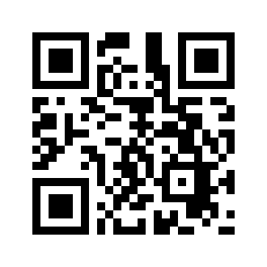
The Physical Web
You've all seen the QR-Code Symbols on posters or stickers, next to a store, on a product display, on a bus stop sign.
It holds an “encoded URL” or INTERNET address, using a smartphone camera and application to “SCAN” the QR-Code, and launch the web browser to that address.
Can yield a more seamless “physical” to “virtual” user experience
Source: Google

Slide 22

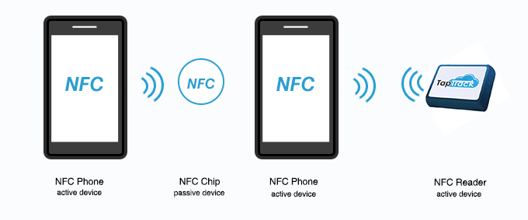
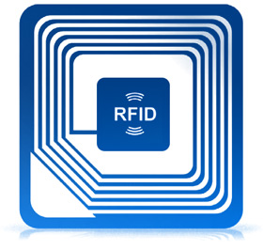
Near Field Communication
NFC – Near Field Communication
“Tap” to Join/Pair/Exchange
Source: Wikipedia

Slide 23

Global Positioning System
Most smart phones include GPS capability these days
Uses a LOT of battery power
Doesn't work well indoors or under the forest canopy
Can give fine grain position (3meters)
Source: Wikipedia

Slide 24
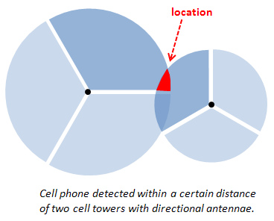
Cell Tower Positioning
Triangulation/Location
Not very accurate
Uses cell phone
Only where cell towers are...
Source: Wikipedia

Slide 25
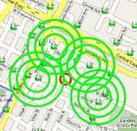
Indoor Positioning System
Uses Wi-Fi signal strength (RSSI)
Triangulation from known location of several Wi-Fi access points
Popular in Malls, Campus, etc.
Needs Wi-Fi radio on (uses power)
Source: Wikipedia

Slide 26
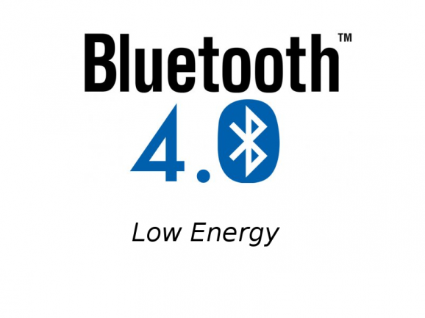
Bluetooth Communication
A Wireless Personal Area Network
Originally Nokia “Wibree” (2006)
Merged into Bluetooth SIG (2010)
Very low power transmitter
Ubiquitous now...
Source: Wikipedia

Slide 27
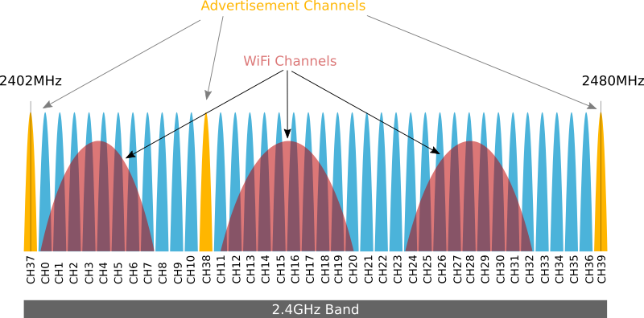
Bluetooth vs. WiFi
Source: Bluetooth SIG

Slide 28

Okay, so what is a Beacon?
Imagine that each Lighthouse could flash it's light in a unique pattern that would identify each lighthouse individually...
A Bluetooth Beacon functions similarly to a Lighthouse, it transmits information about a location, using a Bluetooth Low Energy radio, programmed to emit a known pattern, or universally unique identifier.
(i.e. “You are near here!”)
Lighthouse Photo by Dennis Jarvis

Slide 29
Why Beacons for Bees?
Raise awareness of pollinator health problems
Proximity warning for those allergic to Bees, Wasps, etc.
Locate, monitor, and protect Wild Hives
New approach to Geo-Tagging wildlife habitat
More appropriate technology for remote areas
Lower power than existing monitoring solutions
(Wi-Fi uses more power and transmits longer)
Source: @PatternAgents

Slide 30
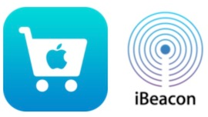

What is an iBeacon?
A proprietary and licensed Beacon system developed by Apple in 2013 to create location aware services for Apple Pay.
iBeacon uses Bluetooth low energy proximity sensing to transmit a universally unique identifier (UUID), which is picked up by a compatible application or operating system.
The unique identifier can be used to determine the device's physical location, track customers, or trigger a location-based action on the device such as a check-in on social media, or a push notification.
Source : Apple

Slide 31
First Use Case
Originally, Apple envisioned the iBeacons to be run on iPad Tablets used as Point-of-Sale Systems.
When you are close enough to the Point-of-Sale System, a coupon or membership offer might appear in the application (“the app”) running on the users iPhone
Didn't need any dedicated hardware, as the Bluetooth Radios were already present in the iPhones and iPad tablets
Source : Apple

Slide 32

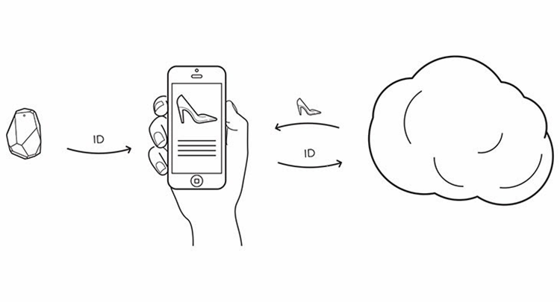
How iBeacons Work
Source: estimote.com

Slide 33
iBeacon - First
First Beacon Specification/Most widely installed base
Requires the Implementer to develop an “App”
Requires the User to install that “App”
Uses Vendor/Manufacturer Specific BT Frame
“One Beacon, One App”
Hard Codes UUID to Application (Maintenance...)
Source: Apple Computer

Slide 34
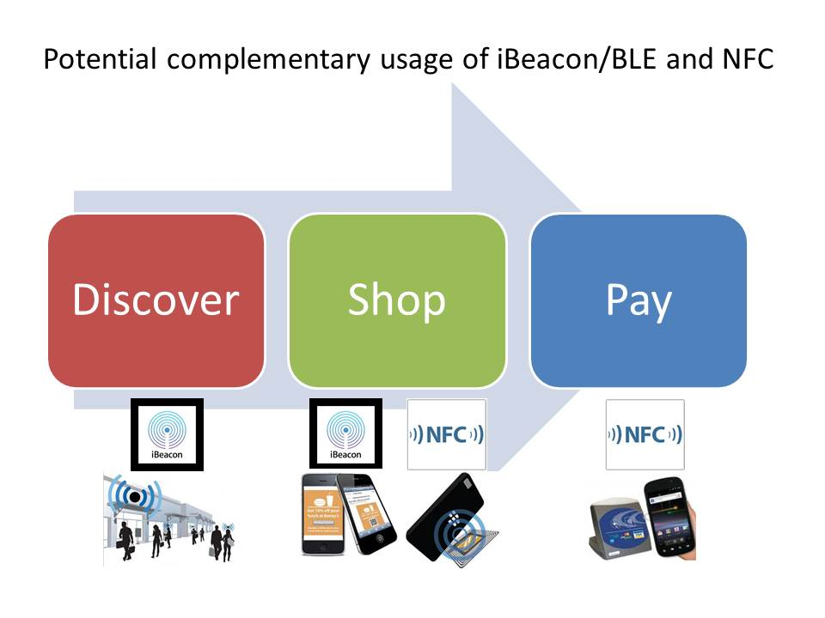
iBeacon – Apple Pay
Can be very costly to implement and maintain
Costs : $10K typical startup (small event)
: > $250-$500K (large event)
: Apple Passbook can be less expensive
Users : Apple, Sephora, Dunkin' Donuts,
Nordstrom, Macys, ...
Source: Apple Computer

Slide 35
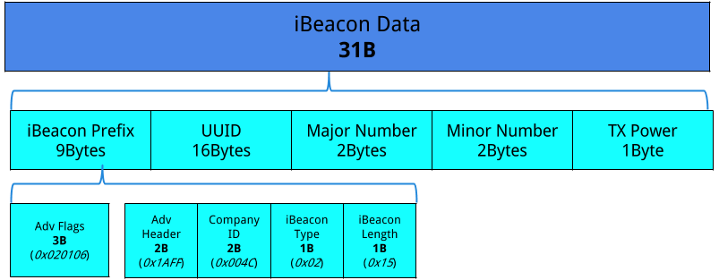
Advertising Packet iBeacon
Custom Prefix (Apple Specific) 10 Packets per Second (100ms)
(UUID) Universal Unique Identifier is an assigned number and needs to be interpreted by the application to be useful
Only 31 Bytes!
Source: Apple

Slide 36

What is an AltBeacon?
Developed as an Open Source alternative to Apple's closed and proprietary iBeacon technology.
Specification by Radius Networks
Adds Manufacturer ID, Beacon Code, Reserved Code
Started gaining steam until EddyStone Beacons were introduced, now loosing share to EddyStone
Source : altbeacon.org

Slide 37
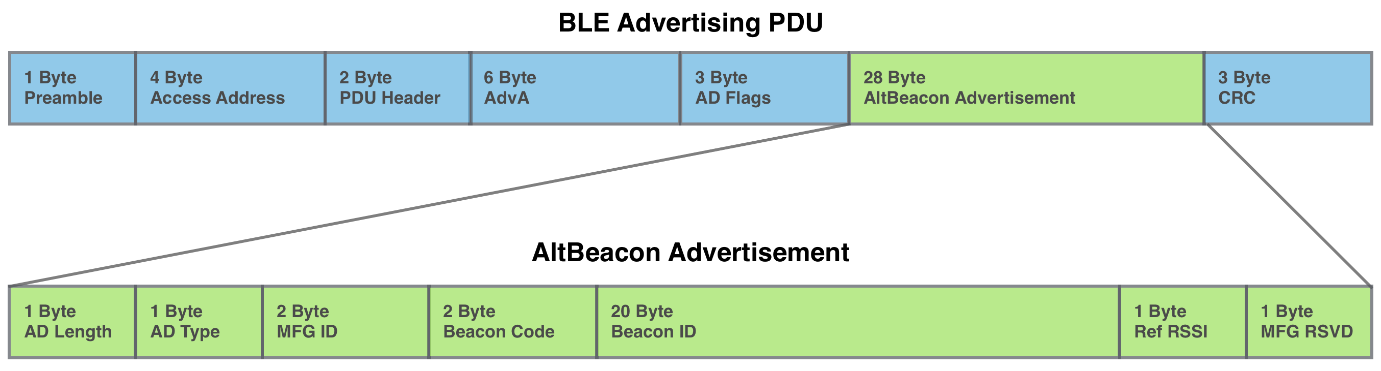
AltBeacon Packet
Interesting Use Cases with Manufacturer ID, and MFG reserved codes
Limited installed base

Slide 38

What is Eddystone?
Eddystone is an open beacon format developed by Google and designed with transparency and robustness in mind
Eddystone can be detected by both Android and iOS devices
Eddystone doesn't require a dedicated “app” to function, as it can deliver a target URL directly
Google Chrome IS the “app”!
Source: Google

Slide 39
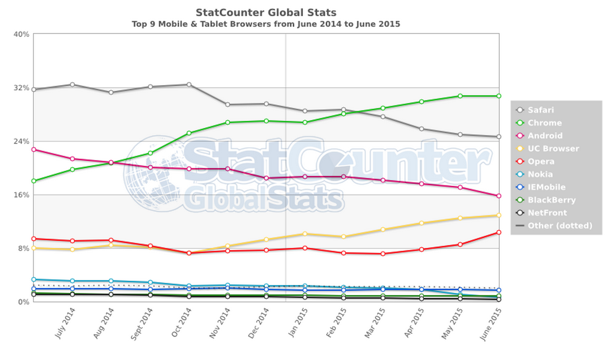
Chrome App Share
Source: StatCounter

Slide 40
Eddystone Frame Types
Eddystone-URL : delivers a “short” URL directly to the user when they are in range
Eddystone-UID : delivers a UUID, similar to how iBeacon works, but 16 bytes in length
Eddystone-TLM : delivers Beacon Telemetry data for Beacon management (battery level, uptime, temperature, etc.)
Source: Google

Slide 41
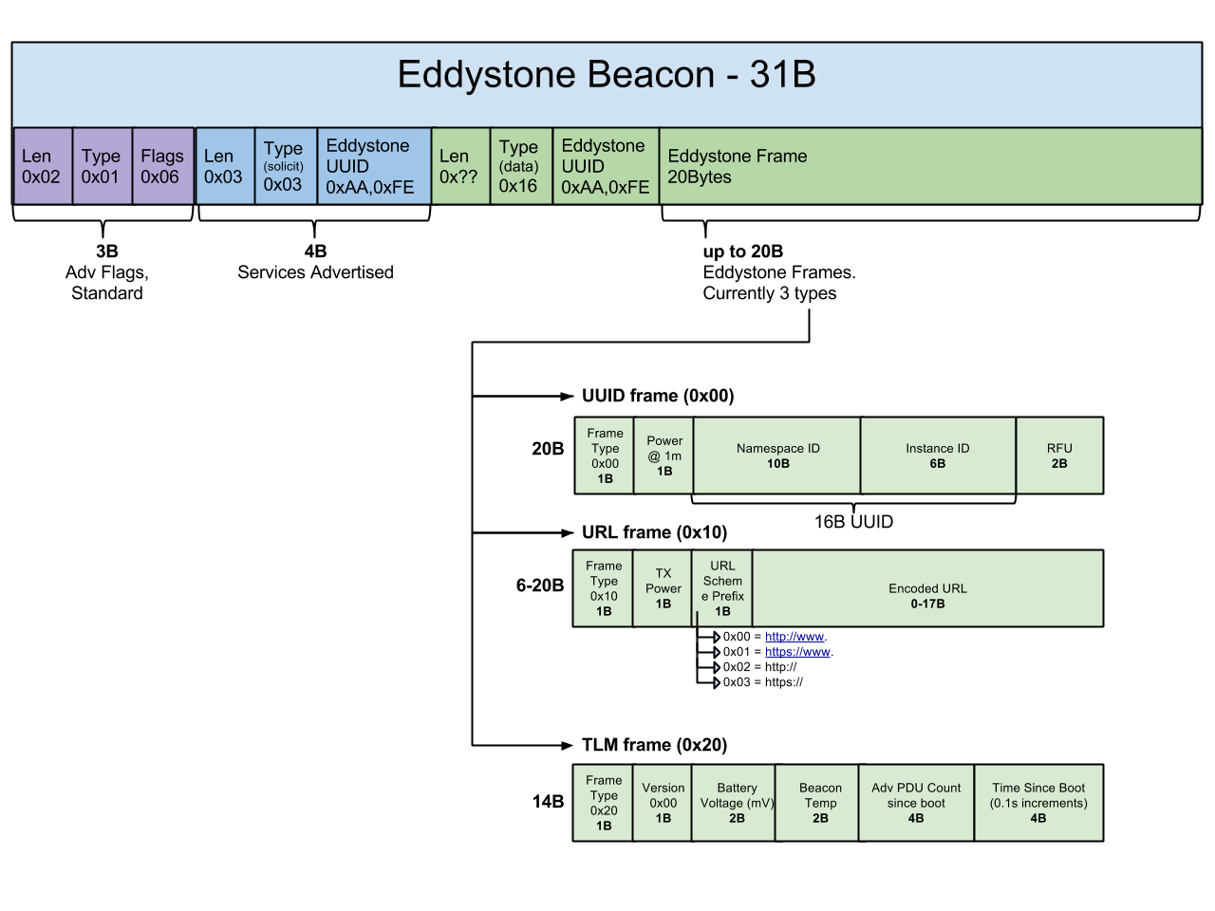
Eddystone Packet
Uses Service Frames
1-2 Packets per Second
10X less than iBeacon
Much longer battery life
Includes Telemetry packet
No Licensing Required
Source: Google

Slide 42
Eddystone-UUID
Functions similar to iBeacon, AltBeacon (app required)
Beacon UUID is registered with Google Beacon Dashboard
Available for Google Developer Project once registered
Open Standard, no licensing, fees, Apple taxes...
Use free “Beacon Tools” app to register beacons
Almost NO barrier to entry (low cost, open source, etc.)
“One Beacon, Many Apps...”
Source: Google

Slide 43
Eddystone-UUID
Recommended Practice
Use a SHA1 Hash of your company FQDN
sha1(www.patternagents.com) =
fba4fd8d86e4726632962dfff9f21eafbbe93ed2
UUID = fba4fd8d86e472663296
Use sub-domains if you need more than one
foo.patternagents.com
Source: Google

Slide 44
Eddystone-URL
The Eddystone Beacon provides an encoded URL
The URL is 17 bytes long (max), and uses an encoded format (UriBeacon format) :
Prefix Suffix
0x00 – http://www. 0x00 - .com/
0x01 – https:/www. 0x01 - .org/
0x02 – http:// 0x02 - .edu/
0x03 – https:// 0x03 - .net/
Works great with a URL shortener, like bit.ly, git.io, etc.
Must be an “https://” URL for Google to index it...
Source: Google

Slide 45
Eddystone-URL
Eddystone-URL beacons are NOT registered, unless they also transmit UUID frames (which ARE registered)
Any HTTPS address can be used and will give a pop-up notification, if notifications are enabled
Gives control back to the user/implementer, you an direct the user to any valid, secure URL and they can opt-in/visit
No tracking generally, unless the user has a login/account with the referred URL, can be redirected to user page...
Source: Google

Slide 46
Eddystone-URL
IMHO, the costs associated with developing apps for iBeacon and AltBeacon are prohibitive unless your company (or application/event/etc.) is large enough to warrant it
Eddystone-URL is an equalizer here, it is a much lower cost solution to implement and deploy, and there are no application development costs or Apple licensing costs to incur.
Eddystone-URL makes the design, and deployment of location aware services, faster, easier, and less expensive
Source: @PatternAgents

Slide 47
Eddystone TLM
Telemetry Frame
Great for Beacon fleet management
Battery Level, Temperature, Packet Count, etc.
Interleaved with other frames occasionally
Can be uploaded to cloud via your “app”
(is it stealing my data? Paranoia runs deep...)
Source: Google

Slide 48
Eddystone EID
Empheral ID, changes every few minutes
A secure key is exchanged during beacon registry
Meant to be more secure, not easily spoofed
Useful for wearable, medical data devices
Source: Google

Slide 49

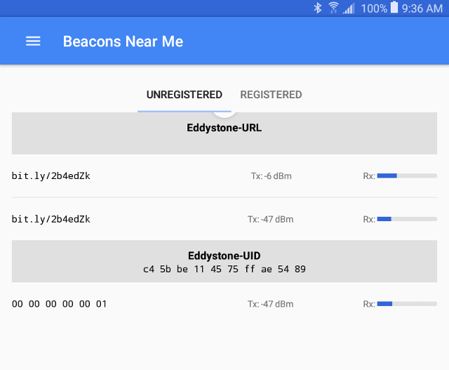
Google Beacon Tools App
Install from Google Play Store
Source: Google

Slide 50
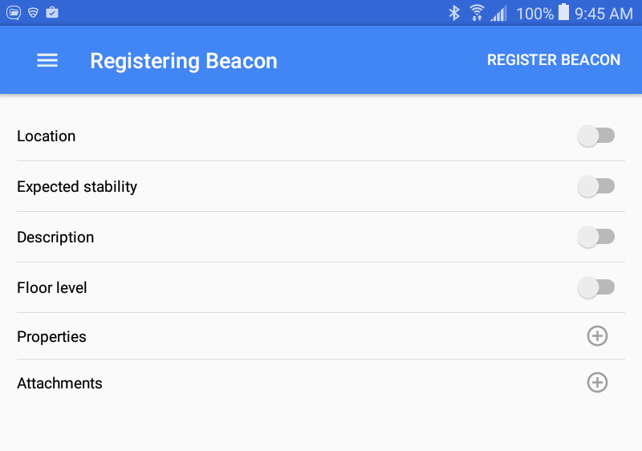
Register Your Beacons
Source: Google

Slide 51
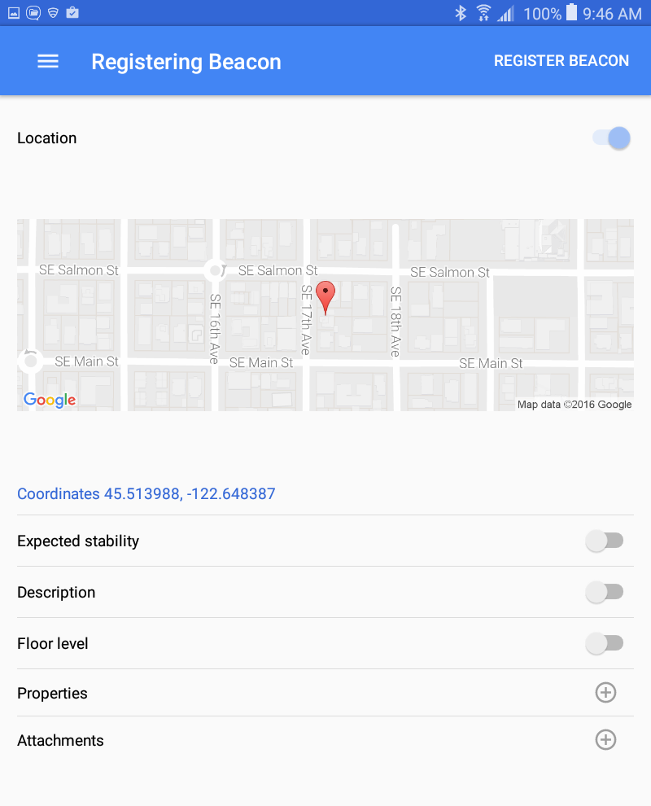
Enter Location
Source: Google

Slide 52
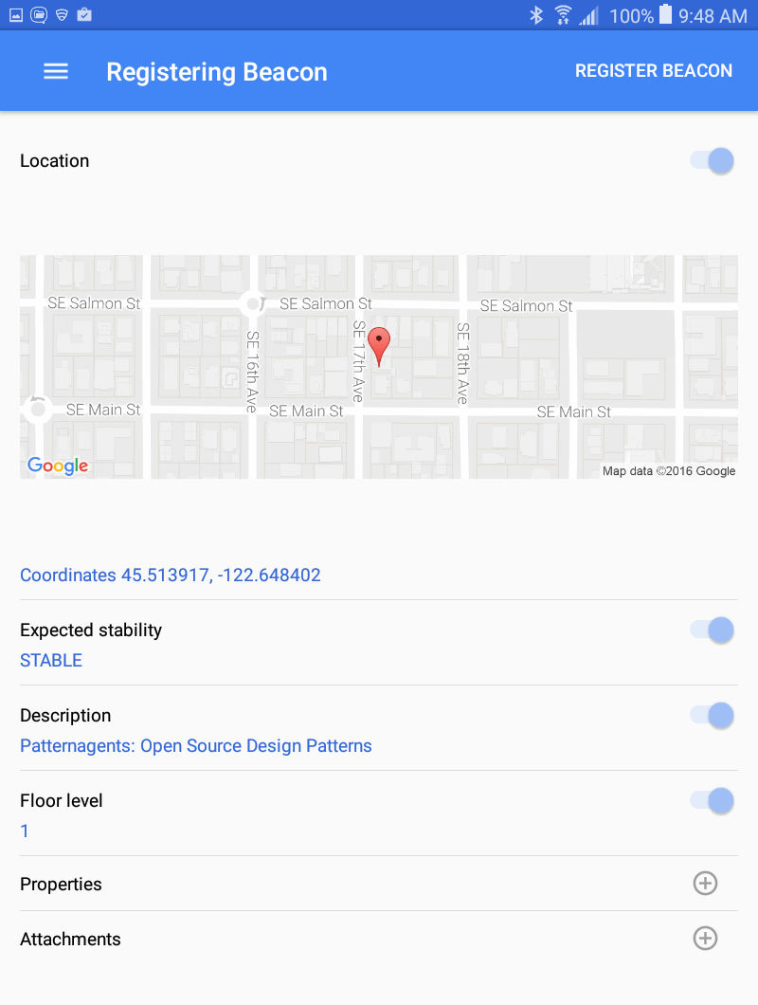
Stability
Mark your beacon as stable, moving, etc.
Source: Google

Slide 53
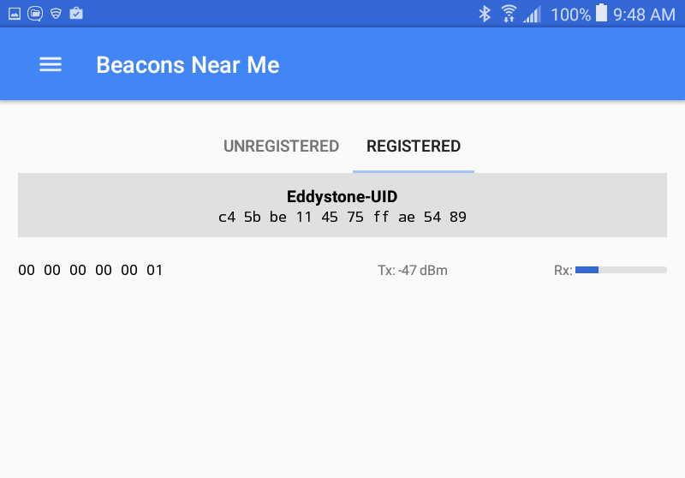
Registered
Source: Google

Slide 54
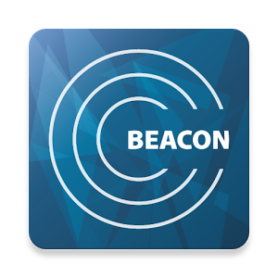
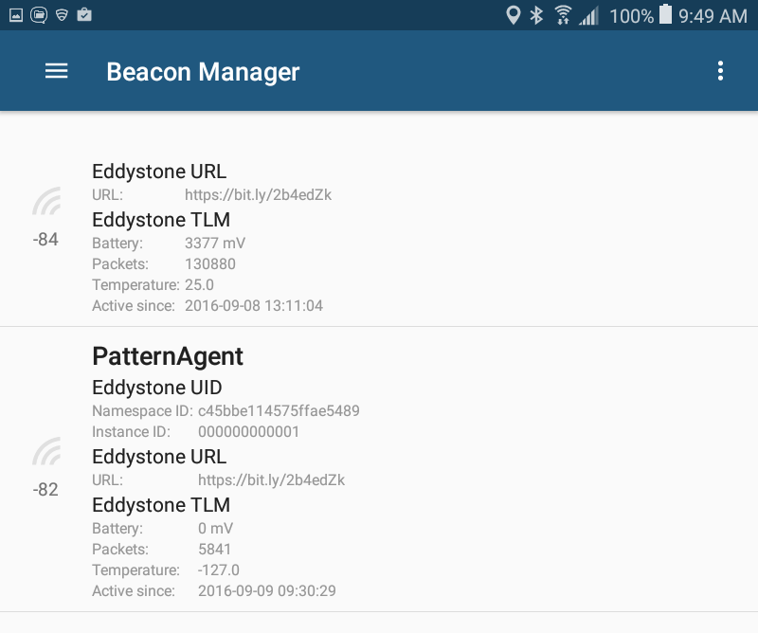
Beacon Manager
Source: BEACONinside GmbH

Slide 55

Beacon Toy
Turn your phone into a Beacon!
Great for impromptu testing, etc.
Free app
Source: Adrian Cretu

Slide 56
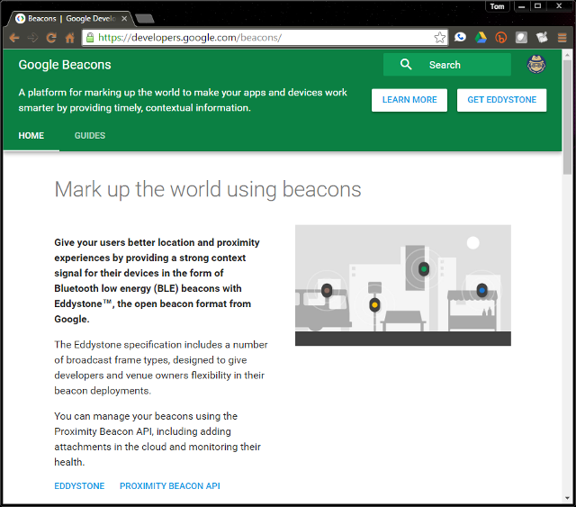
Google Developer - Beacons
Source: Google

Slide 57
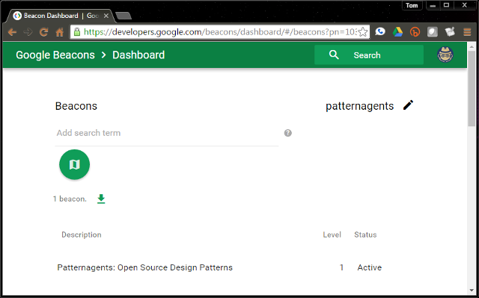
Google Beacon Dashboard
Source: Google

Slide 58
Proximity Beacon API
Eddystone is much more than just a Beacon Format
Registered Beacons can have additional Properties and Attachments that get delivered to the app by the Proximity Beacon API
Also supports iBeacon, AltBeacon
Attachment can indicate functional location
(i.e. Store X Front Door, Store Y Aisle 19, etc.)
Makes it easier to replace or retask a beacon
Integrates with other Google APIs, Nearby, etc.
Source: Google

Slide 59
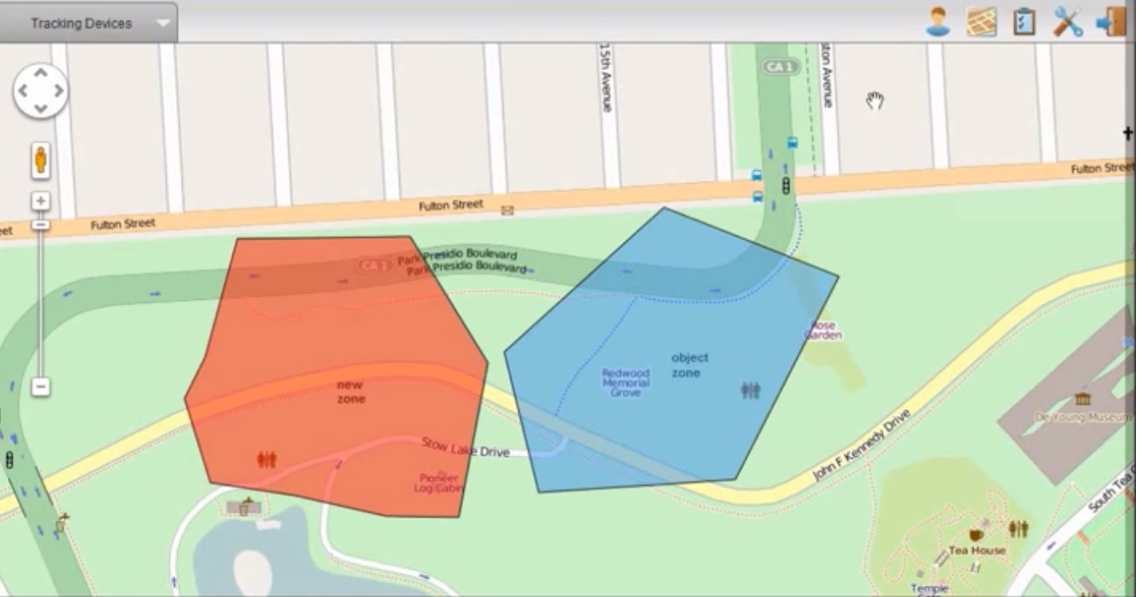
What is a Geo-Fence?
A Geo-Fence is a virtual perimeter for a real-world geographic area.
Geo-Fences can be implemented using Cell Tower Positioning, GPS location, Wi-Fi Signal Strength measurement or any combination of those.
Source : Wikipedia

Slide 60
eBeacons vs. Geo-Fences
Chrome is the App
Self-Contained
User enables Phy. Web
Typical 70m area max
Best for small areas
Needs dedicated App
Needs GPS, Cell, Wi-Fi
User must Opt-In
Typical 100m area min
Best for large areas
Source: @PatternAgents

Slide 61
Hardware for Beacons
A quick How-To Overview...

Slide 62
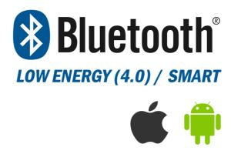
Bluetooth Hardware
Several Solutions available, including your phone!
Cypress Semiconductor, Nordic Semiconductor, TI, Silicon Labs, etc. all have Bluetooth Radios
Almost all of them have Eddystone Reference Designs that are freely available
Source: @PatternAgents

Slide 63
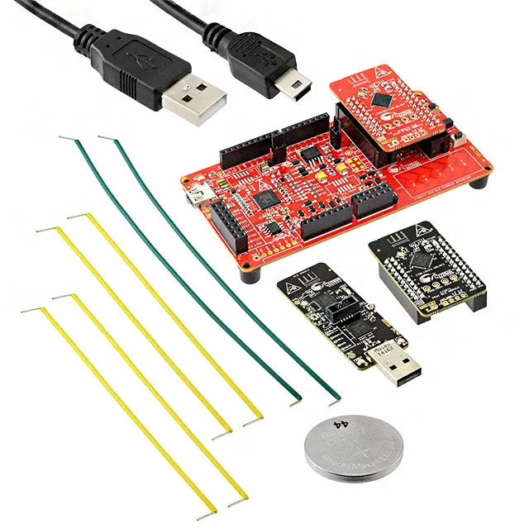
Cypress CY8CKIT-042-BLE
Cypress Programmable System-on-Chip
Malleable hardware that you can program!
Source: Cypress

Slide 64
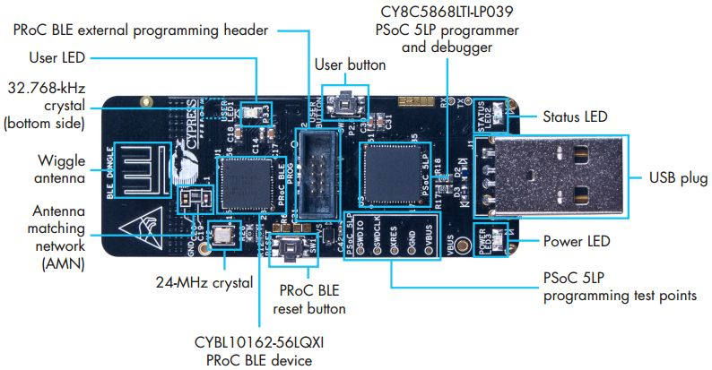
Cypress Smart Dongle
Cypress Programmable System-on-Chip
Built-in JTAG Programmer
Source: Cypress

Slide 65
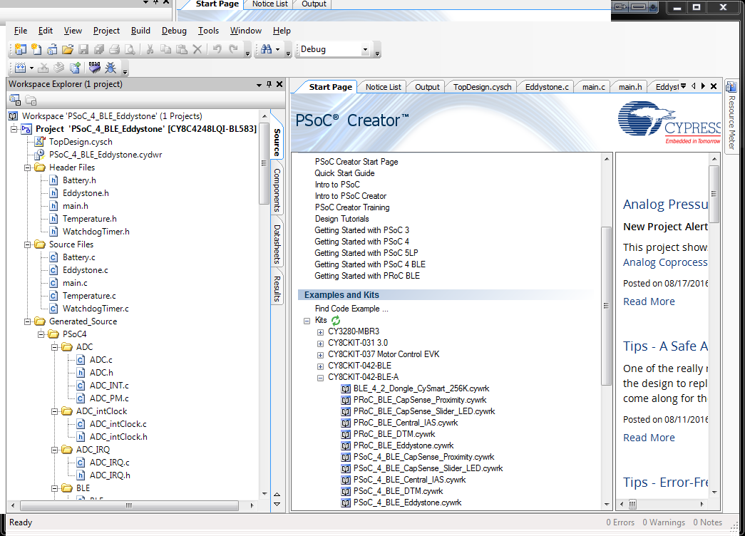
PsoC Creator
Source: Cypress

Slide 66
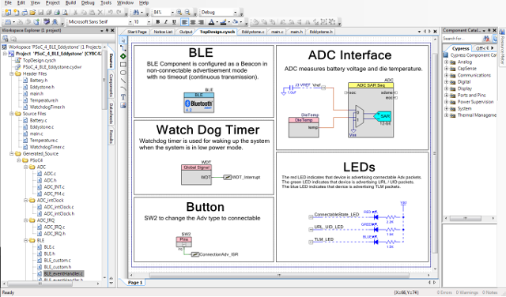
Creator Schematic
Source: Cypress

Slide 67
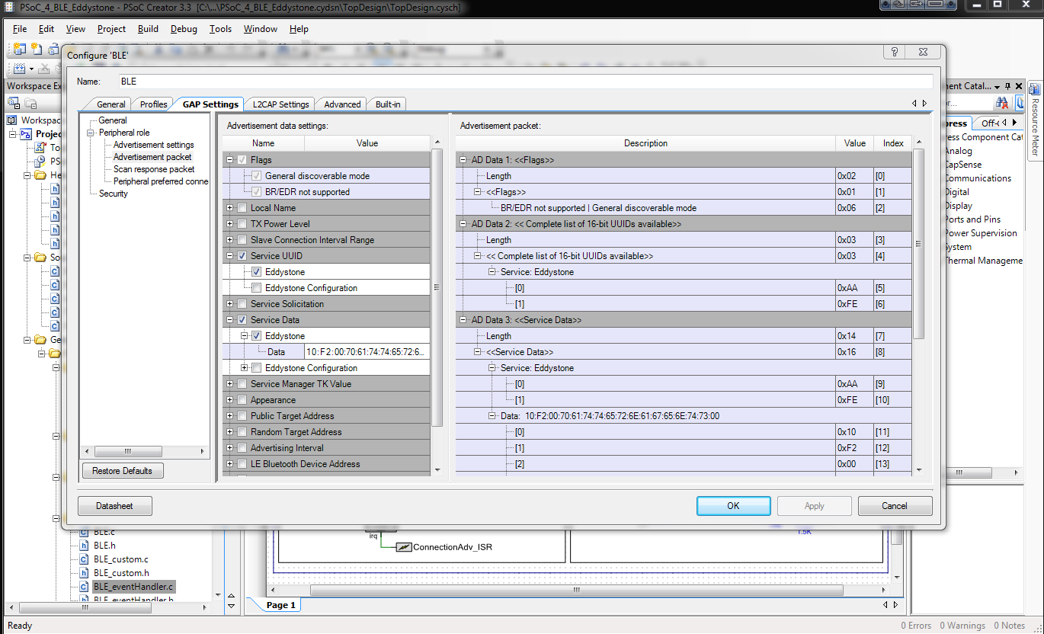
BLE Component Design
Source: Cypress

Slide 68
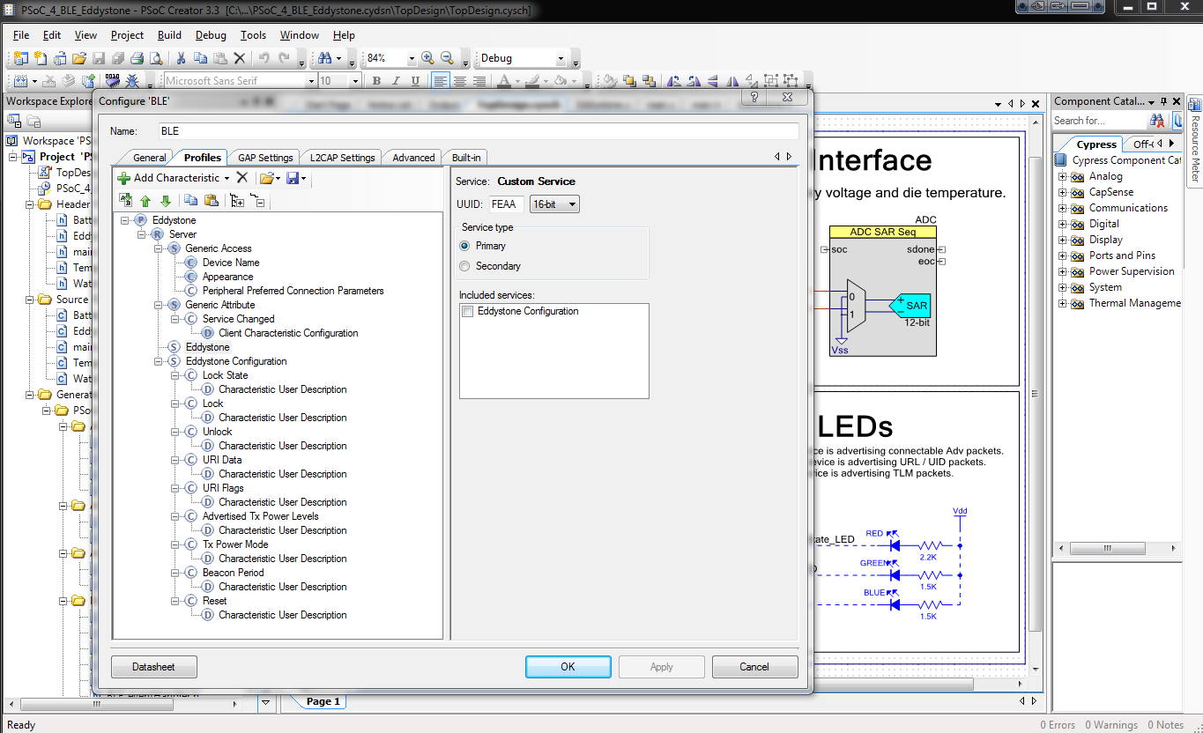
GAP/GATT Configuration
Source: Cypress

Slide 69
Test the Beacon Firmware
Source: @PatternAgents

Slide 70
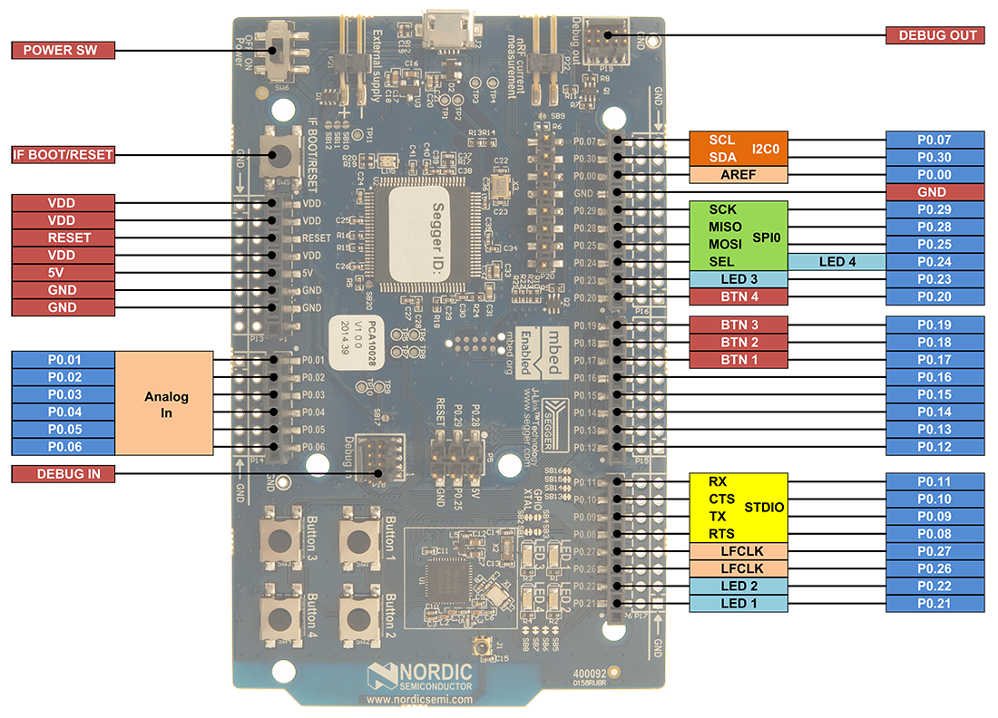
Nordic nRF51 Series
Source: NordicSemi

Slide 71
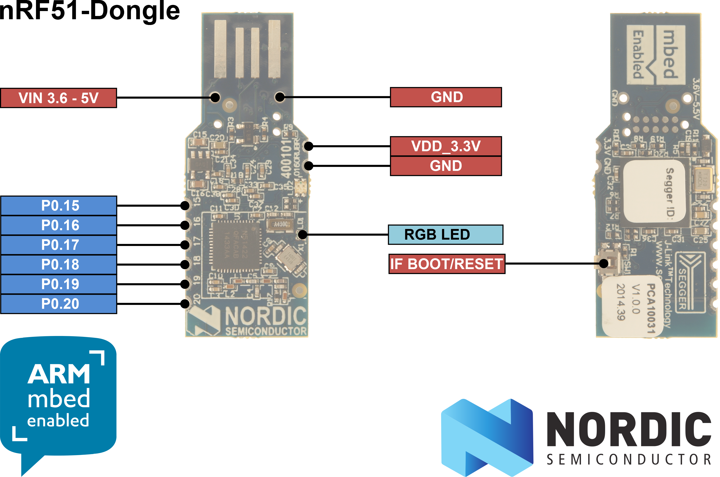
Nordic nRF51 Series

Slide 72
ARM mBed Online
We'll use the ARM mbed on-line tools
Nothing to install, just create account
We'll import the Google Reference code
The boards enumerate via USB as Mass Storage device class
Just download the compiled hex file to the Mass Storage class device (i.e. E:) and it programs the firmware for you, Easy!
Source: ARM

Slide 73
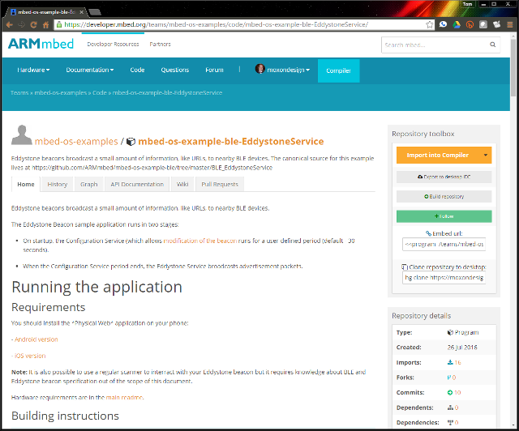
ARM mbed Example
Source: ARM

Slide 74
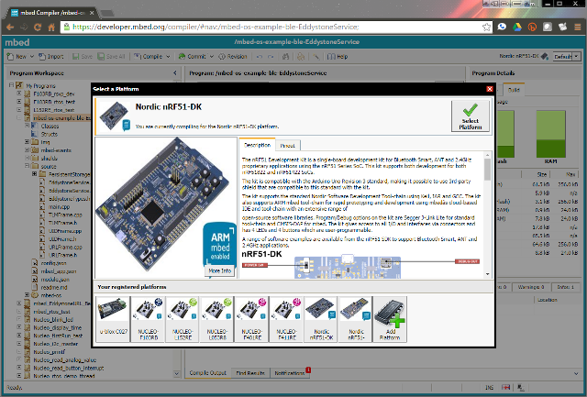
Select your Board

Slide 75

Change UUID

Slide 76

Change URL

Slide 77

Compile Eddystone Project

Slide 78

Download and Run

Slide 79
Test the Beacon Firmware
Source: @PatternAgents

Slide 80

Creekside Five Beehive
The Beacon is set to describe the Beehive just outside
It's a simple page, just a demo
We'll be adding metrics to it as time allows...

Slide 81
Summary
Beacons are just starting to take off
IMHO, Eddystone will win in 2-3 years time
Decentralized, open standard
Low barriers to entry
Proximity Beacon API is awesome, well designed
Attachments provide more data to apps than the beacon is capable of in hardware, a nice idea!
Attachments can be JSON packets or whatever...
“One beacon, Many apps!”
It's easy, go ahead and deploy your own beacons!
Source: @PatternAgents

Slide 82
Questions?
Thank You!

Slide 83
Questions
Are World Bee Populations actually increasing?
Personally, I don't think there is enough data on
wild hives to make that assertion; however,
(perhaps in response to increased CCD awareness) the number of new, “managed” hives introduced in the US is currently exceeding the CCD die-off rate of older and existing “managed” hives.
Many more people are introducing backyard and urban hives in the U.S. and elsewhere; and are volunteering to share data on their hives, so – more hives...
(AgPro & FAOSTAT data - http://faostat3.fao.org/ )

Slide 84
Questions ?
Are RF emissions safe for Bees and/or People?
Clearly, exposure to any high power RF source can be a problem for living things, but are the 2.4Ghz signals of Bluetooth and Wi-Fi radios high enough power to be a problem for Bees? In my experience, there has been no discernible difference between adjacent hives, one in close proximity to the transmitter, and the other 6-8 feet away.
(Hardly a study... just anecdotal...)
However, the transmitter works best “outside” the hive, so an external antennae placement is preferred.

Slide 85


Beacons for the Bees
For PDXMakerWeek, we will be talking about working with the new Google EddyStone Beacon technology and other physical web applications, like Beacons for Beehives. Google Beacons create a simple way to "tag" the physical location of objects, such as wild and domestic Beehives. We'll demonstrate ways to monitor and Geo-tag Beehives.
To participate in the presentation, you can:
bring a Bluetooth Enabled Smart Phone
install the latest version of Google Chrome
enable Physical Web Notifications in Google Chrome
(see: support.google.com/chrome/answer/6239299)
RSVP REQUIRED:
Wednesday, September 14, 2016
6:00 PM to 8:00 PM
@PatternAgents
Open Source Design Patterns

