Slide 1
Electronics One
A Brief Introduction to Electronics
for Programmers, Makers, and Students
PatternAgents 2016

Slide 2
Agenda
Basic Electronics Introduction
“It's the Law!”, Ohms, Watts, and Moore
“On the Bus” Keseyian Signaling Methods
UART, I2C, SPI, and other Acronyms
Questions & Answers
General Discussion
Source : PatternAgents.com

Slide 3
Basic Electronics Introduction
In order to make sure everyone starts on the same page, we’ll briefly cover some basic concepts in physics, mathematics, and electronics
Please be patient if you know this, we'll quickly get into new material for most people
For many people, electronics are literally a “black box”, that they interact with daily, but don't really understand. Let's open the lid, void the warranty,
and have a look inside...
Source : PatternAgents.com

Slide 4
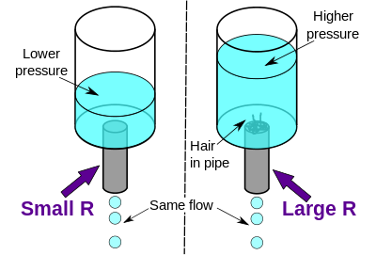
Basic Electronics Concepts
It is often easier for people to visualize the physics of electrons by comparing them to moving water in a hose/pipe as an analogy :
Source : Wikipedia

Slide 5
Basic Electronics Parameters
So, the first electronics terms we will cover are the basic parameters of voltage, current, and resistance.
By analogy to water they would be :
Voltage - analogous to the water pressure
Current - analogous to the volume of water
Resistance - analogous to the diameter of the pipe
See, you already have an intrinsic understanding of these physical concepts, now you just need to learn the terms and symbols to “speak” electronics properly
Source : PatternAgents.com

Slide 6
Representations of Electronics
We use different representations of electronic systems for different purposes, and often to convey different types of information quickly and efficiently.
A Schematic, or Schematic Diagram is a representation of the elements of an electronic system using abstract, graphic symbols rather than realistic pictures. A schematic usually omits all details that are not relevant to the information the schematic is intended to convey, and may add unrealistic elements that aid in comprehension or in conveying the essential “design intent”.
Source : PatternAgents.com

Slide 7
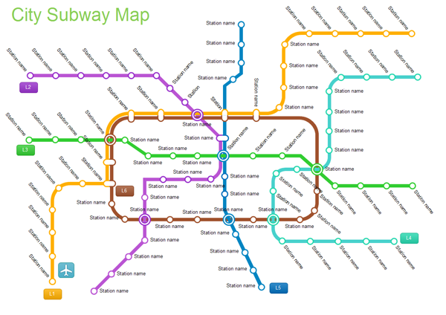
Schematic Subway Map
Sometimes is it easier to think of an electronics schematic diagram as a subway map for the electrons, it describes where they can go, and the stops along the way
Source : PatternAgents.com

Slide 8
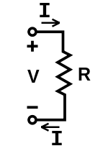
Basic Schematic Symbols
We often read a schematic diagram like a Subway map, as the electrons must follow the wires, just like a train on the tracks
The (most) basic schematic to the left, shows a Voltage (V) being applied across a Resistor (R), causing a current (I) to flow from the positive terminal through the Resistor(R) and to the negative terminal. This relationship is described by Ohm's Law
Source : PatternAgents.com

Slide 9
Ohm’s Law
Voltage (V) - electric potential (in Volts)
Current (I) - electric charge (in Amperes)
Resistance (R) - material opposition (in Ohms)
Ohm’s Law defines the relationship :
I = V / R ( 1 Ampere = 1 Volt / 1 Ohm)
Source : PatternAgents.com

Slide 10
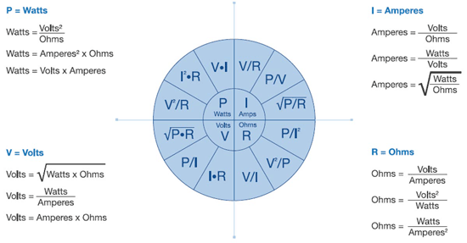
Basic Ohm's Law Equations
Source : PatternAgents.com

Slide 11
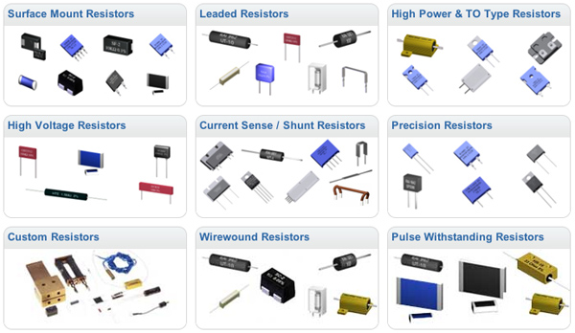
Resistor Physical Types
Source : Digikey

Slide 12
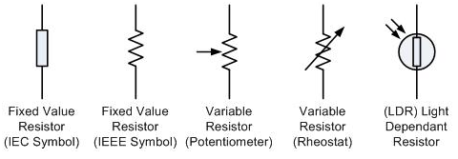
Resistor Schematic Types
We use different schematic symbols to describe different
physical resistor types, but they are all members of the
same resistor “class” of components
Source : PatternAgents.com

Slide 13
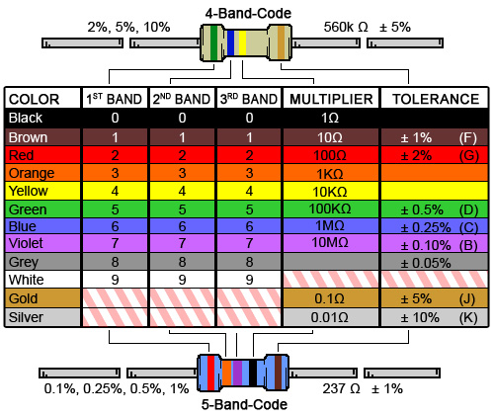
Axial Resistor Color Code
Source : Digikey

Slide 14
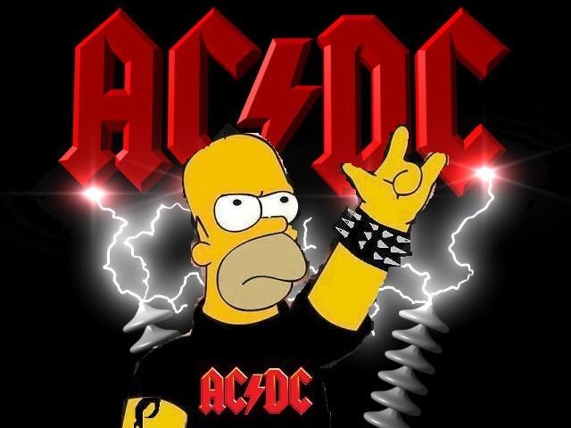
AC-DC
We already talked a little about “Current”, or the amount of electrons flowing in a circuit, which is measured in Amperes (or Amps for short)
We break down current into two major classes, Alternating Current and Direct Current (AC~DC)

Slide 15
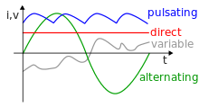

Alternating & Direct Current
Direct Current, or D.C. as the name would suggest moves in only one direction in a wire, from positive to negative
Alternating Current, or A.C. changes the direction of current flow in a wire from positive to negative, and then from negative to positive, as some frequency
Source : PatternAgents.com

Slide 18
Electronics for Audio
There are a number of special electronics terms we use for working with Audio, such as loudness, sound pressure, harmonics, overtones, and more.
The next section is a brief introduction to some Audio terminology

Slide 19
Loudness Measurement
dB (Decibel) relative logarithmic scale for comparing the loudness of two sources
dB = log (source1/source2)
dBm (Decibel milliWatt) logarithmic scale referenced to one milliwatt of power
dBm = 10 * log(source1/1mW)
Source : wikipedia.com

Slide 20
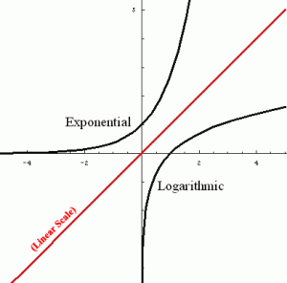

Sound Pressure Levels
Reference level for air pressure chosen at 20 micropascals (20uPa), about the limit of sensitivity of the human ear
SPL = 20 log (Source1/Source2)
What does a one dB
difference sound like?
3.0 dB is twice as loud
-3.0 dB is half as loud
Source : UNSW, wikipedia.com
Notes:
20uPa is 2 ten billionths of an atmosphere.
One decibel is close to the Just Noticeable Difference (JND) for sound level. As you listen to these files, you will notice that the last is quieter than the first, but it is rather less clear to the ear that the second of any pair is quieter than its predecessor. 10*log10(1.26) = 1, so to increase the sound level by 1 dB, the power must be increased by 26%, or the voltage by 12%.

Slide 21
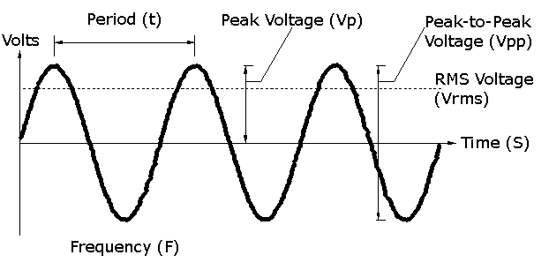
Electronic Waveforms
Electronic waveforms can be shown graphically in a number of different ways
Usually they are graphed against Time (S)
Sine Waveform
Source : PatternAgents.com
Notes:
Period is also known as “Wavelength”
This is an AC (Alternating Current) waveform,
a DC (Direct Current) waveform would just be a flat line…

Slide 22
Waveform Parameters
In a sine wave it is easy to find the primary or fundamental frequency, by measuring the time between the peaks. Period and frequency are merely the inverse of each other
Frequency (Hertz) = 1 / Period (Sec)
Source : PatternAgents.com

Slide 23
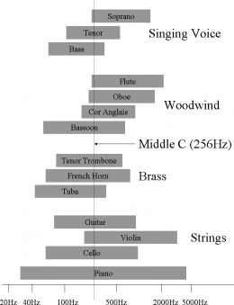
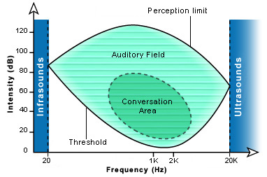
Audio Waveform Frequencies
Human hearing is generally in the range of 20 hz to 22,000 hz
Source : wikipedia.com

Slide 24
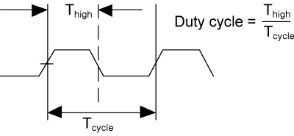
Waveform Duty Cycle
The Duty Cycle is the percentage of “on” time to the total time of the wave period
Source : wikipedia.com

Slide 25
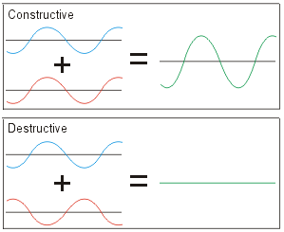
Waveform Interference
When multiple waveforms meet (in the air or on a wire…) there can be interference between them, yielding a new waveform
Destructive Interference is how noise canceling
headphones work….
Source : wikipedia.com
Notes:
These are also known as Additive and Subtractive Interference.

Slide 26
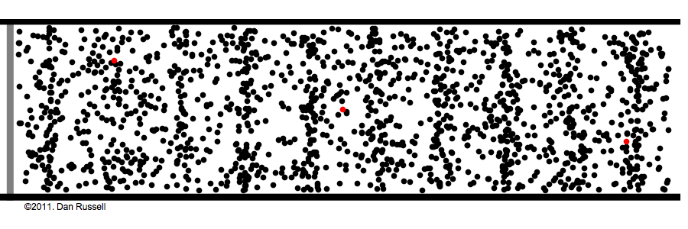
Longitudinal Waves
In a longitudinal wave the energy (or the particle displacement) is parallel to the direction of the wave propagation
Source : wikipedia.com

Slide 27
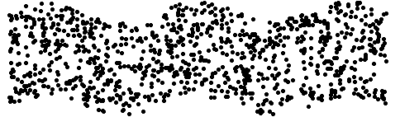
Transverse Waves
In a transverse wave the energy (or the particle displacement) is perpendicular to the direction of the wave propagation
Source : wikipedia.com

Slide 28
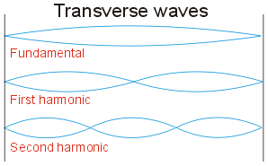
Harmonics
Transverse waves can produce harmonics
such as when a string that is fixed on both ends is plucked or bowed. Because both ends are fixed, a standing wave pattern with center antinodes can be produced
Source : wikipedia.com

Slide 29
Overtones
An overtone is any frequency higher than the fundamental frequency of a sound
Together the fundamental and the overtones are called partials
Harmonics are partials whose frequencies are integer multiples of the fundamental
Inharmonics are partials whose frequencies are not integer multiples of the fundamental
Source : wikipedia.com

Slide 30
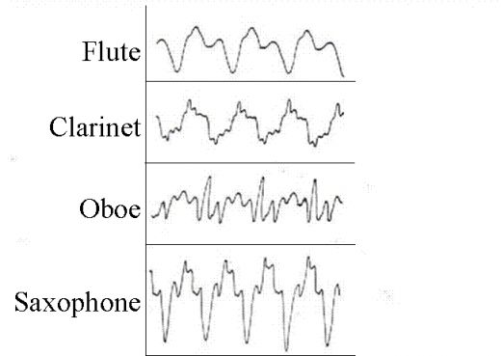
Complex Waveforms
Most sounds you hear are complex waveforms, they have many overtones
Source : wikipedia.com

Slide 31
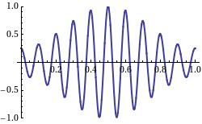
Modulating Waveforms
A basic waveform (carrier wave) can have its parameters modified by another waveform using a process known as modulation
Source : wikipedia.com

Slide 32
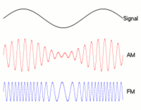
Amplitude Modulation
If the Amplitude of the carrier waveform is changed by another signal it is called Amplitude Modulation
Source : wikipedia.com

Slide 33
Frequency Modulation
If the Frequency of the carrier waveform is changed by another waveform it is called Frequency Modulation
Source : wikipedia.com

Slide 34
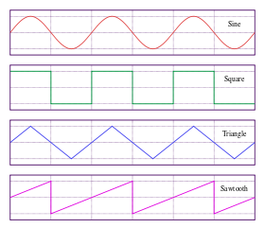
Creating Basic Waveforms
A electrical circuit known as an oscillator is used to create basic waveforms
1 Khz
256 Khz
Source : wikipedia.com

Slide 35
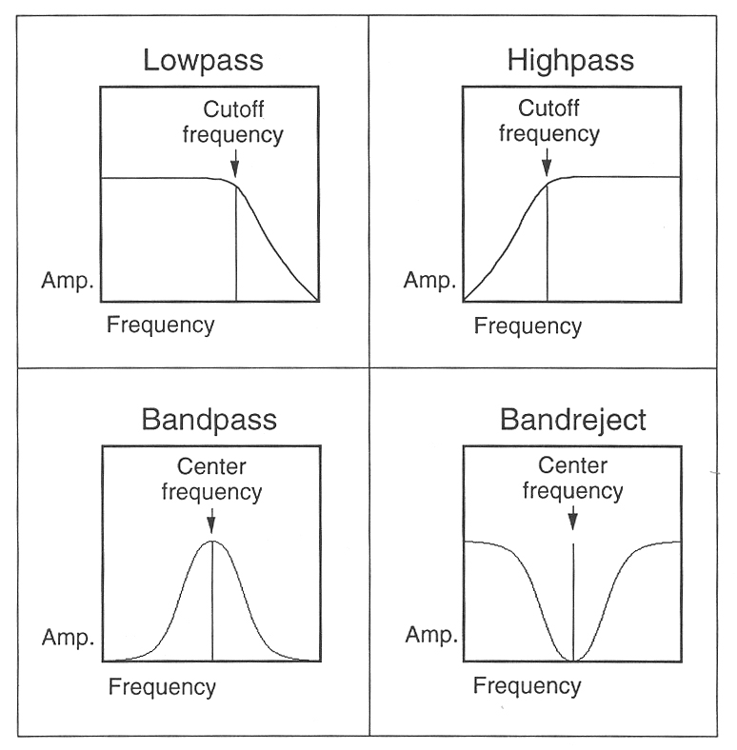
Audio Filters
This is a topic would could spend days on
An Audio Filter is a frequency dependent amplifier circuit, with several variations
Source : wikipedia.com

Slide 36
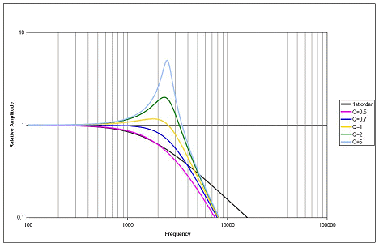
Filter Parameters
Cutoff Frequency : Fc (in Hertz)
Resonance : Q , Quality Factor (no units)
a measure of bandwidth relative to frequency
Several others : Order (2nd/3rd), Type (Elliptical)
Source : Graphic- Beb Hennick/TI

Slide 37
Audio Filter Sounds
Okay, so what do they sound like?
LPF – High Q
HPF – High Q
LPF – Low Q
HPF – Low Q
BPF – High Q
BRF – High Q
BPF – Low Q
BRF – Low Q
Source : wikipedia.com, Ableton

Slide 38
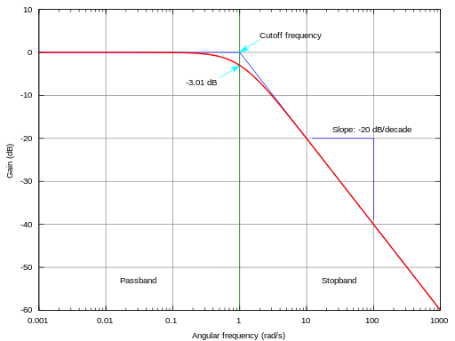
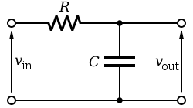

Low Pass Filter (Passive)
As the name suggests, only lower frequencies can “pass” thru the filter
Source : wikipedia.com

Slide 39
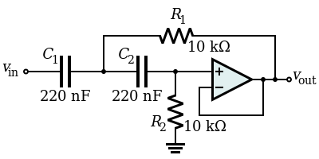
Sallen-Key Filter (Active)
Sallen Key is a popular example of an active filter, and uses an operational amplifier (OpAmp) as the active element
This LPF has Fc = 15.9Khz and Q = 0.5
Source : wikipedia.com

Slide 40
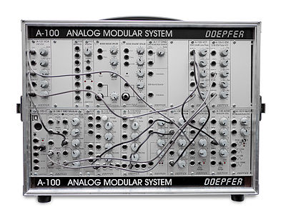
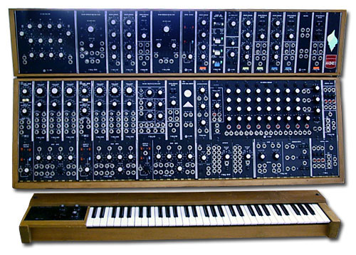
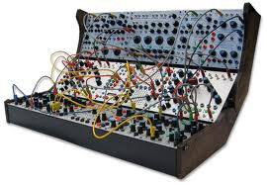
Voltage Controlled Analog
In the 1960’s voltage control of audio functions became popular with the analog synthesizers designed by Dieter Doepfer, Bob Moog, Don Buchla, and many others
Source : wikipedia
Notes:
In voltage control, a specified voltage would be applied to control paramters like, pitch, filter cutoff, filter-Q, etc.
These are known as subtractive synthesizers.

Slide 41
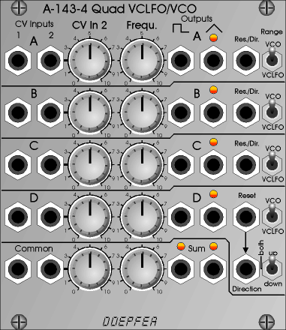
Voltage Controlled Oscillators
In a Analog Voltage Controlled Oscillator (VCO), the frequency of the oscillator output is controlled by an input “Control Voltage”
Source : doepfer.de

Slide 42
Low Frequency Oscillator
A Low Frequency Oscillator, or LFO is an oscillator that produces a waveform below the human hearing range (< 20Hz).
LFO’s can be used in several ways, either to frequency modulate a carrier signal
(Vibrato effect), to amplitude modulate a carrier signal (Tremolo effect) or to control another function, such as a filter center (Wah-Wah effect)
Source : wikipedia.com

Slide 43
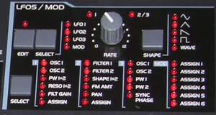
LFO Examples
Tremolo Effect (Amplitude Modulation)
Wobble Effect (Frequency Modulation)
Ripple Effect (Filter Modulation)
Source : wikipedia.com

Slide 44
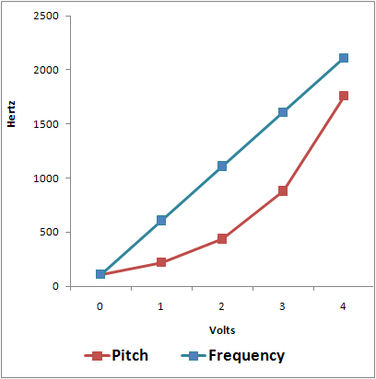
Volt per Octave Frequency
Voltage Control, or “CV” was often used with Volt per Octave Frequency control.
“Subjective Pitch”
can be nonlinear,
and is measured in Mels.
Source : emusician.com
Notes:
Subjective Pitch, measured in Mels can be different from the “true” frequency of the sound.
The human ear can perceive pitch differently based on different volume or sound timbre.

Slide 45
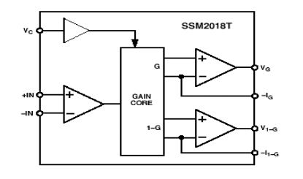
Voltage Controlled Amplifier
The Voltage Controlled Amplifier (VCA) is used to vary the volume of the sound based on a control voltage input. The Solid State Music (SSM20xx) parts were widely used for this by Sequential, Oberheim, etc.
Source : analog devices inc.

Slide 46
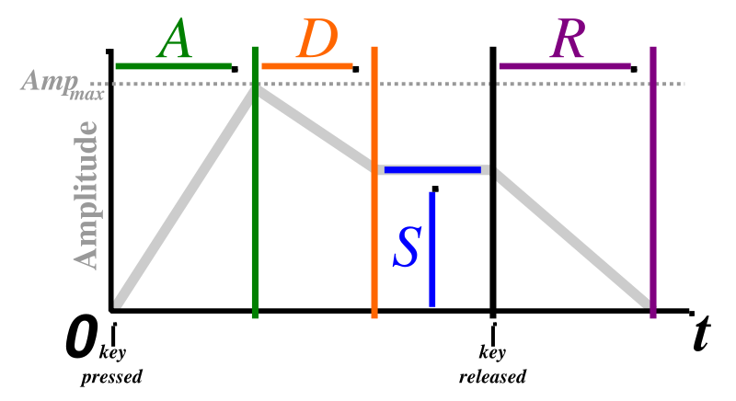
Waveform Shaping (ADSR)
Several ways to “shape” waveform envelopes to synthesize different sounds, one method is ADSR, which stands for :
Attack, Decay, Sustain, Release
Source : wikipedia.com

Slide 47
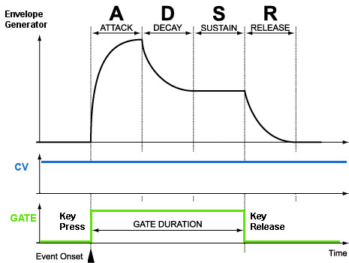
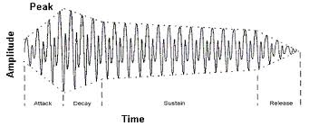
ADSR Envelope Generator
An example of a ADSR Envelope
(Keyboard “Gate” Signal)
Source : PatternAgents.com
Notes:
We will cover waveform generation in much more detail later,
But here is an example of CV/Gate and envelope control.

Slide 48
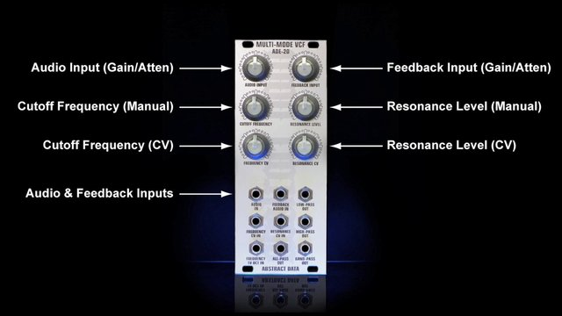
Voltage Controlled Filter (VCF)
An example VCF, the ADE-20
Source : Abstract Data Effects

Slide 49
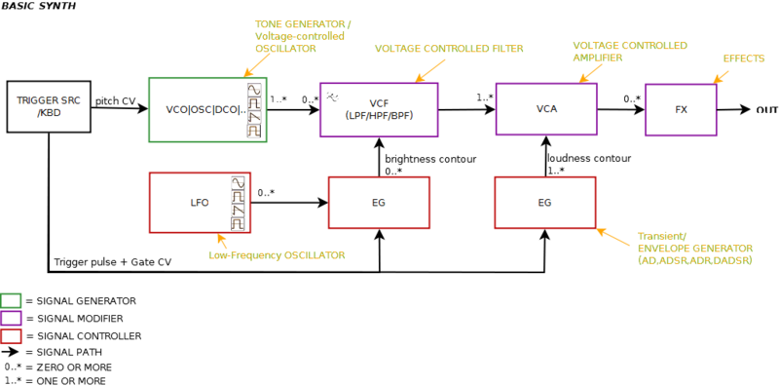
Putting It All Together
Sequencer
Source : wikipedia

Slide 50
Summary
Source : PatternAgents.com

Slide 51
Thank You !
Questions?

Slide 52
Sources and References :
Wikipedia : en.wikipedia.org/wiki/

Slide 53
Notes :

