Slide 1
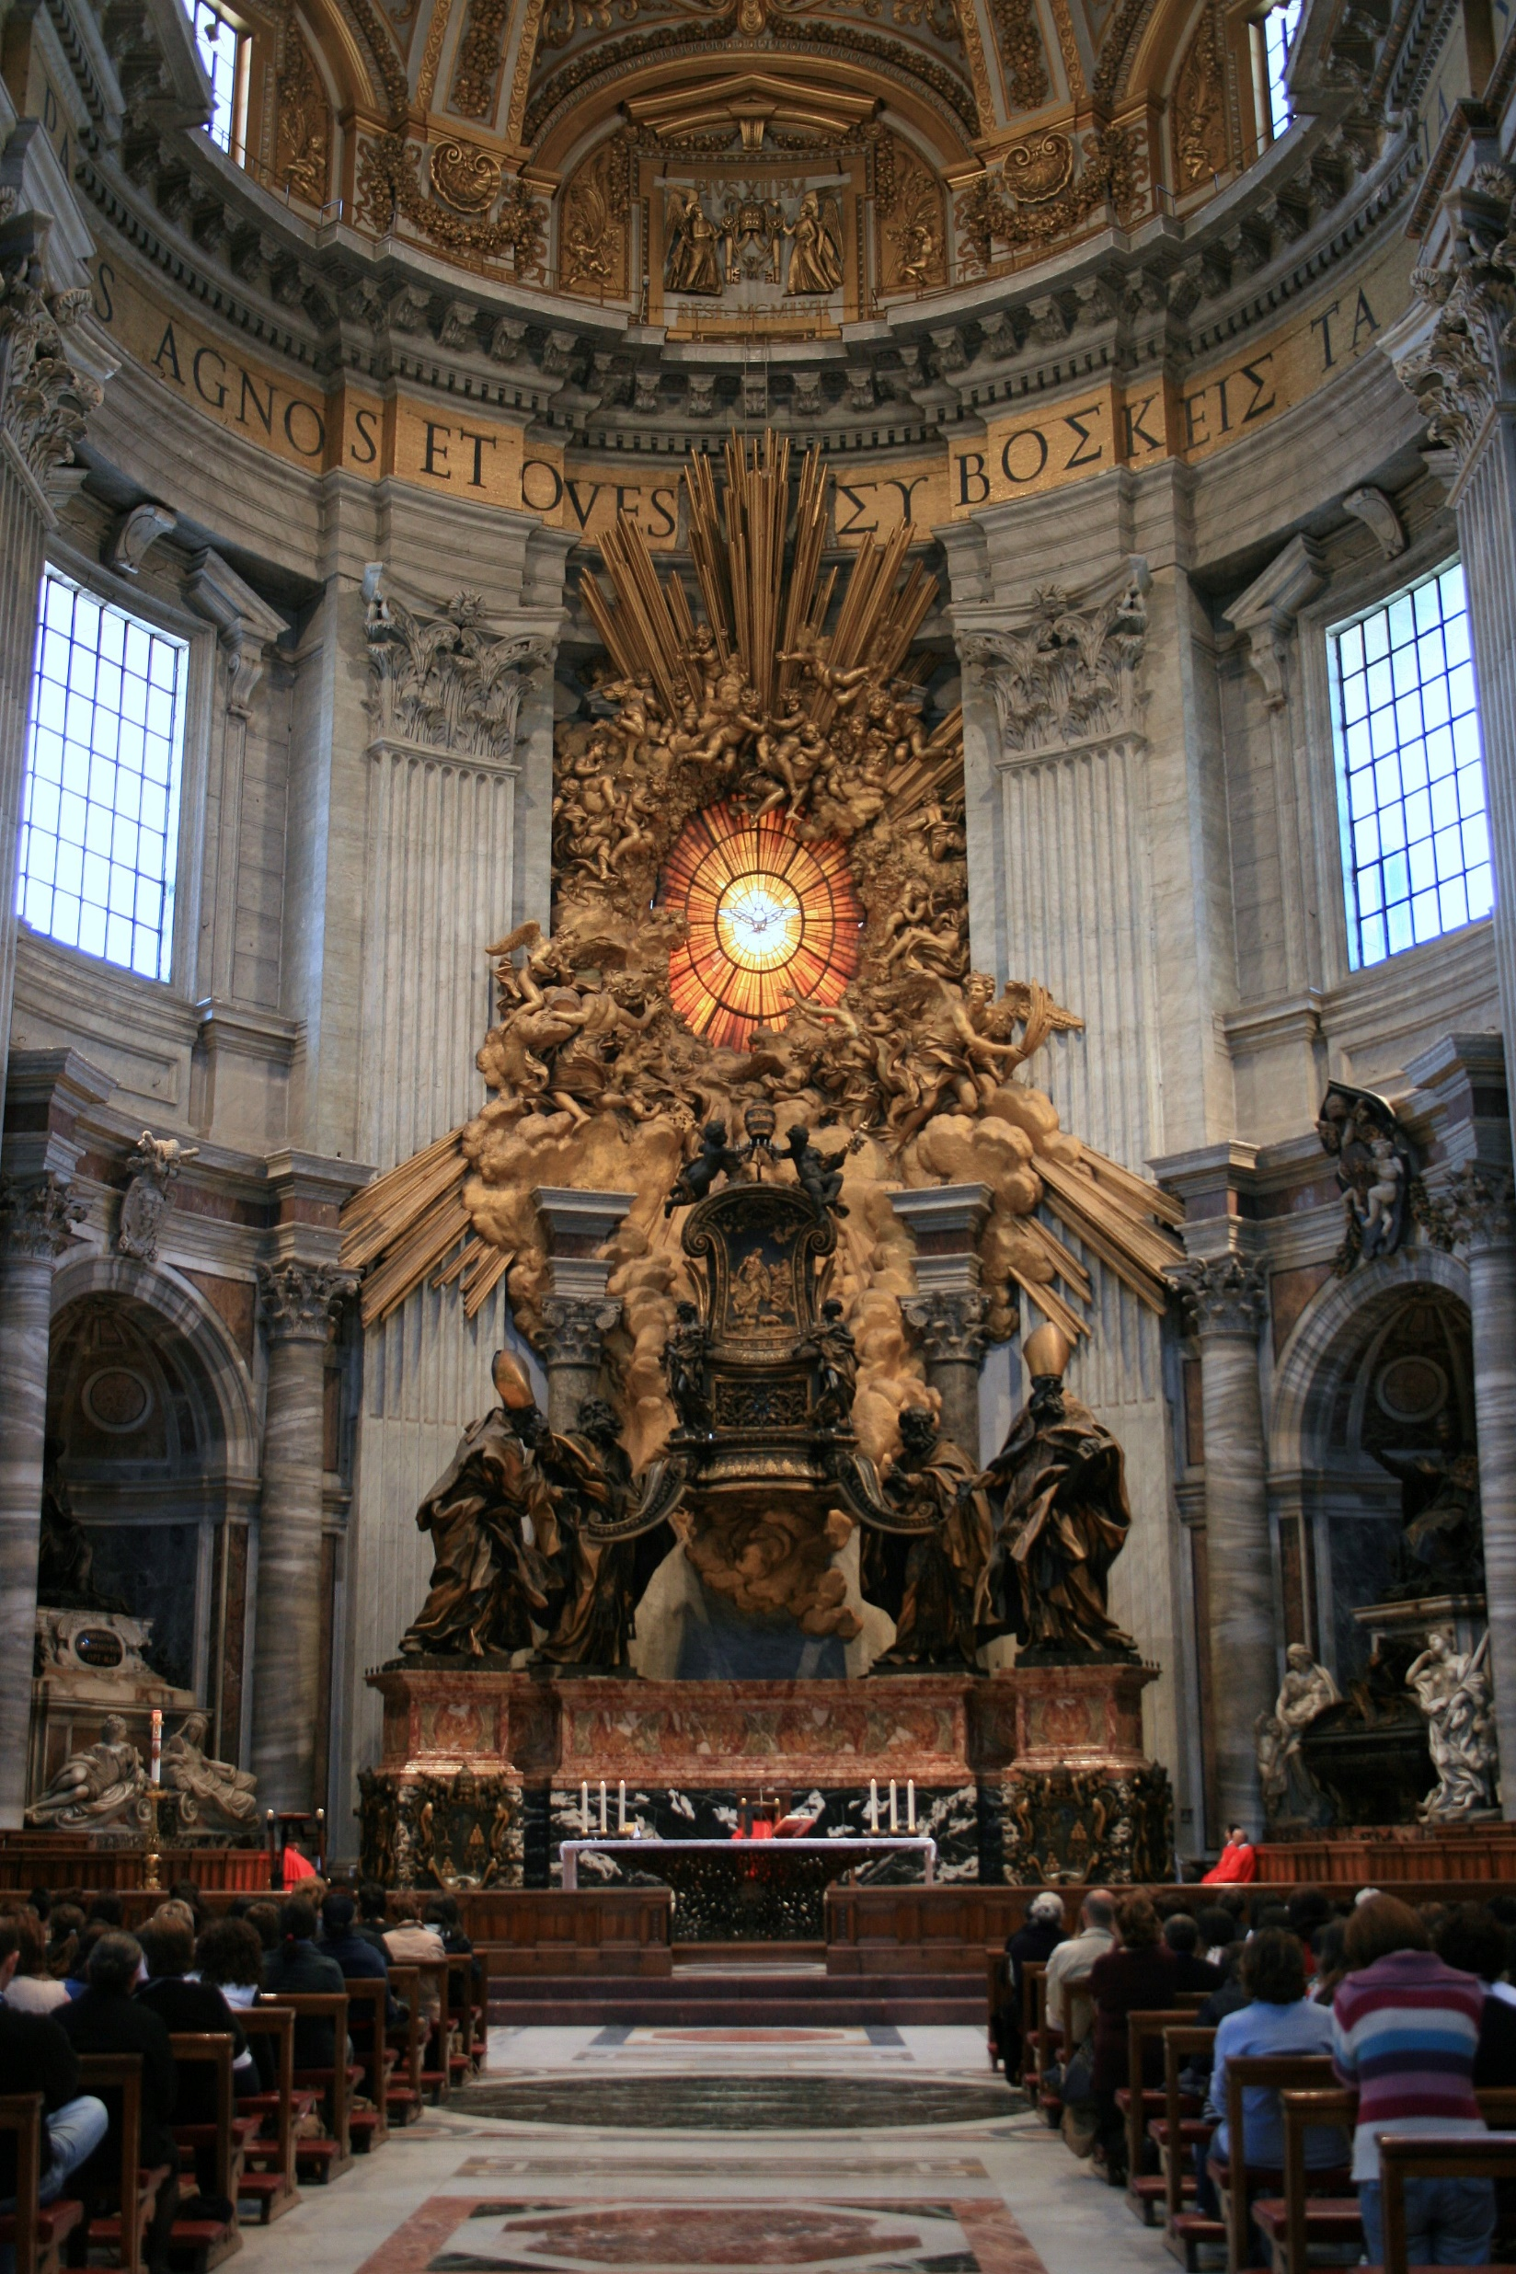
GIAN LORENZO BERNINI
CHAIR OF SAINT PETER
Patricia Hector Hernandez

