Slide 1
Classifying Pneumonia: An analyzation of lung images
Presented by:
Patrick Ryan

Slide 2

Overview
Historical Background
Business Plan/Opportunity
Data Understanding
Modeling
Evaluation
Recommendation
Next Steps

Slide 3
History of pneumonia
It’s an acute infection of the lungs.
Producing coughing, fever, chills, muscle aches, and difficulty breathing.
The pneumonic infection has been noted throughout human history, with mentions of the disease appearing during early Greek civilization.
1875
2013
1881
1930’s
Notes:
The name originated from the ancient Greek meaning for Inflammation or lung itself.
1875 Edwin Klebs first saw bacteria in the airways. It w as later discovered that this bacteria led to Pneumonia.
1881 Louis Pasteur and George Sternberg discovered the bacteria associated with pneumonia cases.
1930-1940 ways to handle the ailment were discovered.
In 2010, $17 Billion was spent on pneumonia itself globally.
The United States estimates that it would take about $20 Billion more to help find a very accurate cure and eventual end to Pneumonia.
A new prediction model with promising results to cure Pneumonia.

Slide 4
Business opportunity
Increase in prevalence of pneumonia.
Upsurge in geriatric population with weaker immune systems.
Increase in incidence and spending for community-acquired pneumonia.
Surge in number of product launches.
Notes:
- Life expectancy

Slide 5
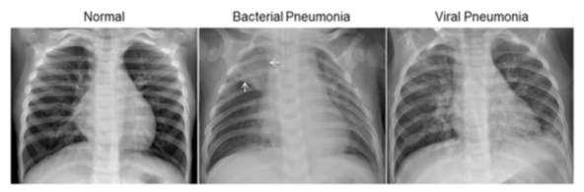
Data understanding
The data provided included 5,863 images.
It was provided by the Guangzhou Women and Children’s Medical Center.

Slide 6
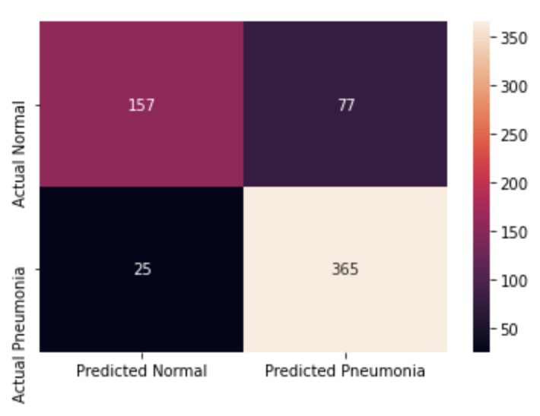
Modeling
Used a Convolutional Neural Network
Allowed a precision score to be obtained.
Precision score allows accuracy with predicted positives.
Needed to reduce false negatives and false positives.
Notes:
CNNs can learn what characteristics in the filters are the most important.
That saves a lot of time since we don't need as many parameters.
The models main purpose is to get data into forms that are easier to process without losing the features that are important for figuring out what the data represents.
This also makes them great candidates for handling huge datasets.

Slide 7
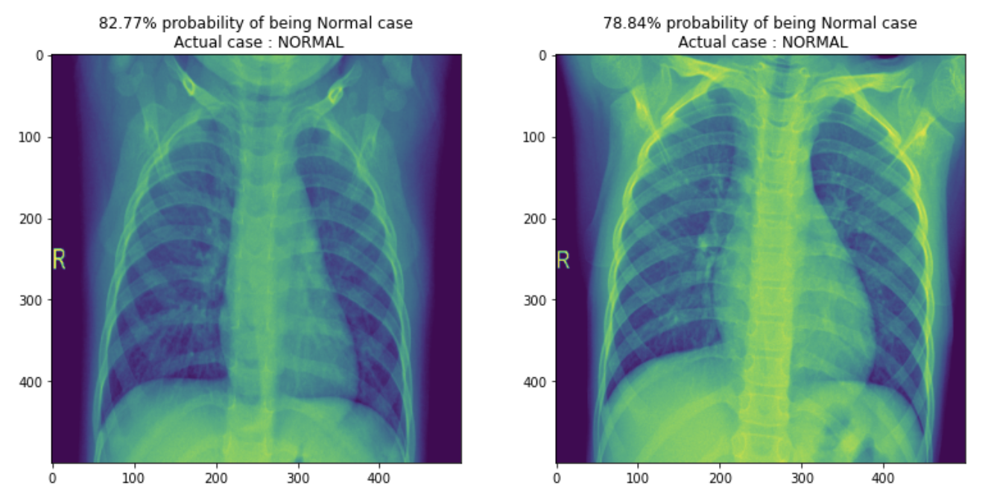
Evaluation
Precision score for predicting pneumonia: 83%.
Precision score for predicting normal: 86%

Slide 8
Recommendations
Chest radiographs are the most widely used tool for diagnosing pneumonia.
Early detection of pneumonia is crucial for determining the appropriate treatment of the disease.
Early detection can keep it from threatening the patient’s life.
Notes:
- Incorporate modeling into disease analyzation.

Slide 9

Next steps
Find more lung images from different age groups.
Use images from different parts of the world rather than just one area.

Slide 10
Thank you
LinkedIn
GitHub

