Slide 1
Classifying Pneumonia: An analyzation of lung images
Presented by:
Patrick Ryan

Slide 2

Overview
Historical Background
Business Plan/Opportunity
Data Understanding
Modeling
Evaluation
Recommendation
Next Steps

Slide 3
History of pneumonia
It’s an acute infection of the lungs.
First mentions of the disease appearing during early Greek civilization.
2012
1881
1930’s
2011
Notes:
The name originated from the ancient Greek meaning for Inflammation or lung itself.
1875 Edwin Klebs first saw bacteria in the airways. It w as later discovered that this bacteria led to Pneumonia.
1881 Louis Pasteur and George Sternberg discovered the bacteria associated with pneumonia cases.
1930-1940 ways to handle the ailment were discovered.
In 2010, $17 Billion was spent on pneumonia itself globally.
The United States estimates that it would take about $20 Billion more to help find a very accurate cure and eventual end to Pneumonia.
A new prediction model with promising results to cure Pneumonia.

Slide 4
Business opportunity
Technicians that read and process x-rays.
Increase in pneumonia cases.
Specifically in the older.
More products available for treatment.
Notes:
- Life expectancy

Slide 5
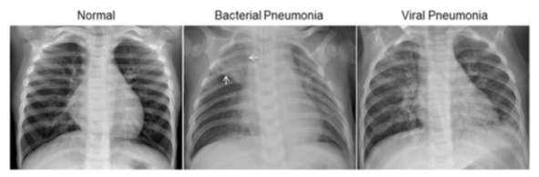
Data understanding
Data includes 5,863 images.
Provided by the Guangzhou Women and Children’s Medical Center.

Slide 6
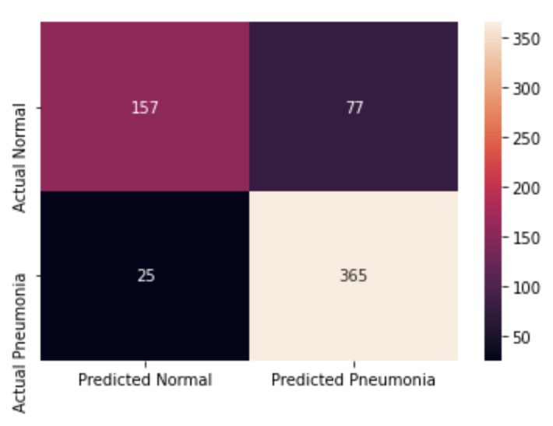
Modeling
Used a Convolutional Neural Network
Allowed a precision score to be obtained.
Needed to reduce false negatives.
Precision score for predicting normal: 88%.
Precision score for predicting pneumonia: 89%
Notes:
CNNs can learn what characteristics in the filters are the most important.
That saves a lot of time since we don't need as many parameters.
The models main purpose is to get data into forms that are easier to process without losing the features that are important for figuring out what the data represents.
This also makes them great candidates for handling huge datasets.

Slide 7
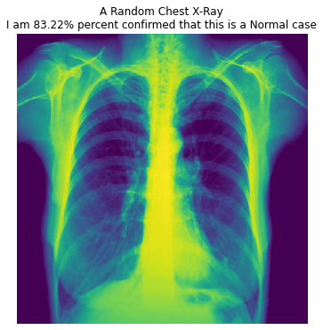
Evaluation
Checked against random sample from internet.
Sample is claimed to be normal beforehand.

Slide 8
Recommendations
Early detection of pneumonia is crucial.
It can keep it from threatening the patient’s life.
Notes:
- Incorporate modeling into disease analyzation.

Slide 9

Next steps
Find more lung images from different age groups.
Use images from different parts of the world rather than just one area.

Slide 10
Thank you
LinkedIn
GitHub

