Slide 1
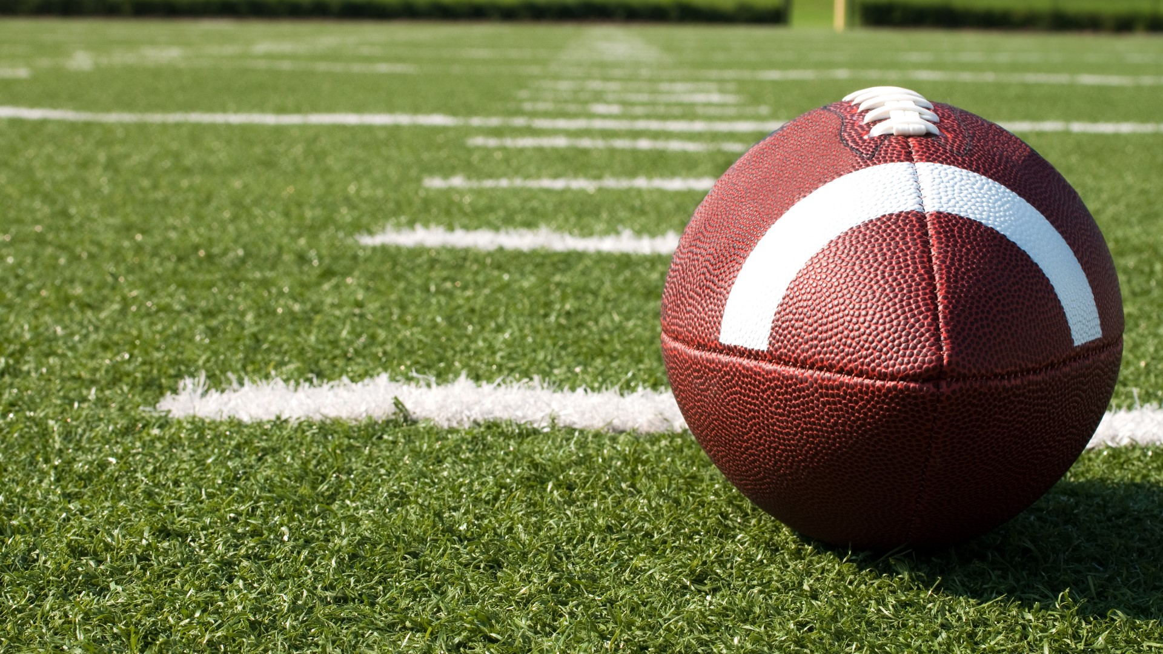
WHICH IS WHICH? Automating Sports Image Classification Presented By: Patrick Ryan

Slide 2

Business Understanding
Automatic retrieval of information.
Tons of available data out there.
Important to establish a methodology.

Slide 3
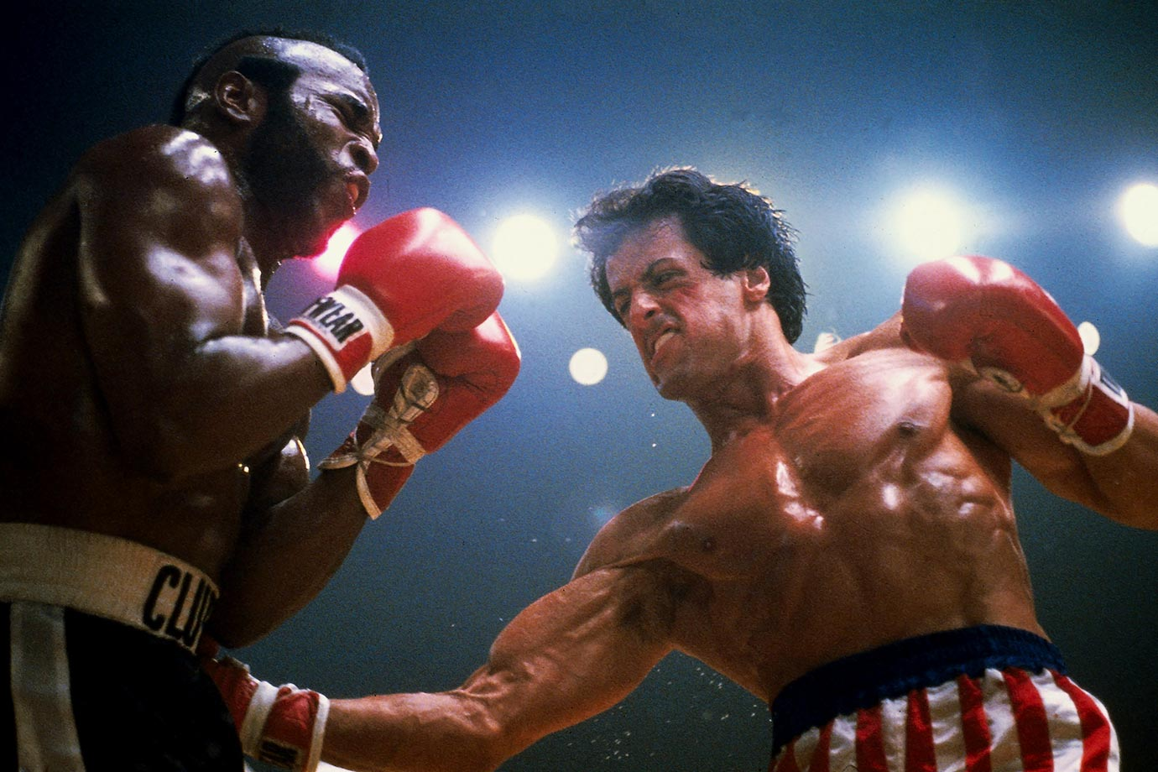
Data Understanding
Working with 4312 images.
7 categories.
Clean up images.

Slide 4
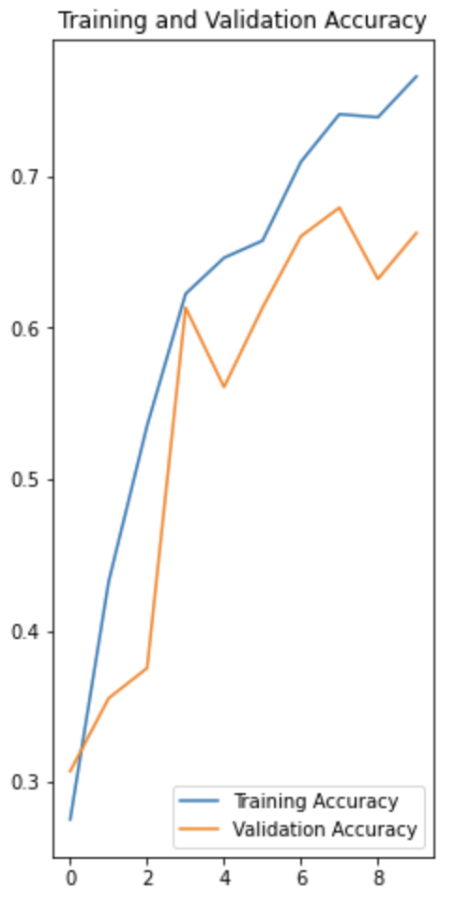
Modeling
Used a Convolutional Neural Network (CNN).
Accuracy score: 72%
Notes:
The models main purpose is to get data into forms that are easier to process without losing the features that are important for figuring out what the data represents.
This also makes them great candidates for handling huge datasets.
CNNs can learn what characteristics in the filters are the most important.
That saves a lot of time since we don't need as many parameters.
This graph shows how well the model did in terms of learning from the training set.
The model is not overfit.
Which is "the production of an analysis that corresponds too closely or exactly to a particular set of data, and may therefore fail to fit additional data or predict future observations reliably"

Slide 5
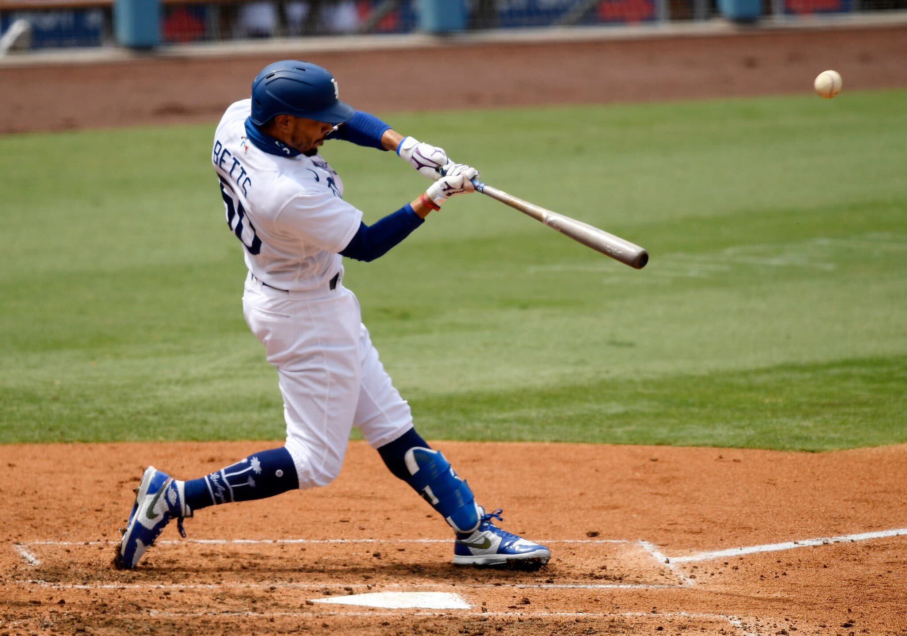
Evaluation
Checked against random sample from internet.
Dataset had no reference on this image.
Mookie Betts – Los Angeles Dodgers

Slide 6
Recommendations
Use a model that automatically classifies images.
Saves time.

Slide 7


Slide 8


