Slide 1

Title: Aircraft Accident Analysis and Safety Insights
PATRICK NJOROGE

Slide 2
BUSINESS UNDERSTANDING
From a business / aviation safety perspective, stakeholders want to know:
Are accidents increasing or decreasing over time?
How severe are most accidents?
How often do accidents involve fatalities?
Which operators appear most frequently in accident reports?
These insights can help:
Airlines improve safety procedures
Regulators focus inspections
Insurance companies assess risk

Slide 3
OBJECTIVES
Understand accident trends over time.
Identify damage severity patterns
Examine fatal vs non-fatal accidents
Identify operators with higher accident counts

Slide 4
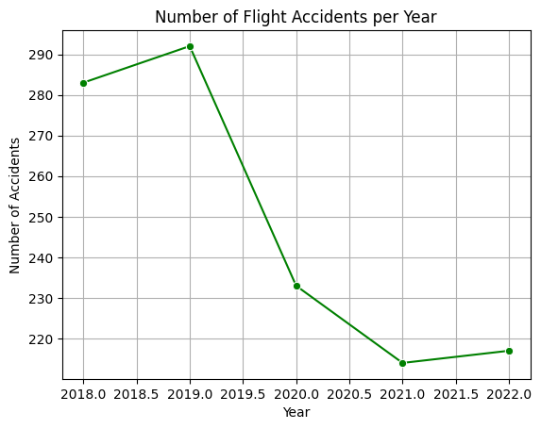
DATA ANALYSIS- EXPLORATORY DATA ANALYSIS(EDA)
Finding out the number of Accidents per year.
The line chart shows that the number of flight accidents peaked around 2018–2019 and declined afterward. This trend may be associated with reduced global air traffic during the COVID-19 pandemic.

Slide 5
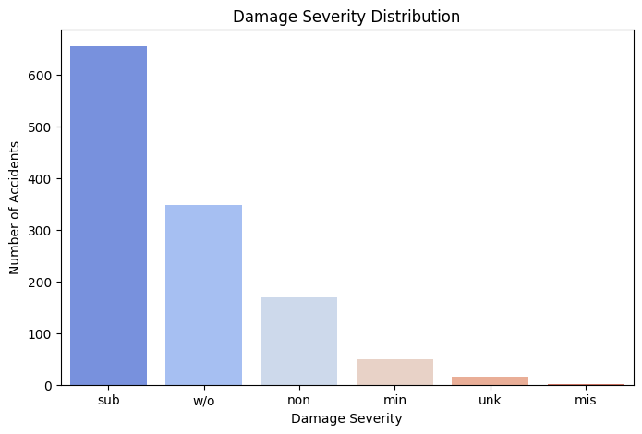
EDA: Damage Severity Distribution. Here we look at accidents that resulted in substantial damage,write-offs, Minor and no-damage.
The damage severity distribution shows that most recorded accidents resulted in substantial damage, followed by write-offs. Minor and no-damage cases are relatively rare, indicating that reported accidents often involve significant aircraft damage.

Slide 6
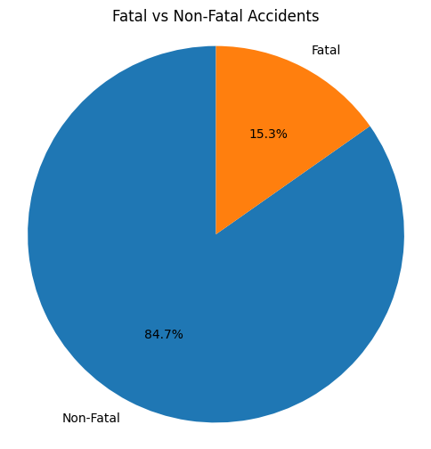
Fatal vs Non-Fatal Accidents
The visualization shows that the majority of flight accidents are non-fatal. Fatal accidents represent a smaller proportion of total incidents, indicating that while accidents occur, loss of life is relatively infrequent.

Slide 7
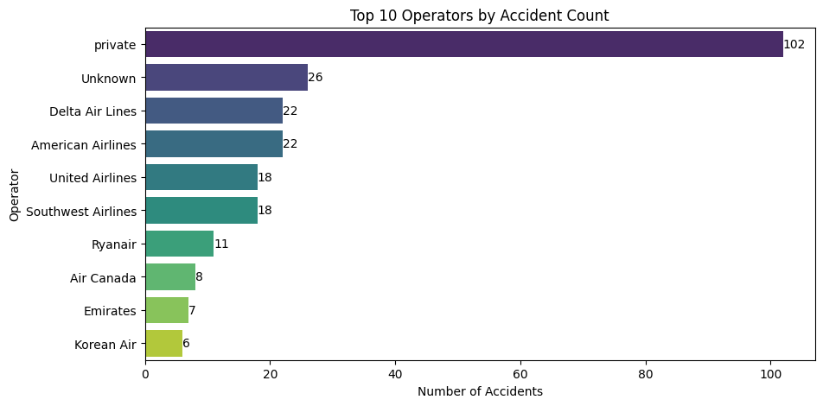
Top 10 Operators by Accident Count
The visualization shows that private operators account for the highest number of recorded accidents. This may be due to a large number of small private flights rather than poorer safety performance. Therefore, accident counts should be normalized by flight volume for fair comparison.

Slide 8
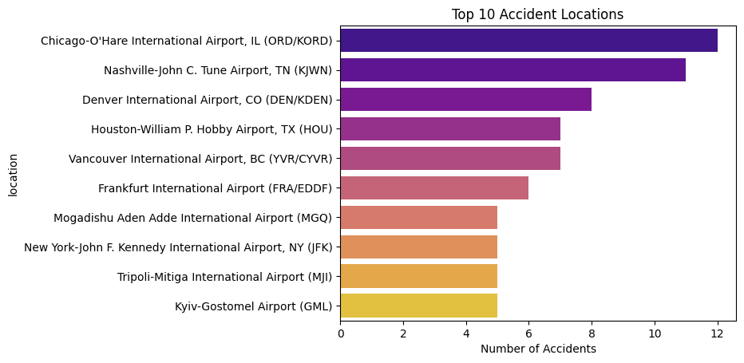
EDA Most Frequent Accident Locations
This is the top ten accident prone locations

Slide 9
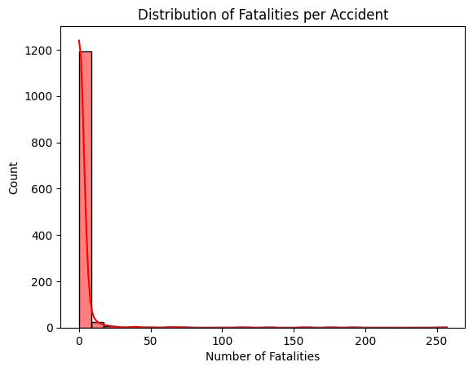
EDA Distribution of Fatalities per Accident
EDA Distribution of Fatalities per Accident
EDA Distribution of Fatalities per Accident
EDA Distribution of Fatalities per Accident
Here we can see The distribution is heavily right-skewed Most accidents occur at 0 fatalities
Most flight accidents do not result in loss of life, but when fatalities occur, they can be severe.

Slide 10
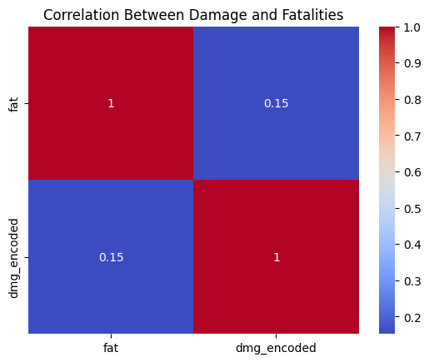
FINDING OUT THE CORRELATION BETWEEN DAMAGE TYPE AND FATALITIES
Higher damage severity correlates with fatalities. The more the damage to an aircraft the more its likely to have fatalities

Slide 11
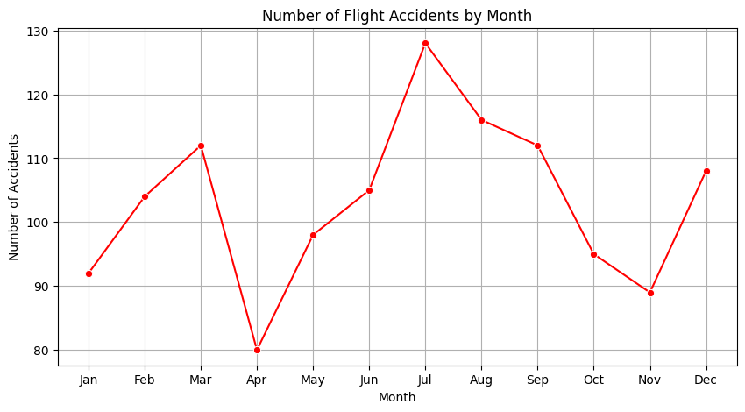
Finding out the Number of Accidents by Month
The line chart shows the distribution of flight accidents across months. Variations in accident counts suggest seasonality, possibly influenced by weather conditions, peak travel periods, and operational factors.

Slide 12
CONCLUSION
Accident Frequency Has Declined in Recent Years. The yearly trend shows a reduction in accidents, especially after 2019.
Most Accidents Are Non-Fatal. The fatal vs non-fatal analysis shows that the majority of accidents do not result in fatalities.
Substantial and Write-Off Damage Is Common. Damage severity analysis shows that most reported accidents involve significant aircraft damage.
Accident Frequency Varies by Month. Environmental and operational factors influence accident occurrence.
Private Operators Appear Frequently in Accident Records. This may be due to Larger number of small private flights.

Slide 13
RECOMMENDATIONS
Seasonal Risk Mitigation. Increase inspections, crew training, and operational caution during high-risk months.
Improve Safety Oversight for Private Operators. Strengthen regulations and audits for private and charter operators.
Enhance Data Collection to include Weather conditions, Aircraft age. Richer data enables better predictive modeling and policy decisions.
The analysis indicates that while flight accidents still occur, the majority are non-fatal and accident frequency has declined over time. However, a small number of catastrophic events account for a disproportionate share of fatalities. Seasonal patterns and operator characteristics further influence accident occurrence. These findings suggest that aviation safety efforts should focus not only on reducing accident frequency but also on mitigating the severity of rare high-impact events.

