Slide 1


In a nutshell

Slide 2

Before we get started
Before we get started
Using Unity
Scripting
Materials
Prefabs
Collisions
Components
Further Reading
I’m not a lecturer
So if my explanations suck, let me know, because I have no idea!
There are a lot of great resources on YouTube
Brackeys
Unity3DCollege
Sebastian Lague
…and more!
Andrew Patton 2019

Slide 3
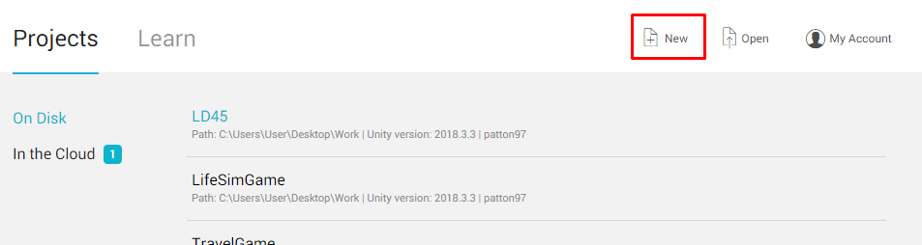
Using Unity
Before we get started
Using Unity
Scripting
Materials
Prefabs
Collisions
Components
Further Reading
Open unity
Create an account (chill, it’s free)
Create a New Project
3D Template
Andrew Patton 2019

Slide 4
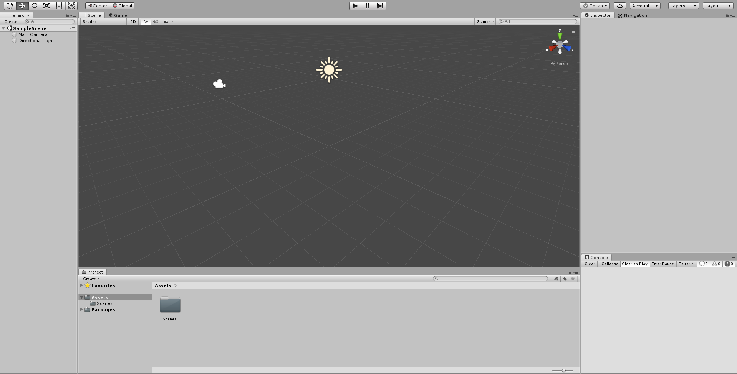
Using Unity
Before we get started
Using Unity
Scripting
Materials
Prefabs
Collisions
Components
Further Reading
That’s a lot of windows!
Don’t worry
Andrew Patton 2019

Slide 5
Using Unity
Before we get started
Using Unity
Scripting
Materials
Prefabs
Collisions
Components
Further Reading
The window on the left is our “Scene Hierarchy”
This is where all the objects in our scene will be listed
Right now, we just have our camera and a light
Andrew Patton 2019

Slide 6
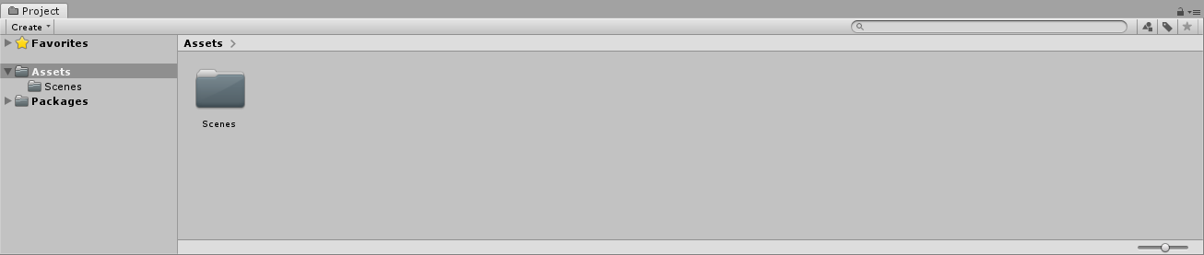
Using Unity
Before we get started
Using Unity
Scripting
Materials
Prefabs
Collisions
Components
Further Reading
The window on the bottom is our “Project”
This is where all the files in our game will be listed
Right now, we just have a Scenes folder with our current scene in it
It’s basically just Windows File Explorer, but in Unity
Andrew Patton 2019

Slide 7
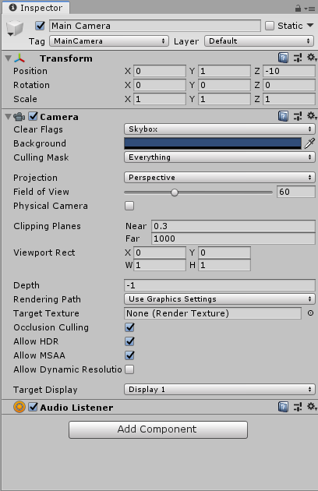
Using Unity
Before we get started
Using Unity
Scripting
Materials
Prefabs
Collisions
Components
Further Reading
The window on the right is our “Inspector”
This is where all the components of the selected object are listed
It’s probably blank for you – that’s fine!
Select the “Main Camera” object to view the attached components
Select the “Directional Light” object to view the attached components
Andrew Patton 2019

Slide 8
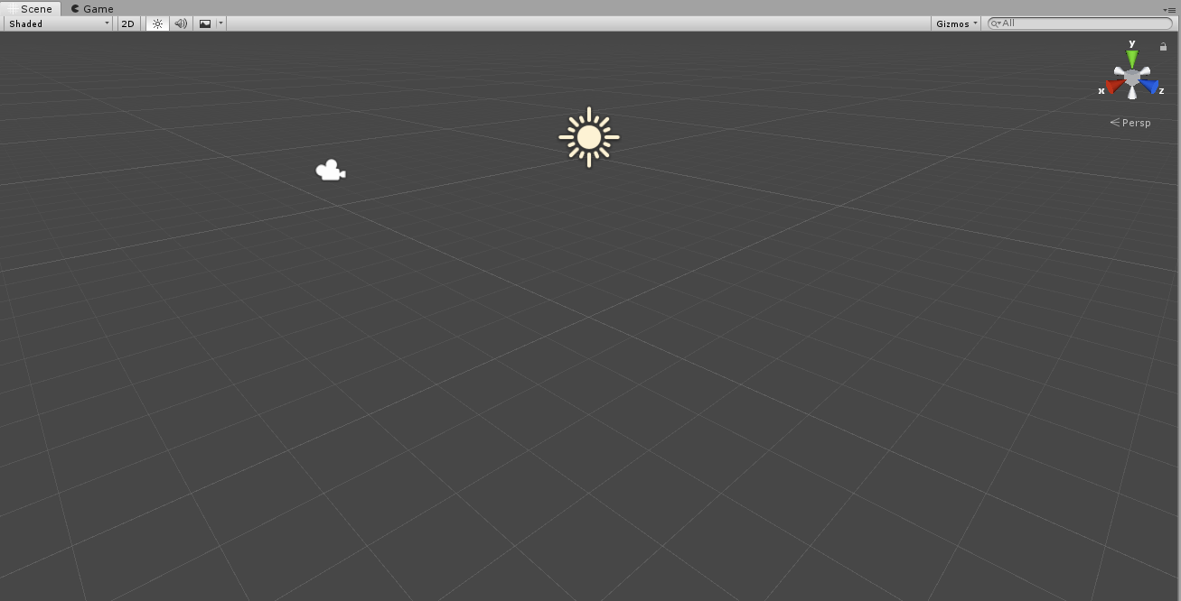
Using Unity
Before we get started
Using Unity
Scripting
Materials
Prefabs
Collisions
Components
Further Reading
The window in the smack-bang in the centre is our “Scene View”
This is the main screen we’ll need to construct our game
Hold down RightMouse to move/pan the camera
[W] Forward
[S] Backward
[A] Left
[D] Right
[Q] Up
[E] Down
Hold down MiddleMouse to drag yourself around
You can switch to the “Game” tab to preview what the game will look like when it runs
If you hit the play button, the game will start
Andrew Patton 2019

Slide 9
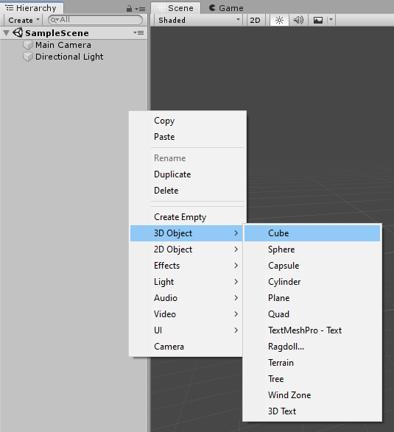
Using Unity
Before we get started
Using Unity
Scripting
Materials
Prefabs
Collisions
Components
Further Reading
So far, fairly boring
Let’s spice things up a bit
We’re going to add a cube object to our scene
Head over to the “Hierarchy” window
Right Click
Select “3D Object” > “Cube”
Andrew Patton 2019

Slide 10
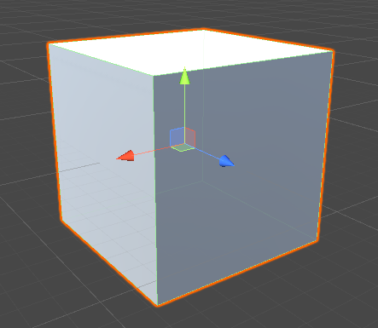
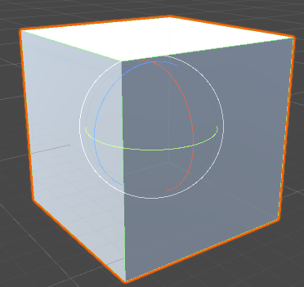
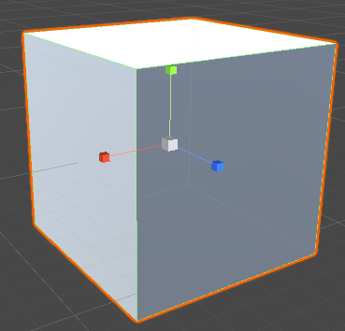
Using Unity
Before we get started
Using Unity
Scripting
Materials
Prefabs
Collisions
Components
Further Reading
Now that we’ve got our cube, let’s move it around a bit
Use the “Transform Gizmos” (the coloured arrows) to move the cube around
Press [E] to edit the rotation
Press [R] to edit the scale
Press [W] to edit the position
Andrew Patton 2019

Slide 11
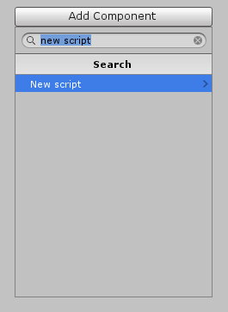
Scripting
Before we get started
Using Unity
Scripting
Materials
Prefabs
Collisions
Components
Further Reading
This cube is great
BUT
It would be a lot better if it actually did something
Let’s add a script to the cube, so we can move it around
Click on the Cube
Head over to the “Inspector” window
Click “Add Component”
Choose “New Script”
Name the script…whatever you like.
I’m just going to call mine “Player”, because I’m boring
Andrew Patton 2019

Slide 12
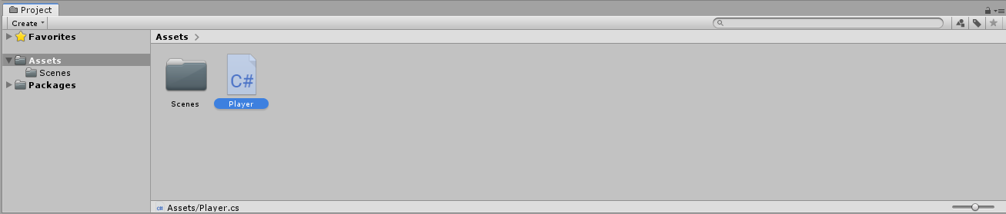
Scripting
Before we get started
Using Unity
Scripting
Materials
Prefabs
Collisions
Components
Further Reading
The new script will be now be in your “Project” window
Double-click it, and it should* open in Visual Studio
*If you don’t have Visual Studio installed, go do that https://visualstudio.microsoft.com/downloads/
Andrew Patton 2019

Slide 13

Scripting
Before we get started
Using Unity
Scripting
Materials
Prefabs
Collisions
Components
Further Reading
In this script, you’ll see there are 2 functions premade for you
void Start() – Runs in the first frame the object is loaded
void Update() – Runs every frame
Our code is going to go inside the Update function
First, let’s create a new Vector3
If the player presses [W], the cube should move forward. I’ve decided ‘forward’ is going to be along the z-axis
Finally, let’s add our vector to the cube’s position in the scene
Andrew Patton 2019

Slide 14
Scripting
Before we get started
Using Unity
Scripting
Materials
Prefabs
Collisions
Components
Further Reading
If you’re new to programming, that was probably a lot of information!
Let’s slow down for a slide or two and pick apart what some of that meant
A Vector3 is a 3D Vector. It stores 3 floats, [x, y, z].
Floats are just numbers, by the way
Here, we are asking the engine if the [W] key is currently pressed down. If it is, we set our vector’s z-value to 1
This means our vector now looks like this: [0, 0, 1]
Andrew Patton 2019

Slide 15
Scripting
Before we get started
Using Unity
Scripting
Materials
Prefabs
Collisions
Components
Further Reading
To actually move the object, we need to update its position. This line looks ugly, but think of it in chunks.
We go to the object this script belongs to
We get that object’s transform (remember the coloured gizmos from earlier)
We get that transform’s position vector
We add our vector to that position vector
A transform position is just another Vector3.
If the position is [7, 5, 3]
We add our vector [0, 0, 1]
The position is now [7, 5, 4]
Andrew Patton 2019

Slide 16
Scripting
Before we get started
Using Unity
Scripting
Materials
Prefabs
Collisions
Components
Further Reading
What about if we wanted to move in other directions?
Try adding more if blocks checking the following keys
[S] – Move backwards along the z-axis
[A] – Move left along the x-axis
[D] – Move right along the x-axis
Try adding two more if blocks, for vertical movement
[Q] – Move up the y-axis
[E] – Move down the y-axis
Here’s a reminder of how we did the forwards movement
Andrew Patton 2019

Slide 17

Scripting
Before we get started
Using Unity
Scripting
Materials
Prefabs
Collisions
Components
Further Reading
What if we wanted to change the speed?
First, create a member variable to store the speed
(This goes before the Start function is declared)
Next, in the Update function, change your code to instead use the speed variable
Andrew Patton 2019

Slide 18

Scripting
Before we get started
Using Unity
Scripting
Materials
Prefabs
Collisions
Components
Further Reading
So far, this won’t do anything. If you hit play, your cube will probably do the same as before
This is because we haven’t told it what “speed” is yet
Head back into the script, and add “[SerializeField]” in front of the variable declaration
This allows us to change the variable from our inspector window
Go take a look!
Play around with changing the speed
Andrew Patton 2019

Slide 19
Scripting
Before we get started
Using Unity
Scripting
Materials
Prefabs
Collisions
Components
Further Reading
This slide and the next discuss framerates. I find it boring, but it’s helpful to know why & how framerates affect our speed.
Our code runs every frame, so our cube is moving around 60 times a second. If your speed variable is set to 2, the cube is moving 120 units per second, and so on.
This is a problem
If our speed is 4, and the game runs at 60FPS
The player moves 4 units every frame, so 240 units per second
If our speed is 4, but the game runs at 30FPS
The player moves 4 units every frame, so 120 units per second
It’s not really fair if one player moves twice as fast
To fix this, we can multiply our vector by Time.deltaTime
Andrew Patton 2019

Slide 20
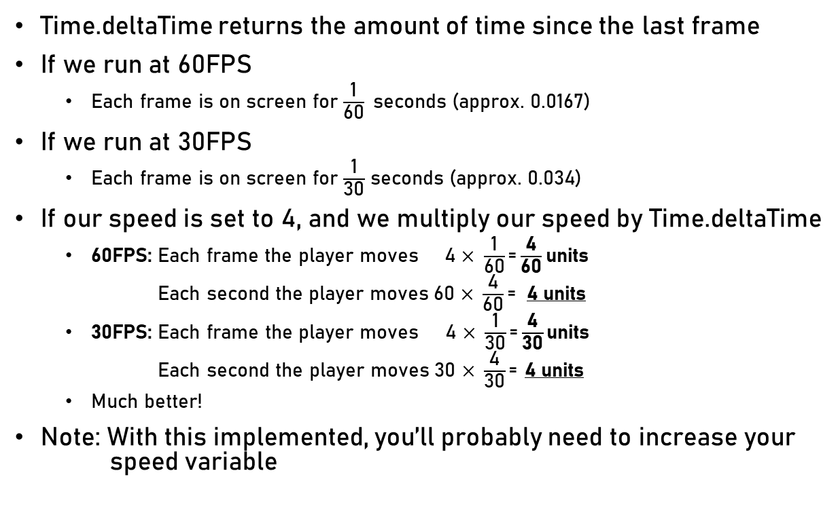
Scripting
Before we get started
Using Unity
Scripting
Materials
Prefabs
Collisions
Components
Further Reading
Time.deltaTime returns the amount of time since the last frame
If we run at 60FPS
Each frame is on screen for $\frac{\text{1}}{\text{60}}$seconds (approx. 0.0167)
If we run at 30FPS
Each frame is on screen for $\frac{\text{1}}{\text{30}}$ seconds (approx. 0.034)
If our speed is set to 4, and we multiply our speed by Time.deltaTime
60FPS: Each frame the player moves $\text{4 }\text{×} \frac{\text{1}}{\text{60}}\text{=}\frac{\text{4}}{\text{60}}$ units
60FPS: Each second the player moves $\text{6}\text{0} \text{×} \frac{\text{4}}{\text{60}}\text{=}$ 4 units
30FPS: Each frame the player moves $\text{4 }\text{×} \frac{\text{1}}{\text{3}\text{0}}\text{=}\frac{\text{4}}{\text{3}\text{0}}$ units
30FPS: Each second the player moves $\text{30} \text{×} \frac{\text{4}}{\text{3}\text{0}}\text{=}$ 4 units
Much better!
Note: With this implemented, you’ll probably need to increase your speed variable
Andrew Patton 2019

Slide 21
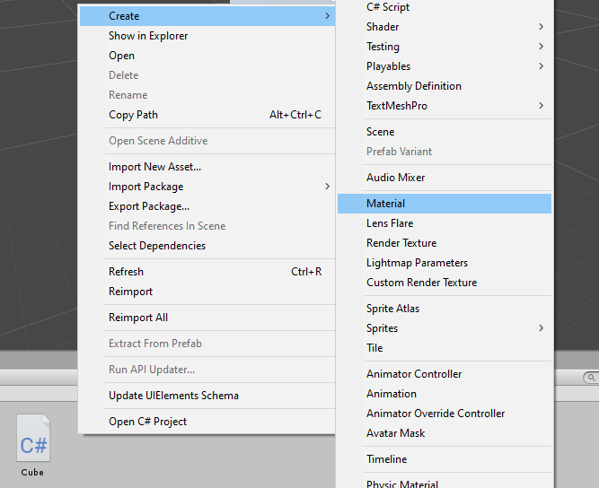
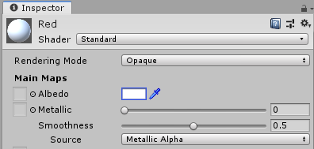
Materials
Before we get started
Using Unity
Scripting
Materials
Prefabs
Collisions
Components
Further Reading
First, make a new material
Right click in the “Project” window
Choose “Create” > “Material”
It’s probably a good idea to name the material something sensible
I’m going to call mine “Red” because that’s what colour I’m going to make it
You can choose whatever colour you like
In the inspector window, click the white box labelled “Albedo”, and choose your colour
Andrew Patton 2019

Slide 22
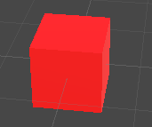
Materials
Before we get started
Using Unity
Scripting
Materials
Prefabs
Collisions
Components
Further Reading
Now that you’ve got your material, you can give it to your cube
Click & drag the material onto your cube
This little cube looks pretty cool, now
Andrew Patton 2019

Slide 23
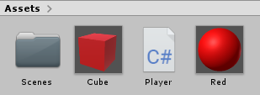
Prefabs
Before we get started
Using Unity
Scripting
Materials
Prefabs
Collisions
Components
Further Reading
The object we’ve created so far only exists within our scene.
It’s often helpful to have a copy saved in our project
Click and drag the “Cube” listing from the “Hierarchy” window, into the “Project” window
Now you can add more of the same cube to your scene without having to go through and setup each one all-over again.
This isn’t really useful for our player cube, because there’s usually only one player*, but we might want several NPC cubes
*Unless, of course, you make it a multiplayer game
Andrew Patton 2019

Slide 24
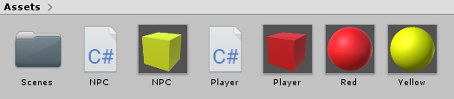
Prefabs
Before we get started
Using Unity
Scripting
Materials
Prefabs
Collisions
Components
Further Reading
Create a new cube in your scene
Give it a material
Make this one a different colour to your player
Mine’s going to be Yellow
Create a new script called “NPC”
Add this script to your new cube
Save your new cube as a prefab
Now might be a good time to rename your prefabs
I’ve named mine “Player” and “NPC”, respectively
Andrew Patton 2019

Slide 25
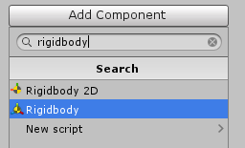
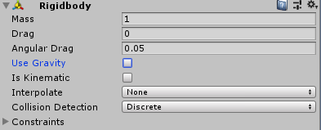
Collisions
Before we get started
Using Unity
Scripting
Materials
Prefabs
Collisions
Components
Further Reading
Alright, let’s start bumping into things
If you select one of your cubes, you’ll see they have a component called “Box Collider” in the inspector. This collider can be resized and even repositioned, if needed
Before we can collide, we need to add a “RigidBody” component to both of our prefabs
Double click the Player prefab
Go to the inspector
Add Component > RigidBody
Do the same for the NPC prefab
For now, disable “Use gravity” on both prefabs. We’ll come back to this.
Andrew Patton 2019

Slide 26


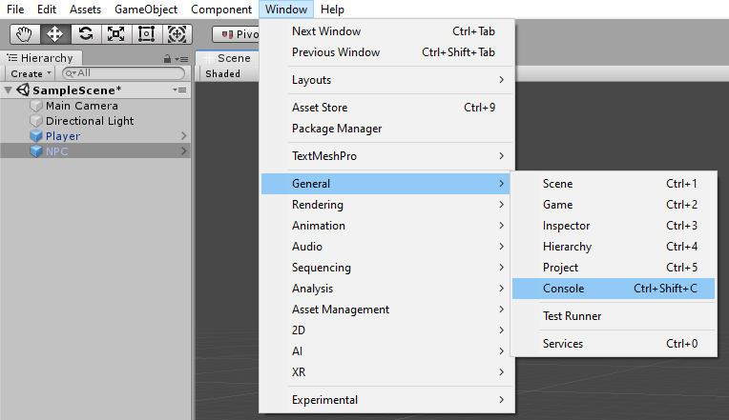
Collisions
Before we get started
Using Unity
Scripting
Materials
Prefabs
Collisions
Components
Further Reading
When two colliders overlap – and they have a RigidBody - this triggers a function called “OnCollisionEnter”
To demonstrate this, add the following code to your NPC script
Try it out, smash your Player cube into your NPC cube
If you don’t see the console window in the bottom right
Go to the top of the screen
Window > General > Console
Andrew Patton 2019

Slide 27

Collisions
Before we get started
Using Unity
Scripting
Materials
Prefabs
Collisions
Components
Further Reading
This function uses a parameter, called “collision”. This parameter tells us what exactly we collided with.
Try out the following code
If your console just says “Cube collided with Cube”, rename your cubes to “Player” and “NPC”, respectively
You can rename objects by double clicking the in the Scene Hierarchy window
Andrew Patton 2019

Slide 28
Components
Before we get started
Using Unity
Scripting
Materials
Prefabs
Collisions
Components
Further Reading
What is a component? Truth is, you already know. You just made two: Player & NPC
Components are instances of scripts that have been attached to objects.
If you click your cube, and look at the inspector, you’ll see it has several components
Transform: stores the position, rotation and scale of your object
Mesh Filter: stores the mesh used to display your object, right now it’s using a cube mesh
Mesh Renderer: controls how your mesh is rendered, how it reacts to light, etc
Box Collider: detects other objects colliding with your object
Player (Script): does whatever you just programmed it to do
NPC (Script): does whatever you just programmed it to do
Andrew Patton 2019

Slide 29

Components
Before we get started
Using Unity
Scripting
Materials
Prefabs
Collisions
Components
Further Reading
Let’s take our collisions a step further, and give our NPC some health
In the NPC script
Add a member variable called “health” If you’re unsure how, revisit how we added the speed variable to our Player script
Add a member function called “RemoveHealth”
We haven’t discussed functions yet, so if you’re unsure, here’s what a member function might look like
Whenever this function is called, our NPC’s health is reduced by 1, and a string is output to the console telling us the new health value.
Since this function is public, we can call it from our Player script
Andrew Patton 2019

Slide 30

Components
Before we get started
Using Unity
Scripting
Materials
Prefabs
Collisions
Components
Further Reading
Head over to the Player script
Add the “OnCollisionEnter” function
Inside this function, we’re going to talk to the object the player collides with
Again, fairly ugly, but break it down into chunks
“collision” is the collision component we have collided with
We get the game object that component belongs to
We now request the NPC component belonging to that game object
We call that NPC component’s RemoveHealth function
Try it out
When you collide, your console should report the NPC’s new health, and each time you collide this health should go down by 1
Andrew Patton 2019

Slide 31
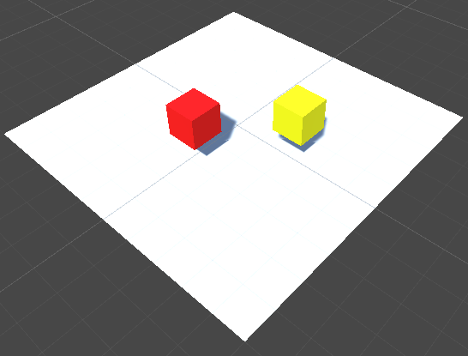
Components
Before we get started
Using Unity
Scripting
Materials
Prefabs
Collisions
Components
Further Reading
Your player cube is probably flying around in zero-gravity right now
It’s pretty annoying
Head into the NPC and Player prefabs, and enable “Use Gravity” from the RigidBody component
If you hit play now, both cubes will just start falling … because … gravity
To solve this, add a floor
Right-click the Scene Hierarchy window
3D Objects > Plane
Reposition your floor below the cubes
Andrew Patton 2019

Slide 32
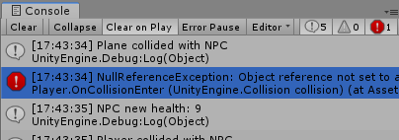
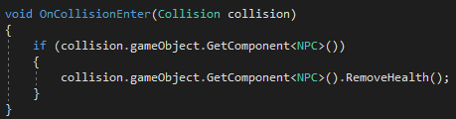
Components
Before we get started
Using Unity
Scripting
Materials
Prefabs
Collisions
Components
Further Reading
If you hit play, your cubes should no longer fly around
However, your console is reporting an error
Since your floor has a collider, your player is colliding with it. Each time they collide, the player tries to get the floor’s NPC component. The problem: it doesn’t have one
We can change our Player script to check if a NPC component exists before doing anything with it
Andrew Patton 2019

Slide 33
Further Reading
Before we get started
Using Unity
Scripting
Materials
Prefabs
Collisions
Components
Further Reading
I’ve called this section “Further Reading” because it looks professional, but what I really mean is go watch some YouTube videos and play around with Unity.
If you’re not sure what to look into/experiment with, try the following:
Use your prefab to make multiple NPCs Give each of your NPCs a string that stores their unique name, like “Kate” or “Jeremy”
Add a 3D text object to your NPC prefab
Make this text object display the NPC’s name and current health
Reminder: There are a bunch of great tutorials on YouTube
Brackeys
Unity3DCollege
Sebastian Lague
My personal recommendation is Brackeys’ Unity Beginner Tutorials
It covers everything from what we’ve done so far in this slideshow, all the way up to a fully finished video game, and even some extra polish on top
Andrew Patton 2019

Slide 34
Before we get started
Using Unity
Scripting
Materials
Prefabs
Collisions
Components
Further Reading
If this was useful, let me know
If it wasn’t, also let me know!
As I said on the first slide, I’m not a lecturer. I have no idea whether I’ve introduced Unity perfectly or just rambled on for the past 34 slides
Fin
Andrew Patton 2019

