Slide 1
Analysis
Patton

Slide 2
Intro to Counter-Strike
Popularity
Fundamentals about the game
Features that matter

Slide 3
Previous Approaches

Slide 4
My Methods
Research Question

Slide 5
Data Gathering
Web Scraping
Demo Parser

Slide 6
Variables

Slide 7
My Approach & Results
Terrorists
Methods
Use Utilities
Engage in Fights
Get CT away from the site
Sub Goals
Kill CT
Goals
Plant Bomb

Slide 8
My Approach & Results
Terrorists
Methods
Use Utilities
Engage in Fights
Sub Goals
Kill CT
Positioning
How?

Slide 9
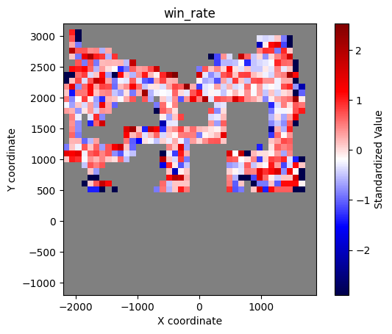
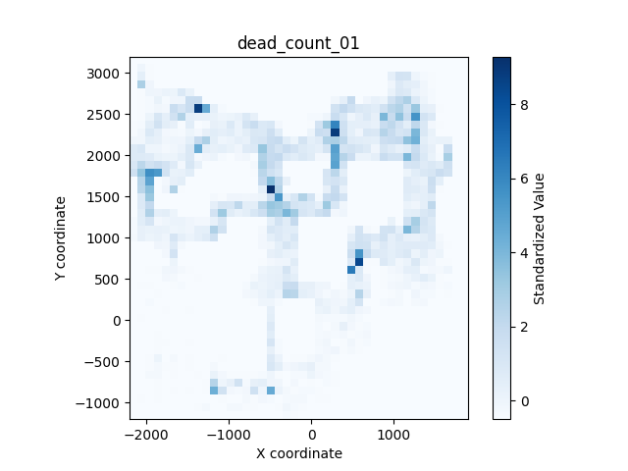
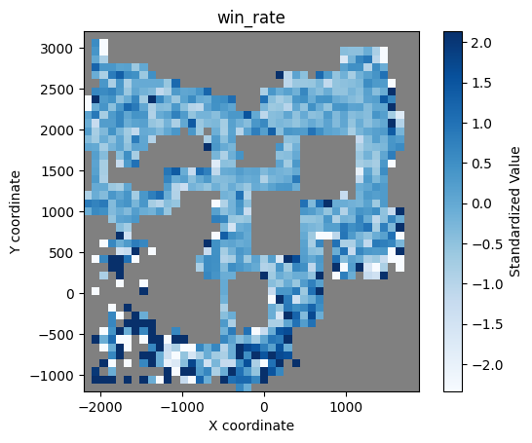
Positioning

Slide 10
My Approach & Results
Terrorists
Methods
Use Utilities
Engage in Fights
Sub Goals
Kill CT
Positioning
Weapon
How?
Positioning
Armor
…

Slide 11
Feature Variables
Target Variable
Positioning
Weapon
Positioning
Armor
…
Win / Lose
Peason correlation
0.049 -0.092 0.084 -0.167 -0.221 -0.171 -0.197 -0.005 0.050
Mutual Information
0.009 0.019 0.005 0.022 0.026 0.019 0.019 0.019 0.000
How about
Machine Learning Models?

Slide 12
xWinRate
xGoal

Slide 13
My Approach
Most Vulnerable Positions
Features that Contribute to Winning
MI; …
ML Method
Expected Win Rate
Crosshair movement

Slide 14

$$H\left(coord\right)=−\sum_{\left\{\text{att}\text{_}\text{coord}\right\}}{P({\text{att}_\text{pixel}}_{i} | \text{pixel})\backslash log P}$$

