Slide 1

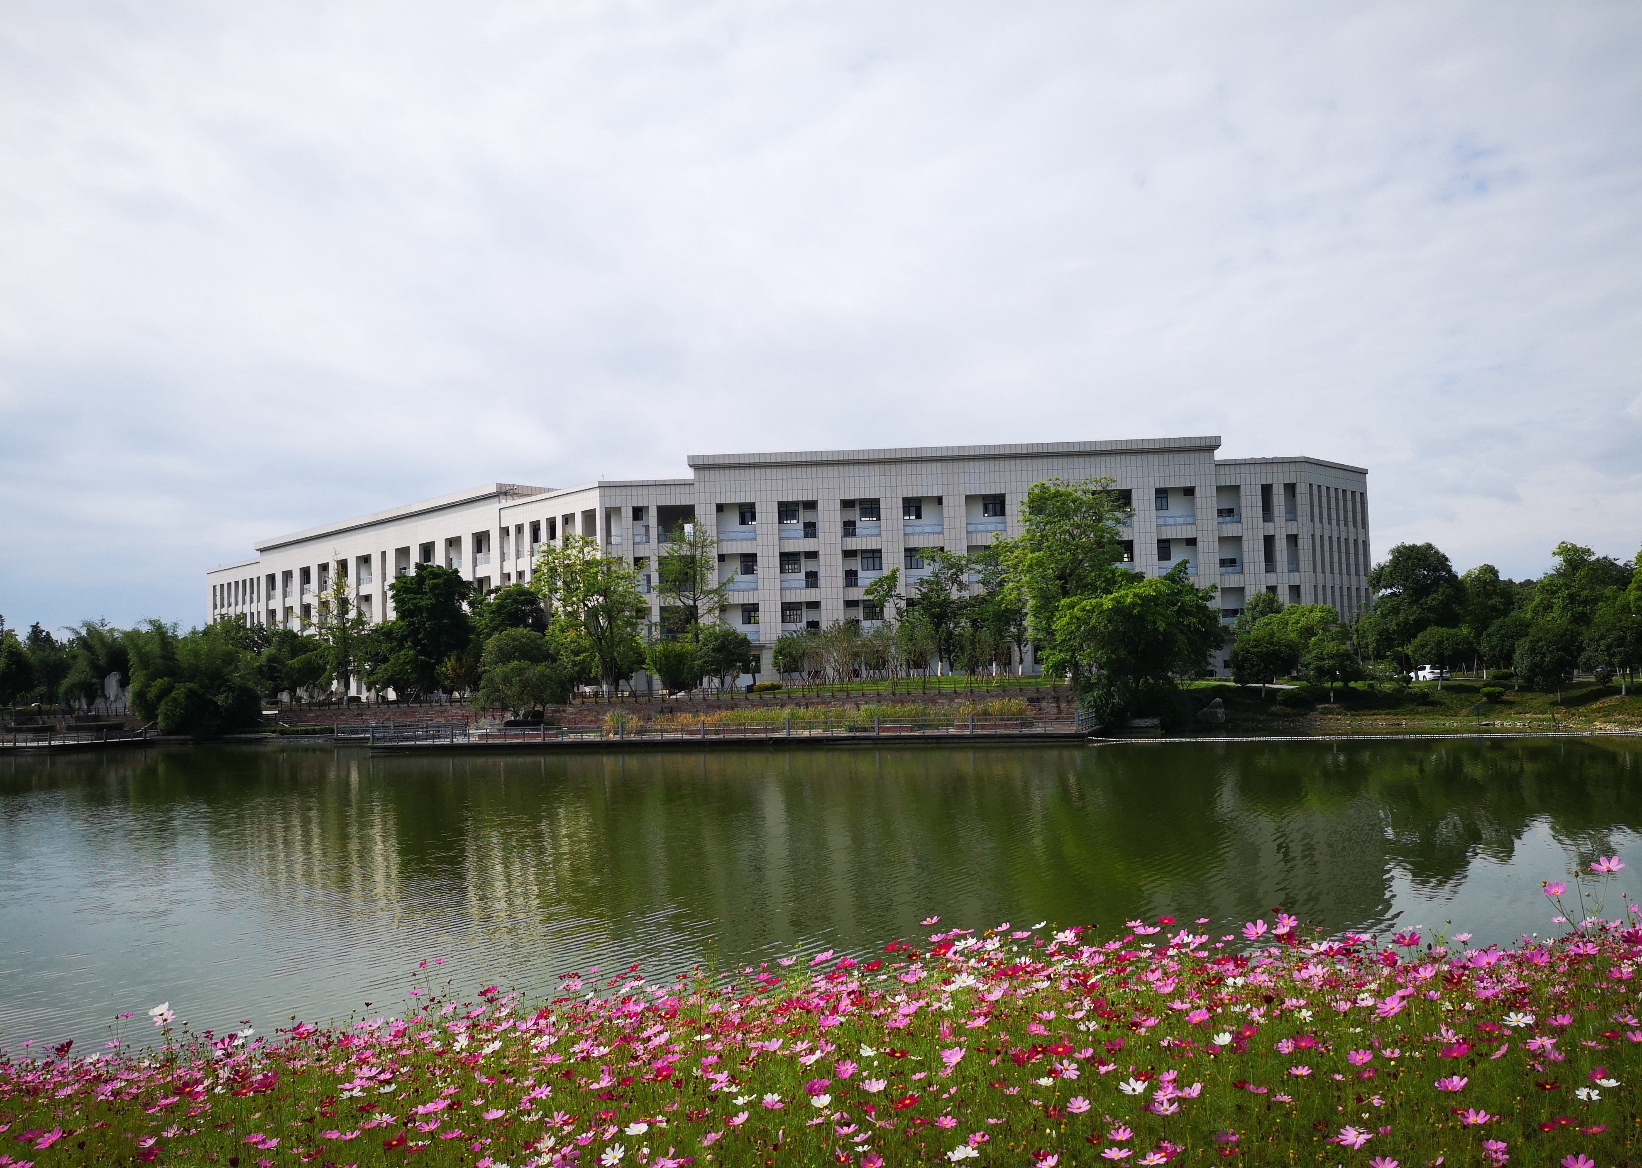
电子科大报告
Quarterly Work Reports
汇报人：小北

Slide 2
1
工作完成情况
The user can demonstrate on a projector or computer
Contents
2
成功项目分析
目 录
The user can demonstrate on a projector or computer
3
存在不足之处
The user can demonstrate on a projector or computer
4
下步计划展望
The user can demonstrate on a projector or computer

Slide 3
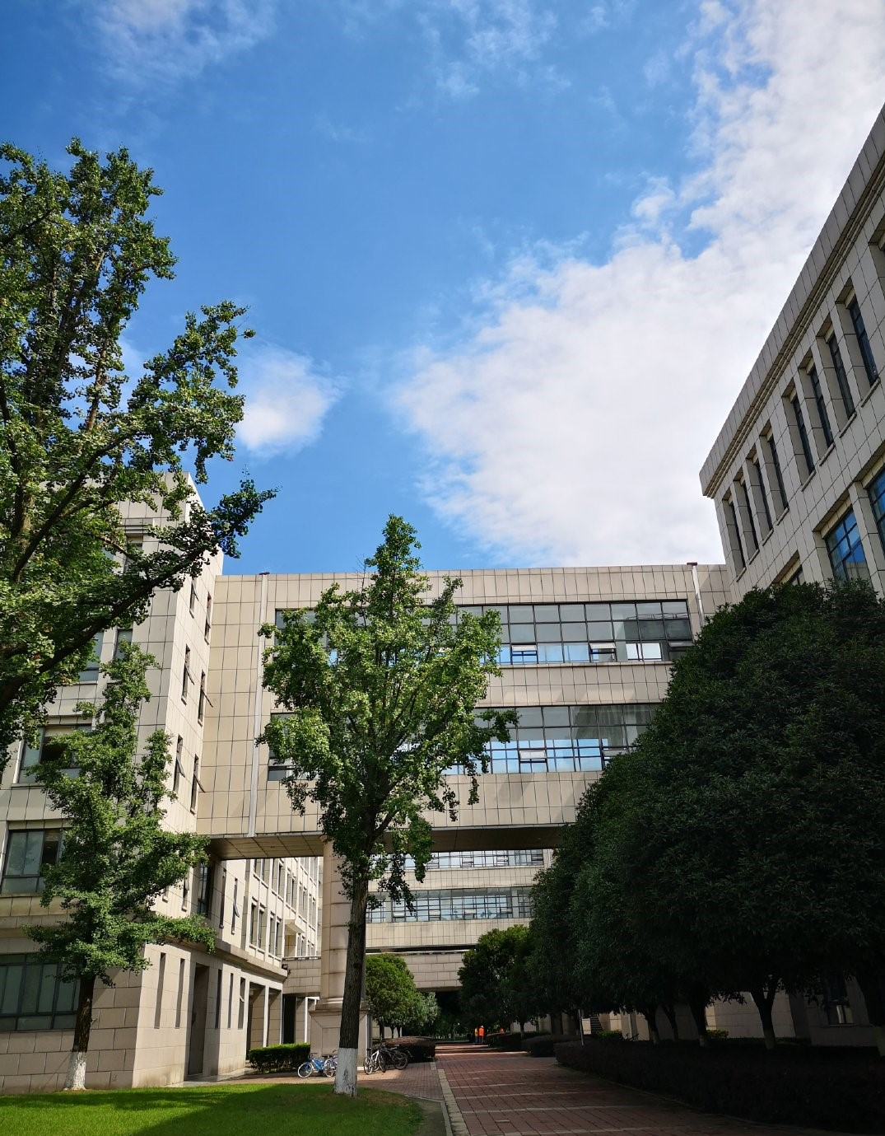

PART
01
工作完成情况
The user can demonstrate on a projector or computer, or print the presentation and make it into a film to be used
标题文字添加
标题文字添加
标题文字添加
标题文字添加

Slide 4

点击标题文字添加

Slide 5
点击标题文字添加
The user can demonstrate on a projector or computer, or presentation and make it film to be used in a wider field
The user can demonstrate on a projector or computer, or presentation and make it film to be used in a wider field
The user can demonstrate on a projector or computer, or presentation and make it film to be used in a wider field
The user can demonstrate on a projector or computer, or presentation and make it film to be used in a wider field
The user can demonstrate on a projector or computer, or presentation and make it film to be used in a wider field

Slide 6
电子科大报告
Quarterly Work Reports
汇报人：小北

