Slide 1
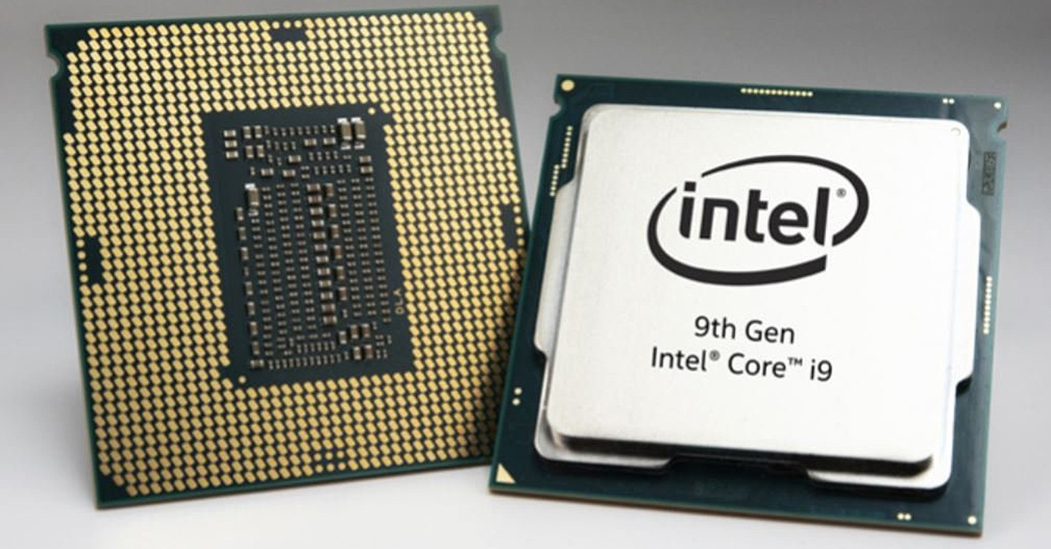
CPU

Slide 2
CENTRAL PROCESSING UNIT It carries out the instructions of a computer program by performing the basic arithmetic, logic, controlling, and input/output (I/O) operations specified by the instructions

Slide 3
Principal components of a CPU are the arithmetic logic unit (ALU) that performs arithmetic and logic operations. Control unit (CU) which extracts all the instructions from the memory, decodes and the executes them, calling ALU whenever is necessary.

Slide 4
OPERATION
Fetch
The first step, fetch, involves retrieving an instruction (which is represented by a number or sequence of numbers) from program memory.
Decode
The instruction that the CPU fetches from memory determines what the CPU will do. In the decode step, performed by the circuitry known as the instruction decoder, the instruction is converted into signals that control other parts of the CPU.
Execute
After the fetch and decode steps, the execute step is performed. Depending on the CPU architecture, this may consist of a single action or a sequence of actions. During each action, various parts of the CPU are electrically connected so they can perform all or part of the desired operation and then the action is completed.

Slide 5
MULTIPROCESSOR
A multi-core processor is a computer processor integrated circuit with two or more separate processing units, called cores, each of which reads and executes program instructions, as if the computer had several processors.

Slide 6
Overclocking is the process of forcing a computer (CPU,memory,GPU etc) to operate faster than the manufactured clock frequency (The speed at which the device does a particular task).

Slide 7
ADVANTAGES Increases performance (get extra speed) Achieve a better performance at no cost Squeeze all the resources from a component

Slide 8
DISADVANTAGES Due to the extra speed gained by overclocking, this would result in more work done by the CPU in less time, so it’s going to consume more resources. -It would increase power consumption -Reduces lifespan of components -It would increase fan noise -Overheating (damage other components) -You might need to increase the number of fans or add any cooling system - Your manufacturer warranty would get void - Damage your CPU if not done properly.

Slide 9
UNDERCLOCKING
Reduces power consumption
Reduces temperature and cooling requirements
Quiet operation
Increase battery life
Slower operation

