Slide 1


Swiggy Project

Slide 2
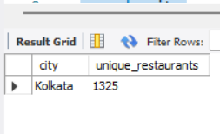
1. Which cities have the highest number of unique restaurants listed?
select city, count(distinct Restaurant)
from swiggy
group by city
order by count(distinct Restaurant) desc
limit 1;

Slide 3
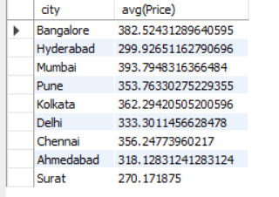
2.What is the average food price in each city?
select city, avg(Price)
from swiggy
group by city;

Slide 4
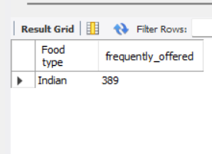
3.Which food type is the most frequently offered across all restaurants?
SELECT `Food type`, COUNT(*) AS frequently_offered
FROM swiggy
GROUP BY `Food type`
ORDER BY frequently_offered DESC
LIMIT 1;

Slide 5
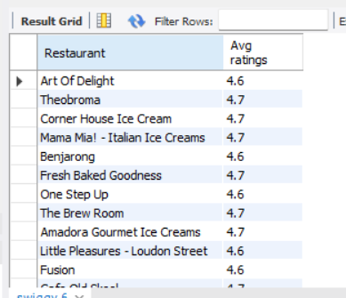
4.Which restaurants have an average rating above 4.5?
SELECT Restaurant, `Avg ratings`
FROM swiggy
WHERE `Avg ratings` > 4.5;

Slide 6
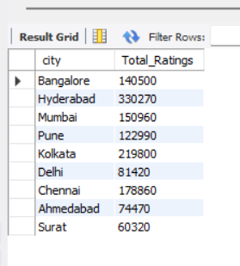
5.What is the total number of ratings received per city?
select city, sum(`Total Ratings`) as Total_Ratings
from swiggy
group by city;

Slide 7
6. Which areas have the longest average delivery times?
SELECT Area, ROUND(AVG(`Delivery time`), 2) AS avg_delivery_time
FROM swiggy
GROUP BY Area
ORDER BY avg_delivery_time DESC
LIMIT 1;

Slide 8
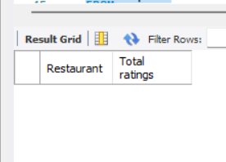
7. What are the top 3 most-rated restaurants in Bengaluru?
SELECT Restaurant, `Total ratings`
FROM swiggy
WHERE City = 'Bengaluru’
ORDER BY `Total ratings` DESC
LIMIT 3;

Slide 9
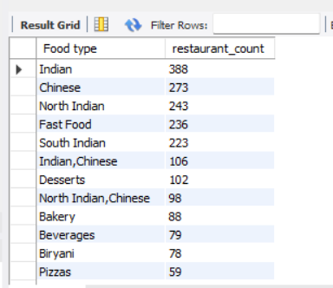
8. How many restaurants offer each type of cuisine?
SELECT `Food type`, COUNT(DISTINCT Restaurant) AS restaurant_count
FROM swiggy
GROUP BY `Food type`
ORDER BY restaurant_count DESC;

Slide 10
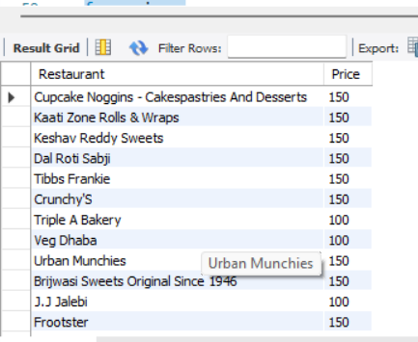
9.Which restaurants offer meals priced below ₹200?
select Restaurant, Price
from swiggy
where Price<200;

Slide 11
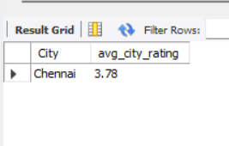
10. Which cities have the highest average restaurant ratings?
SELECT City, ROUND(AVG(`Avg ratings`), 2) AS avg_city_rating
FROM swiggy
GROUP BY City
ORDER BY avg_city_rating DESC
LIMIT 1;

Slide 12


Slide 13
Thank you

