Slide 1

What is ADO.Net?
A data-access technology that enables applications to connect to data stores and manipulate data contained in them in various ways
An object oriented framework that allows you to interact with database systems

Slide 2
.NET Data Providers
Data Provider | Namespace
SQL Server | System.Data.SqlClient
OLE DB | System.Data.OleDb
ODBC | System.Data.Odbc
Oracle | System.Data.OracleClient

Slide 3
ADO.NET Core Objects
Object | Description
Connection | Establishes a connection to a specific data source. (Base class: DbConnection)
Command | Executes a command against a data source. Exposes Parameters and can execute within the scope of a Transaction from a Connection. (The base class: DbCommand)
DataReader | Reads a forward-only, read-only stream of data from a data source. (Base class: DbDataReader)
DataAdapter | Populates a DataSet and resolves updates with the data source. (Base class: DbDataAdapter)
DataTable | Has a collection of DataRows and DataColumns representing table data, used in disconnected model
DataSet | Represents a cache of data. Consists of a set of DataTables and relations among them

Slide 4
Data Provider Functionality
Client
.Net Data Provider
Connection
Command
Rows
DataReader
DataSet
DataAdapter
database

Slide 5
Namespaces
System.Data & System.Data.Common
System.Data.SqlClient & System.Data.OleDB
System.Data.SqlTypes

Slide 6
Command class core methods:
ExecuteNonQuery : Executes a SQL statement against a connection object
ExecuteReader: Executes the CommandText against the Connection and returns a DbDataReader
ExecuteScalar: Executes the query and returns the first column of the first row in the result set returned by the query

Slide 7
Connection String in Web.Config
<connectionStrings>
<add name="myConnectionString" connectionString="server=XXXXX;database=TestDB;uid=XXX;password=XXXX;" />
</connectionStrings>
Reading the Connection String in code :
ConfigurationManager.ConnectionStrings["myConnectionString"].ConnectionString;
Creating a New Connection Object
SqlConnection con = new SqlConnection(connStr);

Slide 8
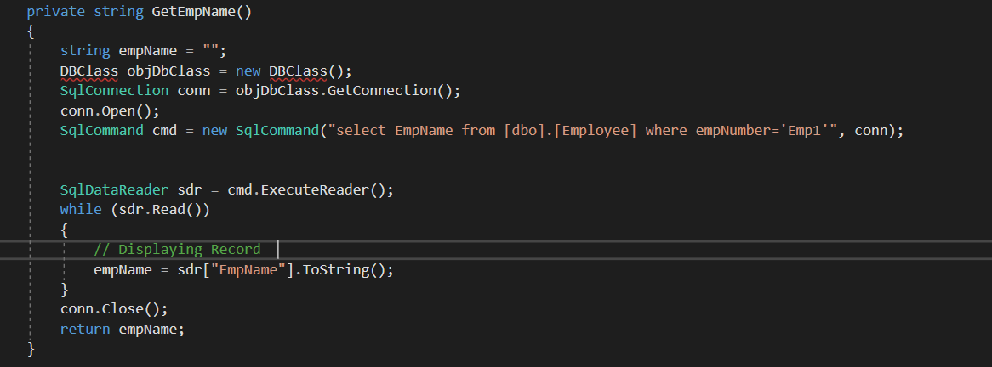
Code snippet to select the data from Database:

