Slide 1

What is ADO.Net?
A data-access technology that enables applications to connect to data stores and manipulate data contained in them in various ways
An object oriented framework that allows you to interact with database systems

Slide 2
.NET Data Providers
Data Provider | Namespace
SQL Server | System.Data.SqlClient
OLE DB | System.Data.OleDb
ODBC | System.Data.Odbc
Oracle | System.Data.OracleClient

Slide 3
ADO.NET Core Objects
Object | Description
Connection | Establishes a connection to a specific data source. (Base class: DbConnection)
Command | Executes a command against a data source. Exposes Parameters and can execute within the scope of a Transaction from a Connection. (The base class: DbCommand)
DataReader | Reads a forward-only, read-only stream of data from a data source. (Base class: DbDataReader)
DataAdapter | Populates a DataSet and resolves updates with the data source. (Base class: DbDataAdapter)
DataTable | Has a collection of DataRows and DataColumns representing table data, used in disconnected model
DataSet | Represents a cache of data. Consists of a set of DataTables and relations among them

Slide 4
Data Provider Functionality
Client
.Net Data Provider
Connection
Command
Rows
DataReader
DataSet
DataAdapter
database

Slide 5
Namespaces
System.Data & System.Data.Common
System.Data.SqlClient & System.Data.OleDB
System.Data.SqlTypes

Slide 6
Command class core methods:
ExecuteNonQuery : Executes a SQL statement against a connection object
ExecuteReader: Executes the CommandText against the Connection and returns a DbDataReader
ExecuteScalar: Executes the query and returns the first column of the first row in the result set returned by the query

Slide 7
Connection String in Web.Config
<connectionStrings>
<add name="myConnectionString" connectionString="server=XXXXX;database=TestDB;uid=XXX;password=XXXX;" />
</connectionStrings>
Reading the Connection String in code :
ConfigurationManager.ConnectionStrings["myConnectionString"].ConnectionString;
Creating a New Connection Object
SqlConnection con = new SqlConnection(connStr);

Slide 8
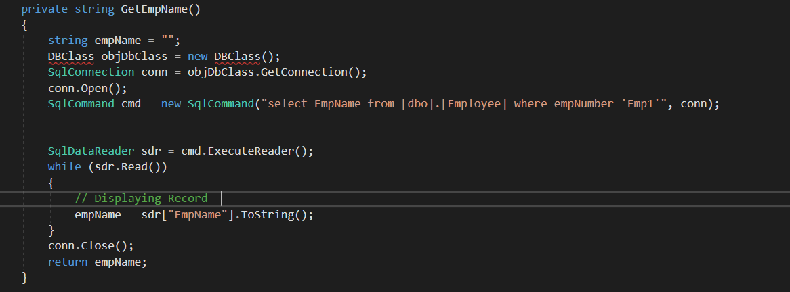
Code snippet to select the data from Database:

Slide 9
Commands with Stored Procedures
Stored procedures—SQL scripts stored in the database—are a key ingredient in any successful large-scale database applications.
One advantage of stored procedures is improved performance.
Stored procedures typically execute faster than ordinary SQL statements because the database can create, optimize, and cache a data access plan in advance.
Security.
Easy to maintain.
Reduce network traffic, because SQL statements can be executed in batches.

Slide 10
Executing a Stored Procedure
Using a stored procedure with ADO.NET is easy. You simply follow four steps:
Create a Command, and set its CommandType property to StoredProcedure.
Set the CommandText to the name of the stored procedure.
Add any required parameters to the Command.Parameters collection.
Execute the Command with the ExecuteNonQuery( ), ExecuteScalar( ), or ExecuteQuery( ) method (depending on the type of output generated by the stored procedure).

Slide 11
Executing a Stored Procedure
string SQL = "UpdateCategory";
// Create ADO.NET objects.
SqlConnection con = new SqlConnection(connectionString);
SqlCommand cmd = new SqlCommand(SQL, con);
cmd.CommandType = CommandType.StoredProcedure;
SqlParameter param;
param = cmd.Parameters.Add("@CategoryName", SqlDbType.NVarChar, 15);
param.Value = "Beverages";
param = cmd.Parameters.Add("@CategoryID", SqlDbType.Int);
param.Value = 1;
// Execute the command.
con.Open();
int rowsAffected = cmd.ExecuteNonQuery();
con.Close();

