Slide 1
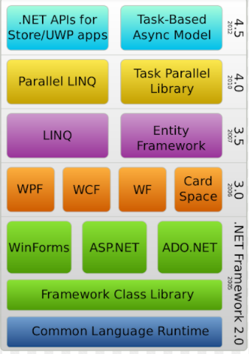

Slide 2
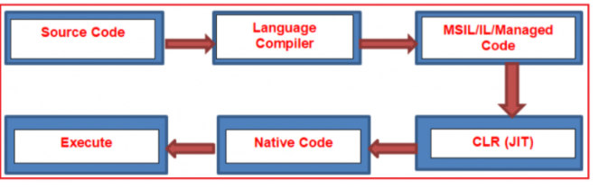

Slide 3
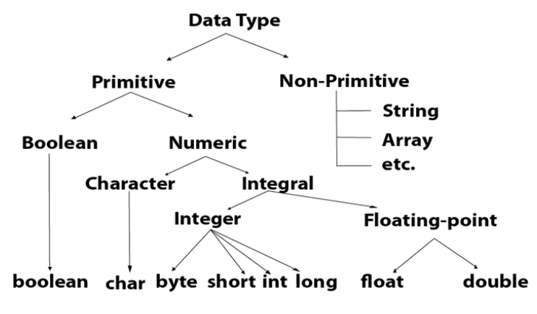

Slide 4
Primitive Data Type,
A primitive data type is one that fits the base architecture of the underlying computer such as int, float, and pointer, and all of the variations, thereof such as char short long unsigned float double and etc, are a primitive data type.
Primitive data are only single values, they have not special capabilities.
The examples of Primitive data types are given byte, short, int, long, float, double, char etc.
The integer reals, logic data character data pointer, and reference are primitive data structures data structure that normally is directly operated upon by machine-level instructions are known as the primitive structure and data type.

Slide 5
Non- Primitive Data Type,
A non-primitive data type is something else such as an array structure or class is known as the non-primitive data type.
The data type that is derived from primary data types is known as a non-primitive data type.
The non-primitive data types are used to store the group of values.
Examples of the non-primitive data types are Array, structure, union, link list, stacks, queue etc…

Slide 6
C# Exception handling
The C# language uses exceptions to handle errors and other exceptional events. Exceptions are the occurrence of some conditions that changes the normal flow of execution . Exceptions are occurred in situations like your program run out of the memory , file does not exist in the given path , network connections are dropped etc. More specifically for better understanding , we can say it as Runtime Errors occurs during the execution of a program that disrupts the normal flow of instructions.
The Anatomy of C# Exceptions
Exceptions allow an application to transfer control from one part of the code to another. When an exception is thrown, the current flow of the code is interrupted and handed back to a parent try catch block. C# exception handling is done with the following keywords:
try: A try block is used to encapsulate a region of code. If any code throws an exception within that try block, the exception will be handled by the corresponding catch.
catch: When an exception occurs, the catch block of code is executed. This is where you are able to handle the exception, log it, or ignore it.
finally: The finally block allows you to execute certain code if an exception is thrown or not. For example, disposing of an object that must be disposed of.
throw: The throw keyword is used to actually create a new exception that is the bubbled up to a try catch finally block.

Slide 7
The following example trying to divide a number by zero.
try
{
int val = 100;
int div = 0;
int resultVal;
resultVal = (val / div);
MessageBox.Show("The result is : " + resultVal);
}
catch (System.Exception ex)
{
MessageBox.Show("Exception catch here - details : " + ex.ToString());
}
finally
{
MessageBox.Show("Enter finally block ");
}

Slide 8
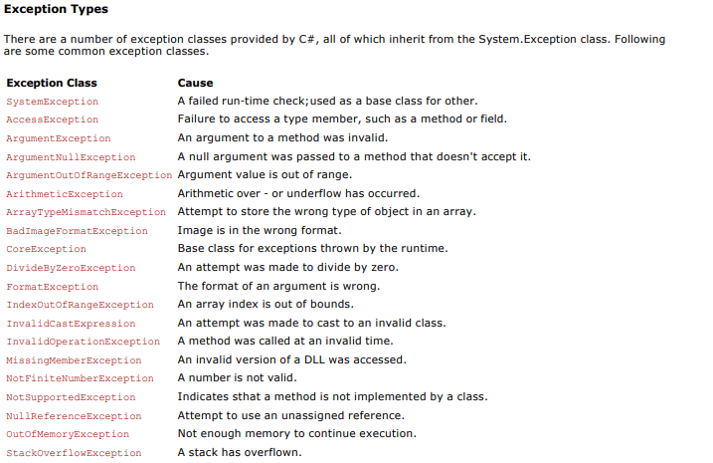

Slide 9
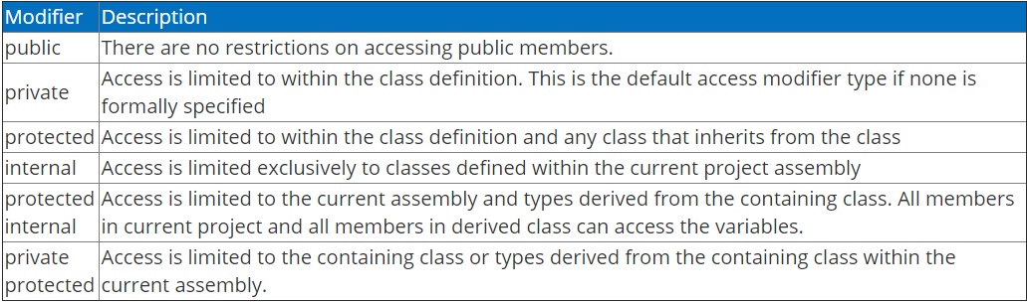
Access Modifiers In C#
Access modifiers in C# are used to specify the scope of accessibility of a member of a class or type of the class itself. For example, a public class is accessible to everyone without any restrictions, while an internal class may be accessible to the assembly only.
Access Modifiers In C#
Access modifiers in C# are used to specify the scope of accessibility of a member of a class or type of the class itself. For example, a public class is accessible to everyone without any restrictions, while an internal class may be accessible to the assembly only.

Slide 10
Encapsulation
In c#, Encapsulation is a process of binding the data members and member functions into a single unit. In c#, the class is the real-time example for encapsulation because it will combine various types of data members and member functions into a single unit.
Generally, in c# the encapsulation is used to prevent alteration of code (data) accidentally from the outside of functions. In c#, by defining the class fields with properties we can protect the data from accidental corruption.
If we define class fields with properties, then the encapsulated class won’t allow us to access the fields directly instead, we need to use getter and setter functions to read or write data based on our requirements.

Slide 11
Inheritance :
In c#, Inheritance is one of the primary concept of object-oriented programming (OOP) and it is used to inherit the properties from one class (base) to another (child) class.
The inheritance will enable us to create a new class by inheriting the properties from other classes to reuse, extend and modify the behavior of other class members based on our requirements.
In c# inheritance, the class whose members are inherited is called a base (parent) class and the class that inherits the members of base (parent) class is called a derived (child) class.
Inheritance Syntax
<access_modifier> class <base_class_name>
{
// Base class Implementation
}
<access_modifier> class <derived_class_name> : <base_class_name>
{
// Derived class implementation
}

Slide 12
If you observe the above syntax, we are inheriting the properties of base class into child class to improve code reusability.
Following is the simple example of implementing inheritance in c# programming language.
public class X
{
public void GetDetails()
{
// Method implementation
}
}
public class Y : X
{
// your class implementation
}
class Program
{
static void Main(string[] args)
{
Y y = new Y();
y.GetDetails();
}
}

Slide 13
Sealed Class: 1. A class, which restricts inheritance for security reason is declared, sealed class. 2. Sealed class is the last class in the hierarchy. 3. Sealed class can be a derived class but can't be a base class. 4. A sealed class cannot also be an abstract class. Because abstract class has to provide functionality and here we are restricting it to inherit.
Why Singleton Class sealed in C#
Please refer the link to understand more about this.
https://dotnettutorials.net/lesson/singleton-class-sealed/
Notes:
namespace SingletonDemo
{
public class Singleton
{
private static int counter = 0;
private static Singleton instance = null;
public static Singleton GetInstance
{
get
{
if (instance == null)
instance = new Singleton();
return instance;
}
}
private Singleton()
{
counter++;
Console.WriteLine("Counter Value " + counter.ToString());
}
public void PrintDetails(string message)
{
Console.WriteLine(message);
}
}
public class DerivedSingleton : Singleton
{
}
}

