Slide 1
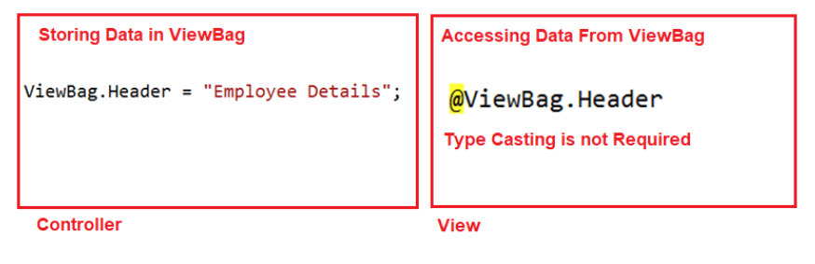
In ASP.NET MVC application, we can pass the model data from a controller to a view in many ways such as by using ViewBag, ViewData, TempData.
When to use ViewData, ViewBag, TempData?
ViewBag in ASP.NET MVC Application
The ViewBag in MVC is one of the mechanisms to pass the data from a controller to a view.
How to Pass and Retrieve data From ViewBag in ASP.NET MVC?
As the ViewBag is operating on the new dynamic data type. The advantage is that we do not require typecasting while accessing the data from a ViewBag irrespective of the data that we are accessing.
ViewBag in ASP.NET MVC with String Type:

Slide 2
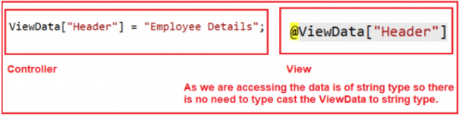
What is ViewData in ASP.NET MVC?
The ViewData in ASP.NET MVC is a mechanism to pass the data from a controller action method to a view.
How to Pass and Retrieve data From ViewData in ASP.NET MVC?
As it stores the data in the form of an object so while retrieving the data from ViewData type casting is required.
If you are accessing string data from the ViewData dictionary, then it is not required to typecast the ViewData to string type
ViewData in MVC with String Type:

Slide 3
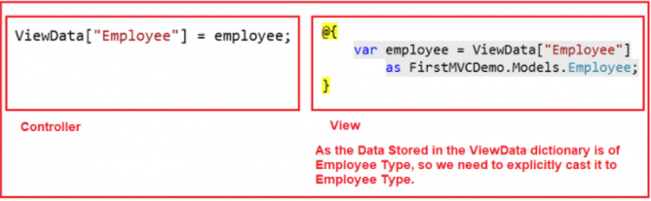
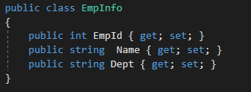
ViewData in MVC with Complex Type:
Example of ViewData in MVC:
First, we create the following Employee Model to hold the employee data in memory.

Slide 4
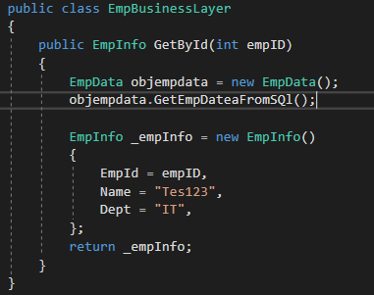
Then we created the following EmployeeBusinessLayer model to manage the employee data. Here we created one method which will take the employee id as input parameter and returns that employee information. As of now, we have hardcoded the employee data and in our upcoming article, we will discuss retrieving the employee data from a database like SQL Server.

Slide 5
Then we modify the Index action method of Home Controller as shown below to retrieve the employee data from EmployeeBusinesslayer and store it in the Employee model.
Passing ViewData From a Controller:
public ActionResult Index()
{
EmployeeBusinessLayer employeeBL = new EmployeeBusinessLayer();
Employee employee = employeeBL.GetEmployeeDetails(102);
ViewData["Employee"] = employee;
return View();
}

Slide 6
Accessing ViewData in a View:
Now we will see how to access the ViewData within an MVC view. So, modify the Index Action method which is there within the Home folder in your application as shown below.
@{
var employee = ViewData["Employee"]
as FirstMVCDemo.Models.Employee;
}
<h2>@ViewData["Header"]</h2>
<table style="font-family:Arial">
<tr>
<td>Employee ID:</td>
<td>@employee.EmployeeId </td>
</tr>
<tr>
<td>Name:</td>
<td>@employee.Name</td>
</tr>
</table>

Slide 7
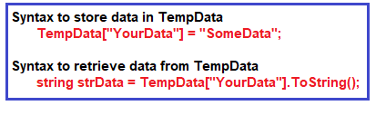
TempData in ASP.NET MVC Application
The TempData in ASP.NET MVC is one of the mechanisms to pass the small amount of temporary data from a controller to a view as well as from a controller action method to another action method either within the same controller or to a different controller.
How to Pass and Retrieve data From TempData in ASP.NET MVC:
The most important point that you need to remember is, as it stores the data in the form of an object so while retrieving the data from TempData type casting is required. If you are accessing string value from the TempData, then it is not required to typecast. But it is mandatory to typecast explicitly to the actual type if you are accessing data other than the string type from the TempData.

Slide 8
HTML Helpers in MVC Application
Why HTML Helper in ASP.NET MVC?
In our traditional ASP.NET web forms application, as a developer, we generally use the toolbox for adding controls on any particular web page.
However, coming to ASP.NET MVC application there is no such toolbox available to drag and drop HTML controls on to the view. So those developers who are coming from ASP.NET Web Forms background, they find it little difficult to create views in ASP.NET MVC application.
So, to overcome the above problem, the ASP.NET MVC Framework provides Html Helper classes which contain different extension methods.
We can use those extension methods to create HTML controls programmatically within a view.

Slide 9
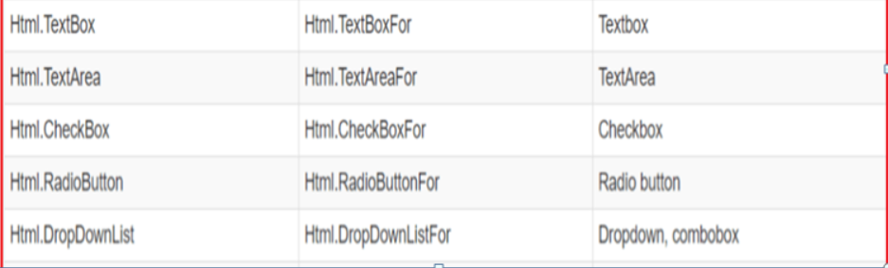

Slide 10
TextBox HTML Helper in MVC Application
To create TextBox using HTML Helper in MVC application you need to use the TextBox Helper method.
The HtmlHelper class in ASP.NET MVC Framework provides two extension methods to generates a textbox in a view.
Those two extension methods are TextBox() and TextBoxFor().
The TextBox() HTML Helper method is a loosely typed method whereas the TextBoxFor() HTML Helper method is a strongly typed method.
For example, if you want to generate a textbox with id=”firstname” and name=”firstname” then you can type all the required HTML in a view as shown below
<input type=”text” name=”firtsname” id=”firstname” />
But in MVC, you can use the following “TextBox” HTML helper method in a view to generating a text box.
@Html.TextBox(“firstname”)

Slide 11
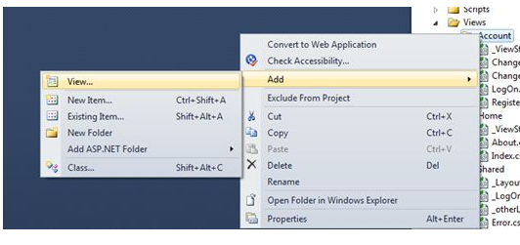
Partial View
Partial view in ASP.NET MVC is special view which renders a portion of view content.
It is just like a user control of a web form application.
Partial view can be reusable in multiple views.
It helps us to reduce code duplication.
In other word a partial view enables us to render a view within the parent view.
Creating Partial View
Creating Partial View
To create a partial view, right-click on view -> shared folder and select Add -> View option. In this way we can add a partial view.

Slide 12
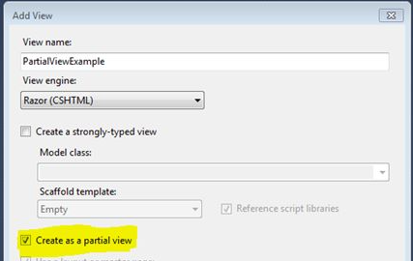
It is not mandatory to create a partial view in a shared folder but a partial view is mostly used as a reusable component, it is a good practice to put it in the "shared" folder.
HTML helper “Partial” is used for rendering the partial view:
@Html.Partial("PartialViewExample")

