Slide 1
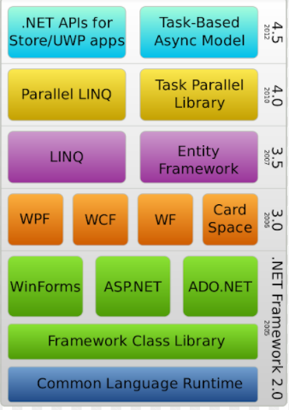

Slide 2
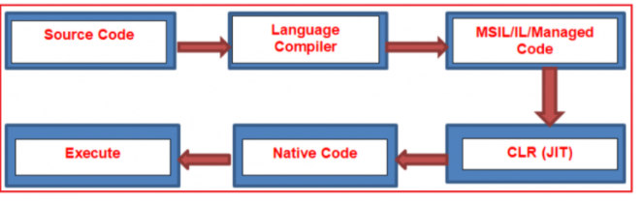

Slide 3
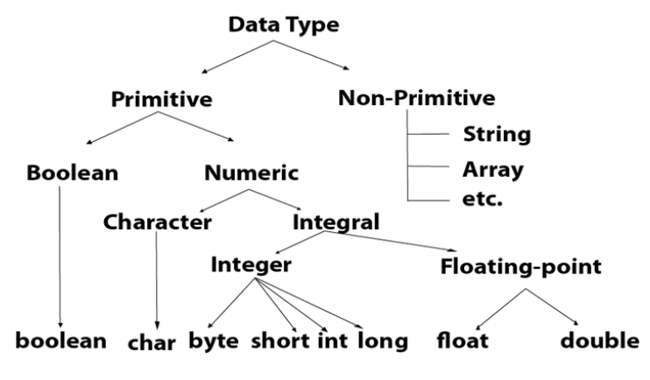

Slide 4
Primitive Data Type,
A primitive data type is one that fits the base architecture of the underlying computer such as int, float, and pointer, and all of the variations, thereof such as char short long unsigned float double and etc, are a primitive data type.
Primitive data are only single values, they have not special capabilities.
The examples of Primitive data types are given byte, short, int, long, float, double, char etc.
The integer reals, logic data character data pointer, and reference are primitive data structures data structure that normally is directly operated upon by machine-level instructions are known as the primitive structure and data type.

Slide 5
Non- Primitive Data Type,
A non-primitive data type is something else such as an array structure or class is known as the non-primitive data type.
The data type that is derived from primary data types is known as a non-primitive data type.
The non-primitive data types are used to store the group of values.
Examples of the non-primitive data types are Array, structure, union, link list, stacks, queue etc…

Slide 6
