Slide 1
TypeScript Overview
JavaScript is not strongly typed.
  It allows ANY type of data in a Java Script variable.
Data Types in JavaScript, TypeScript allows us to add data type to your variable and function declarations.
  This makes JS a TypeSafe language and a strongly typed language.
TypeScript is a open source language that is a superset of JavaScript, developed by Microsoft.
  with ES6 support.
  Strongly Typed
  Class-based and Object-Oriented
  Transpiles to Java Script
  Types are declared as Type Annotation (Explicit Declaration) and Type Inferring (Implicit Declaration).

Slide 2
Hands On Example
In Current Project, create TS folder
Create a file test.ts in TS folder
let v1:string = “My Test";
console.log(v1);
Verify the Output in Browser Console.
Browser throws an error.
Transpile: TypeScript code (saved with extension .ts) is compiled to regular Java Script (.js) file and supposed to work on any browser
Using in HTML Document: HTML document includes a script element that refers a file with the 'js' extension.

Slide 3
TS Development Environment
Official web site: typescriptlang.org
We use npm to install the typescript with the following command: npm install -g typescript
To verify installation:
AngularTraining\day1project>tsc -v
After the TypeScript is installed we can use the
tsc (TypeScript Compiler) to compile any file with the ts extension to a js file.
To Compile: tsc test
To Compile with source code changes detection:
tsc –w filename.ts

Slide 4
TypeScript Configuration
To generate transpiled files of a project / folder, we need Typescript Configuration file (tsconfig.json) to apply compiler settings.
To Create tsconfig.json file, in project folder
tsc --init
When TypeScript Compiler (tsc) is executed the tsconfig.json file is read and the js files are created.
Open tsconfig.json file and observe the properties therein.

Slide 5
TypeScript Configuration Props
Understanding Configuration Properties
  target: sets up the ECMAScript version being used.
  noEmitOnError: Do not emit outputs if any errors were reported.
  rootDir: Specifies the root directory of input files.
  outDir: Redirect output structure to the directory.
Transpile by using > tsc -w

Slide 6
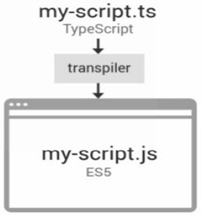
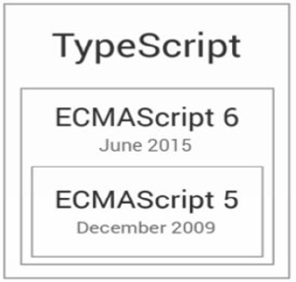
What is Type Script? - Review
TypeScript = JavaScript + Types

Slide 7
Data Types in TypeScript
Primitive Types
  string
  number
  boolean
Special Types
  any, void
Array Types
  [ ]
  Array
Function Types
  Function
Object Types
  { }

Slide 8
Hands On Example
In typesdemo.ts file, define Built-In Types
let v1:number = 40;
console.log(v1);
let v2:string = "Str";
console.log(v2);
let v3:boolean = false;
console.log(v3);
let v4:string[] = ["JS", "Angular"]
console.log(v4);
let v5:Function = () => "Function Type Example****";
console.log(v5());
let v6:{fname: string; lname:string} = {fname: "Satya", lname: "Narayana"};
console.log(v6);

Slide 9
Functions in TypeScript
When we define a function we can specify the types of each one of the parameters as well as the type of the returned value.
function sum(a:number,b:number):number
{
return a+b;
}
var result:number = sum(7,18);
console.log("result="+result);

Slide 10
Decorators
Decorators in typescript are used to describe more information about a
  class or
  method or
  property or a
  data member.
Prefixed with an @

Slide 11
Modules
Modules allows you to organize your code, breaking up complex systems into small, self contained pieces that can be managed easily.
    Each file is a module OR a module is in a file
  export keyword: In order to avail an Interface or Class or a function to a different TypeScript module you need to expose it using the export keyword.
  import keyword: In order to access Class or an Interface of different module we need import it.

Slide 12
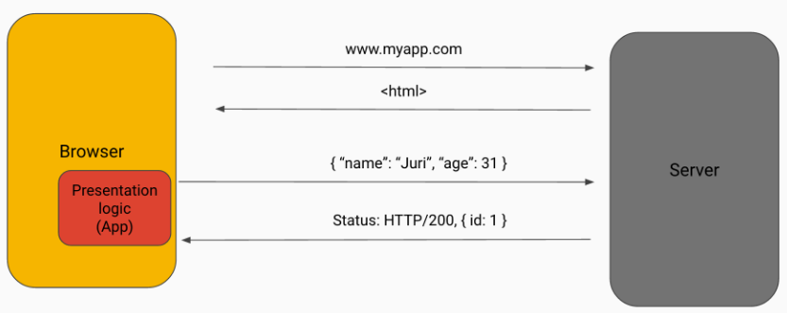
Web Application Development
Client-side Applications (Modern Development)
Java Script MVC Frameworks (Client-Side Frameworks)
  AJAX-based Applications, Single Page Applications
A Framework gives you an architecture and you will need to follow the rules.
  AngularJS, KnockoutJS, BackboneJS, EmberJS
  Angular, React, Aurelia

Slide 13
Angular Versions
Visit: angularjs.org and angular.io
AngularJS is written in JavaScript
Angular is written in TypeScript
Angular 2: Initial Release 14.09.2016
Angular 4: Release on 23.03.2017
Angular 5: Release 16.08.2017
Angular 6:
Angular 7:
Angular8

Slide 14
What is Angular2+
Angular is an open-source Client-Side framework developed by Google has been designed with modern web standards.
Implement many Design Patterns e.g.:
  MVC Pattern, Singleton, Dependency Injection etc..,
Angular 2 was written in TypeScript, a superset of JavaScript that implements many new ES6 features.
Visit official website: angular.io
Angular2 is a framework for all types of apps
  Web Apps, Mobile Apps (Hybrid), Desktop Apps
Angular 2 is Component based Framework, it allows us to create new components to extend the HTML

Slide 15
Angular2+ Framework API
Angular API is organized in the form of modules.
Angular follows the modular design.
A module is a collection of
  Components, Templates,
  Services,
  Decorators, Pipes,
  Classes, Interfaces,
  Directives,
  etc..,
  Modules helps us to better organize and manage our code base
  Built In modules are: @angular/core, @angular/common, @angular/forms, @angular/http, @angular/router etc..,

Slide 16
Angular2 Project Setup
There are various options to create Angular2 Project Setup:
Manual Setup
Angular Command Line Interface (CLI) Tool – Generates boilerplate code.
Using Angular CLI:
One of the easiest ways start a new Angular 2 application is to use the Angular command-line interface (CLI) that allows you to:
  generate boilerplate code for new Angular 2 applications
  add features (components, directives, services, pipes, etc) to Angular 2 applications

Slide 17
Angular CLI (Command Line Interface)
Angular CLI helps us to make it easier and faster to build Angular applications.
Bootstrapping a project: It creates the initial project structure. The project is also configured to use the webpack.
Serving and live reloading: The CLI starts a local web-server so we can view our application in the browser via localhost:4200.
  The CLI also watches for any changes to our files and automatically reloads the webpage if there are any.
Testing: We can use the CLI to compile and run all the tests with a single command.
  Whenever the CLI detects changes to any file it re-runs all the tests automatically in the background.
Packaging and releasing: we can also package our application ready for release to a server.

Slide 18
Working with Angular CLI
To install Angular CLI: npm install -g @angular/cli
  which will install the ng command globally on your system.
  To verify whether your installation completed successfully:
ng version display the version you have installed.
Angular CLI commands:
  new is used to create a new angular project with ready-to code.
  serve is used to execute angular application in live-reload server
  test is used to unit test and end-to-end test an angular application
  build is used to make angular application deployable app in a hosting server.

Slide 19
Hands On- Creating Angular Application
Create a New Project in your workspace.
We use CLI to create an Angular application:
In Workspace: ng new ngproject1
  This will create a new directory for us with everything we need to get started
Observe the CLI project folder structure: Important folder is src and app folders
Delete files generated in app folder
Open the Project in VS Code
Modify index.html
<app-root>Please Wait. Loading..</app-root>

Slide 20
Structure of Angular Application
Angular Application is organized in Modules.
Every Angular app has at least one root module
Angular application is a tree of Web Components.
  We design and build each component individually and then stack them nicely to create our application.
Directive is an custom element, attribute class that allows us to attach behavior to DOM elements.
There are three kinds of directives:
  Components – Tag / Element Directives.
  Structural Directives – Directives that creates and destroys DOM elements known as Structural Directives.
  Attribute Directives – doesn’t change the DOM but can change the appearance or behavior of an element

Slide 21
Angular Application Flow – Step 1
Root Component: To bootstrap an Angular app, we need a root component and it is defined using @Component Decorator.
  selector: defines the tag to be used for the instance of the component on the html page.
  template: defines the html content that will be displayed for the component.
As per convention, each component will have .component.ts file app.component.ts
import {Component} from "@angular/core“
@Component({
selector: “app-root”,
template: “<h3>First Angular Component</h3>”
})
export class AppComponent {}

Slide 22
Angular Application Flow – Step 2
Root Module: Each root component lives within a module, and it is defined using @NgModule Decorator.
  declarations: Registers particular components within this module
  bootstrap: Tells the module which component to bootstrap
  imports: Imports other modules into this module
Angular Module is a collection of components to use in project.
Create a file app.module.ts
import {NgModule} from "@angular/core"
@NgModule({})
export class AppModule {}

Slide 23
Angular Application Flow - Step 3
Register Component in Module
To use component in angular app, we need to register the component in Angular Module
@NgModule({
declarations: [AppComponent],
imports: [BrowserModule],
bootstrap: [AppComponent]
})
export class AppModule {}
Use the Component in HTML (index.html)
<app-root>Please Wait. Loading...</app-root>

Slide 24
Bootstrapping Angular Application
The Bootstrapping is a technique of initializing or loading our Angular 2 application.
Angular Application Entry Point
Initializing Angular App in Browser.
Angular applications need a bootstrap file, which contains the code required to start the application and load the Angular module.
The entry point of our application is main.ts
Platformbrowserdynamic Angular 2 isn’t limited to only working in the browser which is why we need to tell Angular exactly how we want it to bootstrap itself.

Slide 25
Executing Angular Application
In ngproject1 folder and start the development server
ng serve
  which will start a local development server that you can navigate to in your browser on http://localhost:4200/.
  To change default port: ng serve --port 9090
Open Browser, In address bar:
  Type: localhost:4200

Slide 26
Hands On Exercise
Create a web component <hello>
Register in AppModule
Use the web component in AppComponent Template
Multi Line Template
Use backtick (`) to work with multiple lines in template

Slide 27
Angular Feature Modules
Angular Modules help organize the source code of an application.
An Angular Module is a class decorated with @NgModule decorator function.
Every Angular app has at least one module class, the root module.
We bootstrap the root module to launch the application.
As the app grows, we can add feature modules that represent collections of related functionality.
Feature modules are available as dependencies for Root Module.

Slide 28
Hands On Example – Feature Module
Create counter folder in Project app folder
Create counter.module.ts file in counter folder
@NgModule({})
export class CounterModule { }
Create a WebComponent counter in counter.component.ts file with Internal Template.
Use <counter> component in App Component Template.
<h3>First Angular Application</h3>
<hr>
<counter></counter>

Slide 29
Working with Feature Module
Use CounterModule as dependency to AppModule
imports: [BrowserModule, CounterModule],
The CounterComponent should avail to AppModule, export the CounterComponent from CounterModule.
declarations: [CounterComponent],
exports: [CounterComponent]

Slide 30
Interpolation
Interpolation markup with embedded expressions is used by Angular.
Expressions are JavaScript-like code snippets that are mainly placed in interpolation bindings such as:
  String Literal
  Operators (Calculations)
  Members (Data Members OR Method Members)
Example
{{10+20}}
{{“Angular”}}
{{userName}}

