Slide 2
Analysis of the data
93.34 % no changes
16 classes
Most common class is “PLAIN”, with 74.14%
The two most common classes does not need normalization
Each class follows a few fixed rules for its normalization.

Slide 3
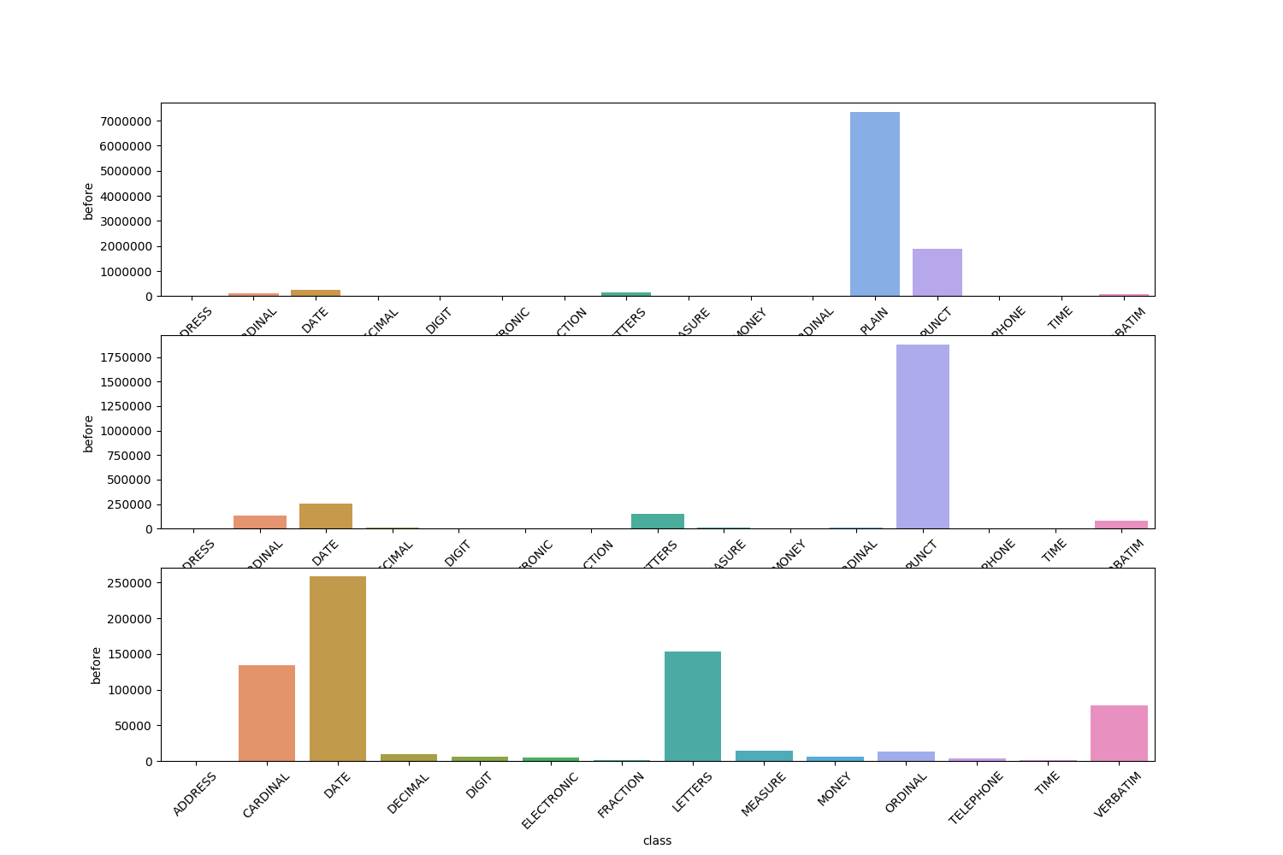
Analysis of the data

Slide 4
Strategies
Do nothing
Using word embedding as help

Slide 5
Do nothing
Accurancy: 93.34 %

Slide 6
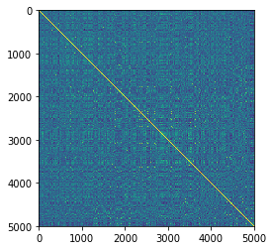
Use word embeddings as help I
Using the learned vocabulary and two embeddings (original and translation)
Accurancy: 96.6 %

Slide 7
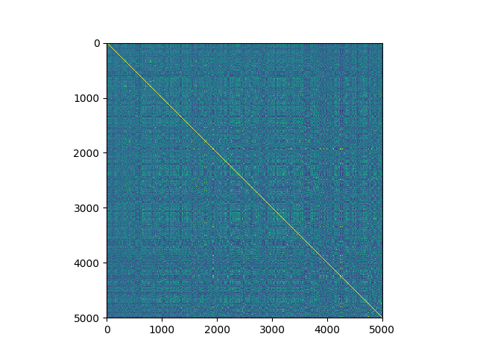
Use word embeddings as help II
Using word embedding for classifyng in one of the 16 classes
Accurancy of classification: 96.87%

Slide 8
Use word embeddings as help III
Using word embedding for classifyng in two classes
Accurancy of classification: 97.07%

Slide 9
Conclusions
Word embedding is not a final methodologic in this case.
In fact, it works quite similar to a dictionary

