Slide 1

Lab Book 1.0. Waveguides
Student: Paula Daniela Ortiz Cuervo

Slide 2
Instructions General
SCRIPTS
From GitHub →
Fork the repo: cccanvas-upv/pic-upv-lab1
Clone the repo using VSCode
Run the Jupyter Notebook:
WAVEGUIDES_Student.ipynb
W (width)
W (width)
Core
Core
h_core
h
(height)
Cladding
Cladding
Slab
h_slab
deep waveguide
shallow waveguide

Slide 3
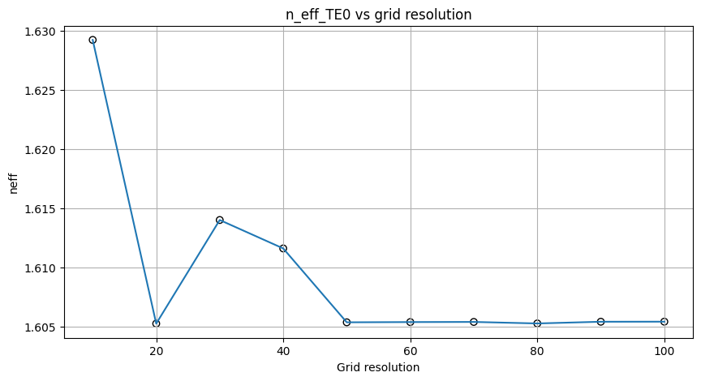
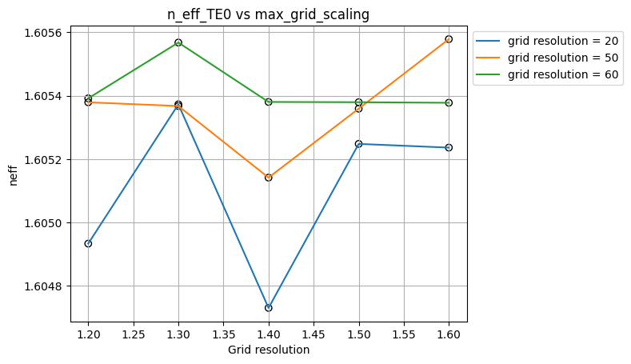
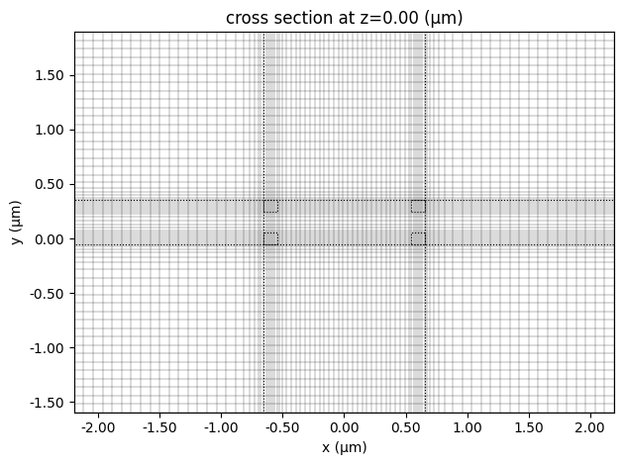
Learning outcome #1 – Convergence tests DE waveguide, w = 1.2 µm, neff_TE0, wvl 1.55 µm.
Case I (Silicon Nitride): We simulated how the effective index changes for different grid resolutions. For grid resolution values above 50 and for a value of 20, the effective index values are very similar, meaning that there is not a significant variation between the resulting effective indices. Since several points produce similar results, we analyze how the effective index varies when changing the max grid scaling for grid resolution values of 20, 50, and 60.
For a grid resolution of 20, the graph is not very stable; however, at a max grid scaling of 1.30 the effective index is very similar to the results obtained in the other graphs. For the case of 50, we observe that for three values of max grid scaling the effective index is approximately 1.6054. Finally, for a resolution of 60, the values of max grid scaling produce effective indices closer to the ones previously obtained.
Considering the computational cost and aiming to reduce the simulation time, the selected parameters are a grid resolution of 20 and a max grid scaling of 1.30, since this configuration produces results very similar to those obtained with a larger number of simulation points. With these parameters, the simulation mesh looks like the one shown in the image, where there are more simulation points (higher resolution) in the regions where the refractive index changes.

Slide 4
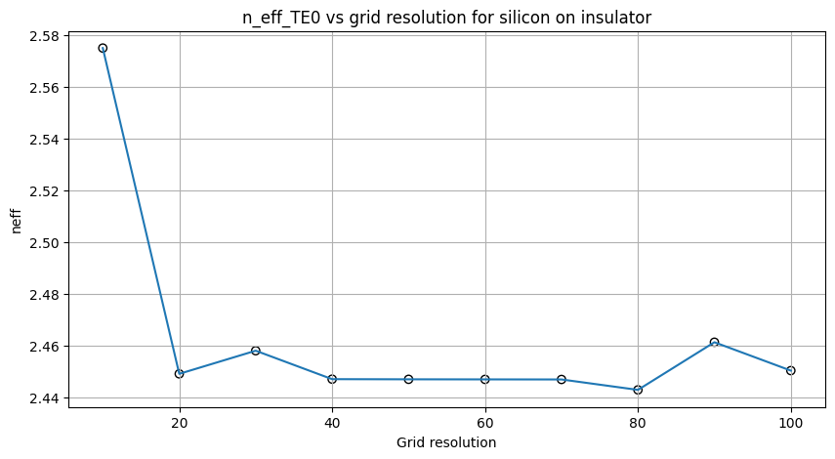
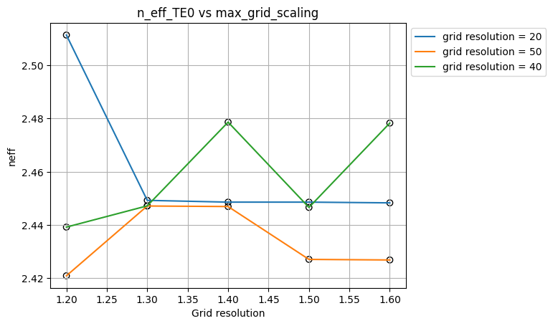
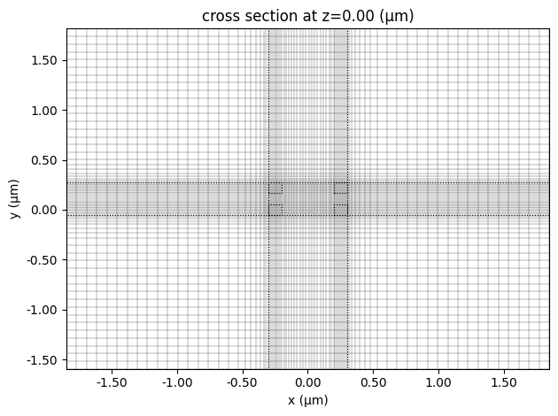
Learning outcome #1 – Convergence tests DE waveguide, w = 0.5 µm, neff_TE0, wvl 1.55 µm. Silicon On Insulator
Case II (Silicon on Insulator): We observe that for values of 20 and from 40 to 70 the effective indices are very similar. As in the previous case, three grid resolution values were selected in order to vary the max grid scaling and determine which values better suit this waveguide. The chosen grid resolutions were 20, 40, and 50.
For a grid resolution of 20, we obtain almost the same effective index across most of the selected range, whereas for higher resolutions this is not always the case. For a grid resolution of 40 and 50, we also obtain similar values of the refractive index; however, considering the lower computational cost and shorter simulation time, a value of 1.30 was selected for the max grid scaling whit grid resolution of 20.
Compared with the previous case, we see that for SOI different max grid values could be selected for the same grid resolution of 20. This means that more simulation points could be used when refractive index changes occur without significantly affecting the effective index, or alternatively the grid resolution could be increased.

Slide 5
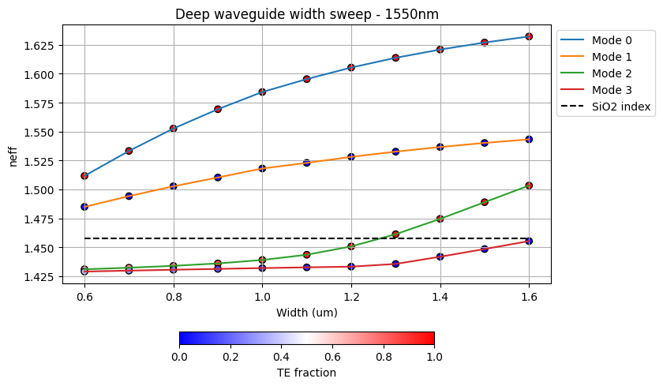
Learning outcome #2 – Width dependence Width 0.6 - 1.6 µm (step 0.1 µm) – Wavelength 1.55 µm
deep waveguide
Paste plot here
We also observe that as the width of the waveguide increases, the number of propagating modes also increases. For a width of 0.6 µm, only the fundamental modes propagate, meaning that the waveguide is single-mode if the input polarization is controlled (only TE or TM polarized light is launched). Additionally, as the width increases, the effective index value also increases, going from 1.51172534 for the first mode to 1.63222705, corresponding to a difference of 0.121 between the initial and final values. This increase indicates that enlarging the cross section in the x-direction allows the mode to become more confined within the waveguide.
Another important aspect is that this increase causes additional modes to start propagating once the width reaches 1.6 µm. In this case, mode 2 (TE) begins to propagate. This shows that as the cross section becomes wider, more modes appear. Initially, these modes propagate mainly through the cladding (meaning they are weakly confined), and as the cross section continues to increase, they become more confined. However, they still do not propagate strongly confined because the refractive index contrast between the materials is not sufficiently large for strong confinement within the core and the width is small.

Slide 6
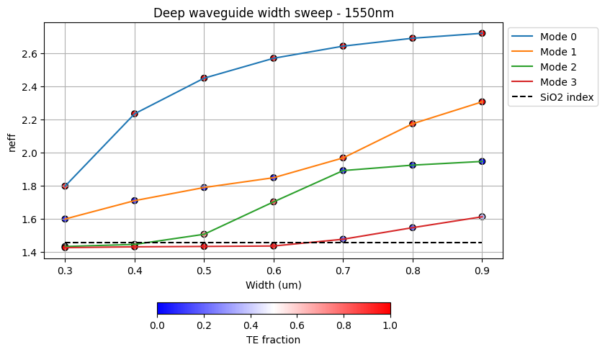
Learning outcome #2 – Width dependence Width 0.3 - 1 µm (step 0.1 µm) – Wavelength 1.55 µm – Silicon On Insulator
deep waveguide
Paste plot here
It is observed that with SOI, increasing the width of the waveguide allows higher-order modes to appear more rapidly. While in SiNx a higher-order mode begins to propagate after increasing the width by about 0.7 µm, in SOI higher-order modes appear after increasing the width by only 0.2 µm. This must be carefully considered during fabrication, since if a single-mode waveguide is required for one polarization, fabrication with SOI could be more sensitive to dimensional variations. Additionally, it is important to highlight that in SOI polarization conversion occurs around a width of 0.7 µm, where mode 1 changes from magnetic polarization to electric polarization. This behavior also occurs for higher-order modes, where they transition from one polarization to the other. In contrast, for SiNx the polarization does not change.
Finally, in this case the effective index of mode 0 increases from 1.79 to 2.72, corresponding to a difference of 0.93. This indicates that increasing the waveguide width significantly increases mode confinement. When compared with the SiNx case, where the increase for mode 0 was 0.121, the SOI increase is about 7.68 times larger. This is related to the refractive index contrast between the cladding and the core, since in SOI this contrast is much higher, which allows stronger confinement of the modes.

Slide 7
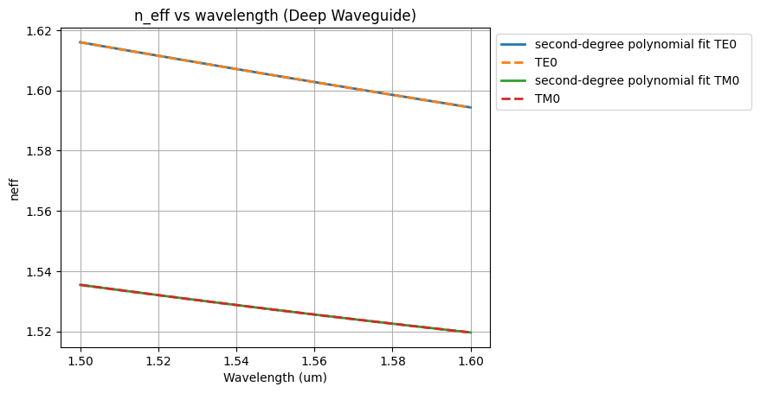
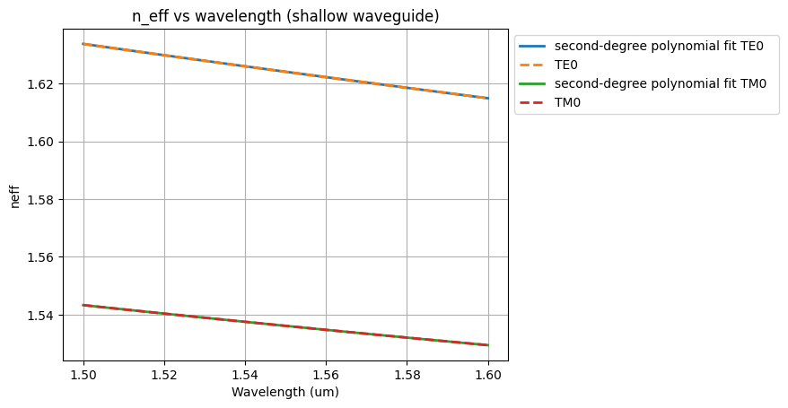
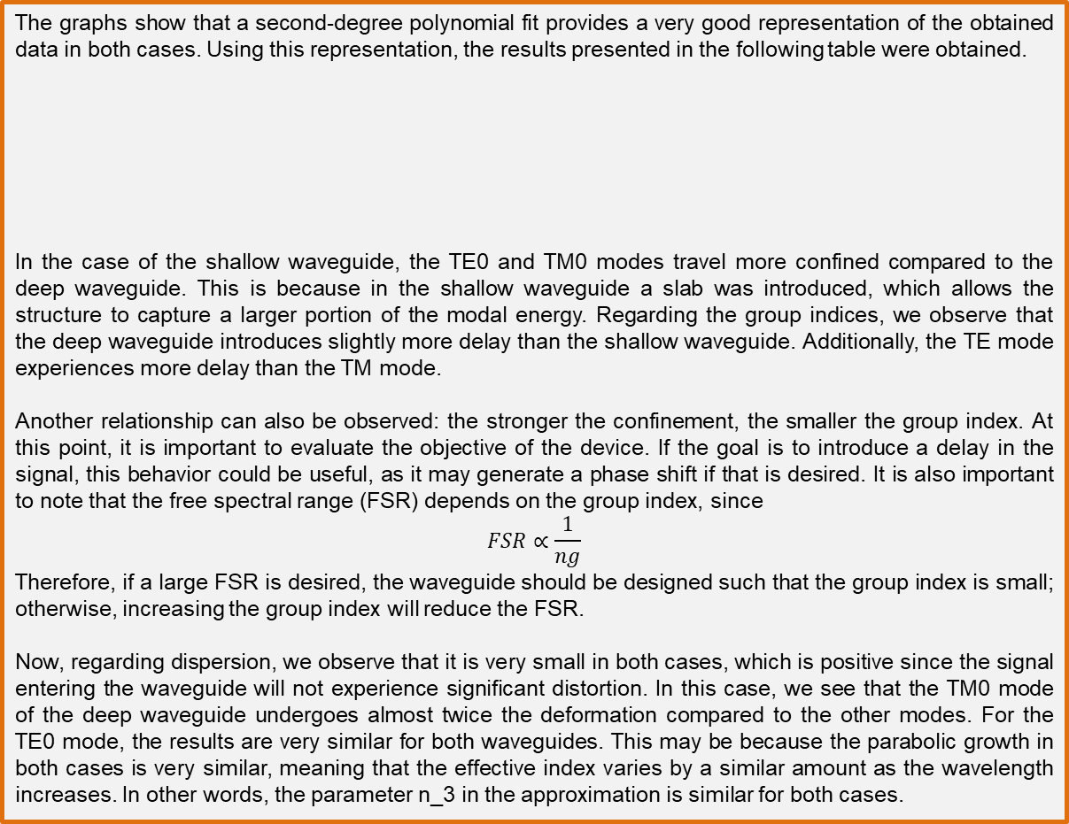
Learning outcome #3 – Waveguide compact model
The graphs show that a second-degree polynomial fit provides a very good representation of the obtained data in both cases. Using this representation, the results presented in the following table were obtained.
In the case of the shallow waveguide, the TE0 and TM0 modes travel more confined compared to the deep waveguide. This is because in the shallow waveguide a slab was introduced, which allows the structure to capture a larger portion of the modal energy. Regarding the group indices, we observe that the deep waveguide introduces slightly more delay than the shallow waveguide. Additionally, the TE mode experiences more delay than the TM mode.
Another relationship can also be observed: the stronger the confinement, the smaller the group index. At this point, it is important to evaluate the objective of the device. If the goal is to introduce a delay in the signal, this behavior could be useful, as it may generate a phase shift if that is desired. It is also important to note that the free spectral range (FSR) depends on the group index, since
$$FSR∝\frac{1}{ng}$$
Therefore, if a large FSR is desired, the waveguide should be designed such that the group index is small; otherwise, increasing the group index will reduce the FSR.
Now, regarding dispersion, we observe that it is very small in both cases, which is positive since the signal entering the waveguide will not experience significant distortion. In this case, we see that the TM0 mode of the deep waveguide undergoes almost twice the deformation compared to the other modes. For the TE0 mode, the results are very similar for both waveguides. This may be because the parabolic growth in both cases is very similar, meaning that the effective index varies by a similar amount as the wavelength increases. In other words, the parameter n_3​ in the approximation is similar for both cases.

Slide 8
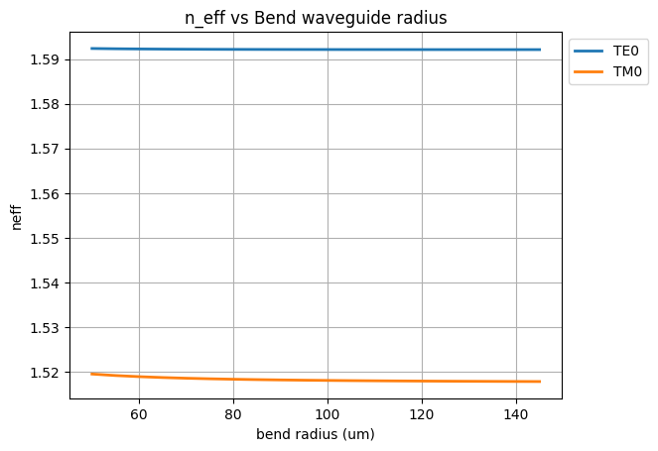
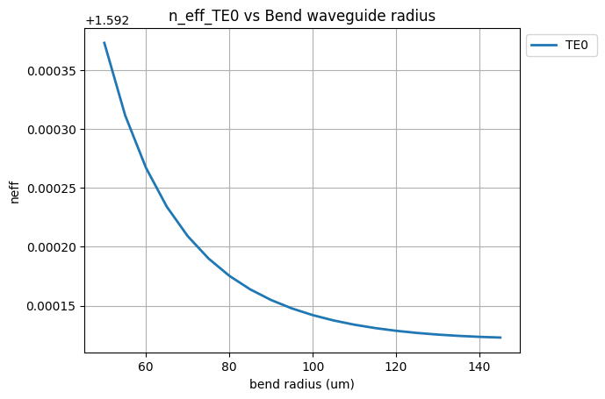
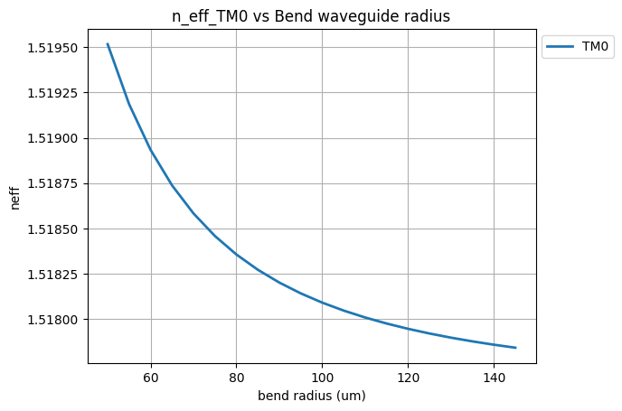
Learning outcome #4 – Bend waveguide radius vs. loss – deep Find neff_TE0 for wvl 1.55 µm, width 1.0 µm for R=25,50,75,100, 125,150 µm
First, we analyze how the effective index changes with respect to the bending radius. We find that in both cases (TE0 and TM0), as the bending radius increases, the effective index slightly decreases. This means that the modes become slightly less confined, approaching the refractive index of the cladding. In both cases the variation is extremely small; as seen in the first graph, the change is almost negligible compared with the scale used.

Slide 9
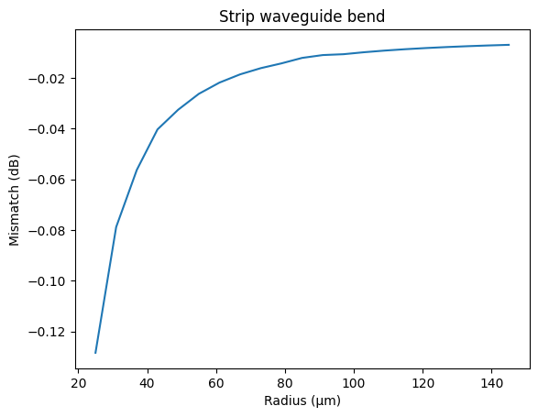
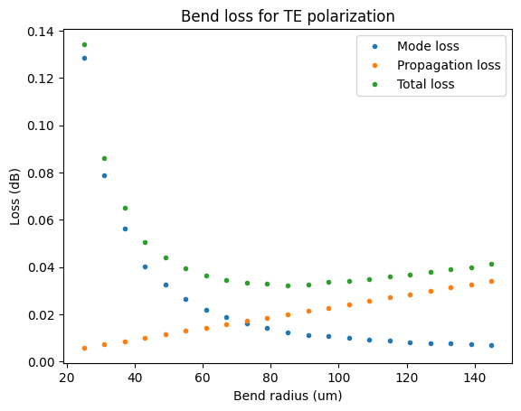
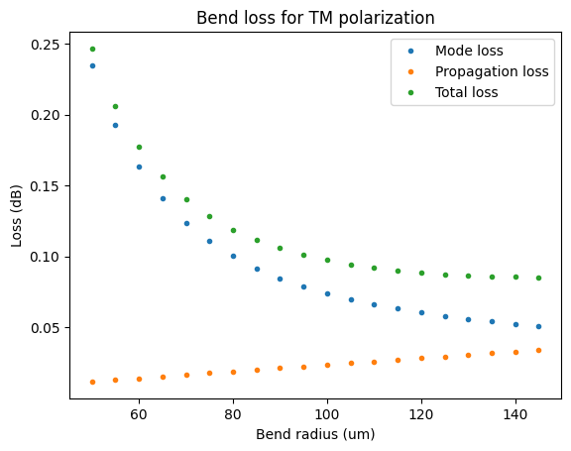
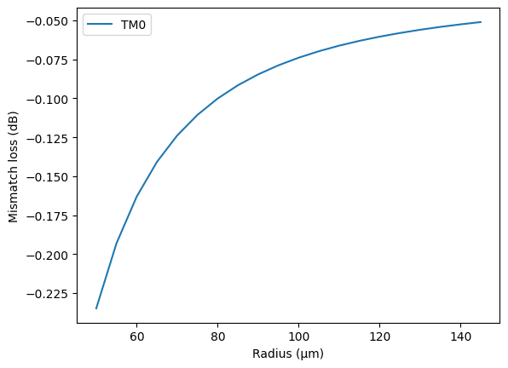
Learning outcome #4 – Bend waveguide radius vs. loss – deep Find neff_TE0 for wvl 1.55 µm, width 1.0 µm for R=25,50,75,100, 125,150 µm
Next, when analyzing the losses, we find that mode losses decrease as the radius increases. This occurs because when the radius increases, the mode interacts less abruptly with the refractive index discontinuity at the waveguide walls.
For both TE0 and TM0 modes, propagation losses become more significant as the radius increases. For the TE0 mode, from approximately 70 µm onward, propagation losses dominate the behavior of the total losses. Therefore, it is necessary to find a balance between the two types of losses. In this case, a bending radius of around 65 µm would provide the lowest overall losses, making it a safe radius for the TE0 mode.
For the TM0 mode, we observe larger losses. Additionally, even at 150 µm the final behavior is not yet fully dominated by propagation losses, although this is likely where they begin to dominate. Therefore, if the goal is to propagate the TM0 mode in this waveguide, larger bending radii are required compared to the TE0 case.

Slide 10
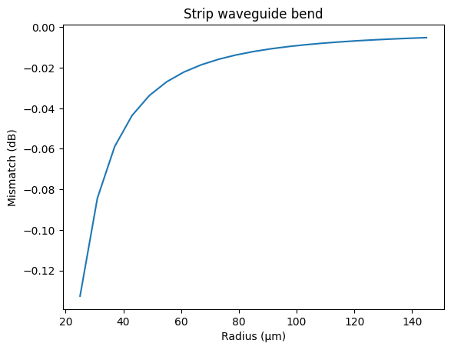
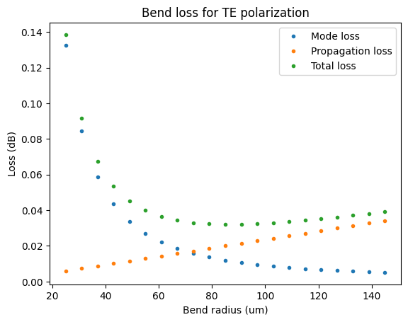

Learning outcome #4 – Bend waveguide radius vs. loss – deep Use the code provided in this section to calculate the safe radius for 1.2 um width deep waveguides at 1.5 um.
$α\left[\frac{dB}{90°}\right]=$ $R\frac{π}{2}α\left[\frac{dB}{µm}\right]$
Now, in the case of a 1.2 µm width deep waveguide at a wavelength of 1.5 µm, the safe radius would be approximately 85 µm. This value is larger than in the previous case, where the safe radius was around 65 µm. This difference may be caused by both the change in wavelength and the increase in the core width.

Slide 11
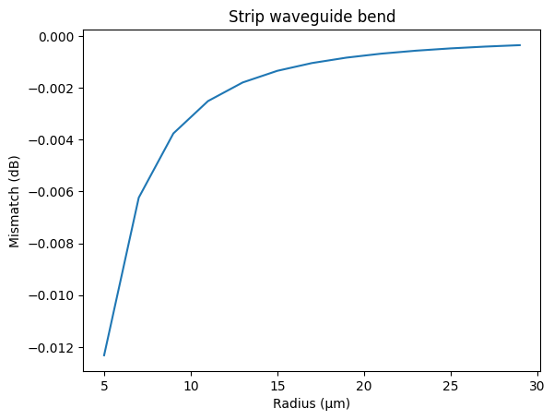
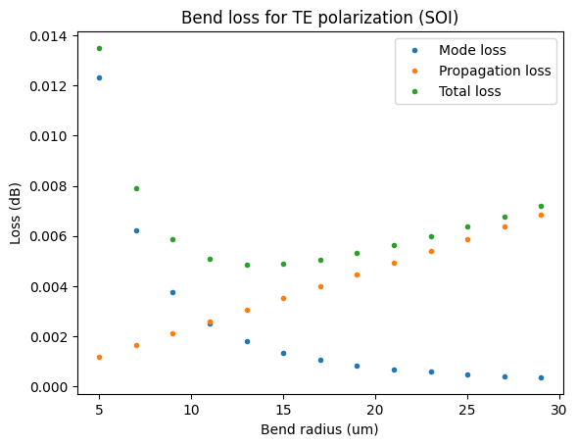
Learning outcome #4 – Bend waveguide radius vs. loss – deep Use the code provided in this section to calculate the safe radius for 0.5 um width deep waveguides at 1.55 um – Silicon On Insulator
$α\left[\frac{dB}{90°}\right]=$ $R\frac{π}{2}α\left[\frac{dB}{µm}\right]$
Finally, for the SOI case, we observe that a safe radius is around 15 µm, which is significantly smaller compared with the SiNx case, where the safe radius was about 65 µm. This represents a reduction by a factor of about 4.3. Therefore, SOI technology allows much smaller bending radii and consequently more compact integrated circuits. However, care must still be taken, since larger radii will increase propagation losses. Nevertheless, the total losses in dB remain smaller because the technology itself is more compact and the propagation distances are shorter.

Slide 12

Thank you

