Slide 1

Lab Book 3. Interferometers I - MZI
Student: Paula Daniela Ortiz Cuervo

Slide 2




Instructions General
SOFTWARE
Python notebook supplied by instructors
SCRIPTS
From Poliformat → download the 030_INTERFEROMETERS_v2025_Student_UPDATE2.ipynb
Either run locally or at Cloud workspace
COMPONENT to be studied: Mach-Zendher Interferometer (MZI)
$β_{u}$, $L_{u}$
In2
Out2
$$k_{a}$$
$$k_{b}$$
In1
Out1
$β_{d}$, $L_{d}$

Slide 3
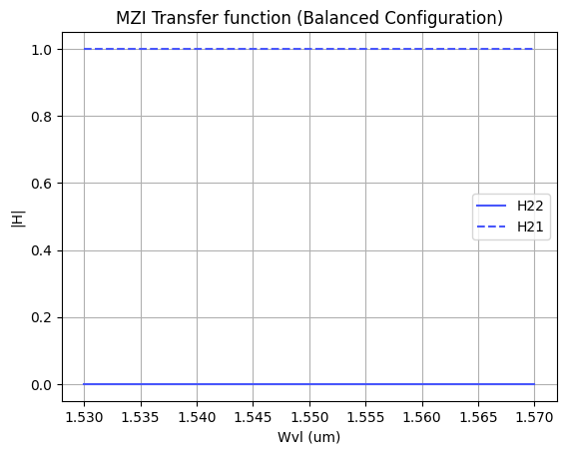
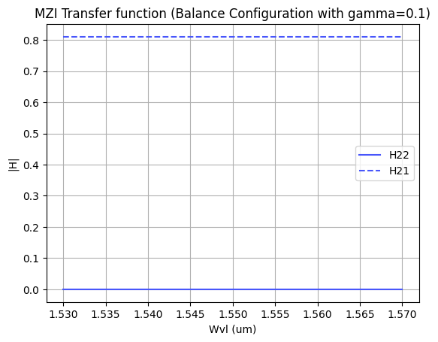
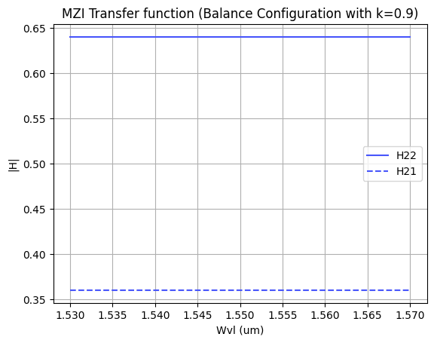
ASSESSMENT #1 – Recap from theory – Balanced MZI
We observe that for the case of a balanced MZI, there is no spectral periodicity. This occurs because when we split the signal into both paths, no phase shift is introduced (since the MZI is balanced). Without this phase difference, spectral periodicity does not arise; instead, we find that one of the outputs exhibits constructive interference while the other shows destructive interference.
Now, if the coupler changes to a 90:10 ratio, we see that we no longer have purely destructive or purely constructive interference. This is because the power in each arm is no longer the same. In this scenario, destructive interference results in approximately 0.35, while constructive interference reaches around 0.65.
If we consider excess losses, we will find that the magnitude of constructive interference cannot reach 1. This is because the output power is no longer equal to the input power; some power is lost. In this case, we introduced a loss of 0.1 for each coupler. As a result, nearly 0.2 of the power is lost, as observed in the graph.

Slide 4
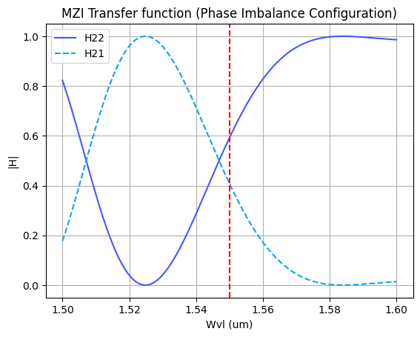
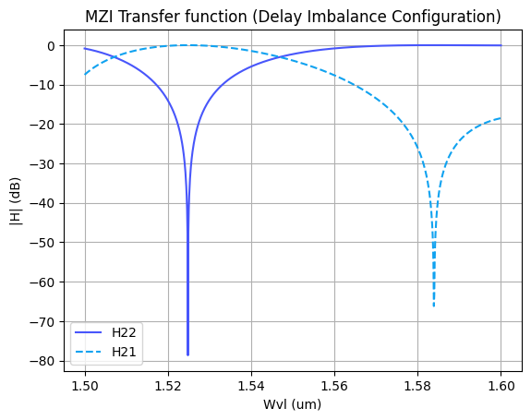
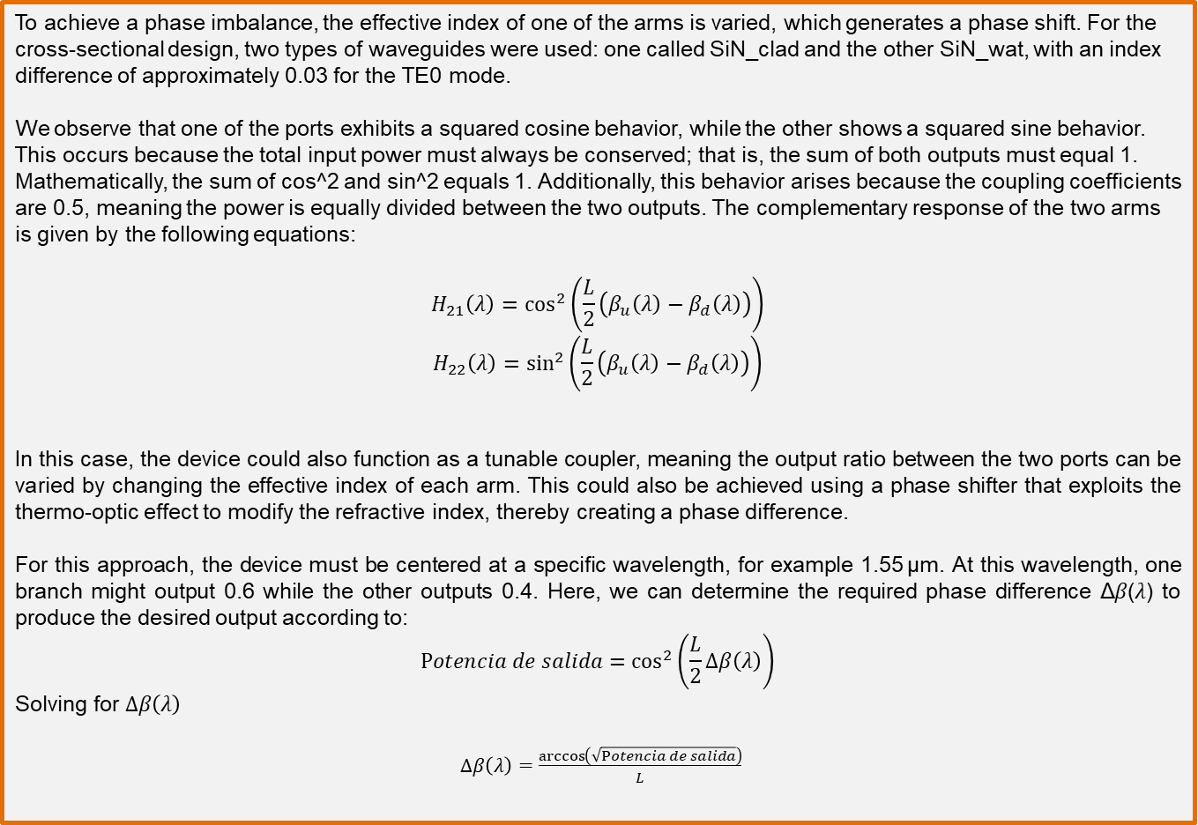
ASSESSMENT #1 – Recap from theory – Phase Imbalance MZI
To achieve a phase imbalance, the effective index of one of the arms is varied, which generates a phase shift. For the cross-sectional design, two types of waveguides were used: one called SiN_clad and the other SiN_wat, with an index difference of approximately 0.03 for the TE0 mode.
We observe that one of the ports exhibits a squared cosine behavior, while the other shows a squared sine behavior. This occurs because the total input power must always be conserved; that is, the sum of both outputs must equal 1. Mathematically, the sum of cos^2 and sin⁡^2 equals 1. Additionally, this behavior arises because the coupling coefficients are 0.5, meaning the power is equally divided between the two outputs. The complementary response of the two arms is given by the following equations:
$$H_{21}\left(λ\right)=\cos^{2}\left(\frac{L}{2}\left(β_{u}\left(λ\right)−β_{d}\left(λ\right)\right)\right)$$
$$H_{22}\left(λ\right)=\sin^{2}\left(\frac{L}{2}\left(β_{u}\left(λ\right)−β_{d}\left(λ\right)\right)\right)$$
In this case, the device could also function as a tunable coupler, meaning the output ratio between the two ports can be varied by changing the effective index of each arm. This could also be achieved using a phase shifter that exploits the thermo-optic effect to modify the refractive index, thereby creating a phase difference.
For this approach, the device must be centered at a specific wavelength, for example 1.55 µm. At this wavelength, one branch might output 0.6 while the other outputs 0.4. Here, we can determine the required phase difference Δ𝛽(𝜆) to produce the desired output according to:
$$Potencia de salida=\cos^{2}\left(\frac{L}{2}Δβ\left(λ\right)\right)$$
Solving for $Δβ\left(λ\right)$
$Δβ\left(λ\right)=\frac{\arccos\left(\sqrt{Potencia de salida}\right)}{L}$

Slide 5
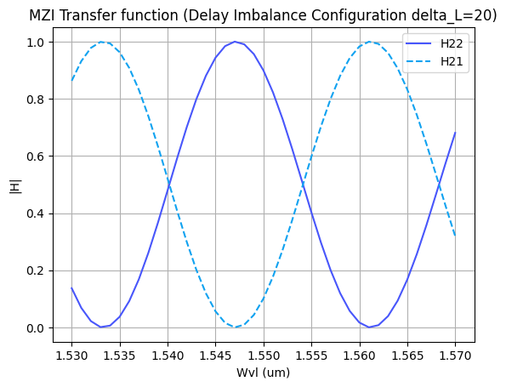
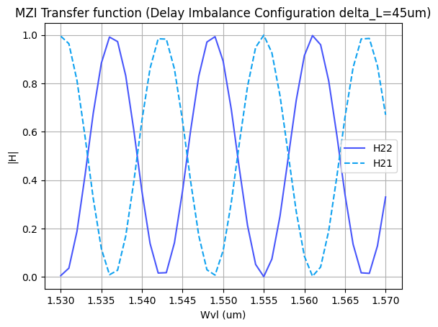
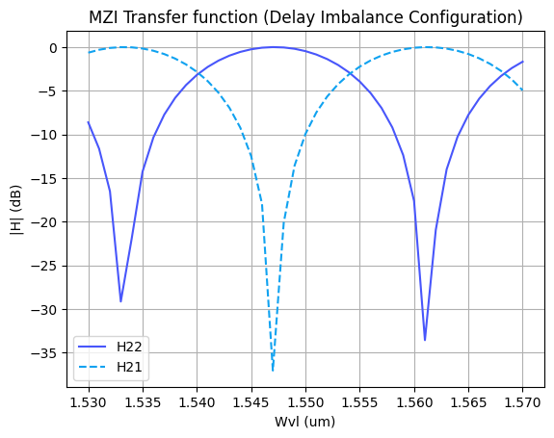
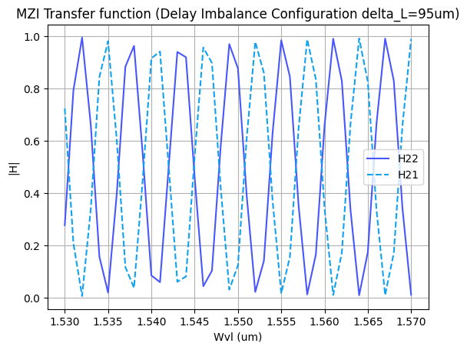

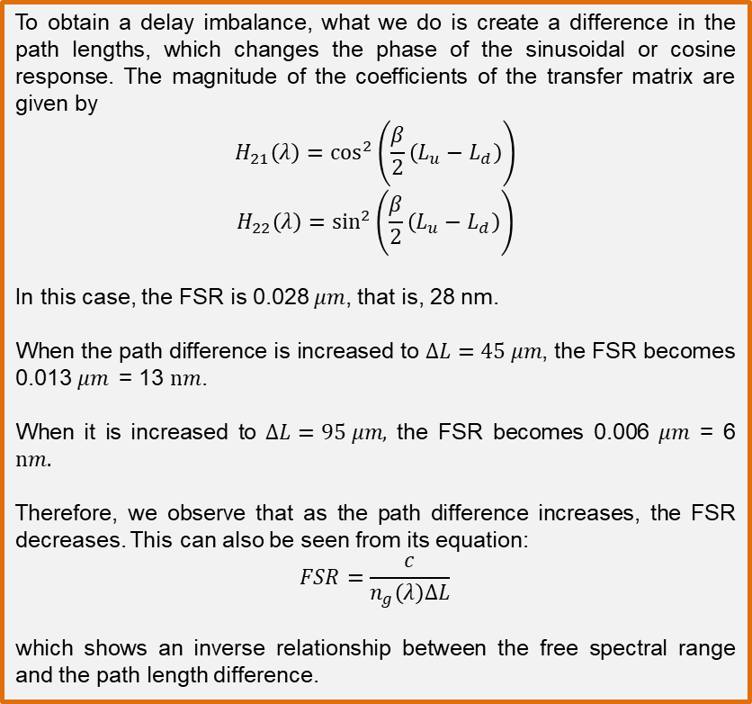

ASSESSMENT #1 – Recap from theory – Delay Imbalance MZI
$ΔL$=20
Other $ΔL$
To obtain a delay imbalance, what we do is create a difference in the path lengths, which changes the phase of the sinusoidal or cosine response. The magnitude of the coefficients of the transfer matrix are given by
$$H_{21}\left(λ\right)=\cos^{2}\left(\frac{β}{2}\left(L_{u}−L_{d}\right)\right)$$
$$H_{22}\left(λ\right)=\sin^{2}\left(\frac{β}{2}\left(L_{u}−L_{d}\right)\right)$$
In this case, the FSR is 0.028 𝜇𝑚, that is, 28 nm.
When the path difference is increased to $∆L=45 μm$, the FSR becomes 0.013 $μm$= 13 $nm$.
When it is increased to $∆L=95 μm,$ the FSR becomes 0.006 $μm$= 6 $nm.$
Therefore, we observe that as the path difference increases, the FSR decreases. This can also be seen from its equation:
$$FSR=\frac{c}{n_{g}\left(λ\right)ΔL}$$
which shows an inverse relationship between the free spectral range and the path length difference.

Slide 6
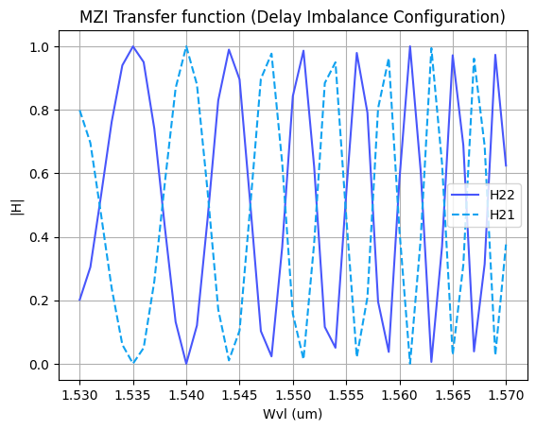
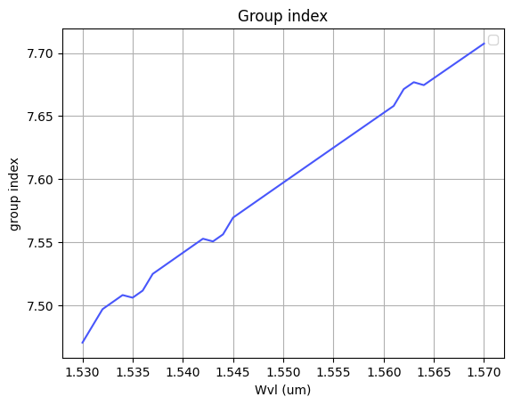
ASSESSMENT #1 – Recap from theory – Delay Imbalance MZI
If we did not have this condition, the dependence would not be linear. In other words, if β does not grow linearly with the wavelength, the period would change along the spectrum. Since we make the effective index vary following a parabolic behavior, when taking the derivative, the group index becomes a linear function. This means that as the wavelength increases, the group index corresponding to that wavelength also increases, which affects the propagation of the signal.
Thus, we observe how the group index is related to the FSR, since a larger group index results in a smaller FSR, and therefore a larger spectral period of the signal
The group index defines the spectral period because it determines the FSR of our device. As can be observed, the FSR is inversely proportional to the group index, meaning that the larger n_g ​ is, the smaller the FSR becomes. This occurs due to chromatic dispersion, that is, the different propagation velocities of the different wavelengths.
FSR between peaks: [0.009 0.007 0.005 0.005 0.004 0.004]
Spectral period between peaks: [111.11111111 142.85714286 200. 200. 250. 250.]
Therefore, as observed, the group index increases linearly with wavelength, the FSR decreases, and the spectral period increases.

Slide 7
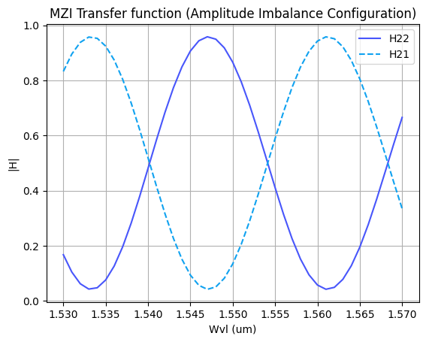
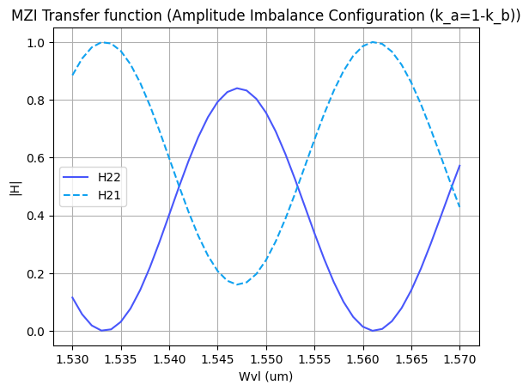
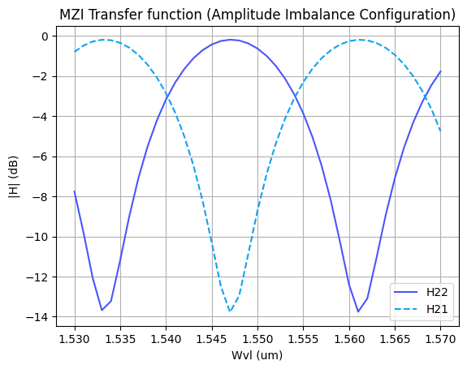
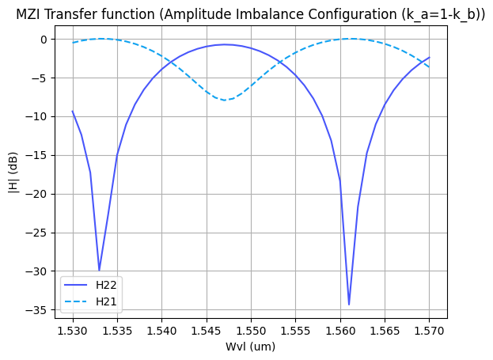
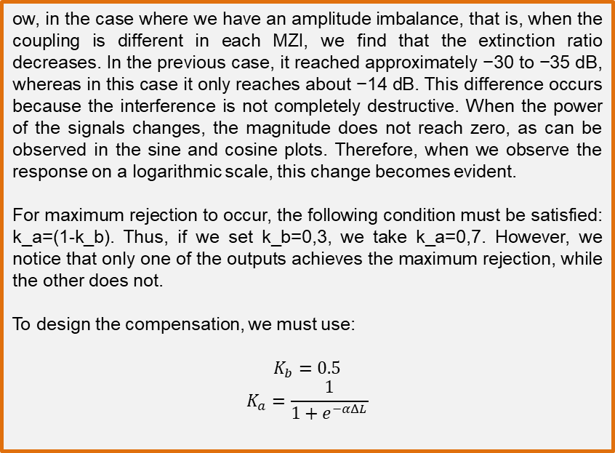
ASSESSMENT #1 – Recap from theory – Amplitude Imbalance MZI
ow, in the case where we have an amplitude imbalance, that is, when the coupling is different in each MZI, we find that the extinction ratio decreases. In the previous case, it reached approximately −30 to −35 dB, whereas in this case it only reaches about −14 dB. This difference occurs because the interference is not completely destructive. When the power of the signals changes, the magnitude does not reach zero, as can be observed in the sine and cosine plots. Therefore, when we observe the response on a logarithmic scale, this change becomes evident.
For maximum rejection to occur, the following condition must be satisfied: k_a=(1-k_b). Thus, if we set k_b=0,3, we take k_a=0,7. However, we notice that only one of the outputs achieves the maximum rejection, while the other does not.
To design the compensation, we must use:
$$K_{b}=0.5$$
$$K_{a}=\frac{1}{1+e^{−αΔL}}$$

Slide 8
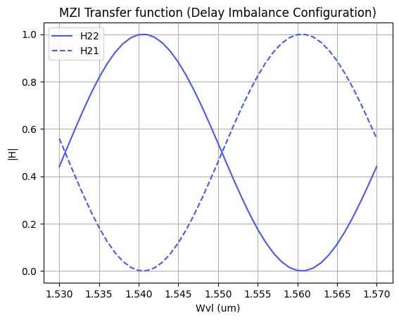


ASSESSMENT #2 – Recap from theory – Calculation of $ΔL$
Considering the n_{eff} values for the SOI cross-section, what would be the path difference ($ΔL= L_{u} −L_{d}$) needed to obtain a Free Spectral Range of 40 nm? Introduce the obtained value in the model to check the MZI response.
Hint: We assume 1550 nm as the central design wavelength ($λ_{0}=$1550 nm).
In this case, since we need to determine which value corresponds to $∆L$ to obtain an FSR of 40 nm, we rearrange the equation to solve for it.
$$∆λ_{FSR}=\frac{λ^{2}}{n_{g}(λ)∆L}$$
$$∆L=\frac{λ^{2}}{n_{g}(λ)∆λ_{FSR}}$$
To do this, we first need the group index. It is calculated as follows:
SOI = np.loadtxt('SOI-w450-h220-clad600.txt', skiprows=1, delimiter='\t')
wl0 = 1.55
wvl = SOI[:, 0]
n_eff=SOI[:,3]
dn_dlambda = np.gradient(SOI[:, 3], wvl) #Calculate the slope for each central wavelength.
#print((2.35452-2.35702)/(1.551-1.549)) Verify that the calculated value corresponds to the correct slope.
i = np.argmin(np.abs(wvl - wl0)) # Identify the index corresponding to the wavelength closest to wl0
ng_1550 = n_eff[i] - wvl[i] * dn_dlambda[i] # Calculate the group index.

Slide 9

ASSESSMENT #2 – Recap from theory – Calculation of $ΔL$
Considering the n_{eff} values for the SOI cross-section, what would be the path difference ($ΔL= L_{u} −L_{d}$) needed to obtain a Free Spectral Range of 40 nm? Introduce the obtained value in the model to check the MZI response.
Hint: We assume 1550 nm as the central design wavelength ($λ_{0}=$1550 nm).
Once we obtain the group index, which is 4.29, we calculate $∆L$as follows:
FSR=40e-3
deltaL=(wl0**2)/(FSR*ng_1550)
print(f"La diferencia de longitud de los caminos debe ser de: {deltaL} um")
The difference in the path lengths must be 13.98 µm.
Now, to verify whether we obtained the required FSR, we check it using the following code:
maxp=wvl[np.argmax(H22)]
minp=wvl[np.argmin(H22)]
FSR=2*(minp-maxp)
The result is 0.040 µm, which corresponds to 40 nm, confirming that the value is correct.

Slide 10
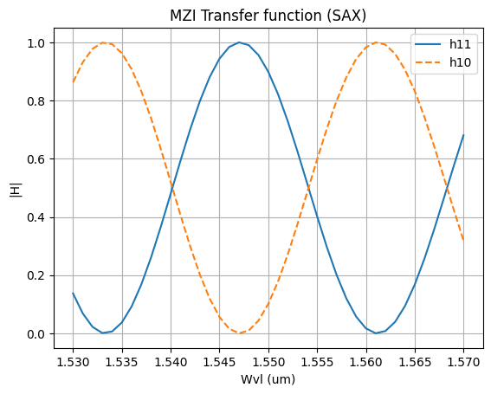
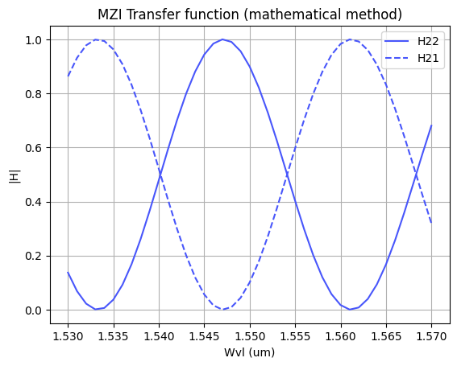
ASSESSMENT #3 – SAX implementation
Now, we are going to implement the design parameters in the MZI model developed in SAX and compare the response obtained with the one simulated by mathematical formulation. This will help us to identify any error in the definition of the SAX model single components.
In order to implement the SAX model, take as example the following lines:
mzi_test = mzi(wl=wl,
coup_a = ...
wvg_d={"length": l_d, "neff": ...},
wvg_u={"length": l_u, "neff": ...},
coup_b = ... )
H00 = mzi_test["in0", "out0"]
For both cases, we obtain the same FSR, which is 28 nm. It can also be observed graphically that the amplitudes are very similar, since both responses oscillate between 1 and 0, reaching their maximum and minimum values at very similar wavelengths. Therefore, using SAX is a very good approximation of the mathematical method.

Slide 11
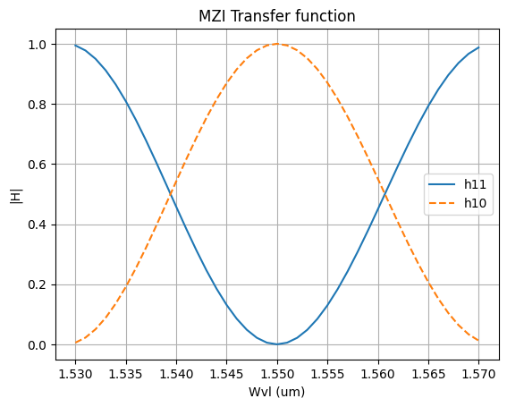
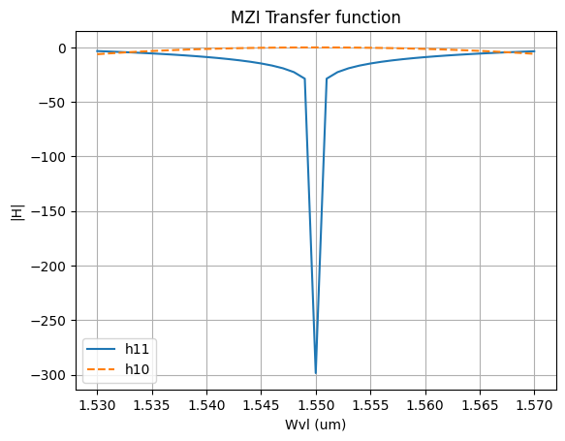

Extra assessments
Assessment 4. Design an MZI for filtering at a specific wavelength. Calculate and adjust the arm lengths to configure the MZI to have a maximum transmission at 1550 nm.
We want one of the outputs to have the strongest constructive interference at a specific wavelength. Therefore, the phase difference must satisfy
$$∆∅\text{=2}πm$$
Considering that the phase is given by
$$∆∅=β∗\frac{∆L}{2}=π∗n_{eff}∗\frac{∆L}{λ}$$
Equating both expressions:
$$∆∅=π∗n_{eff}∗\frac{∆L}{λ}=\text{2}πm$$
Solving for the difference between the arms:
$$∆L=\frac{\text{2}πmλ}{πn_{eff }}=\frac{2mλ}{n_{eff}}$$
Taking m=20:
$$∆L=\frac{20λ}{n_{eff}}$$
In the code, the value of neff​ at 1550 nm is obtained, and 𝜆 =1550nm is also used. From this, the corresponding plots are generated, where we observe that at 1550 nm the magnitude in logarithmic scale reaches approximately −300 dB.

Slide 12
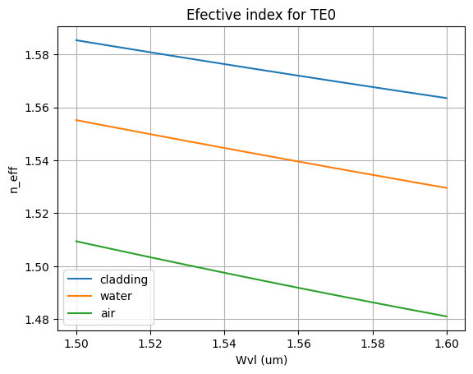
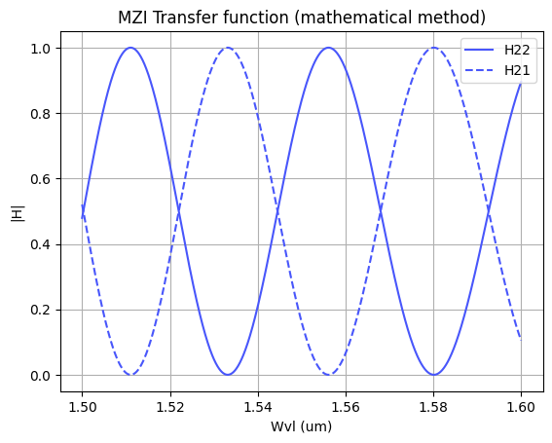
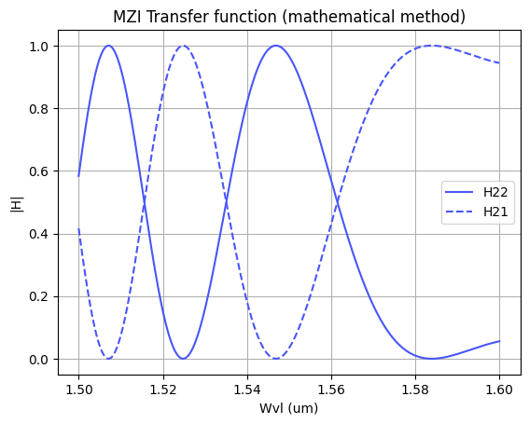
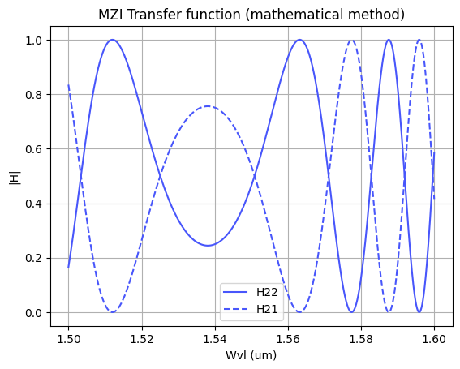
Extra assessments
Assessment 5. Let's see how the response of the MZI varies with the effective index. Vary the effective index of one of the arms and analyze how the spectrum shifts. To do this, you can use the data provided in the .txt files entitled ‘SiN’. Can you give an example of an application where this configuration is used?
In the first two cases, the length of the arms was taken as 2000 um. As we can see, the change of material modifies the effective indices, which in turn changes the FSR, since it is directly related to the variation of the refractive index.
In the first case, this corresponds to the smallest refractive index change, the second case corresponds to the largest refractive index change, and the third case represents the intermediate index change. This shows that the larger the refractive index difference, the smaller the FSR.
In the case of using SiNx with air cladding, it is possible to design a sensor, where the substance to be detected is placed in the surrounding region so that it interacts with the waveguide, thereby slightly modifying the effective index of the waveguide.
A similar situation could occur in the case of SiNx with water cladding.
SiN_cladding y SiN_water
FSR es 0.04704705 um
SiN_cladding y SiN_air
FSR = 0.03973974 um
SiN_water y SiN_air
FSR = [0.03933934 0.01841842]
L=8000

Slide 13
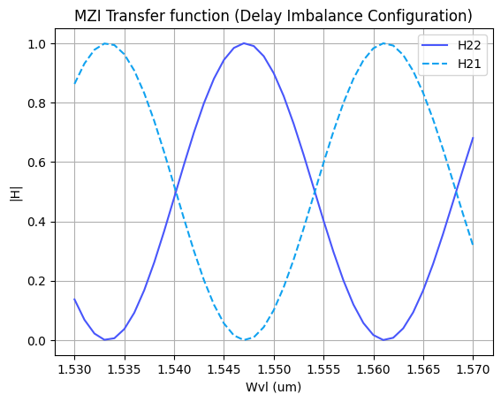
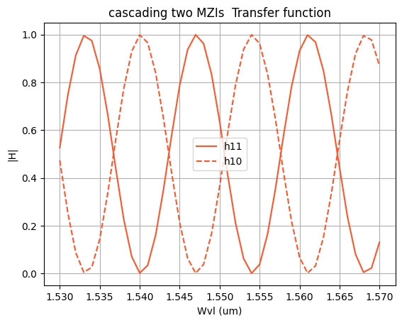
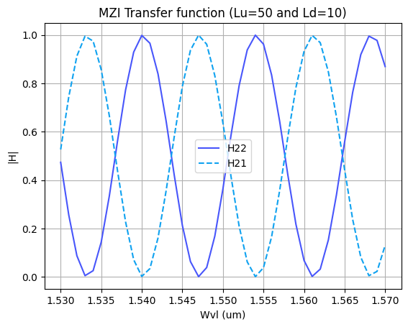
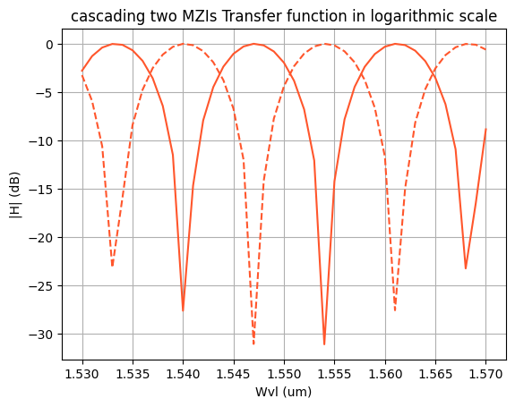


Extra assessments
Advanced level assessment. Explore how cascading two MZIs affects the transmission spectrum. To do so, design a system in which two MZIs are cascaded. Simulate and observe the spectrum, explaining how the transmission peaks behave.
In this case, I used two MZIs with delay imbalance. One has $L_{u}=5 μm$ and $L_{d}=25 μm$, while the other has${ L}_{u}=25 μm$ and $L_{d}=5 μm$, In the previous case, shown in slide 5, the response of MZI 2 could be observed, where H22​ had one maximum and two minima.
When the interferometers are cascaded, we observe that the response changes to three maxima and three minima within the same wavelength interval. Therefore, the device can now filter three different signal bands at its outputs, meaning it can filter approximately from 1530 to 1540 nm, around 1540 to 1554 nm, and around 1554 to 1567 nm.
Regarding the FSR, we observe that it changes from 28 nm for a single MZI to approximately 11 nm when the interferometers are cascaded.
Finally, i performed a simulation to observe what happens if we use only one MZI with $L_{u}=50 μm$ and $L_{d}=10 μm$ which corresponds to the total path length behavior of the two arms of the MZI. The result shows that we obtain a very similar response.

Slide 14

Thank you

