Slide 1
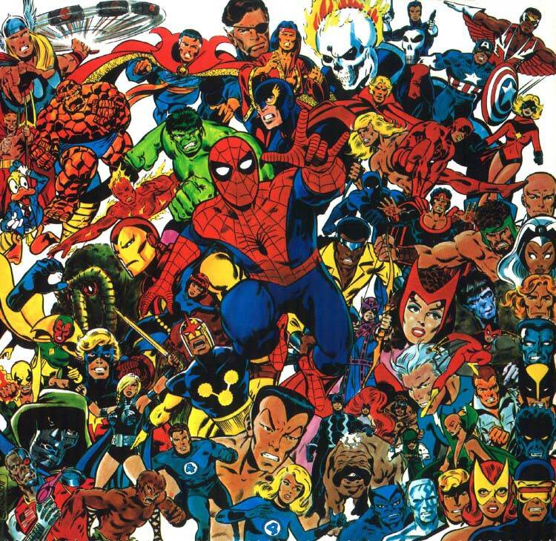
Marvelist
The Marvel Social Network

Slide 2
Purpose
Easily find common appearances in issues between two characters
Including first appearance
Identify the top “friends” of characters
Identify size of individual characters’ networks and their relative place in it
Output to user above information in visually appealing and comprehensive fashion

Slide 3
Databases
Marvel Universe Social by Kai Chang, Tom Turner, and Jefferson Braswell
Comic and Hero Network Data
Hero Social Network Data
Marvel Developer Database
Issue year of publication
Marvel Chronology Project
Keys for issue codenames

Slide 4
Python Libraries
PyMarvel
Python wrapper for Marvel developer API
Networkx
Python library for visualizing and analyzing networks
SQLite
Databases
Tkinter
Graphics
BeautifulSoup
Webscrapper

Slide 5
Tasks
Have two characters met?
Individual’s network
List of shared appearances, chronological
Series with most shared appearances
Images of two characters
Years created and first year of meeting
Link to individual networks
Top 5 Encounters
Links to two character meeting screen
Character image
Size of network
Year created
Network measurements
Location in macro network visualization

Slide 6
1. Tables
Keys
Series
Key
Title
Series key
Full series title
Marvel series ID (Marvel API)
Issues
Codename
ID (From Marvel API)
Full issue title (from Key table)
Year of publication (From Marvel API)
Series title
Characters
ID
Image
Name
Civilian Name
Alias

Slide 7
2. Images
Option 1
Webscrapper for Wikipedia images
Option 2
Marvel API

Slide 8
Code and Data Interaction
Asks user to input character name and matches to relevant rows in database
Pulls relevant queries and outputs to GUI in correct format and order.
Visualizes network data and creates graphic
With help from networkx library
Image and key webscrappers add new data to tables and databases

Slide 9
Expected Difficulties
Image webscrapper pulls relevant image
Issue codenames without key
Merging data from Social Network databases with Marvel Developer API databases
Highlighting location in network while still being clear

Slide 10
Home Screen
view character’s network
find common appearances between two characters

Slide 11
Home Screen
view character’s network
find common appearances between two characters
Enter Character:
Enter Characters:

Slide 12
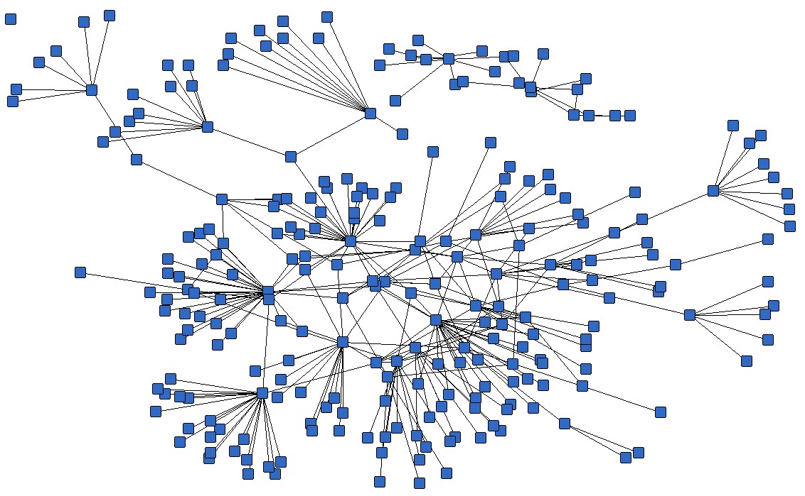
Individual Network Screen
n
Top Five Friends
Name
Name
Name
Name
Name
Network Statistics
Centrality
Degrees
Name
Etc…
Alias
Year created

Slide 13
Common Appearance Screen
Series with most common appearances
Common Appearances
Issue Year
… …
… …
… …
… …
… …
… …
… …
… …
… …
… …
Name
Name
Alias
Alias
Year created
Year created

