Slide 1
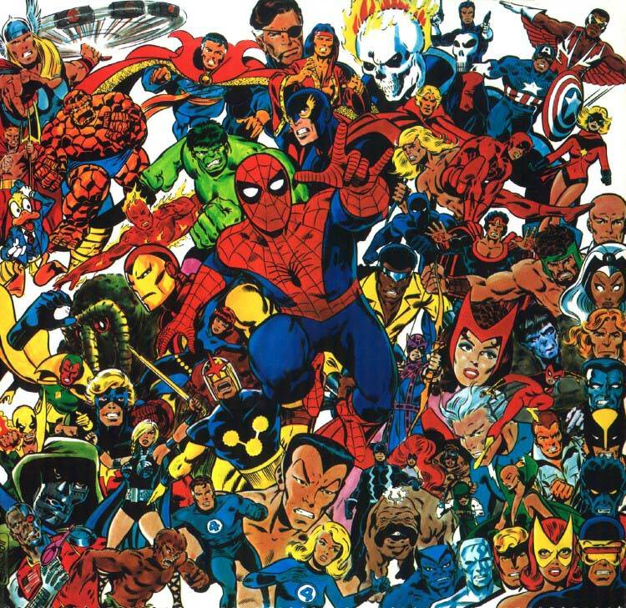

The Marvel Social Network
Paulina Toro Isaza

Slide 2
Overview
Display Marvel social network info in appealing and comprehensive manner
Find common appearances
Identify size of individual characters’ networks and their relative place in it
Data only until 2001

Slide 3
Data
Marvel Universe Social by Kai Chang, Tom Turner, and Jefferson Braswell
Comic and Hero Network Data
Hero Social Network Data
Marvel Developer Database
Character image
Full name
First appearance
Marvel Chronology Project
Keys for issue codenames
Marvel Wikia API
Publication year for issues

Slide 4
Goals
Have two characters met?
Individual’s network
✓
✓
List of shared appearances, chronological
Series with most shared appearances
Images of two characters
Years created and first year of meeting
Link to individual networks
Top 5 Encounters
Links to two character meeting screen
Character image
Size of network
Year created
Network measurements
Location in macro network visualization
✓
✗
✓
✓
✓
✓
✓
✓
✓
✗

Slide 5
Tools
Python program separating name from superhero code name in social network table
Python program to populate SQL table with all Marvel API entries
Python program that matched entries in network table with entry in API table by character name
Python program to separate issues in issue table by name, volume, and issue

Slide 6
Tools
Webscrapper for Marvel API that scraps the first appearance of the character from the developer Wiki
Python program to grab relevant info from Marvel API
Python program to get issues from SQL database and turn into usable URL for Marvel Wikia API
Webscrapper that scraps Marvel Wikia API to find the year of publication for an issue and insert into table

Slide 7
Tools
Python program that creates new table based on matches between API table and network table
Function that finds all issues in which both hero 1 and hero 2 appear. Uses Wikia Issue scrapper to get year, assign it as a key, and sort issues by year
Modify autocomplete program

Slide 8
Tools
Single character object class that holds identity and network information of character
GUI for single character screen
GUI for common appearance screen
GUI start screen

Slide 9
Problems
✓
Data needed cleaning
Connecting to APIs or scrapping websites without getting kicked off or exceeding call limits
Dealing with inconsistencies in data
Not all characters were matched when match existed
Having complete GUI on one window
Installing python modules with pip
Using matplotlib in virtual environment
✓
✗
✗
✗
✓
✗

Slide 10
Problems
Takes too long to load
Some characters cause issues for unknown reasons
✗
✗

Slide 11
Lessons learned
Break everything down into small tasks!
How to filter, match, and manipulate large amount of data
How to write web scrappers and use APIs
Take advantage of what others have done before, but recognize you’ll have to modify for your project
Classes can make coding for Tkinter a lot easier

Slide 12
Project expansions
Include characters and issues after 2001
Include more of Marvel API characters
Network visualization
List of characters in each issue
Overall network statistics and rankings
Scrap websites only once and insert into table to fix loading times

