Slide 1
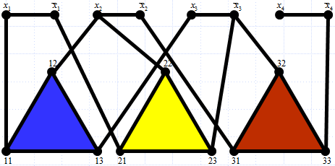
Lesson 15
NP-Complete Problems:
Handling Problems From the Field of All Possibilities
Wholeness of the Lesson
Decision problems that have no known polynomial time solution are considered hard, but hard problems can be further classified to determine their degree of hardness. A decision problem belongs to NP if there is a polynomial p and an algorithm A such that for any instance of the problem of size n, a correct solution to the problem can be verified using A in at most p(n) steps. In addition, the problem is said to be NP-complete if it belongs to NP and every NP problem can be polynomial-reduced to it.
Science of Consciousness: The human intellect can grasp truths within a certain range but is not the only faculty of knowing. The transcendental level of awareness is a field beyond the grasp of the intellect (“beyond even the intellect is he’’ -- Gita, III.42). And the field of manifest existence, from gross to subtle, is too vast and complex to be grasped by the intellect either (“unfathomable is the course of action” – Gita IV.17).
NP-Completeness
Notes:
Graphs

Slide 2
Overview
In this lesson:
Review polynomial time decision problems and the class P
Review the class NP of decision problems.
Describe the class of “hard” NP problems – the NP complete problems.
Demonstrating NP-completeness, with examples, and the P=NP problem
Techniques for handling NP-completeness in practice, with examples.
NP-Completeness

Slide 3
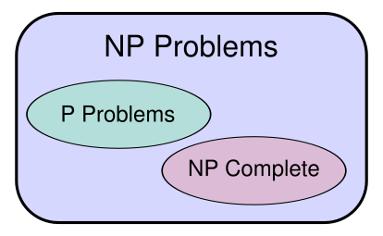
P versus NP problem
Notes:
Prepared by Dr. Zakir H. Ahmed

Slide 4
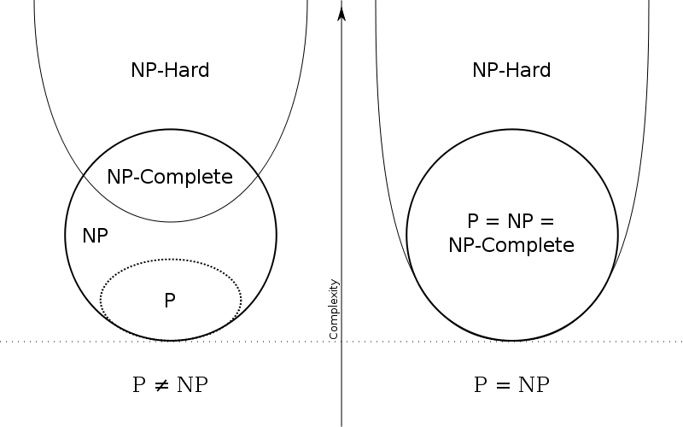
P versus NP problem
Notes:
Prepared by Dr. Zakir H. Ahmed

Slide 5
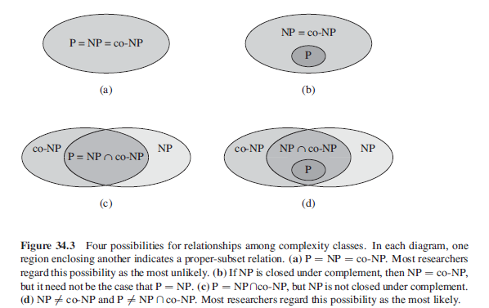
P versus NP problem versus Co-NP
Notes:
Prepared by Dr. Zakir H. Ahmed

Slide 6
Polynomial-Time Algorithms
Are some problems solvable in polynomial time?
  Of course: many algorithms we’ve studied provide polynomial-time solutions to some problems
Are all problems solvable in polynomial time?
  No: Turing’s “Halting Problem” is not solvable by any computer, no matter how much time is given
Most problems that do not yield polynomial-time algorithms are either optimization or decision problems.

Slide 7
How Do We Know When a Problem Does Not Belong to P?
Hard to know for sure because even if there is no known polynomial time algorithm today, tomorrow someone may come up with one.
Modern-day example: The IsPrime problem. Before 2002, all known deterministic algorithms to solve this problem ran in superpolynomial time.
AKS Primality Test was the first polynomial-time solution. Its fastest known implementation runs in
O(length(n)⁶ * log^{k}(length(n)))
for some k. (AKS stands for Agrawal–Kayal–Saxena)
EXPTIME-Complete problems, like nxn chess, do require superpolynomial time and therefore do not belong to P
NP-Completeness

Slide 8
The class NP
To understand decision problems that may not belong to P, one approach is to see how hard it is to check whether a given solution is correct. Typically easier to check a solution than to obtain a solution in the first place.
The class of decision problems with the property that a solution can be verified in polynomial time is denoted NP.
NP-Completeness

Slide 9
Optimization/Decision Problems
Optimization Problems
  An optimization problem is one which asks, “What is the optimal solution to problem X?”
  Examples:
    0-1 Knapsack
    Fractional Knapsack
    Minimum Spanning Tree
Decision Problems
  A decision problem is one with yes/no answer
  Examples:
    Does a graph G have a MST of weight ≤ W?

Slide 10
Optimization/Decision Problems
An optimization problem tries to find an optimal solution
A decision problem tries to answer a yes/no question
Many problems will have decision and optimization versions
  Eg: Traveling salesman problem
    optimization: find hamiltonian cycle of minimum weight
    decision: is there a hamiltonian cycle of weight ≤ k
Some problems are decidable, but intractable:
as they grow large, we are unable to solve them in reasonable time
  Is there a polynomial-time algorithm that solves the problem?
Notes:
A Hamiltonian cycle (or Hamiltonian circuit) is a cycle in an undirected graph that visits each vertex exactly once and also returns to the starting vertex.

Slide 11
Decision Problems and Instances of Problems
Example of a Decision Problem (VertexCover)
Given a graph G = (V,E) and a positive
integer k, is there a vertex cover for G
of size at most k?
Example of an instance of a Decision Problem:
Is there a vertex cover of size at least
3 for the complete graph on 5 vertices?
An instance of a Decision Problem is said to have a solution or be a solvable instance if “true” is the correct answer to the problem.
  Example: “Is there a vertex cover of size at least 3 for the complete graph on 5 vertices?” has a solution (so “true” is the correct answer)
  Example: “Is there a vertex cover of size at least 3 for the complete graph on 8 vertices?” does not have a solution (so “true” is not correct)
NP-Completeness
Notes:
Graphs

Slide 12
(continued)
An instance I of a problem has input data (e.g. (V,E,k) for VertexCover); any candidate solution for an instance also consists of data (e.g. a subset W of V for VertexCover) called solution data.
Need to know the size of input data. For graphs, the convention is that the number of vertices is the size that is used
NP-Completeness

Slide 13
NP-Complete Vrs. NP-Hard
NP-complete problems are a set of problems that any other NP-problem can be reduced to in polynomial time, but retain the ability to have their solution verified in polynomial time. Alternatively,
A problem (in NP) is NP-complete if any problem in NP is reducible to it
Examples: Traveling Salesman Problem & Hamiltonian Cycle problem
NP-hard problems are those at least as hard as NP-complete problems, meaning all NP-problems can be reduced to them, but not all NP-hard problems are in NP, meaning not all of them have solutions verifiable in polynomial time.
NP-Completeness

Slide 14
Another Definition of P
Definition A decision problem Q is said to belong to P if there exists a polynomial p(y) (“polynomial witness”) and an algorithm A such that for any instance I of Q that has a solution and that has input data X of size n, when A is run on input X, A outputs “true” in
O(p(n)) time.
We say A, p(y) witness that Q belongs to P.
NP-Completeness

Slide 15
Another Definition of NP
Definition. A decision problem Q is said to belong to NP if there exists a polynomial p(y) (“polynomial witness”) and an algorithm B such that for any instance I of Q that has a solution, if X is input data of size n and Y is a solution data (called a certificate), then when B is run with input (X, Y), B outputs the message “verified” in O(p(n)) time. (Time includes the effort to read the certificate Y.)
We say that B, p(y) witness that Q belongs to NP
NP-Completeness

Slide 16
Yet Another Definition of NP
NP: the class of decision problems that are solvable in polynomial time on a nondeterministic machine (or with a nondeterministic algorithm)
(A determinstic computer is what we know)
A nondeterministic computer is one that can “guess” the right answer or solution
  Think of a nondeterministic computer as a parallel machine that can freely spawn an infinite number of processes (to some extent similar to Quantum Computing).
Note that NP stands for “Nondeterministic Polynomial-time”

Slide 17
Quantum Computing and NPC
Uses Qbit that can super impose inputs in a probabilistic way.
a qubit is the superposition |Sai> = alpha |0> + beta |1> with probabilities alpha^2 and beta^2 etc. alpha, beta are complex numbers.
Can store 2^n in a probabilistic way in n qbits etc.
Thus, bits, algorithms, results are all probabilistic.
At this time only some classes of problems can be solved fast in a quantum machine.
Quantum computer cannot solve NPC or NP-Hard problems in Polynomial time (in general, may be some specific problems can be solved in P time)

Slide 18
Quantum Computing Complexity
BQP - : bounded error quantum polynomial time is the class of decision problems solvable by a quantum computer in polynomial time, with an error probability of at most 1/3 for all instances.
QMA - Quantum Merlin Arthur, is the quantum analog of the nonprobabilistic complexity class NP or the probabilistic complexity class MA.
QMA is related to BQP in the same way NP is related to P, or MA is related to BPP.
(BPP is bounded-error probabilistic polynomial time)

Slide 19
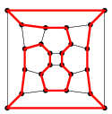
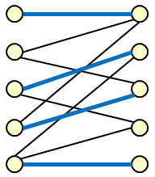

NP Examples
The HamiltonianCycle and VertexCover problems have already been shown to belong to NP.
HamiltonianCycle: Given G=(V,E), does G have a Hamiltonian Cycle? Solution data: a subset of E
VertexCover: Given G=(V,E) and k, does G have a vertex cover of size at most k? Solution data: subset of V
Hamiltonian path is a path in an undirected or directed graph that visits each vertex exactly once. A Hamiltonian cycle (or Hamiltonian circuit) is a Hamiltonian path that is a cycle
A matching in a graph is a set of edges no two of which share an endpoint.
Konig’s Theorem. In a bipartite graph, the number of edges in a maximum matching is the same as the number of vertices in a minimum vertex cover.
NP-Completeness
Notes:
Hamiltonian Graph facts
Dirac (1952)
A simple graph with n vertices (n ≥ 3) is Hamiltonian if every vertex has degree n / 2 or greate
Solution to Matching Problem: A minimal vertex cover for the graph is {U, C, X, E} where
vertices in left side are labeled A-E, vertices on the right side labeled U – Z.
^{[3]}
Graphs

Slide 20
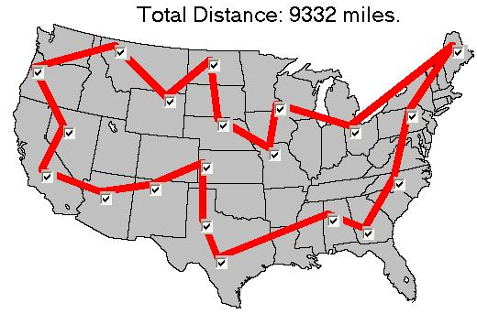
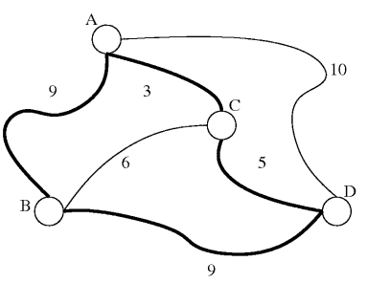
Traveling Salesman Problem
Traveling Salesman Problem (TSP): Given a complete graph G with cost function c: E → N and a positive integer k, is there a Hamiltonian cycle C in G so that the sum of the costs of the edges in C is at most k? Solution data: a subset of E.
NP-Completeness

Slide 21
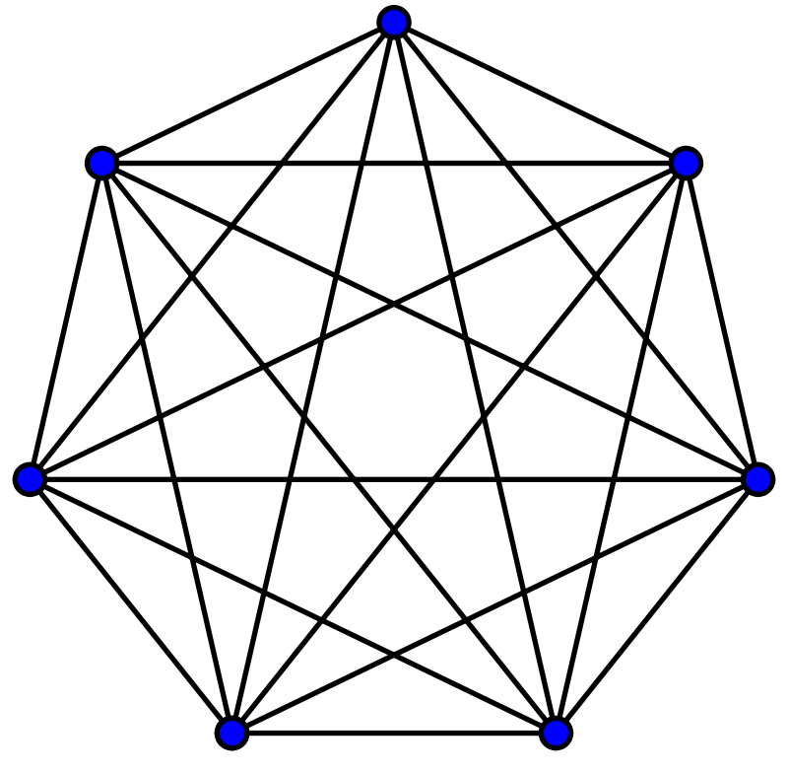
Complete Graph, Induced Graph and Clique
A complete graph is a graph where every pair of distinct vertices are connected by a unique edge. Example: K₇ - a complete graph with 7 vertices
A subgraph, H, of a graph, G, is said to be induced (or full) if, for every pair of vertices x and y of H, xy is an edge of H if and only if xy is an edge of G.
A clique is subset of vertices of an undirected graph, such that its induced subgraph is complete.
NP-Completeness

Slide 22
TSP Belongs to NP
Given an instance I of TSP with input data a complete graph G with n vertices, a cost function c: E → N and a positive integer k, and given a certificate E₀, a subset of E, the algorithm B checks that E₀ is a Hamiltonian cycle for G and then computes the sum of c(e) over the edges e in E₀ to verify that it is at most k.
NP-Completeness

Slide 23
Example: Not in NP
PowerSet problem. Given a set X of size n, a kind of optimization problem concerning the power set of X is to generate all subsets of X (“find the largest possible collection of subsets of X without duplicates”). Whatever method is used, just writing out the output requires at least 2^{n} steps. A corresponding decision problem is: Given a set X and a collection P, is P = P(X)? Any algorithm that solves this problem must check every element of P to see if it is a subset of X, so the algorithm requires at least 2^{n} steps in the worst case. So this problem does not belong to P.
Moreover, verifying correctness requires checking that each set that is output is a subset of X, and this has to be done 2^{n} times, so it doesn’t belong to NP either.
[A Power Set is a set of all the subsets of a set. E.g. for set {a,b,c}, the Power set is
{ {}, {a}, {b}, {c}, {a,b}, {a,c}, {b,c}, {a,b,c} } ]
Finite Halting Problem and N x N Chess. Finite Halting Problem: Given a program P and positive integers n, k, does P, when running with input n, produce an output after excecuting k or fewer steps? Neither of these problems belong to P, but it is not known whether they belong to NP.
NP-Completeness

Slide 24
Is P = NP ?
The answer is not known
Many thousands of research papers have been written in an attempt to make progress in solving this problem.
If it were true, then thousands of problems that were believed to have infeasible solutions would suddenly have feasible solutions
Clay Mathematics Institute (CMI, Rhode Island, Providence, USA) in 2000 has announced $1M award if one can prove that P = NP or P! = NP.
[In fact, there are 6 other problems, each for $1M. These are called Millennium Prize Problems]
NP-Completeness

Slide 25
A Remarkable Fact About NP
Many of the problems that are known to be in NP can also be shown to be NP-complete. Intuitively, this means they are the hardest among the NP problems.
It can be shown that if someone ever figures out a polynomial-time algorithm to solve an NP-complete problem, then all problems in NP will also have polynomial time solutions.
One consequence: If anyone finds a polynomial time solution to an NP-complete problem, then P = NP.
These points are elaborated in the next slides
NP-Completeness

Slide 26
Reducibility
Intuitively: Q is polynomial reducible to R if, in polynomial time, you can transform a solvable problem of type Q into a solvable one of type R so that a solution to one yields a solution to the other.
Formally: A problem Q is polynomial reducible to a problem R if there is a polynomial p(y) and an algorithm C so that when C runs on input data X of size O(n) for an instance I_{Q} of Q, C outputs input data Y of size O(p(n)) for an instance I_{R} of R in O(p(n)) steps so that
I_{Q} has a solution iff I_{R} has a solution
In this case, we say that C, p(y) witness that Q is polynomial reducible to R.
We write Q → R
poly
NP-Completeness

Slide 27
VertexCover → HamiltonianCycle
poly
It can be shown that VertexCover is polynomial reducible to HamiltonianCycle. What does this mean?
Formally: There is a polynomial p(y) and an algorithm C that does the following: Using an instance G, k of the VertexCover problem (where G has n vertices) as input to C, C outputs, in O(p(n)) time, a graph H with O(p(n)) vertices so that:
G has a vertex cover of size at most k iff
H has a Hamiltonian cycle
Intuitively: the VertxCover problem can be turned into a Hamiltonian Cycle problem in polynomial time, so if you can solve the Hamiltonian Cycle problem, you can solve the VertexCover problem without doing much more work.
Note: The details for this algorithm C are tricky – not given here, but we make use of this result later.
NP-Completeness

Slide 28
HamiltonianCycle → TSP
poly
We show HamiltonianCycle is reducible to TSP
Given a graph G = (V,E) on n vertices (input for HamiltonianCycle) – notice G is a subgraph of K_{n}. Obtain an instance H, c, k of TSP as follows: Let H be the complete graph on n vertices (i.e. H is K_{n}), obtained by adding the missing edges to G. Let
c(e) = 0 if e ∈ E, else c(e) = 1. Let k = 0.
Need to show: G has a Hamiltonian cycle if and only if H, c, k has a Hamiltonian cycle with edge cost ≤ k
If G has Hamiltonian cycle C, C is Hamiltonian in H also. Since each edge e of C is in G, c(e) = 0. So cost sum ≤ k. Converse: A solution C for H,c,k implies all edges of C have weight 0; therefore, every edge of C also is an edge in G. Therefore C is an HC in G.
NP-Completeness

Slide 29
NP-Complete Problems (Review)
A problem Q is NP-complete if Q belongs to NP, and for every problem R in NP, R is polynomial reducible to Q.
NP-Completeness

Slide 30
Exptime (EXP) and Exptime-Complete Problems
A problem Q is EXPTIME-complete if Q belongs to EXP, and for every problem R in EXP, R is polynomial time reducible to Q.
Notice that although we don't know if NP is equal to P or not, we do know that EXPTIME-complete problems are not in P; it has been proven that these problems cannot be solved in polynomial time. These are harder than NP-Complete problems.
NP-Completeness

Slide 31
The First NP-Complete Problem
Cook-Levin discovered the first NP-complete problem, known as the Satisfiability Problem (called SAT). The proof is complicated. We are skipping the proof (use logic table to show the idea).
SAT is the following problem: Given an expression using boolean variables p,q,r,… joined together using connectives AND, OR, NOT, is there a way to assign values “true” or “false” to the variables so that the expression evaluates to true?
Example: Consider
p AND NOT (q OR (NOT r))
Assigning T to p and to r and assigning F to q causes the expression to
evaluate to T (i.e. “true”).
NP-Completeness

Slide 32
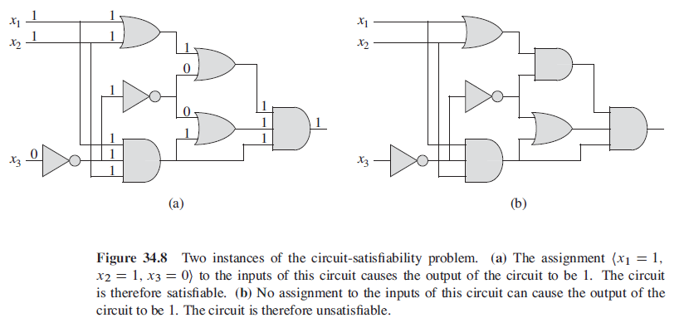
The Satisfiability (SAT) Problem

Slide 33
Other NP-Complete Problems
Once a single NP-complete problem was discovered, others could be found by using the Cook-Levin result
Example: VertexCover can be shown to be NP-complete. The main idea is to prove that SAT is polynomial reducible to VertexCover. Then: Given any NP problem Q, to show Q is polynomial reducible to VertexCover, observe:
  Q is polynomial reducible to Sat
  Sat is polynomial reducible to VertexCover
  Therefore, Q is polynomial reducible to VertexCover
  (the last step requires verification: Exercise: if PROB1 is poly reducible to PROB2 and PROB2 is poly reducible to PROB3, then PROB1 is poly reducible to PROB3. )
NP-Completeness

Slide 34
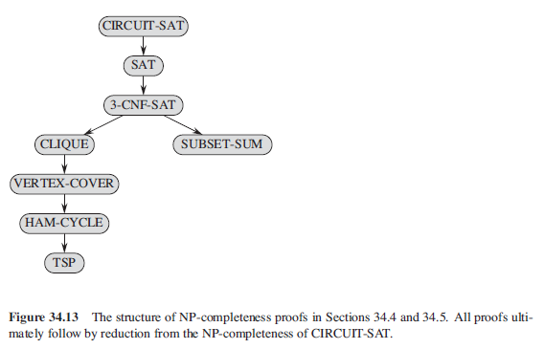
More on Reducibility (From Corman)
Notes:
P ⊆ NP ⊆ PSPACE ⊆ EXPTIME ⊆ NEXPTIME ⊆ EXPSPACE

Slide 35
HamiltonianCycle is NP-Complete
This is an outline of a proof that HamiltonianCycle is NP-Complete under the assumption that VertexCover is NP-complete:
Recall that VertexCover is polynomial reducible to HamiltonianCycle.
Therefore, since VertexCover is NP-complete, given any NP problem Q, Q is polynomial reducible to VertexCover
Therefore, any such Q is polynomial reducible to HamiltonianCycle as well.
NP-Completeness

Slide 36
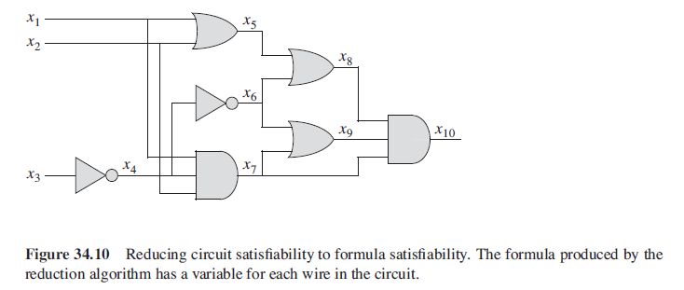
CSAT is NP-complete

Slide 37
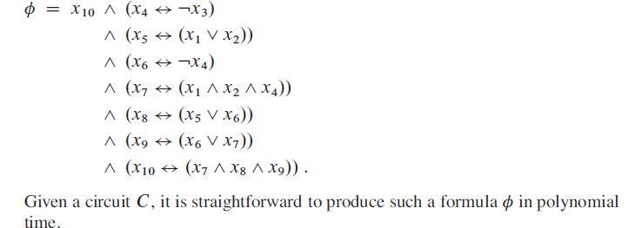
SAT is NP-complete

Slide 38
3-CNF is NP Complete
The following Boolean Formula is in 3-CNF (Conjunction of Disjunctions) form:
Any Boolean Expression can be converted to CNF form (next page)

Slide 39
Conversion to CNF
B_{1,1} ⇔ (P_{1,2} ∨ P_{2,1})
Eliminate ⇔, replacing α ⇔ β with (α ⇒ β)∧(β ⇒ α).(B_{1,1} ⇒ (P_{1,2} ∨ P_{2,1})) ∧ ((P_{1,2} ∨ P_{2,1}) ⇒ B_{1,1})
2. Eliminate ⇒, replacing α ⇒ β with ¬α∨ β.
  (¬B_{1,1} ∨ P_{1,2} ∨ P_{2,1}) ∧ (¬(P_{1,2} ∨ P_{2,1}) ∨ B_{1,1})
3. Move ¬ inwards using de Morgan's rules and double-negation:
  (¬B_{1,1} ∨ P_{1,2} ∨ P_{2,1}) ∧ ((¬P_{1,2} ∧ ¬P_{2,1}) ∨ B_{1,1})
4. Apply distributive law (∧ over ∨) and flatten:
  (¬B_{1,1} ∨ P_{1,2} ∨ P_{2,1}) ∧ (¬P_{1,2} ∨ B_{1,1}) ∧ (¬P_{2,1} ∨ B_{1,1})

Slide 40
3-CNF is NP Complete
Thus the following formula can be converted to 3-CNF in Polynomial time
Thus, SAT can be reduced to 3-CNF in Polynomial time. Hence 3-CNF is NP-Complete as SAT is NP-Complete.

Slide 41
Solving One NP-Complete Problem Solves Them All
Suppose Q is an NP-complete problem and someone finds a polynomial-time algorithm A that solves it in O(p(n)) time.
Let R be any problem in NP. R is polynomial reducible to Q, with witness polynomial q(y).
Polynomial-time algorithm to solve R: Given an instance I_{R} of R, create an instance I_{Q} of Q (in O(q(n)) time) that has a solution iff I_{R} does. Solve I_{Q} in O(p(q(n))) time. Output solution to I_{R} . The algorithm runs in O(q(n) + p(q(n))).
NP-Completeness

Slide 42
Main Point
The hardest NP problems are NP-complete. These require the highest degree of creativity to solve. However, if a polynomial-time algorithm is found for any one of them, then all NP problems will automatically be solved in polynomial time. This phenomenon illustrates the fact that the field of pure consciousness, the source of creativity, is itself a field of infinite correlation – “an impulse anywhere is an impulse everywhere”.
NP-Completeness

Slide 43
What To Do with NP-Complete Problems?
There are many thousands of NP-complete problems, and a large percentage of these would be very useful if they could be implemented in a feasible way. But the known algorithms are too slow. What can be done?
NP-Completeness

Slide 44
Handling NP-Hard Problems
Find a more efficient algorithm somehow
The IsPrime breakthrough of 2002
The technique of dynamic programming – examples: SubsetSum (Also Knapsack as shown before)
Sometimes exponential running time is good enough
Approximation algorithms
Probabilistic algorithms
Use hard problems as an advantage - cryptosystems
NP-Completeness

Slide 45
Options: Find a Better Algorithm
In the case of NP problems not known to be NP-complete, this is at least a reasonable goal.
Example: a polynomial time solution to the IsPrime problem was discovered in 2002; all known (deterministic) algorithms before 2002 were exponential
NP-Completeness

Slide 46

Example: Subset Sum Problem using Dynamic Programming (DP is Covered Before)
The Subset Sum optimization problem says: We have set S = {s₀, s₁, …, s_{n-1}} of n positive integers and a non-negative integer k. Find a subset T of S so that the sum of the s_{r} in T is k.
Note. A solution to the optimization problem gives a solution to the decision problem

Slide 47
Main Observation
Given an instance of SubsetSum: S = {s₀, s₁, …, s_{n-1}} and k. If T is a solution, then s_{n-1} is either in T or not.
If s_{n-1} not in T, then T is a solution for {s₀, s₁, …, s_{n-2}}, k.
If s_{n-1} is in T, then T – {s_{n-1}} is a solution for {s₀, s₁, …, s_{n-2}}, k – s_{n-1}.
NP-Completeness

Slide 48

Applying Dynamic Programing to Solve SubsetSum
There are only (k+1) * n problems to solve, namely:
Build a solution for bigger values of i and j using stored solutions for smaller values of i and j.
NP-Completeness

Slide 49

The Goal
Obtain a 2-dimensional array (a matrix) A so that
If S contains values > k, we ignore them since they don’t
contribute to the solution (computations for which j is too
big are skipped – see the implementation in code)
Fill row i = 0 first, then fill later rows based on values of
earlier rows.
Each cell requires O(1) time, so computation of
A[n-1, k] requires O(kn) time.
NP-Completeness

Slide 50
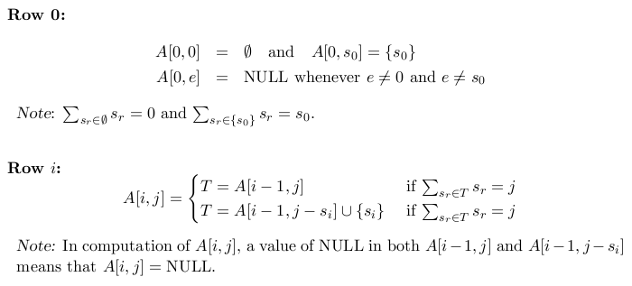
Details
Note – First eqn. for Row i corresponds to if Sr Not in j
NP-Completeness

Slide 51
Pseudo-polynomial time
The dynamic programming solution to SubsetSum runs in O(kn). However, k may be much bigger than n, and even if k is Θ(n), the true running time is based on the number of bits in k, not on the value of k. So even this algorithm runs in exponential time.
NP-Completeness

Slide 52
Options: Sometimes Exponential Time is Good Enough
Sometimes the context in which an exponential algorithm is to be used does not require very large inputs. In such cases, exponential algorithms don’t present difficulties.
NP-Completeness

Slide 53
Options: Approximation Algorithms
Use an approximation algorithm. There are many examples of NP-hard problems that have been “approximately solved” using a very fast algorithm. Sometimes an approximate solution is good enough.
NP-Completeness

Slide 54
An Approximation Algorithm for VertexCover
An approximation algorithm outputs values that are within a specified tolerance of the correct outputs, but typically runs much faster than an algorithm that can produce completely correct outputs.
The idea behind VertexCoverApprox is this: Loop through all the edges of G. For each edge e = (u,v), include u, v in the cover and then delete all edges that are incident to u or v.
NP-Completeness

Slide 55
(continued)
Algorithm VertexCover Approx(G)
Input: A graph G
Output: A small vertex cover C for G
C ← new Set
while G still has edges do
select an edge e = (v,w) of G
add vertices v and w to C
for each edge f incident to v or w do
remove f from G
return C
NP-Completeness

Slide 56
(continued)
C is a vertex cover. Notice that the empty set covers any isolated vertex. Every edge was either used or discarded. Suppose e = (v,w) was a used edge. Then both v and w are in C. Suppose e = (v,w) was a discarded edge. Then one of v and w is in C, by the criterion for discarding.
C is at worst twice the size of an optimal vertex cover. Let r be the number of edges that are used in VertexCoverApprox. The vertex cover C obtained from the algorithm will therefore have size 2r. At least one endpoint of each of these r edges must occur in a minimal vertex cover, and no endpoint is ever shared between two such edges. Therefore, a minimal vertex cover U must have at least r vertices:
r ≤ |U| ≤ 2r = |C|
Running time of VertexCoverApprox is clearly O(m²); with attention to implementation details, this can be improved to O(m+n).
NP-Completeness

Slide 57
Options: Probabilistic Algorithms
Use a probabilistic (or “randomized”) algorithm. Sometimes, randomization can be used in the construction of an algorithm to guarantee correct outputs with high probability, and also to guarantee fast running times. Example: The IsPrime problem again.
NP-Completeness

Slide 58

Solovay-Strassen Solution to IsPrime
Fact: There is a function f, which runs in O(log n) (that is,
O(length(n))), such that for any odd positive integer n and any a chosen randomly in [1, n-1], if f(a,n) = 1, then n is composite, but if f(a,n) = 0, n is “probably” prime, but is in fact composite with probability < ½.
The function f with range {0,1} is defined by:
When f(a,n) = 1, n must be composite. When f(a,n) = 0,
n is “probably prime” but is composite with probability < ½.
NP-Completeness

Slide 59
(continued)
The Solovay-Strassen algorithm for determining whether an input natural number is prime is the following:
To conclude n is prime with probability > 1 - (1/2)^{k},
  Perform Single-Round IsPrime k times and store outputs in a list L
  If at least one value in L is FALSE, return FALSE.
  Otherwise (if all values in L are TRUE), return TRUE
Algorithm Single-Round IsPrime:
Input: A positive integer n
Ouptut: TRUE if n is probably prime, FALSE if n is composite
if n = 2 return TRUE
if n % 2 = 0 return FALSE
a ← a random number in [1, n-1]
if f(a,n) = 1
return FALSE
return TRUE
NP-Completeness

Slide 60
Options: Use hardness as an advantage
Cryptosystems sometimes base their encryption algorithm on an NP-hard problem. When successful, a hacker would have to, in essence, solve the NP-hard problem in order to crack a code.
Example: Merkle-Hellman attempted to base a cryptosystem on the (hardness of the) Knapsack problem. However, this cryptosystem was eventually hacked.
These days, the problem of factoring large numbers is used as the hard problem hackers have to solve to crack cryptosystems.
NP-Completeness

Slide 61
Optional: Public-Key Cryptography
Alice wants to send message M to Bob and wants assurance that
  No one else will be able to view M (confidentiality)
  The message Bob gets is the one sent by Alice (authorship)
Idea:
  Each person has a public key P and a secret key S.
  P is available to anyone but only the owner of S knows S
  P and S are inverses: P(S(M)) = M = S(P(M))
NP-Completeness

Slide 62
(cont)
Usage:
  Alice can send a message to Bob by encrypting with Bob’s public key: send P_{B}(M). Then Bob can decrypt with his secret key S_{B}(P_{B}(M)) = M. This guarantees confidentiality but not authorship
  To ensure authorship, Alice can also digitally sign P_{B}(M) using her secret key: S_{A}(P_{B}(M)). Then Bob can decrypt using P_{A} followed by S_{B}: M = S_{B}(P_{A}(S_{A}(P_{B}(M)))). If the result is “garbage” it means that the author is not Alice. Both confidentiality and authorship are ensured (though in practice more efficient protocols are followed)
NP-Completeness

Slide 63
RSA Cryptosystem
The Requirements
P(S(M)) = M
Computation of P(M) and S(M) is efficient (when P and S are known)
Infeasible to compute S from P (can therefore make P public)
S(P(M)) = M (S, which is private, serves to digitally sign the message)
Cryptography

Slide 64
Making It Infeasible to Derive D from E
Arrange it so that computation of S from P is an NP-complete (or at least hard ) problem.
Merkle-Hellman tried to do this using hardness of Knapsack problem, but relevant instances of Knapsack were not hard to solve
RSA ties difficulty of factoring large numbers to problem of computing S from P.
Cryptography

Slide 65
RSA Setup
Pick at random two several hundred bit (~512 these days) primes p, q, and let n = pq.
Pick a small prime e relatively prime to
φ(n) = (p-1)(q-1). Often e = 3, 7, 65,537 are used.
Compute d as modular inverse of e mod φ(n); that is,
ed ≡ 1 mod φ(n)
Public key is (e,n). Private key is (d,n).
Encryption of message M:
P(M) = Me mod n
Decryption of message M:
S(M) = M^{d} mod n
Cryptography

Slide 66

Things To Verify
Encryption P(M) and decryption S(M) are fast when P and S are known [fast modular exponentiation]
P(S(M)) = S(P(M)) = M [Euler’s Theorem]
Setup portion is reasonably fast
  Obtain two large primes p, q [probable primes]
  Verify e is relatively prime to φ(n) [gcd algorithm]
  Compute d from e given φ(n) [variation of gcd algorithm]
Argue that computing d from e without knowledge of φ(n) is hard. [If only e and n are known, need to find factors p, q of n. Best known algorithm is exponential. For 512 bit primes, infeasible.]
Cryptography

Slide 67
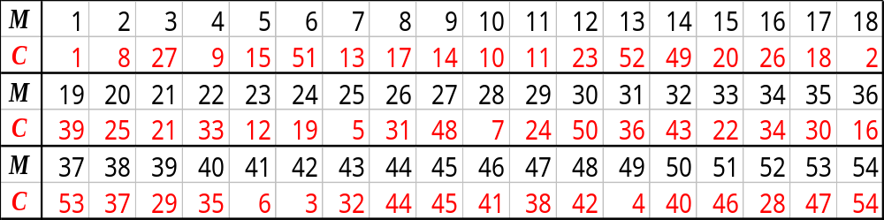
Complete RSA Example
Setup:
  p = 5, q = 11
  n = 5⋅11 = 55
  φ(n) = 4⋅10 = 40
  e = 3
  d = 27 (3⋅27 = 81 = 2⋅40 + 1)
Encryption
  C = M³ mod 55
Decryption
  M = C²⁷ mod 55
Cryptography

Slide 68
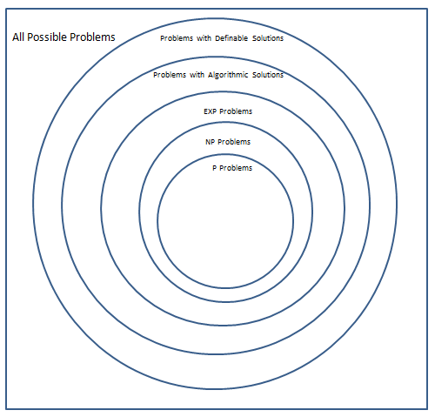
Classes of Problems (Another Look)

Slide 69
Connecting The Parts of Knowledge With The Wholeness of Knowledge
There are many natural decision problems in Computer Science for which feasible solutions are needed, but which are NP-complete. Therefore, there is little hope of finding such solutions.
The hardness of certain NP-complete problems is being used to ensure the security of certain cryptographic systems.
NP-Completeness

Slide 70
3.Transcendental Consciousness is a field of all possibilities and infinite creativity.
4.Impulses Within the Transcendental Field. Pure consciousness as it prepares to manifest is a “wide angle lens” making use of every possibility for creative ends
5.Wholeness Moving Within Itself. In Unity Consciousness, awareness does not get stuck in problems; problems are seen as steps of progress in the unfoldment of the dynamics of consciousness.
NP-Completeness

