Slide 1



Exhaustive Analysis of Indian Agriculture Sector Using Power BI
Paul Andrew D

Slide 2

Learning Objectives
Understand data visualization techniques using Power BI
Gain insights into India's agricultural production trends
Learn to analyze and interpret large datasets for decision-making
Develop dashboard creation skills for effective data storytelling
GOAL
Source :
www.freepik.com/

Slide 3
Tools and Technology used
Power BI for data visualization
Power Query for data cleaning

Slide 4
Methodology
Data Collection: Agricultural production data sourced from government or open datasets
Data Cleaning & Preprocessing: Handling missing values, formatting, and structuring data
Exploratory Data Analysis: Identifying trends, patterns, and outliers
Dashboard Development: Using Power BI to create interactive visualizations
Insights & Interpretation: Extracting key findings from the visualizations

Slide 5
Problem Statement:
Agriculture contributes significantly to India's GDP, but understanding regional production trends and crop performance is challenging.
This project aims to provide data-driven insights into agricultural trends across states, districts, and crop types.

Slide 6
Solution:
A Power BI dashboard was developed to visualize key agricultural metrics, including:
Crop-wise production analysis to determine high-yield crops
State and district-wise production insights for regional comparisons
Seasonal trends and area-wise crop distribution for forecasting
Historical production trends to identify fluctuations over the years

Slide 7
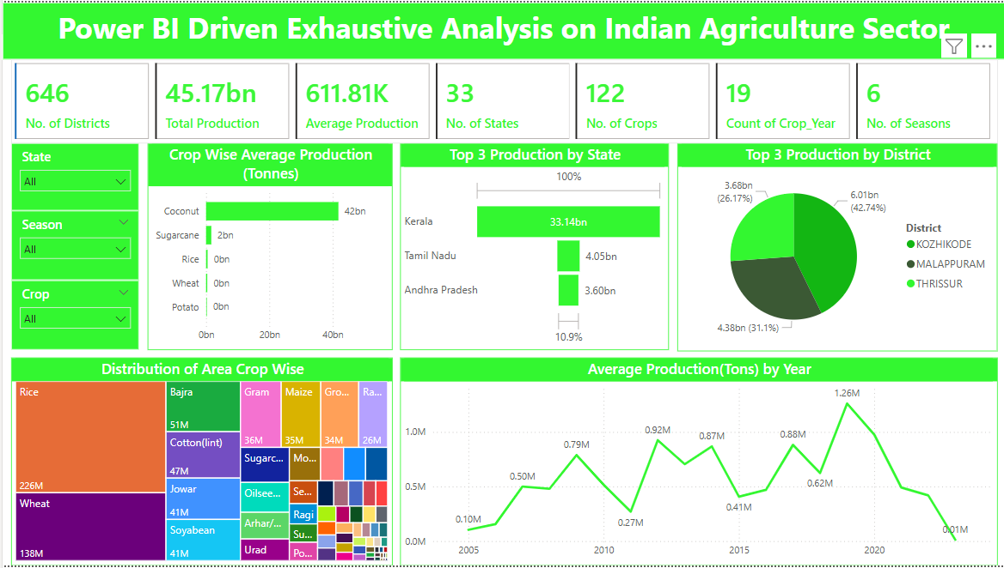
Screenshot of Output:

Slide 8
Conclusion:
The project highlights the power of data visualization in analyzing India's agricultural sector.
The insights can help policymakers, farmers, and stakeholders make informed decisions to improve productivity and sustainability.

