Slide 1
Building an Event Management System
SDLC & System Design Overview

Slide 2
AGENDA
Overview of SDLC
SDLC Phases in Context
System Design for Event Management Systems
Key Architectural Components
Scalability, Security, & Maintenance
Q&A

Slide 3
Introduction to SDLC
Definition: A structured process for designing, developing, testing, deploying, and maintaining software.
Benefits: Improved project management, risk mitigation, quality assurance, cost efficiency.
Common Models: Waterfall, Spiral, Agile, Iterative, etc.

Slide 4
SDLC Phases Overview
Planning & Analysis: Gathering requirements, feasibility studies, defining scope.
Design: Architectural planning, database schema, UI/UX design.
Implementation (Coding): Developing code based on design specifications.
Testing: Unit, integration, user acceptance tests.
Deployment: Releasing the system for public use.
Maintenance: Ongoing support, updates, and enhancements.

Slide 5
Applying SDLC to an Event Management System
Requirement Analysis:
Identify features (event creation, ticketing, payment, notifications).
Stakeholder interviews (organizers, attendees, admin).
Design Documentation:
Create Software Requirements Specification (SRS).
Develop high-level architectural diagrams.
Testing Strategy:
Simulate high traffic scenarios and real-time booking flows.

Slide 6
High-Level System Architecture
Architecture Type: Event-driven, monolith application
Key Components:
User Management Service: Handles registration, authentication, profiles.
Event Management Service: Creates and manages events .
Ticketing & Booking Service: Manages ticket inventory, booking transactions.
Payment Integration: Secure payment gateway integration.
Notification Service: Real-time alerts (email, SMS, app notifications).
Analytics & Reporting: Real-time data processing and dashboard.

Slide 7
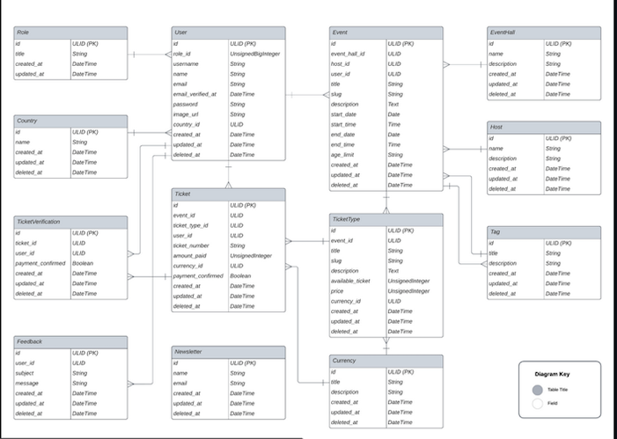
Detailed Component Diagram

Slide 8
Scalability & Performance Considerations
Horizontal Scaling: Add more replicas of databases based on requests
Caching: Use Redis or similar to improve response times.
Event-Driven Design Benefits:
Asynchronous processing reduces bottlenecks.
Push-based messaging lowers network overhead.

Slide 9
Security & Reliability
Security Practices:
Sessions for authentication.
Encryption of data in transit and at rest.
Fault Tolerance:
Automated recovery with event replay.
Testing:
Comprehensive testing strategies (unit, feature, stress testing).

Slide 10
Maintenance & Continuous Improvement
Monitoring Tools: Use of logs, metrics, and dashboards.
CI/CD Pipelines: Automated deployment and updates.
Feedback Loop: Incorporate user feedback and analytics for ongoing enhancements.

