Slide 1
Azure OpenAI Chat Web part for SharePoint Online
Paul Borisov, Cloud Architect

Slide 2
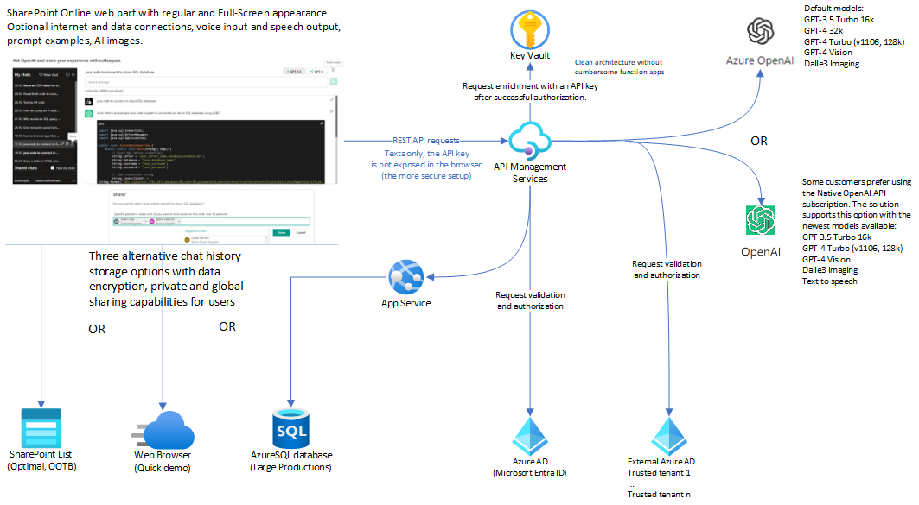
Data Access Diagram: the following slide provides details on data privacy

Slide 3
Data Privacy
Azure OpenAI is the private GDPR-compliant service developed by Microsoft and deployable to your Azure tenant. Data provided to endpoints of Azure OpenAI is kept inside the boundaries of your tenant.
Native OpenAI is a public service, which provides access to its optional API by paid subscriptions. Any data provided to endpoints of Native OpenAI goes outside the boundaries of your tenant. As of December 2023, Native OpenAI is GDPR-compliant.
Azure OpenAI Chat web part interacts with private Azure OpenAI endpoints that are published via Azure API Management service (APIM).
By default, this setup provides enhanced data privacy. In this configuration, requests to AI do not travel outside your Azure tenant.
APIM consistently validates the identities of SharePoint users for each individual request. If the request originates from authorized domains, APIM retrieves the **api-key** from the secure vault and injects it into the request before forwarding it to the AI endpoint. This process ensures that the api-key does not get exposed in the browser.
Chats are private and visible only to their creators. Creators have the option to share their chats when this feature is enabled in the web part settings (disabled by default). Creators can share their chats with everyone or only with specific people in the company.
The web part incorporates tampering prevention logic to guard against unauthorized access to another user's data by their GUID.
In addition to the default configuration, you have the option to publish the Native Open AI endpoint in APIM. You can find instructions in the project documentation.
CONS: Granting access to the Native Open AI endpoint requires a separate api-key for it and could potentially compromise data privacy, as requests might travel outside your Azure tenant under this setup.
PROS: Using the Native OpenAI endpoint could grant you access to the newly released language models that are not yet available in Azure OpenAI.

Slide 4
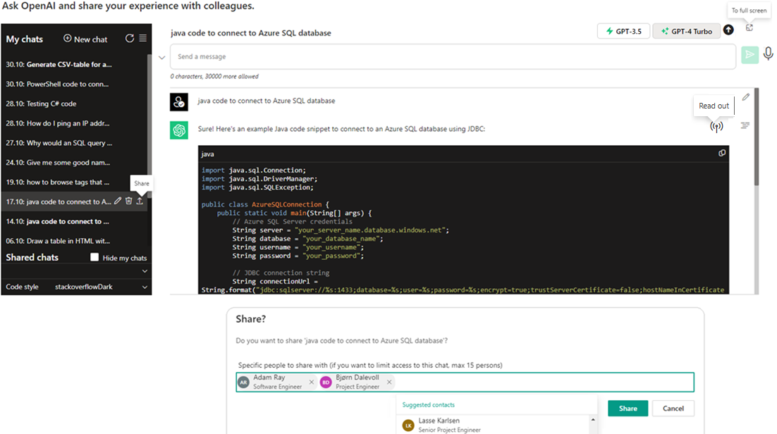
User Interface

Slide 5
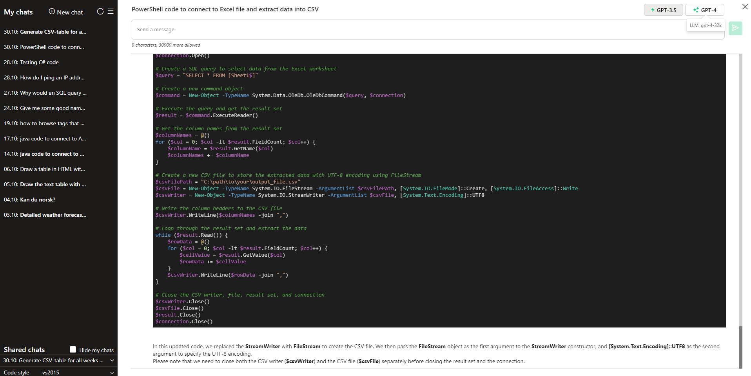
Full-Screen Mode

Slide 6
Key features
Support for the latest text language models provided by Microsoft and Native OpenAI: GPT-4 32k, GPT 3.5 16k, GPT-4 Vision, GPT-4 Turbo (1106, 128k)
Storage data encryption supported for all storage types and the sharing option
Chat Sharing: Private sharing of personal Chats for a limited number of company users and Global sharing with Everyone in the company
Support for the Full-Screen Mode. Support for Regular and Full-Width Site Page Sections
Mobile-Friendly UI with simple customizations (CSS)
Event Streaming to provide consecutive outputs of AI-responses
Code Highlighter with options to select Highlight Styles.
Upper and Lower Side positioning for the Prompt Area Textbox
Full-Scale Localizations: English, Finnish, and Norwegian
Optional integrations with company data. For security reasons, these integrations are disabled by default and must be explicitly enabled in the web part settings.
AI-Image generations with Dalle3. High-definition images available out-of-the-box
Search on the Internet with Bing and Google
SharePoint Search, which works under the current user identity and permissions
Company Users
Local Date and Time
Analysis of an uploaded PDF and summarization of its content
Analysis of uploaded images and description of their content
Voice input and examples for prompt texts
Voice input and Speech output for reading out AI-generated texts
Unlimited Chats per user and the option to support Unlimited Chat History Length

Slide 7
Advanced features
Built-in integration with API Management Service.
For customers that do not have it, the web part also supports direct queries to API with an api-key (configurable)
Default support for Azure OpenAI and Native OpenAI API
Alternative storage types to manage Chat History
SharePoint List: Supports up to 5000 Chats, Built-in “One-Click” list provisioning, Chat Privacy and Security Trimming for SharePoint Search
Azure SQL Database: Provides more advanced storage capabilities tested on 1 Million+ Chat records
Local Storage: it can be used to provide quick demo without long-time configurations

Slide 8
Optional Integrations: SharePoint Search, Company Users, Local Date & Time
How it works
The Function Calling feature is available in both Azure OpenAI and Native OpenAI (more advanced version). The flow for using this feature typically looks like:
In the process of interacting with OpenAI, you can send a request with options to call available integration functions that you have provided.
If OpenAI determines that it requires specific data, it will request to call a function with parameters that it deems suitable.
To meet OpenAI's demand, you can call the function with the proposed parameters on behalf of OpenAI. This allows you to obtain raw results locally, which you can then submit to OpenAI. You have control over what data you submit.
If OpenAI determines that it needs more information, it may demand calling another function, and this process can continue as necessary.
OpenAI handles the received data and transforms it as you have requested. The final response from OpenAI will include the results based on the processed data.
// 3 show cases available in the web part:
// Search in SharePoint for “your text“. Format the results as an HTML table.
// Get company users that have names starting with P. Format the results as an HTML table.
// Date, Time, Date and time.
export default class FunctionHelper {
private static available: { [key: string]: any } = {
companyUsers: this.companyUsers,
currentDateOrTime: this.currentDateOrTime,
currentDateAndTime: this.currentDateAndTime,
peopleSearch: this.companyUsers,
searchSharepoint: this.searchSharepoint,
};

Slide 9
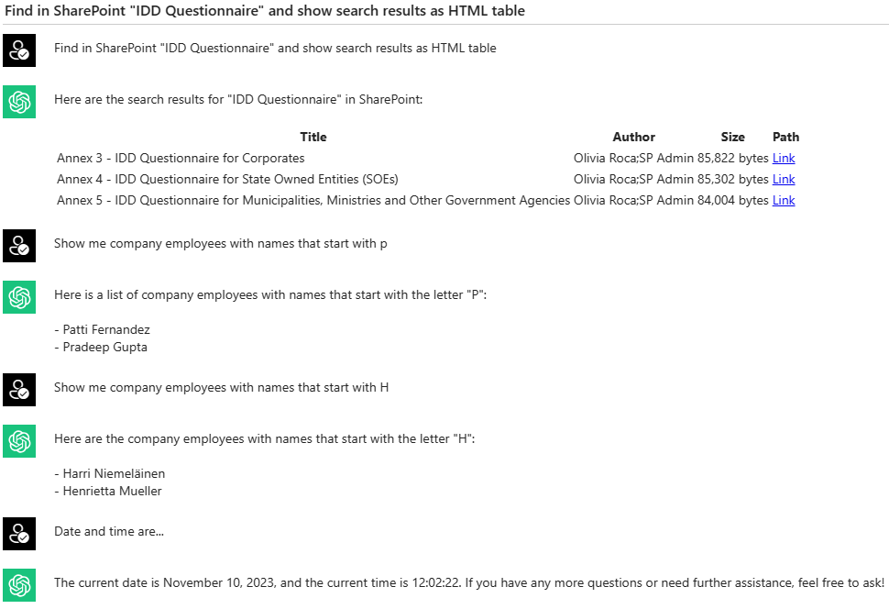
Integrations

Slide 10
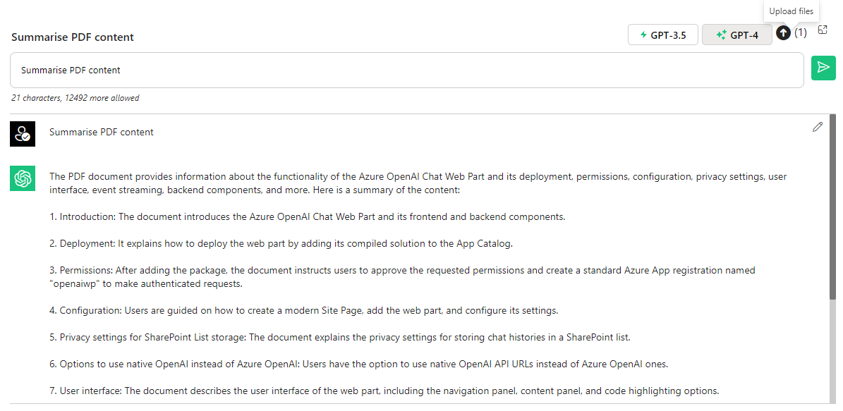
Upload and Summarize PDF content

Slide 11
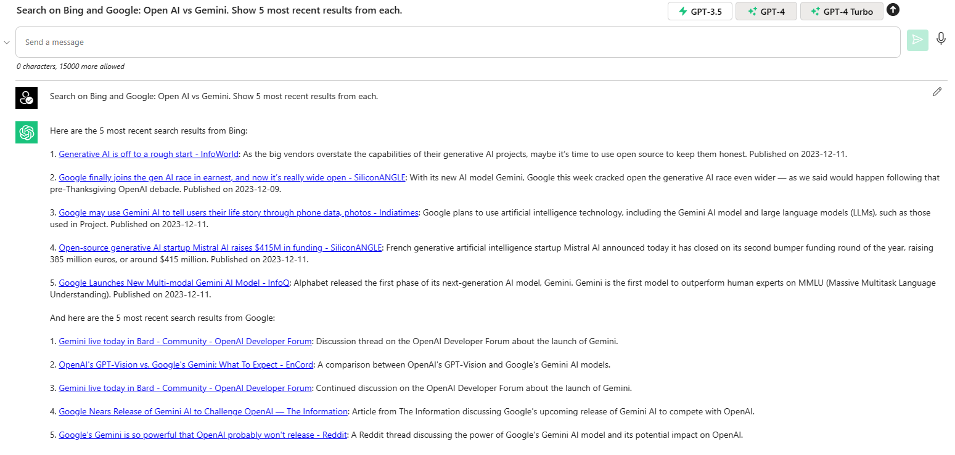
Optional integrations: Search on the Internet with the summary for Bing and Google results

Slide 12
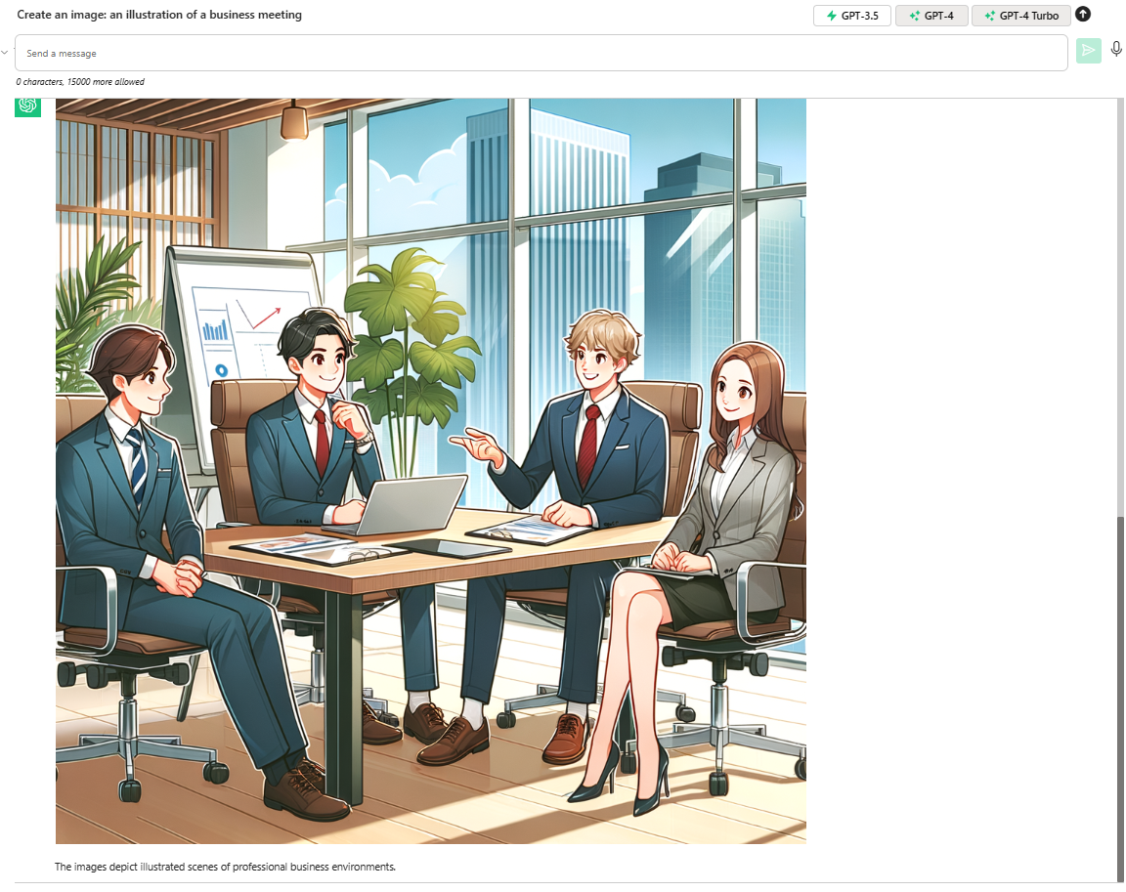
Image Generations: Dalle-3

Slide 13
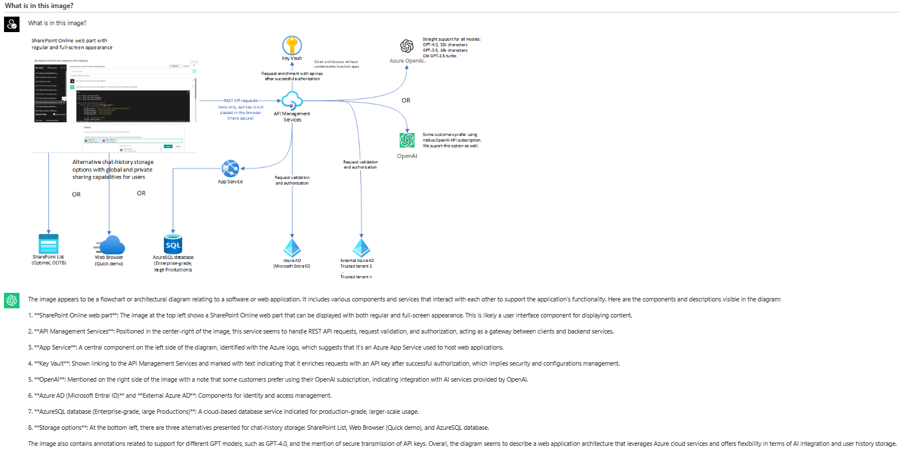
Using GPT-4 Vision for Image Analysis: a Technical Diagram

Slide 14
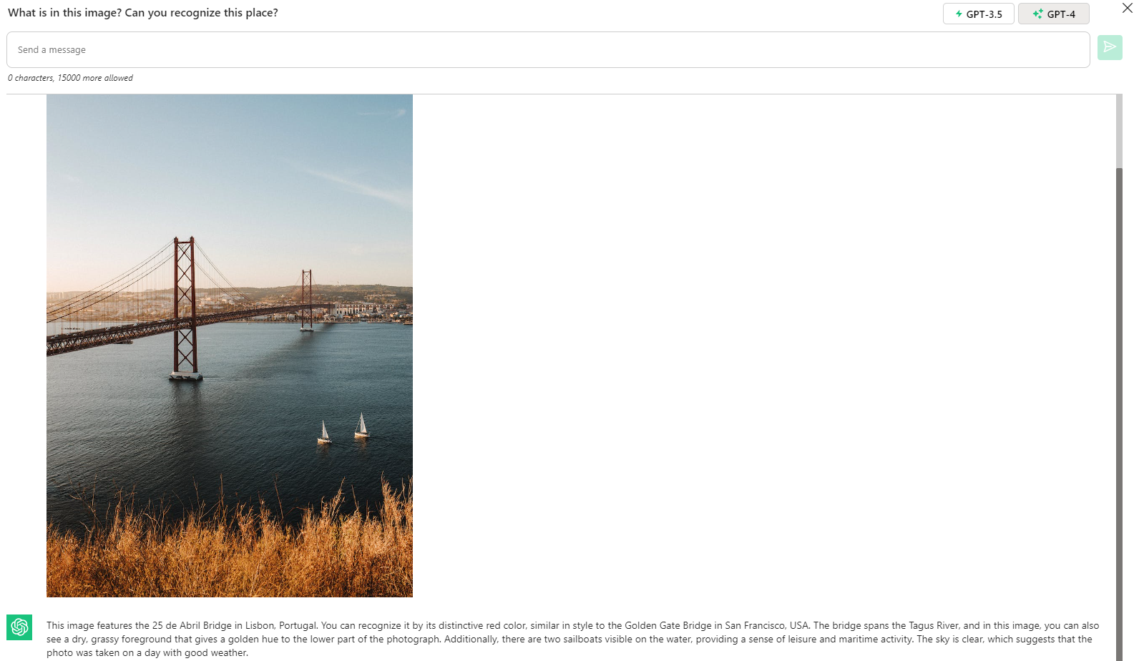
Using GPT-4 Vision for Image Analysis: a Photo

Slide 15
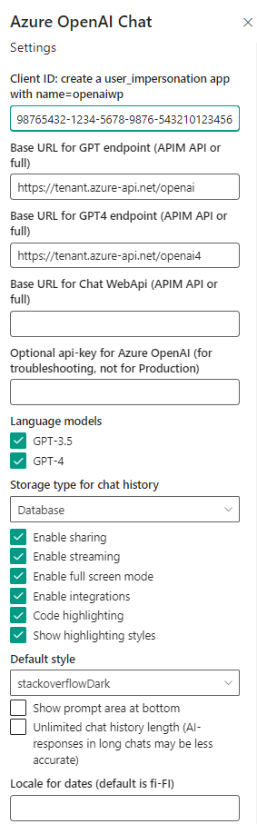
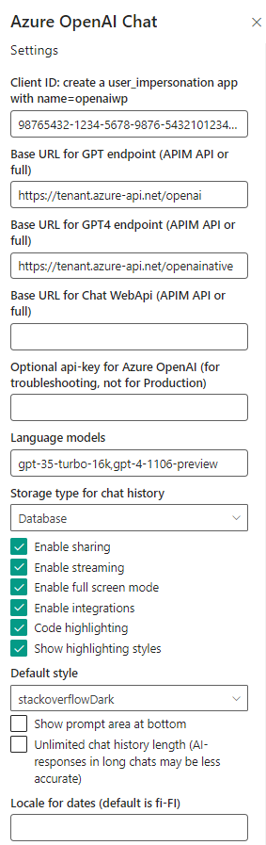
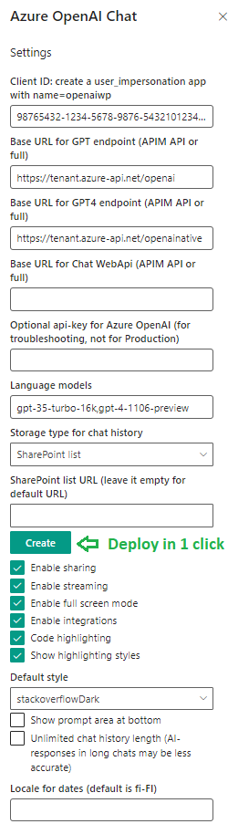

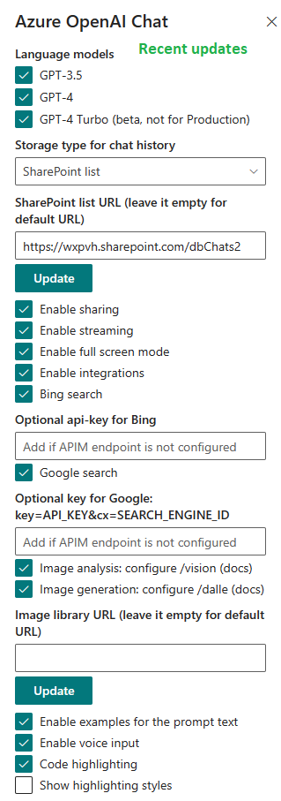
Azure OpenAI Chat web part for SharePoint Online, configurable options

