Slide 1
Gemini AI Chat Web part for SharePoint Online
Paul Borisov, Cloud Architect

Slide 2
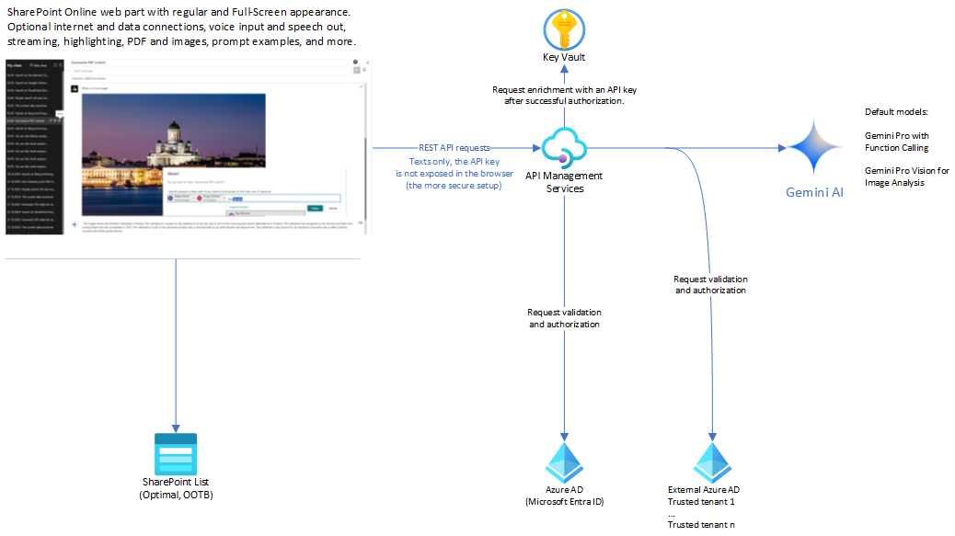
Data Access Diagram: the following slide provides details on data privacy

Slide 3
Data Privacy
Gemini AI is the latest and most capable AI model published by Google. Any data provided to endpoints of Gemini AI goes to external service locations.
As of January 2024, Gemini AI is not yet GDPR-compliant.
RESTful endpoints of Gemini AI can be accessed using a free API key generated via Google AI Studio.
Users from EU and UK locations do not have direct access to Gemini API keys. This web part provides a workaround for them.
The web part interacts with Gemini AI endpoints published via Azure API Management service instance (APIM)
APIM instance can be deployed to US zone to resolve location-based access restrictions for EU and UK customers.
APIM consistently validates identities of SharePoint users for each individual request. If the request originates from authorized domains, APIM retrieves the api-key from the secure vault and injects it into the request before forwarding it to the AI endpoint. This process ensures that the api-key does not get exposed in the browser.
Chats are private and visible only to their creators. Creators have the option to share their chats when this feature is enabled in the web part settings (disabled by default). Creators can share their chats with everyone or only with specific people in the company.
In addition to the default configuration, the web part provides the option to access to Gemini AI endpoints directly with an API key explicitly stored in the web part properties.
This setup, while the least secure, can provide a quicker start. It is not recommended for production use, but it can be used for quick tests or in situations where you do not have access to Azure API Management.
The stored key is encrypted in the web part properties and displayed as *** in the Property Pane. However, it will travel in browser requests and can be viewed within the DEV tools > Network > Request headers.
If you are in Europe or UK, you should use a VPN to connect to Gemini AI endpoints in this setup.

Slide 4
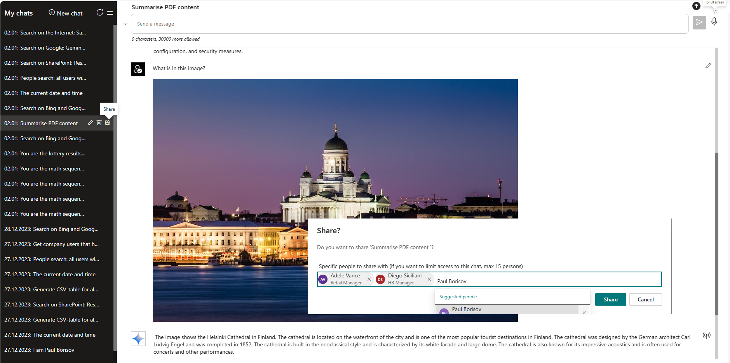
User Interface

Slide 5
Key features
Default support of Gemini Pro and Gemini Pro Vision
Chat history stored into a SharePoint Custom List with the optional data encryption (off by default)
Integration with Azure API Management Service to provide seamless access from European and UK locations.
Global and Private Chat Sharing for selected Azure AD accounts
Full-Screen Mode
Consecutive event streaming
Code Highlighting with Configurable Styles
Unlimited Length of Chat History (Configurable)
Upper and Lower side positioning for the Prompt Text Area
Analysis of an uploaded PDF and summarization of its content
Analysis of uploaded images and description of their content
Optional dropdown box with examples for prompt text.
Optional voice input to prompt text.
Optional speech synthesis to read out AI-generated texts by default. The standard Web Speech API requires selecting the preferred language; using default page language is not always optimal.
Optional data encryption for Chats data.
Configurable Formats for Dates: Default is Finnish, which can be changed to "en-US" in Web Part Settings.
Data integrations
The web part supports optional integrations with external data using the Function Calling feature of Gemini Pro.
Search on the Internet with Bing and Google
SharePoint Search, which works under the current user identity and permissions
Company Users
Local Date and Time

Slide 6
Advanced features
Built-in integration with API Management Service.
For customers that do not have it, the web part also supports direct queries to API with an api-key (configurable)
Chat History is stored into a SharePoint list with the optional data encryption
SharePoint list supports up to 5000 Chats
The web part provides built-in “One-Click” list provisioning, Chat Privacy and Security Trimming for SharePoint Search

Slide 7
Optional Integrations: SharePoint Search, Company Users, Local Date & Time
How it works
The Function Calling feature is available in Gemini AI Pro model. The flow for using this feature typically looks like:
In the process of interacting with Gemini AI, you can send a request with options to call available integration functions that you have provided.
If Gemini AI determines that it requires specific data, it will request to call a function with parameters that it deems suitable.
To meet Gemini AI's demand, you can call the function with the proposed parameters on behalf of Gemini AI. This allows you to obtain raw results locally, which you can then submit to Gemini AI. You have control over what data you submit.
If Gemini AI determines that it needs more information, it may demand calling another function, and this process can continue, as necessary.
Gemini AI handles the received data and transforms it as you have requested. The final response from OpenAI will include the results based on the processed data.
// Several show cases are available in the web part:
// Search in SharePoint for “your text“. Format the results as an HTML table.
// Get company users that have names starting with P. Format the results as an HTML table.
// Date, Time, Date and time.
export default class FunctionHelper {
private static available: { [key: string]: any } = {
companyUsers: this.companyUsers,
currentDateOrTime: this.currentDateOrTime,
currentDateAndTime: this.currentDateAndTime,
peopleSearch: this.companyUsers,
searchSharepoint: this.searchSharepoint,
searchOnInternet: this.searchOnInternet,
searchOnBing: this.searchOnInternet,
searchOnGoogle: this.searchOnGoogle,
};

Slide 8
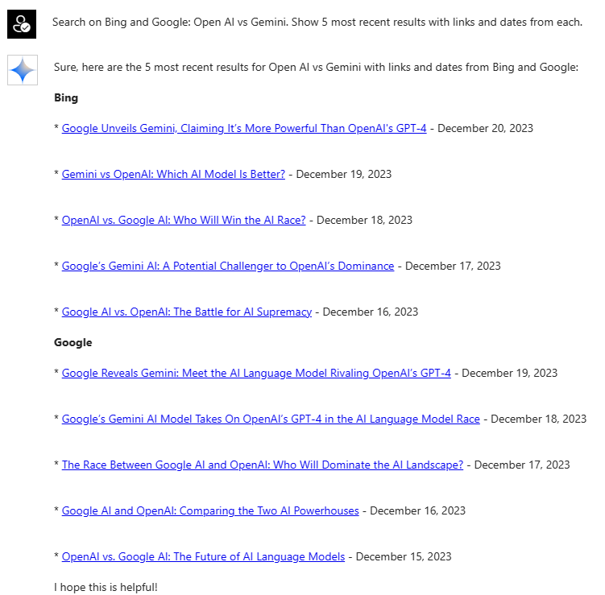
Integrations

Slide 9
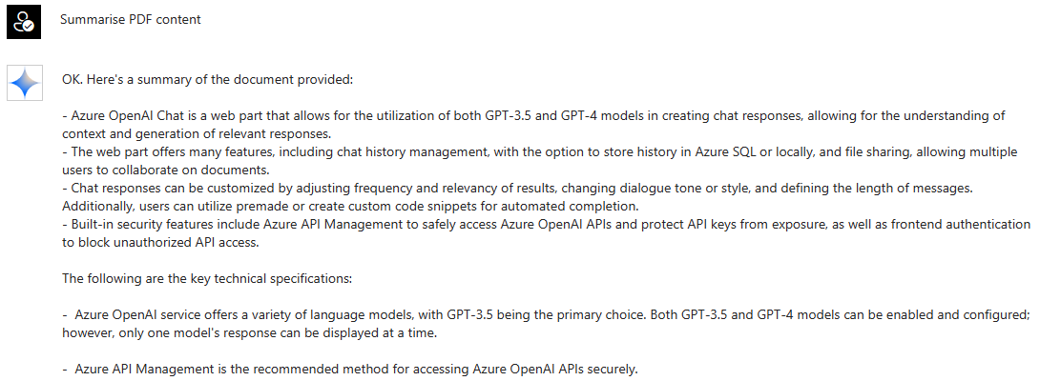
Upload and Summarize PDF content

Slide 10
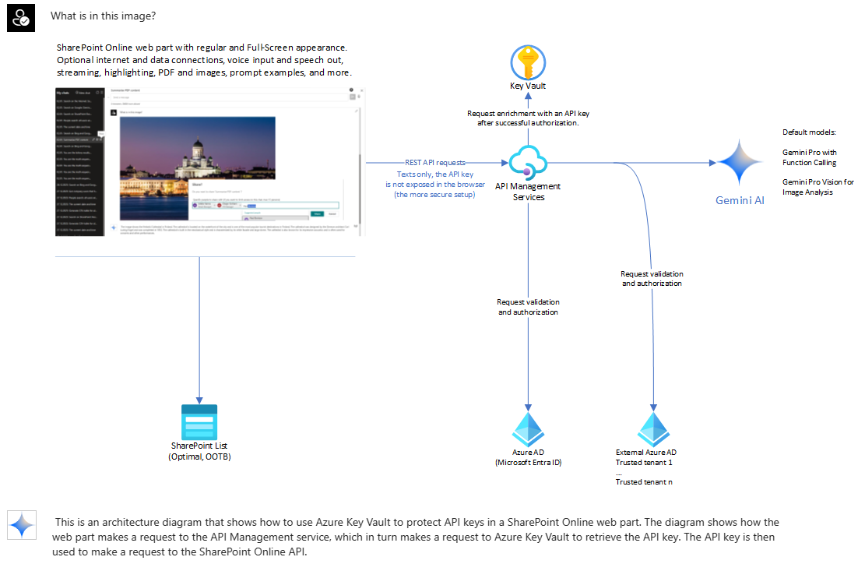
Using Gemini Pro Vision for Image Analysis: a Technical Diagram

Slide 11

Using Gemini Pro Vision for Image Analysis: a Photo

Slide 12
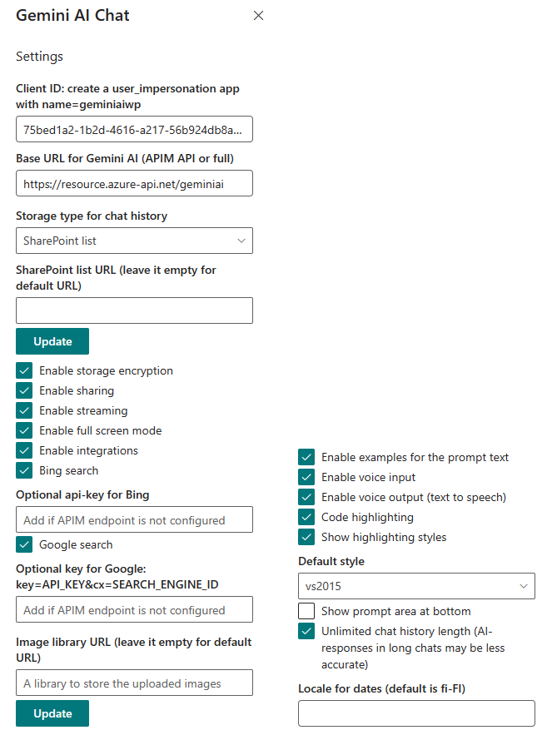
Gemini AI Chat web part for SharePoint Online, configurable options

