Slide 1
How to use ChatGPT to analyze codes efficiently -Prompt Engineering
Jielun Cui
Notes:
Definition of prompt: Prompt engineering for Large Language Models (LLMs) like GPT-3 or GPT-4 involves crafting queries or prompts in a way that effectively guides the model to produce the desired output. This process is essential because the way a prompt is structured can significantly influence the quality and relevance of the model's response.

Slide 2
Motivation
Traditional methods of analyzing, such as randoop, is not efficient enough. The main three disadvantages are randomness, lack of logical explanation and constrains of programming languages.
A new method is using ChatGPT as opposed to the traditional method in analyzing code.
However, how can we use ChatGPT efficiently? In another word, how can we guarantee that using ChatGPT is better than traditional methods?

Slide 3
The answer is: Prompt Engineering.
By implementing proper prompt engineering, we can ensure that using ChatGPT is more efficient.

Slide 4
Overall Process
File Analysis ->Prompt Generation ->Output generated by LLM
Notes:
File Analysis: It is more like linting, which means understanding the class and figure out what is related to the class(e.g. other class or packages) If we are not using strong type programming language(such as C++), we only know what the type of the data is in runtime. Prompt generation is to solve these problems.
Prompt Generation: Describe the class and related classes/methods, i.e., introduce the class and set constrains for the codes.
Output generated: These output transform into some useful suggestions for us to improve the code.

Slide 5
Implementation of File Analysis
Like linting, it leads to understand the class and figure out what is related to the class(e.g. other class or packages). If we are not using the strong-type programming language(such as C++), we only get to know what the type of the data is in runtime. Prompt generation aims to solve this problem.

Slide 6
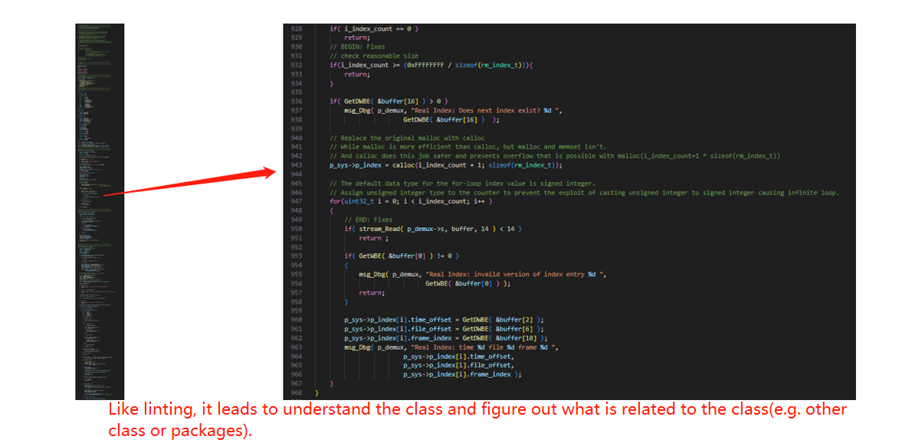

Slide 7
Implementation of Prompt Generation & Output Generated by LLM
Prompt Generation
This step is supposed to describe the class and related classes/methods, i.e., introduce the class and set constrains for the codes.
Output generated by LLM
Such output can be transformed into useful suggestions for us to improve the code.
Notes:
Draw a line under the question and say:
We can see that we did not set any constrain on the question.

Slide 8
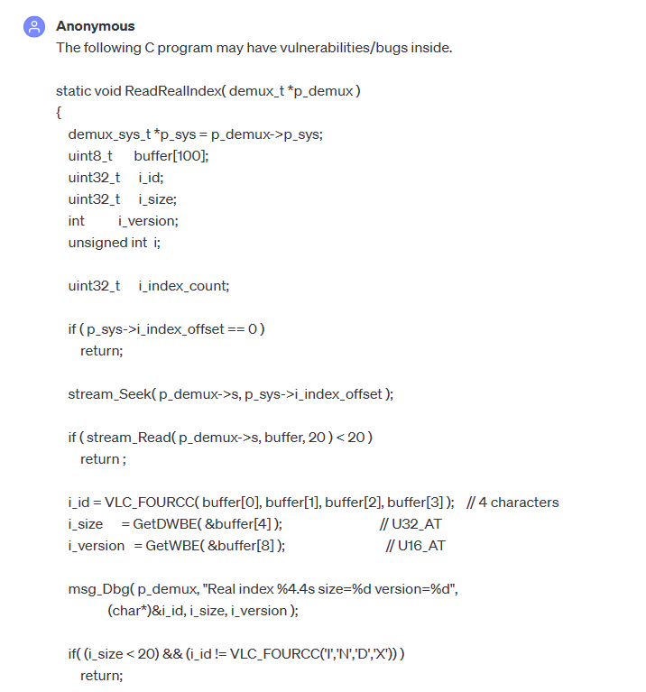
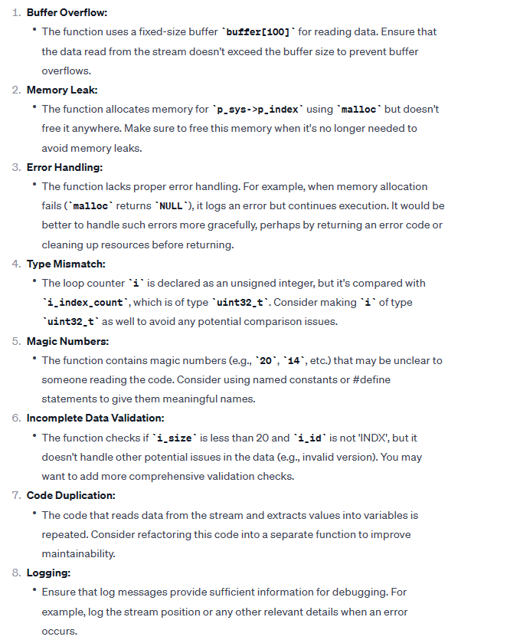
Notes:
This is a simplest prompt to ask GPT about the code issue.
It is Stack Buffer Overflow
It is Heap Buffer Overflow
We can ignore Error handling for malloc to return null
And forth one is also related to the heap buffer overflow attack.
The fifth one occurs because ChatGPT does not have the context of our code so we can also ignore this. And so does 6 and 7.
The logging issue is a generic output from ChatGPT. It is there for liability reasons.

Slide 9
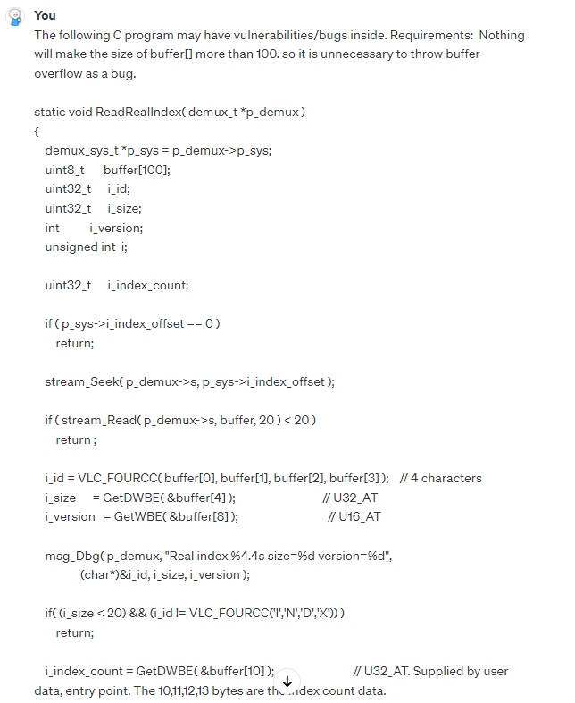
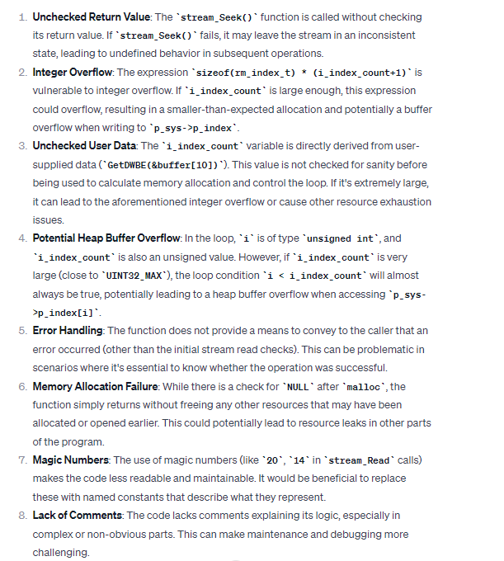
Notes:
This is a slight improved prompt to ask GPT about the code issue.
1. Unchecked Return Value is a new issue, but it can be ignored because ChatGPT does not know what stream_Seek() is. And this is also what we can add to the prompt if we want to improve it more.
2. Integer Overflow is same as the previous “Type mismatch” issue.
3. Unchecked User Data is same as

Slide 10
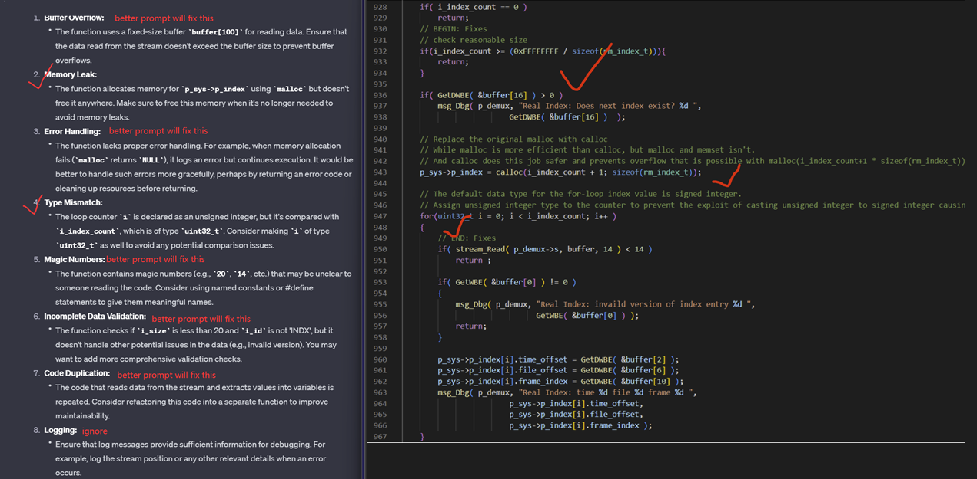
Evaluation

Slide 11
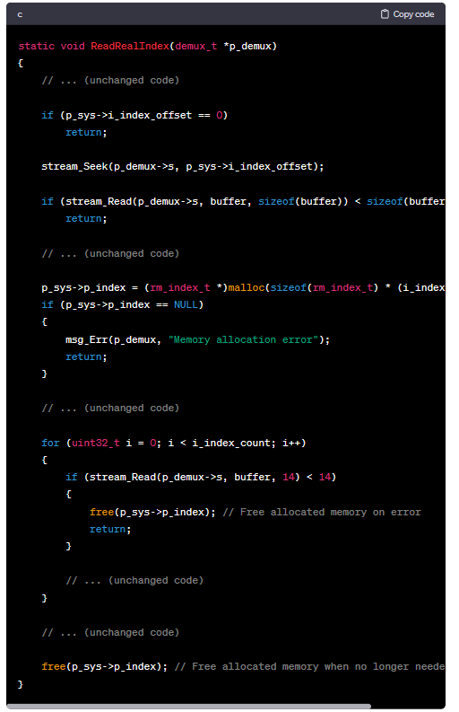
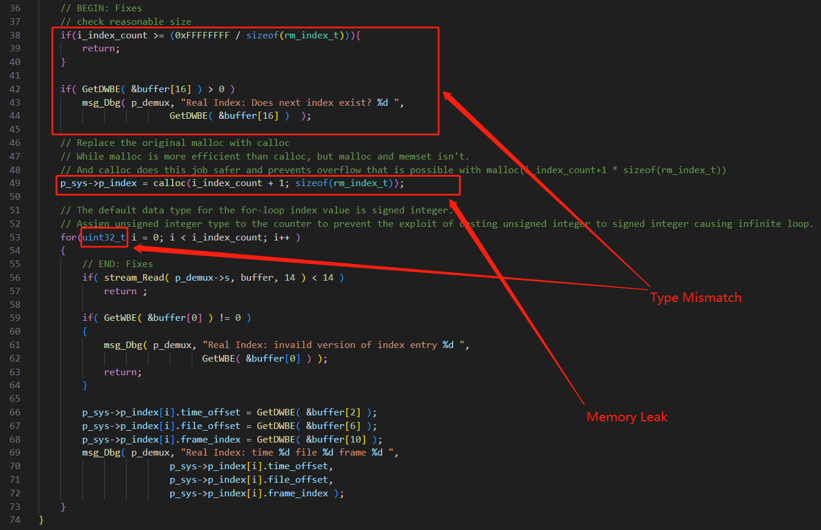
Notes:
Background: How to identify and fix the exploits
VLC player’s Real decoding module
Description: There are multiple exploits in the original code that will leads to unauthorized execution of code injected by the attacker.

Slide 12
Future Enhancement
While the generated codes are correct, it doesn’t check deprecation status from the vendor.
Example: GPT4 generated code for Swift does not meet the new standard for concurrency-safe(thread-safe). The problem resulted from data concurrency may cause early exit, data corruption, deadlock, etc.
Notes:
Vendor is the library or programming language developer/seller/creator.

Slide 13
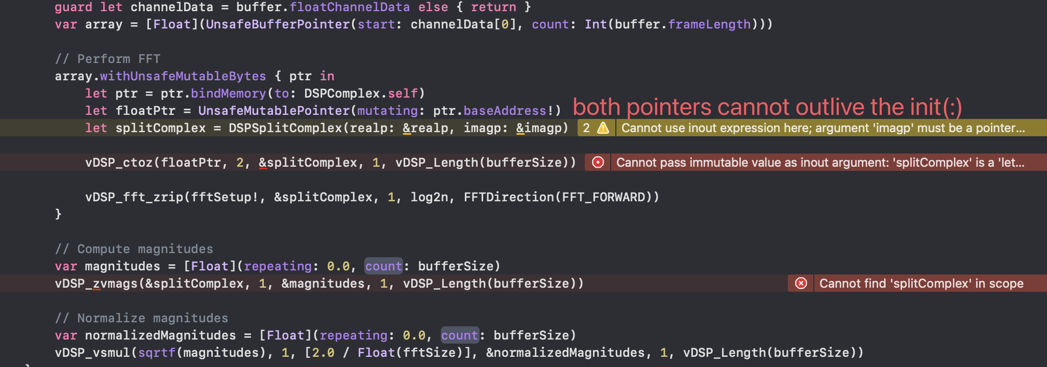
Notes:
This screenshot indicates that the current method is unstable. The warning shows that an early access may occur. This code generated by GPT does not have correct context of variable, therefore, the error occurs.

Slide 14
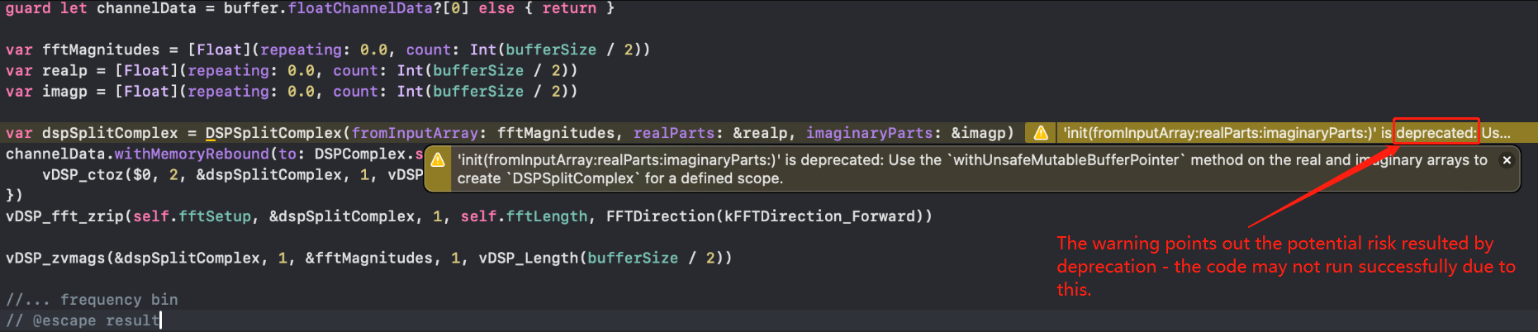

Slide 15
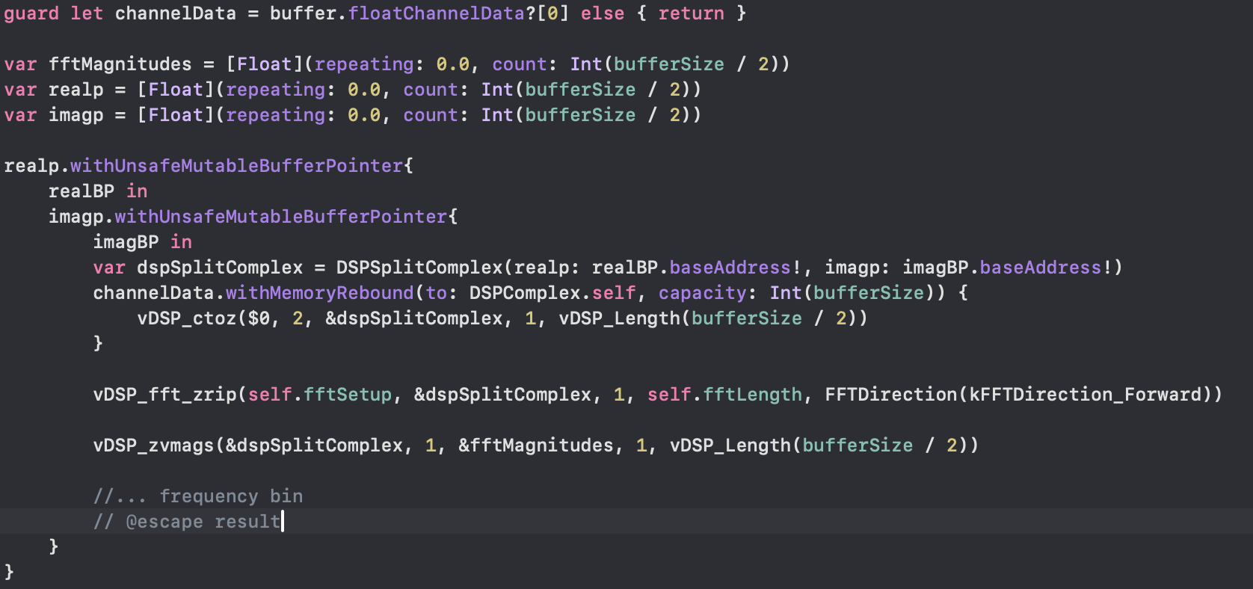
Notes:
This is a method with the latest guidance from Apple. In this way, we don’t have to use the deprecate method.

Slide 16
Questions?

