Slide 1
Using LLM to analyze code
Jielun Cui

Slide 2
Introduction & Motivation
Introduction:
Motivation:
Traditional methods of analyzing, such as randoop, is not efficient enough. The main three disadvantages are randomness, lack of logical explanation and constrains of programming languages.

Slide 3
Implementation

Slide 5
Evaluation

Slide 6
Future Enhancement
While the generated codes are correct, it doesn’t check deprecation status from the vendor.
Example: GPT4 generated code for Swift doesn’t meet the new standard for concurrency-safe(thread-safe). The problem resulted from data concurrency may cause early exit, data corruption, deadlock, ...

Slide 7
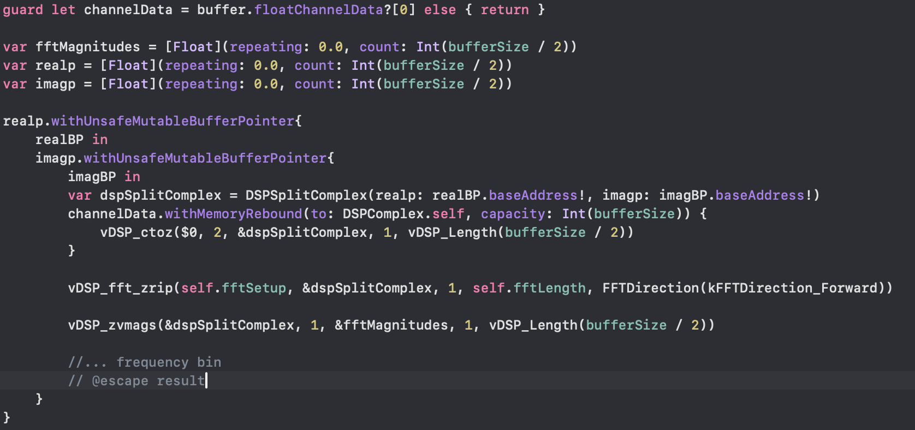

Slide 8
Questions?

