Slide 1
Projecte 2 Part 3 ETIQUETATGE
Intel·ligència Artificial
Kristian Stoyanov Belkin, Paul Daniel Pop i Raúl Jiménez ayza
NIU: 1667799, 1607129 i 1688916

Slide 2
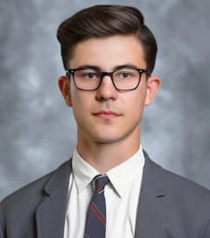
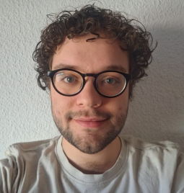
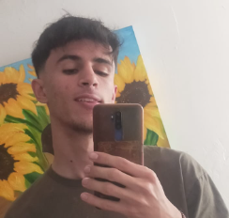
OUR TEAM
Kristian
Paul
Raul

Slide 3
CONTENTS OF THIS TEMPLATE
Here’s what you’ll find in this Slidesgo template:
A slide structure based on a business presentation, which you can easily adapt to your needs. For more info on how to edit the template, please visit Slidesgo School or read our FAQs.
To view this template with the correct fonts in ppt format, download and install on your computer the fonts that we have used. You can learn how to download and install fonts here.
An assortment of graphic resources that are suitable for use in the presentation can be found in the alternative resources slide.
A thanks slide, which you must keep so that proper credits for our design are given.
A resources slide, where you’ll find links to all the elements used in the template.
Instructions for use.
Final slides with:
The fonts and colors used in the template.
A selection of illustrations. You can also customize and animate them as you wish with the online editor. Visit Storyset to find more.
More infographic resources, whose size and color can be edited.
Sets of customizable icons of the following themes: general, business, avatar, creative process, education, help & support, medical, nature, performing arts, SEO & marketing, and teamwork.
You can delete this slide when you’re done editing the presentation.

Slide 4
TABLE OF CONTENTS
01.
02.
03.
BUSINESS OVERVIEW
Market Analysis and Competition
Sales and Marketing Plan
04.
05.
06.
Management
Plan
Operating
Plan
Financial
Plan
Here you could describe the topic of the section
Here you could describe the topic of the section
Here you could describe the topic of the section
Here you could describe the topic of the section
Here you could describe the topic of the section
Here you could describe the topic of the section

Slide 5
MISSION STATEMENT
Do you know what helps you make your point clear?
Lists like this one:
They’re simple
You can organize your ideas clearly
You’ll never forget to buy milk!
And the most important thing: the audience won’t miss the point of your presentation

Slide 6
01.
BUSINESS OVERVIEW
You can enter a subtitle here if you need it

Slide 7
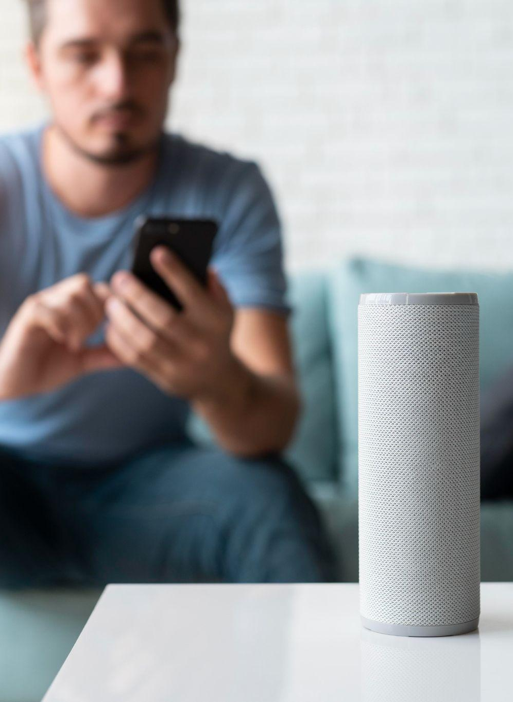
OUR COMPANY
You can give a brief description of the topic you want to talk about here. For example, if you want to talk about Mercury, you can say that it’s the smallest planet in the entire Solar System

Slide 8
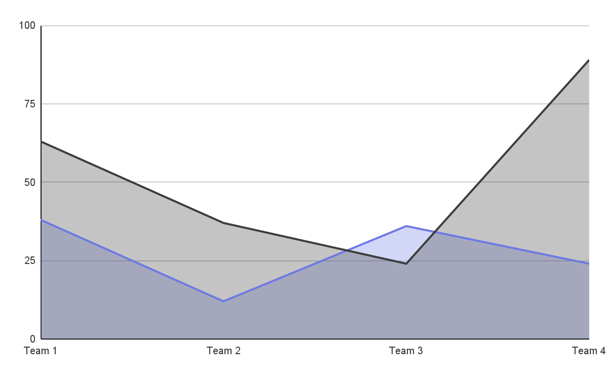
MARKET TRENDS
Periode 1
Mercury is the closest planet to the Sun
Periode 2
Venus is the second planet from the Sun
Follow the link in the graph to modify its data and then paste the new one here. For more info, click here

Slide 9
COMPETITORS
MERCURY
VENUS
MARS
It’s the closest planet to the Sun and the smallest in the Solar System
Venus has a beautiful name and is the second planet from the Sun
Despite being red, Mars is actually a cold place. It’s full of iron oxide dust

Slide 10
PROBLEM VS. SOLUTION
Mercury is the closest planet to the Sun and the smallest one in the Solar System—it’s only a bit larger than the Moon
problem
Venus has a beautiful name and is the second planet from the Sun. It’s hot and has a poisonous atmosphere
solution

Slide 11


THEM
US
Mercury is the closest planet to the Sun and the smallest one in the Solar System—it’s only a bit larger than the Moon
Venus has a beautiful name and is the second planet from the Sun. It’s hot and has a poisonous atmosphere

Slide 12
02.
MARKET ANALYSIS AND COMPETITION
You can enter a subtitle here if you need it

Slide 13
TARGET
65%
35%
€1,500/year
Gender
AVERAGE SPEND
+60
mercury
+50
jupiter
+40
venus
AGE
PROFESSION

Slide 14
Market size
VENUS
Venus is the second planet from the Sun
MERCURY
It’s the closest planet to the Sun

Slide 15
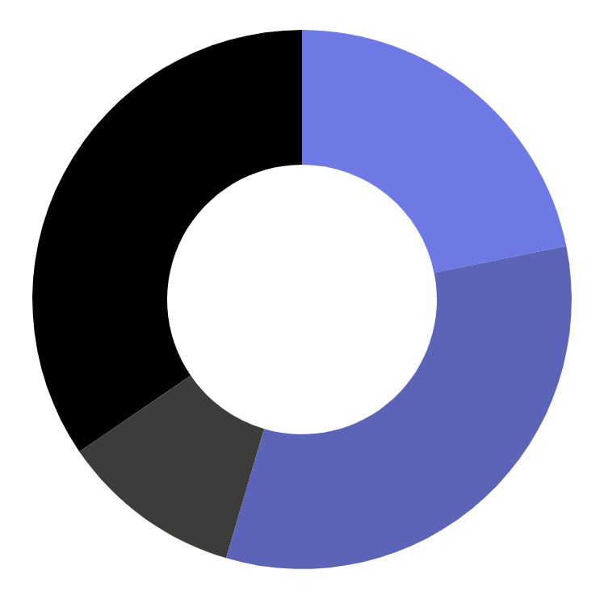
MARKET SHARE
24%
Mercury is the closest planet to the Sun
36%
Venus is the second planet from the Sun
12%
Mars is actually a very cold place
38%
Jupiter is the biggest planet of them all
Follow the link in the graph to modify its data and then paste the new one here. For more info, click here

Slide 16
COMPETITION ANALYSIS
 | COMPANY 1 | COMPANY 2 | COMPANY 3 | COMPANY 4
JUPITER
SATURN
NEPTUNE

Slide 17
03.
SALES AND MARKETING PLAN
You can enter a subtitle here if you need it

Slide 18
OUR SERVICES
mercury
venus
mars
jupiter
saturn
neptune
Mercury is the closest planet to the Sun
Venus has a beautiful name, but it’s terribly hot
Despite being red, Mars is a cold place, not hot
It’s the biggest planet in the Solar System
Saturn is the ringed planet and a gas giant
It’s the farthest planet from the Sun

Slide 19
BREAK-EVEN ANALYSIS
LOSS
PROFIT
Jupiter is the biggest planet of them all
Venus is the second planet from the Sun
BIG LOSS
BREAK-EVEN POINT
HIGH PROFIT
Mercury is the closest planet to the Sun
Mars is actually a very cold place
Earth is the beautiful planet we live on

Slide 20
AWESOME WORDS

Slide 21
OUR PLANS
BASIC
PRO
PREMIUM
€35
€50
€85
Mercury is the closest planet to the Sun and the smallest one
Saturn is a gas giant, composed mostly of hydrogen and helium
Jupiter is a gas giant and the biggest planet in the Solar System

Slide 22
SALES AND DISTRIBUTION
CHANNEL 1
CHANNEL 2
CHANNEL 4
CHANNEL 3
Venus is the second planet from the Sun
Despite being red, Mars is a cold place
Jupiter is the biggest planet in the Solar System
Saturn is a gas giant and has several rings

Slide 23
ADVERTISING AND PROMOTION
MERCURY
VENUS
MARS
Mercury is the closest planet to the Sun
Venus has a beautiful name, but it’s terribly hot
Despite being red, Mars is a cold place, not hot

Slide 24
04.
MANAGEMENT PLAN
You can enter a subtitle here if you need it

Slide 25
ORGANIZATIONAL CHART
CEO
TEAM 1
TEAM 2
employee
employee
employee
employee

Slide 26
OUR PARTNERS
PARTNER 1
Mercury is the closest planet to the Sun
PARTNER 2
Venus is the second planet from the Sun
PARTNER 3
Mars is actually a very cold place
PARTNER 4
Jupiter is the biggest planet of them all

Slide 27
05.
OPERATING PLAN
You can enter a subtitle here if you need it

Slide 28
OUR PROCESS
DAY 1
DAY 3
DAY 5
Earth is the planet we all live on
Despite being red, Mars is a cold place
Saturn is a gas giant and has several rings
DAY 2
DAY 4
Venus is the second planet from the Sun
Jupiter is the biggest planet of them all

Slide 29
06.
FINANCIAL PLAN
You can enter a subtitle here if you need it

Slide 30
—SOMEONE FAMOUS
“This is a quote, words full of wisdom that someone important said and can make the reader get inspired.”

Slide 31
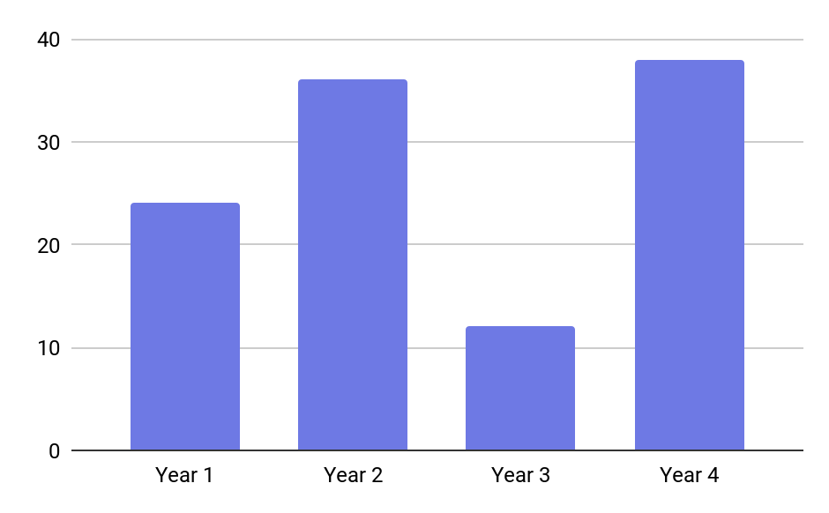
Conclusion
MERCURY
It’s the closest planet to the Sun and the smallest one in the Solar System. This planet's name has nothing to do with the liquid metal, since Mercury was named after the Roman messenger god
Follow the link in the graph to modify its data and then paste the new one here. For more info, click here

Slide 32
The end
THANKS

