Slide 1
Proyecto 2 Parte 3 Etiquetado
Inteligencia artificial
Kristian Stoyanov Belkin, Paul Daniel Pop i Raúl Jiménez ayza
NIU: 1667799, 1607129 i 1688916

Slide 2



Nuestro equipo
Kristian
Paul
Raul

Slide 3
Tabla de Contenido
01.
02.
03.
Introducción
Analisis cualitativo
Analisis cuantitativo
04.
05.
Mejoras
Conclusión
Breve intro de la práctica
Funciones cualitativas
Funciones cuantitativas
Mejoras realizadas
Nuestras conclusiones

Slide 4
01.
Introducción
Proyecto 2 – Etiquetado

Slide 5
Objetivos Proyecto 2
Proyecto 2
Kmeans
KNN
Etiquetado automatico
Clasificación de color
Clasificación de tipo

Slide 6
02.
Análisis cualitativo
Proyecto 2 – Etiquetado

Slide 7
03.
Análisis cuantitativo
Proyecto 2 – Etiquetado

Slide 8
04.
Mejoras
Proyecto 2 – Etiquetado

Slide 9
05.
Conclusión
Proyecto 2 – Etiquetado

Slide 10
FINAL
GRACIAS!

Slide 11


THEM
US
Mercury is the closest planet to the Sun and the smallest one in the Solar System—it’s only a bit larger than the Moon
Venus has a beautiful name and is the second planet from the Sun. It’s hot and has a poisonous atmosphere

Slide 12
TARGET
65%
35%
€1,500/year
Gender
AVERAGE SPEND
+60
mercury
+50
jupiter
+40
venus
AGE
PROFESSION

Slide 13
Market size
VENUS
Venus is the second planet from the Sun
MERCURY
It’s the closest planet to the Sun

Slide 14
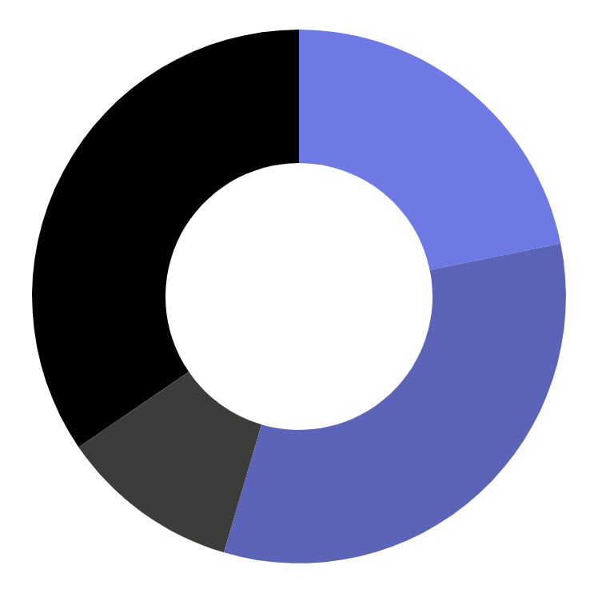
MARKET SHARE
24%
Mercury is the closest planet to the Sun
36%
Venus is the second planet from the Sun
12%
Mars is actually a very cold place
38%
Jupiter is the biggest planet of them all
Follow the link in the graph to modify its data and then paste the new one here. For more info, click here

Slide 15
COMPETITION ANALYSIS
 | COMPANY 1 | COMPANY 2 | COMPANY 3 | COMPANY 4
JUPITER
SATURN
NEPTUNE

Slide 16
OUR SERVICES
mercury
venus
mars
jupiter
saturn
neptune
Mercury is the closest planet to the Sun
Venus has a beautiful name, but it’s terribly hot
Despite being red, Mars is a cold place, not hot
It’s the biggest planet in the Solar System
Saturn is the ringed planet and a gas giant
It’s the farthest planet from the Sun

Slide 17
BREAK-EVEN ANALYSIS
LOSS
PROFIT
Jupiter is the biggest planet of them all
Venus is the second planet from the Sun
BIG LOSS
BREAK-EVEN POINT
HIGH PROFIT
Mercury is the closest planet to the Sun
Mars is actually a very cold place
Earth is the beautiful planet we live on

Slide 18
AWESOME WORDS

Slide 19
OUR PLANS
BASIC
PRO
PREMIUM
€35
€50
€85
Mercury is the closest planet to the Sun and the smallest one
Saturn is a gas giant, composed mostly of hydrogen and helium
Jupiter is a gas giant and the biggest planet in the Solar System

Slide 20
SALES AND DISTRIBUTION
CHANNEL 1
CHANNEL 2
CHANNEL 4
CHANNEL 3
Venus is the second planet from the Sun
Despite being red, Mars is a cold place
Jupiter is the biggest planet in the Solar System
Saturn is a gas giant and has several rings

Slide 21
ADVERTISING AND PROMOTION
MERCURY
VENUS
MARS
Mercury is the closest planet to the Sun
Venus has a beautiful name, but it’s terribly hot
Despite being red, Mars is a cold place, not hot

Slide 22
ORGANIZATIONAL CHART
CEO
TEAM 1
TEAM 2
employee
employee
employee
employee

Slide 23
OUR PARTNERS
PARTNER 1
Mercury is the closest planet to the Sun
PARTNER 2
Venus is the second planet from the Sun
PARTNER 3
Mars is actually a very cold place
PARTNER 4
Jupiter is the biggest planet of them all

Slide 24
OUR PROCESS
DAY 1
DAY 3
DAY 5
Earth is the planet we all live on
Despite being red, Mars is a cold place
Saturn is a gas giant and has several rings
DAY 2
DAY 4
Venus is the second planet from the Sun
Jupiter is the biggest planet of them all

Slide 25
—SOMEONE FAMOUS
“This is a quote, words full of wisdom that someone important said and can make the reader get inspired.”

Slide 26
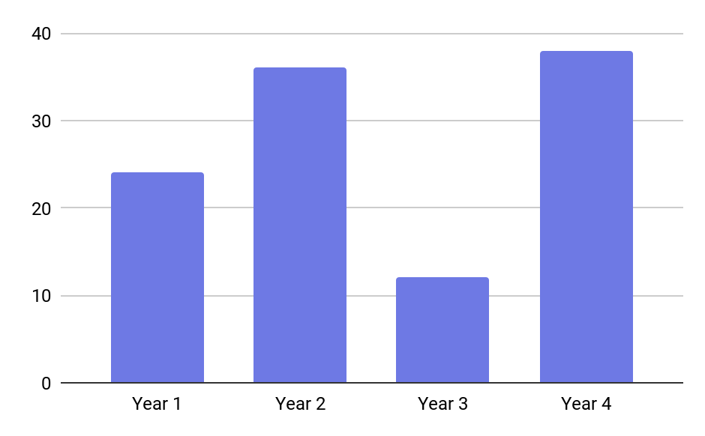
Conclusion
MERCURY
It’s the closest planet to the Sun and the smallest one in the Solar System. This planet's name has nothing to do with the liquid metal, since Mercury was named after the Roman messenger god
Follow the link in the graph to modify its data and then paste the new one here. For more info, click here

