Slide 1
Proyecto 2 Parte 3 Etiquetado
Inteligencia artificial
Kristian Stoyanov Belkin, Paul Daniel Pop i Raúl Jiménez ayza
NIU: 1667799, 1607129 i 1688916

Slide 2



Nuestro equipo
Kristian
Paul
Raul

Slide 3
Tabla de Contenido
01.
02.
03.
Introducción
Analisis cualitativo
Analisis cuantitativo
04.
05.
Mejoras
Conclusión
Breve intro de la práctica
Funciones cualitativas
Funciones cuantitativas
Mejoras realizadas
Nuestras conclusiones

Slide 4
01.
Introducción
Proyecto 2 – Etiquetado

Slide 5
Objetivos Proyecto 2
Proyecto 2
Kmeans
KNN
Etiquetado automatico
Clasificación de color
Clasificación de tipo

Slide 6
02.
Análisis cualitativo
Proyecto 2 – Etiquetado

Slide 7
Funciones Cualitativas
Retrieval_by_color
Retrieval_by_shape
Retrieval_combined
Busca por color especifico
Busca por forma especifica
Busca por la combinación de color y forma

Slide 8
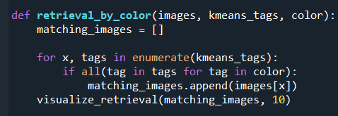
Retrieval_by_color
MERCURY
It’s the closest planet to the Sun and the smallest one in the Solar System. This planet's name has nothing to do with the liquid metal, since Mercury was named after the Roman messenger god
Follow the link in the graph to modify its data and then paste the new one here. For more info, click here

Slide 9
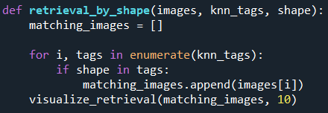
Retrieval_by_shape
MERCURY
It’s the closest planet to the Sun and the smallest one in the Solar System. This planet's name has nothing to do with the liquid metal, since Mercury was named after the Roman messenger god
Follow the link in the graph to modify its data and then paste the new one here. For more info, click here

Slide 10
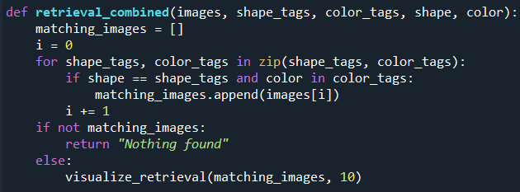
Retrieval_combined
MERCURY
It’s the closest planet to the Sun and the smallest one in the Solar System. This planet's name has nothing to do with the liquid metal, since Mercury was named after the Roman messenger god
PROVISIONAL

Slide 11
03.
Análisis cuantitativo
Proyecto 2 – Etiquetado

Slide 12
Kmean_statistics
Get_shape_accuracy
Genera estadísticas de kmeans
Valida los labels obtenidos de KNN

Slide 13
04.
Mejoras
Proyecto 2 – Etiquetado

Slide 14
Mejoras
Kmeans ++
Coeficiente de fisher
Find_BestK

Slide 15
05.
Conclusión
Proyecto 2 – Etiquetado

Slide 16
FINAL
GRACIAS!

Slide 17


THEM
US
Mercury is the closest planet to the Sun and the smallest one in the Solar System—it’s only a bit larger than the Moon
Venus has a beautiful name and is the second planet from the Sun. It’s hot and has a poisonous atmosphere

Slide 18
TARGET
65%
35%
€1,500/year
Gender
AVERAGE SPEND
+60
mercury
+50
jupiter
+40
venus
AGE
PROFESSION

Slide 19
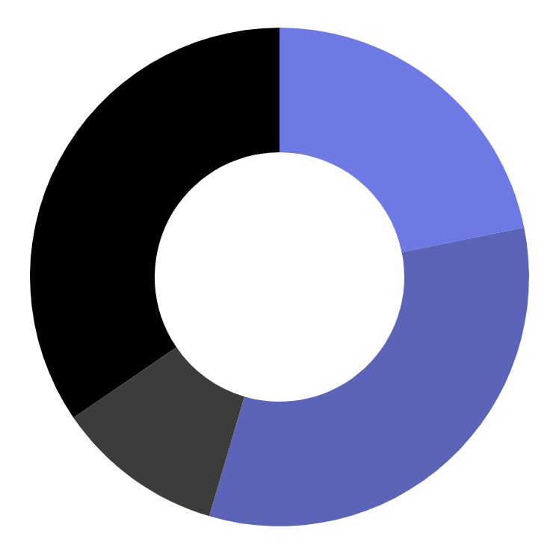
MARKET SHARE
24%
Mercury is the closest planet to the Sun
36%
Venus is the second planet from the Sun
12%
Mars is actually a very cold place
38%
Jupiter is the biggest planet of them all
Follow the link in the graph to modify its data and then paste the new one here. For more info, click here

Slide 20
COMPETITION ANALYSIS
 | COMPANY 1 | COMPANY 2 | COMPANY 3 | COMPANY 4
JUPITER
SATURN
NEPTUNE

Slide 21
SALES AND DISTRIBUTION
CHANNEL 1
CHANNEL 2
CHANNEL 4
CHANNEL 3
Venus is the second planet from the Sun
Despite being red, Mars is a cold place
Jupiter is the biggest planet in the Solar System
Saturn is a gas giant and has several rings

Slide 22
ADVERTISING AND PROMOTION
MERCURY
VENUS
MARS
Mercury is the closest planet to the Sun
Venus has a beautiful name, but it’s terribly hot
Despite being red, Mars is a cold place, not hot

Slide 23
ORGANIZATIONAL CHART
CEO
TEAM 1
TEAM 2
employee
employee
employee
employee

Slide 24
OUR PARTNERS
PARTNER 1
Mercury is the closest planet to the Sun
PARTNER 2
Venus is the second planet from the Sun
PARTNER 3
Mars is actually a very cold place
PARTNER 4
Jupiter is the biggest planet of them all

Slide 25
OUR PROCESS
DAY 1
DAY 3
DAY 5
Earth is the planet we all live on
Despite being red, Mars is a cold place
Saturn is a gas giant and has several rings
DAY 2
DAY 4
Venus is the second planet from the Sun
Jupiter is the biggest planet of them all

Slide 26
—SOMEONE FAMOUS
“This is a quote, words full of wisdom that someone important said and can make the reader get inspired.”

