Slide 1
VODKA
BY: PAUL LOPEZ. DA.
ANALYSIS OF THE VODKA LIQUOR INDUSTRY.
IOWA LIQUOR SALES DB

Slide 2
SCENARIO.
Brought in as an Analyst skimming through and organizing sales data for a financial status end of quarter.
Alongside helping the industry/company bring in more sales and what to improve and optimize for the next year/quarter.

Slide 3
SUMMARY.
WHAT DO WE SELL?
VODKA.
TOTAL REVENUE SALES LAST QUARTER:
$22,173,171
STORES SELLING OUR PRODUCT:
1,000.

Slide 4
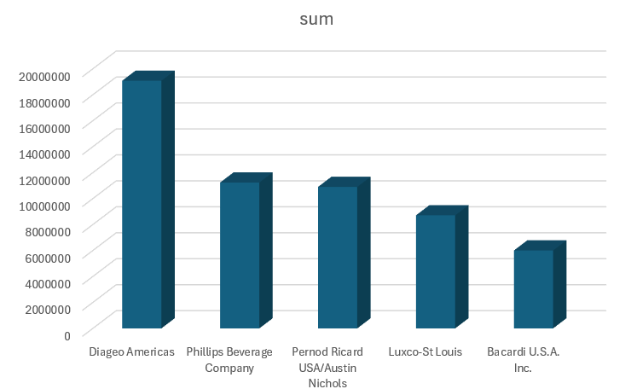
STRENGTH 1: TOP 5 HIGHEST SALE COMPANIES.

Slide 5
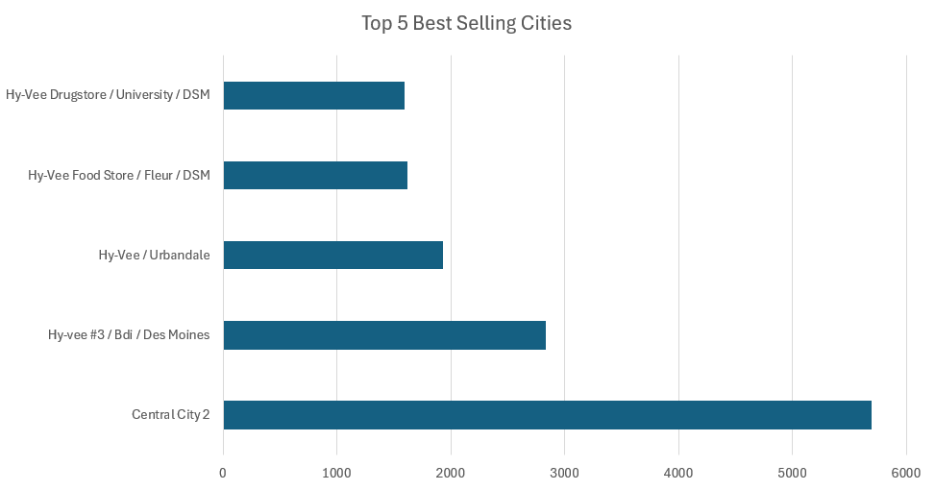
STRENGTH 2: BEST SELLING STORES.

Slide 6
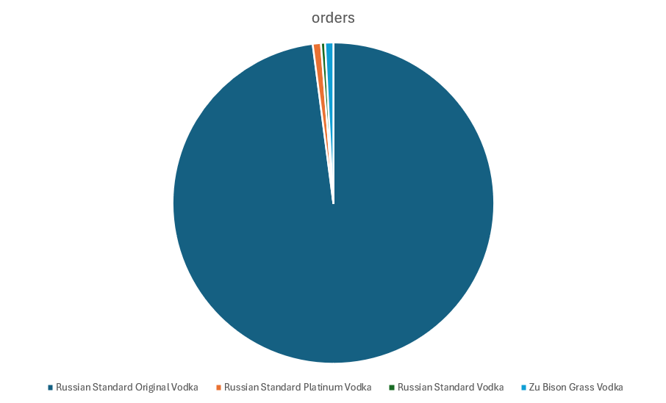
WEAKNESS 1: LACK OF INTEREST
"Russian Standard Original Vodka“ – 476 Units
"Russian Standard Platinum Vodka“ – 4 units
"Russian Standard Vodka“ – 2 units
"Zu Bison Grass Vodka“ – 4 Units

Slide 7
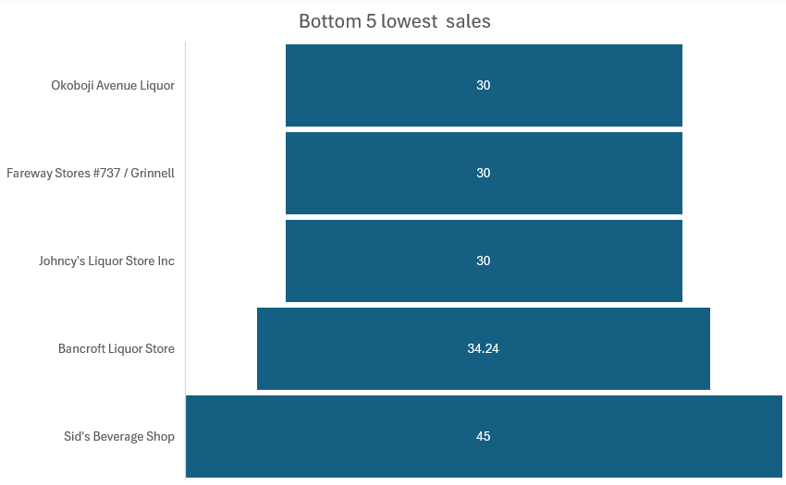
WEAKNESS 2: BOTTOM 5 LOWEST SELLING STORES.

Slide 8
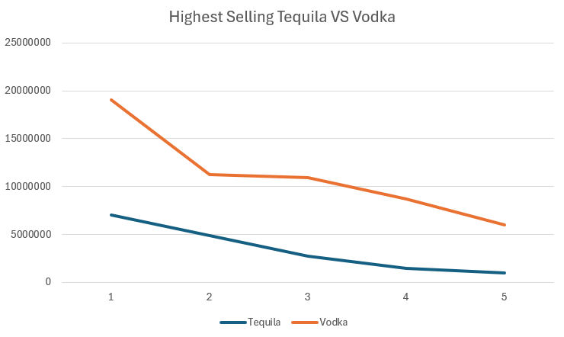
OPPORTUNITY 1: HIGHEST SALES OF VODKA VS TEQUILA

Slide 9
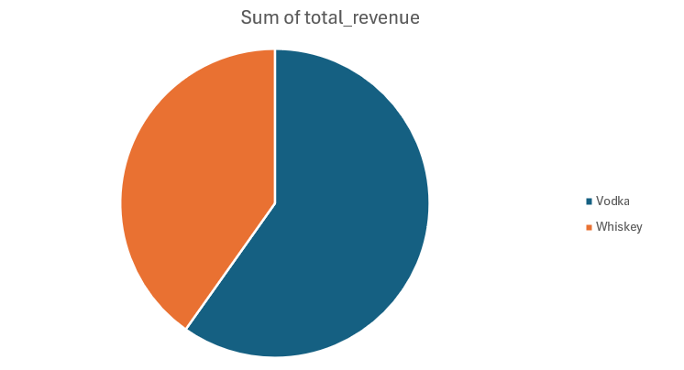
OPPORTUNITY 2: TOTAL REVENUE VS WHISKEY

Slide 10
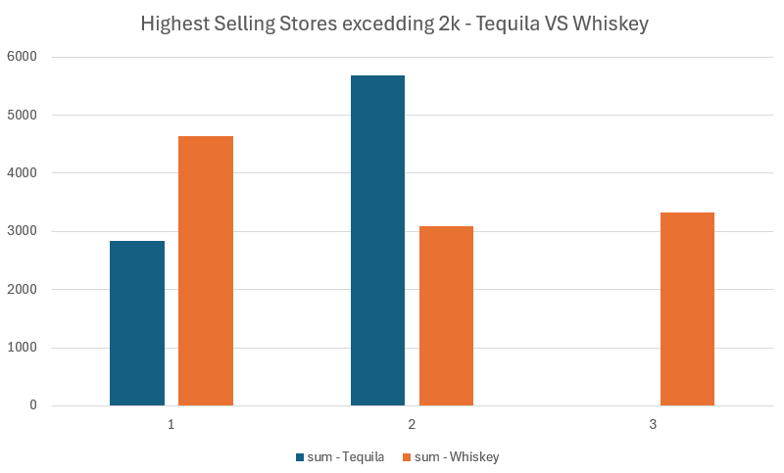
THREAT 1: TEQUILA VS WHISKEY SALES PER 2K UNITS

Slide 11
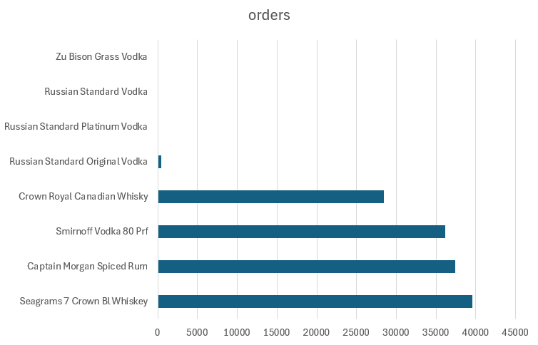
THREAT 2: SPECIFIC ITEM SALES; VODKA VS COMPETITORS.

Slide 12
SUMMARY
STRENGTH:
Our leading companies are selling in the millions threshold, while our stores are also selling in the tens of thousands. Continue current plans.
WEAKNESS:
Low interest in our “premium” product-line with single digit sales, alongside our lowest store sales going on double digits. Discontinue the single digit selling lines and prepare to liquate our lowest selling stores in case of emergency.
OPPORTUNITY:
We are selling more than our competitors by a significant margin and gap, with more advertising and push for our products we can hike over their sales by a significant margin.
THREAT:
Our “Premium” products are sorely lacking behind our competitors premium products, While we may be selling more at the moment if our competitors introduce more brands or products they can easily surpass our profit with the volume of products they sell.

