Slide 1

WEB PROJECT
CREATION OF A PROFESSIONAL WEBSITE FOR THE STUDENT OFFICE OF THE CESI ENGINEERING SCHOOL
UNDER THE SUPERVISION OF:
TSEFFO GHISLAIN : Tuteur X2025

Slide 2
TEAM PROJECT
2
TOUKAM SONIA RYKIEL
ABDULRAHAMAN FARIS
FRONT-END DEVELLOPER
FRONT-END DEVELLOPER
NGANKAM PAAUL-HENRY
NOUMEN DARRYL
BACK-END DEVELLOPER
BACK-END
DEVELLOPER

Slide 3
SUMMARY
3
05
04
STEP
03
STEP
02
STEP
01
STEP
STEP
PROJECT PRESENTATION
WORK DONE
INDIVIDUAL CONCLUSION
PROJECT MANAGEMENT
DEMO

Slide 4
4
PROJECT PRESENTATION

Slide 5
5
CONTEXT
Nowadays, the conception of dynamic, responsive and ergonomic websites is more and more appreciated and claimed by users. Actually, it is in this context that the BDE of the CESI Engineering School asked for a group of qualified computer engineers to design a website which will facilitate the organization and communication of manifestations within the school and suggest to members some giveaways.
01

Slide 6
02
GOALS
The main goal is create a web site that :
aid the planification and the announcement of the school events
allow students to get accessed to the BDE online shop
6

Slide 7
03
CONSTRAINTS
This project must address the following issues :
Presence of a REST API : accessibility to the database by the other sites
Use of modern technologies : personalized, stylish and functional website design
Data Centralization : existence of a common database to all the CESI centres
Forms and REST API Security : Forms queries must be validated through PHP functionalities and the API protected by an authentication mechanism (tokens)
Legal mentions Presence : inform users about cookies purpose and general conditions of sale
7

Slide 8








04
8
SOFTWARE RESSOURCES
FOR PROJECT MANAGEMENT
FOR TECHNICAL WORK
FOR WEB DESIGN

Slide 9
9
PROJECT MANAGEMENT

Slide 10
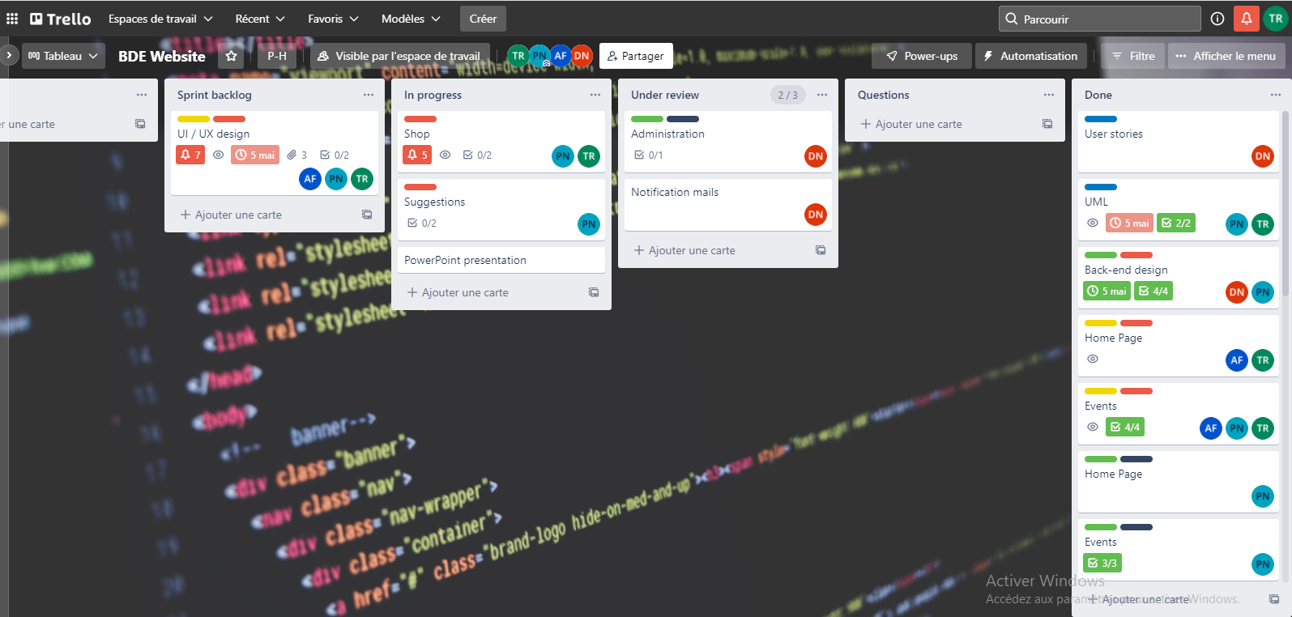
01
10
TRELLO : METHODE AGILE

Slide 11
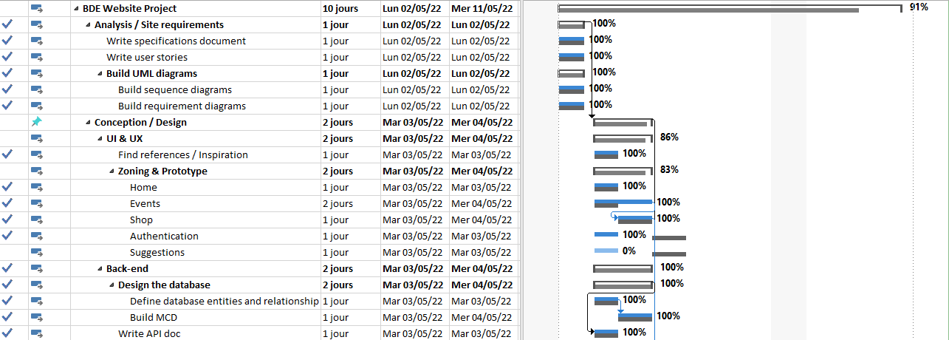
01
MS PROJECT : provisional planning
11

Slide 12
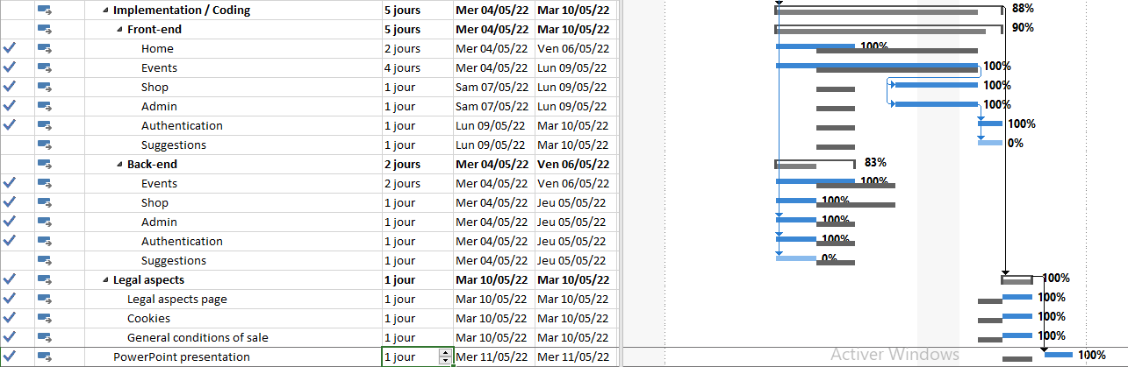
01
MS PROJECT : real planning
12

Slide 13
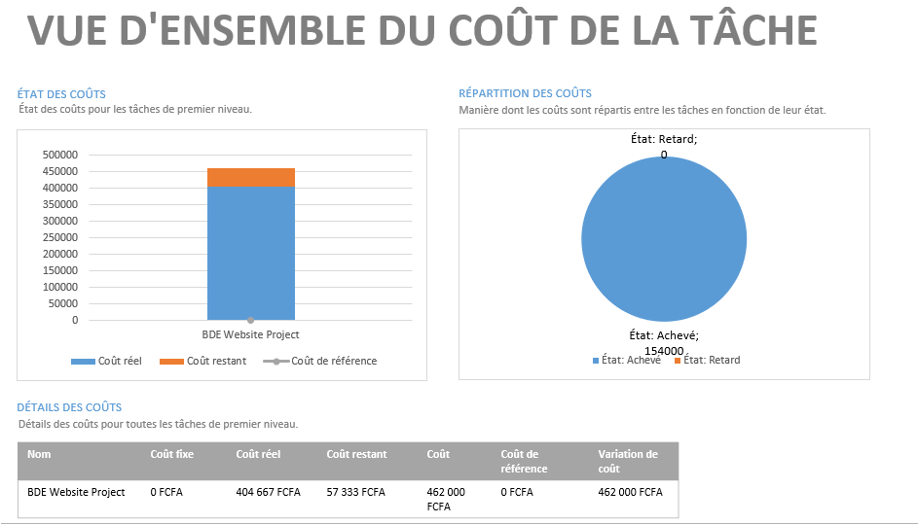
13
BUBDGET

Slide 14
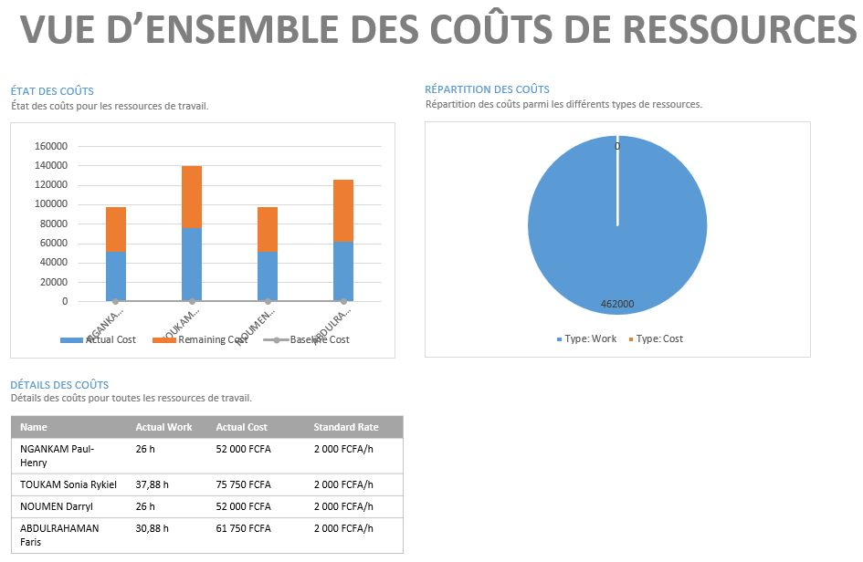
13
BUBDGET

Slide 15
14
WORK DONE

Slide 16

15
UML DIAGRAMS :
SEQUENCE DIAGRAMS
REQUIREMENT DIAGRAMS

Slide 17

16
FRONT-END : WEB-DESIGN
ZONING + FIGMA

Slide 18

17
FRONT-END : CODING
LANGUAGES
HTML/CSS
JAVASCRIPT.
FRAMEWORK
LARAVEL BLADE
BOOTSTRAP
JQWERY

Slide 19
18
BACK-END : CODING
DESIGN OF DATABASE
WEB SERVICE REST
LARAVEL
LARAVEL BREEZE (AUTHENTIFICATION)
LARAVEL VOYAGER (ADMINISTRATOR PAGE)

Slide 20
19
COMMERCIAL ADVANTAGES OF OUR WEBSITE
01
WEB DESIGN : USE OF GRAPHIC CHARTER
02
RESPONSIVE DESIGN
03
PAYPAL PAYMENT
04
ADMINISTRATOR PAGE AND NOTIFACTIONS BY MAIL
05
BEST USERS EXPERIENCE ( LIKE , COMMENT , READ OTHER COMMENTS)

Slide 21
20
DEMO

Slide 22
INDIVIDUAL ASSESSMENTS
04
21
NGANKAM PAUL-HENRY
03
ABDULRAHAMAN
FARIS
02
NOUMEN DARRYL
TOUKAM SONIA RYKIEL
01

Slide 23
22
THANK
YOU

