Slide 1
MY GAME
PAUL MARTE
COMPREHENSIVE DEVELOPMENT PROJECT

Slide 2
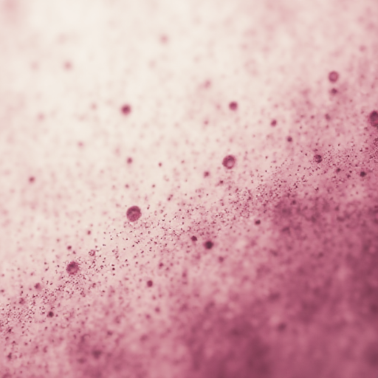
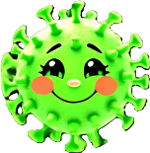
MEET XYRUS
YOUR FRIENDLY VIRUS

Slide 3
GAME CONCEPT
In Xyrus, Your Friendly Virus, players take control of Xyrus, a lovable and misunderstood virus with a noble mission: to spread infection in a good way and protect the body from harmful invaders. Using strategic movement, infection abilities, and teleportation mechanics, players must outsmart relentless white blood cells and infect the whole area.

Slide 4
GENRE
Top-down Tactical Arcade
Action-puzzle game.
TARGET AUDIENCE
Casual gamers who enjoy challenging yet approachable strategic gameplay.
Gamers involved in the medical field or bioscience.
Suitable for ages 10+ due to simple controls and a friendly aesthetic.

Slide 5
NOTABLE FEATURES
Infect areas to spread immunity while limiting Xyrus's movement.
Use a teleportation slime to escape danger and outmaneuver enemies.
Dynamic, increasing difficulty with additional white blood cells and may be environmental hazards.

Slide 6
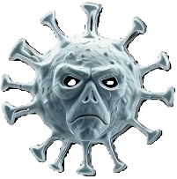
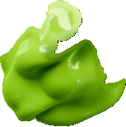

ENTITIES IN THE GAME
XYRUS
WHITE BLOOD CELL
INFECTED AREA
TELEPORTATION
SLIME

Slide 7
ENTITIES IN THE GAME
XYRUS
Friendly and approachable with a bright color scheme.

Slide 8
ENTITIES IN THE GAME
WHITE BLOOD CELL
Anxious-looking and constantly moving

Slide 9
ENTITIES IN THE GAME
TELEPORTATION SLIME
A glowing, slimy projectile.

Slide 10
ENTITIES INVOLVED IN THE GAME
INFECTED AREA
Green slimy to signify immunity

Slide 11
GAME PLAY
Xyrus, the player-controlled virus
Xyrus spawns at the center of the screen.
Movement: Use W, A, S, D for directional movement.
Boundaries: Xyrus cannot leave the screen's walls.

Slide 12
CORE GAME PLAY MECHANICS
Infection Ability
Press Spacebar to infect the current position.
Infected areas are immune to white blood cells and prevents viruses to enter.
Challenge: Xyrus cannot move back into infected areas, limiting mobility.

Slide 13
CORE GAME PLAY MECHANICS
Teleportation Mechanic
Left-click to launch a teleportation slime toward the mouse pointer.
Press R to teleport Xyrus to the slime’s current position.
Only one slime can exist at a time.
If the slime exits the screen before R is pressed, it is destroyed.

Slide 14
ENEMY
Entity
White Blood Cells (WBCs)
Role
Aggressive defenders of the body.
Challenge:
Collision with Xyrus results in instant defeat.

Slide 15
ENEMY
Behavior
Start with one white blood cell on the screen.
Gradually spawn more (up to 7 or predefined quantity).
Move randomly in horizontal, vertical, or diagonal directions.
Bounce off walls and cannot detect infected areas or the teleportation slime.

Slide 16
GAME FLOW PREVIEW

Slide 17
START GAME

Slide 24
ZIRUS NEEDS TO DODGE WBC
OR ELSE HE DIES

Slide 29
IF ‘SPACE BAR’ KEY
IS PRESSED
AND ZIRUS MOVES

Slide 30
PREVIOUS POSITION
IS INFECTED

Slide 31
WBC SPAWN
RANDOMLY.
UP TO 7 WBC

Slide 33
‘SPACE BAR’ KEY
IS PRESSED AGAIN

Slide 34
INFECTED

Slide 40
WBC CAN NOT DO ANYTHING
TO THE INFECTED AREA
HIS HOPELESS

Slide 42
IF MOUSE LEFT CLICK HERE

Slide 43
ZIRUS SPITS A
TELEPORTATION SLIME TOWARDS
THIS POSITION

Slide 46
IF ‘R’ KEY IS PRESSED
WHILE A SLIME IS ON PLAY

Slide 47
ZIRUS TELEPORTS
TO THE POSITION
OF THE SLIME
FROM HERE

Slide 48
INSTANCE WHERE THE
TELEPORTATION SLIME
IS USEFUL

Slide 49
ZIRUS CAN NOT MOVE
TO THE INFECTED AREA

Slide 50
NEED TO USE THE
TELEPORTATION SLIME
STRATEGICALLY

Slide 55
WBC BOUNCE
WHEN COLLIDE WITH
EACH OTHER

Slide 58
PRESS ‘R’ TO TELEPORT
AND SCAPE

Slide 59
TELEPORTED
FROM HERE

Slide 60
PREVIEW OF
XYRUS COMPLETED
HIS MISSION

Slide 62
OPTIONAL FEATURES
Medical Capsules/Tablets
Appear periodically and move horizontally or vertically.
Clear infections upon collision with infected areas.
Hazard: Contact with Xyrus results in defeat.

Slide 63
WHY IT STAND OUT
Flips the traditional "virus as a villain" narrative by making the virus a heroic character.
Combines strategy and quick reflexes for engaging and dynamic gameplay.
Simple mechanics that are easy to learn but challenging to master.

Slide 64
UNIQE SELLING POINT
Innovative Gameplay Mechanics:
Infecting areas for immunity, adding a strategic layer to movement.
Teleportation slime mechanic
Fresh Narrative: Presents a "friendly virus" as the protagonist, subverting traditional roles.
Family-Friendly Appeal: Bright visuals and an approachable concept make it suitable for a wide audience.

Slide 65
ALWAYS REMEMBER
DON’T JUDGE A BOOK
BY ITS COVER
All images generated for this presentation
were created using DeepAI (https://deepai.org).

Slide 66
THANK YOU

