Slide 1

Renewable energy generation development in France
Final Project –
Data Analytics Bootcamp
Paul MELIN
FEB 11th | PARIS
DAFT NOV21

Slide 2
Agenda
01
02
03
04
Business problem presentation
Data cleaning and EDA
Subject introduction and dataset overview
Data process approach stages explanation
Clustering and time series
Visualization and conclusion
Energy growth prediction
Results analysis and conclusion

Slide 3
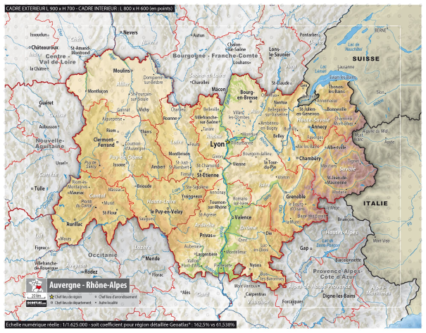

Business problem presentation
Project goal : understand the development and the growth of green electricity production in France over the last few years and forecasts trends for the future.
Because of my computer performance, I decided to focus on one region: Auvergne-Rhone-Alpes. Why this region ? Because, it has a very diverse geographic types which able a broad energy mix that will be interesting to analyse.
Dataset : I collected my dataset from Enedis, the company in charge of the electricity distribution network in France. Enedis makes its data available in open source and I was able to collect the data by filtering on the desired information.
Raw information about my dataset : 50k rows gathering the different types of renewable energy production by city in the region from 2011 to 2020. For my analysis, I decided to focus on the 4 main types of green production: photovoltaic, wind, hydraulic (dams, …) and Bio energy (biomass or geothermal)

Slide 4



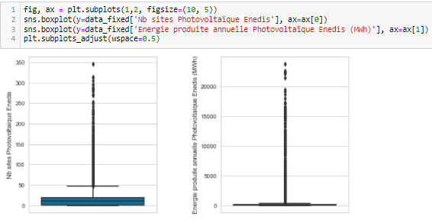
Data cleaning and EDA
Raw inputs of my General Cleaning :
many missing values as each city doesn’t have all types of production / drop columns with too many missing values
For each type of production, I kept 1. Sites number and 2. Electricity production per year (in MWh)
Change format of Year to datime (YYYY > YYYY-MM-DD)
Split centroid column to obtain Latitude and Longitude that will be useful later to visualize results
Rename some values counted twice because capitalized
Set Year as Index
Produce some EDA to understand better the distribution of data

Slide 5
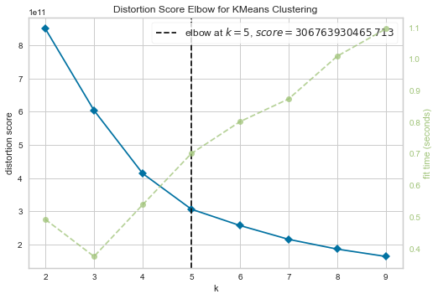
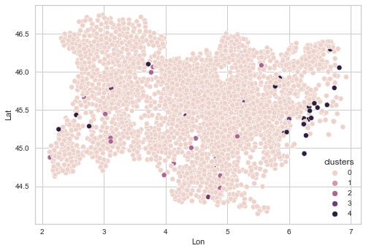
Unsupervised learning : Clustering
Elbow for Kmeans Clustering :
K = 5
Silhouette score = 0.93
Cluster by type of production

Slide 6
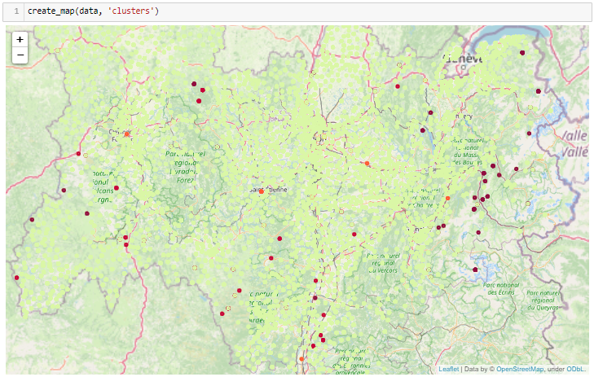
Clustering Visualization
Cluster visualization using
Folium Library
Kmeans model apparently clusters by energy types of production

Slide 7
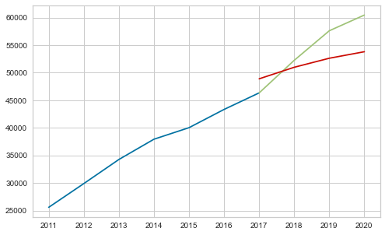
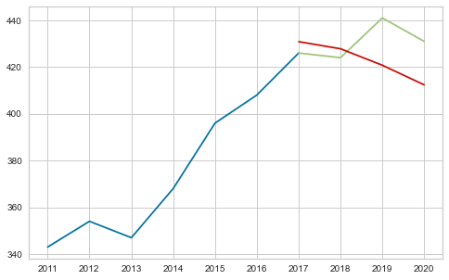
Time Series using auto_ARIMA
Number of solar generation sites forecast model
R2_score= 0.33
Number of hydraulic sites forecast model
R2_score= 0.48

Slide 8
Visualization and conclusion
Dashboard 1 here Dashboard 2 here Dashboard 3 here Dashboard 4 here Dashboard 5 here
What can be learned from this data and the data analysis process :
Regarding number of sites evolution,:
Wind and solar electricity production are experiencing a constant increase in infrastructure is likely to continue in the upcoming years
Bio energy forecast is more difficult to predict as the sector has experienced a strong acceleration in 2020 but is also expected to continue to grow
Hydraulic sector is generally on a stable/decreasing trend
Regarding electricity production :
Solar production is on the way to becoming the leading source of green electricity production in region, and overtaking hydro production, which remains stable overall.
Bio-energy and wind power production is on an upward trend but both have experienced a significant drop in 2020 (weather conditions, impact of COVID and shutdown?)
Regarding the overall data processing :
Only having access to time data by year (and not by month/day) weakened the time series analysis and made the prediction model limited and not very reliable

Slide 9
Do you have any questions ?
Thank you !
GitHub link here !

