Slide 1
Black Hole Effects Research
Advanced Simulation & Analysis

Slide 2
Closest Black Hole
Gaia BH1 (~1,560 light-years away)
No threat to Earth

Slide 3
Key Physics
Gravity: 1/r^2
Tidal Forces: 1/r^3
Orbital Velocity increases near BH

Slide 4
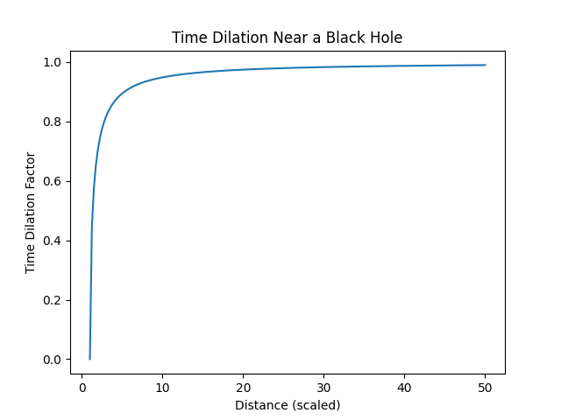
Time Dilation

Slide 5
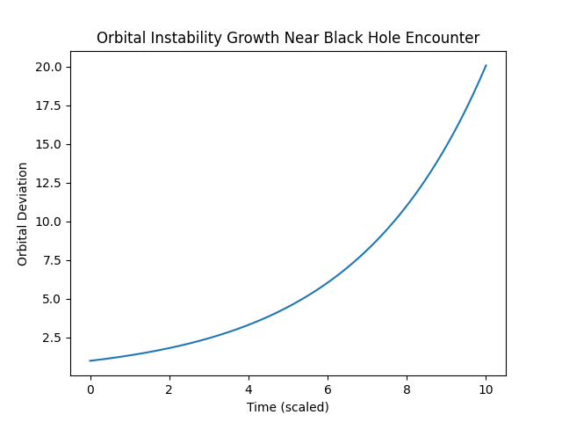
Orbital Instability

Slide 6
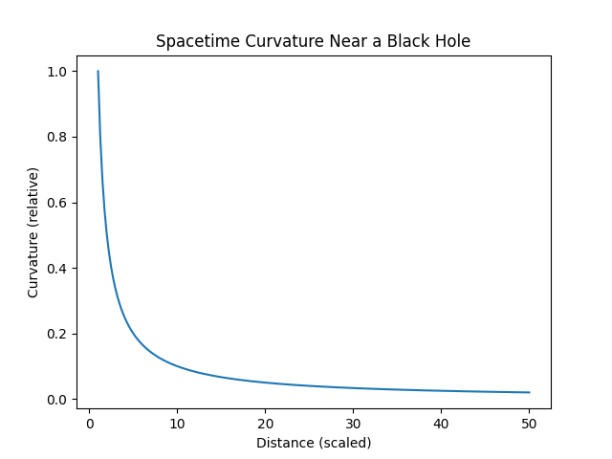
Spacetime Curvature

Slide 7
Key Takeaways
Distance determines danger
No nearby BH threat
Extreme effects only near event horizon

