Slide 1
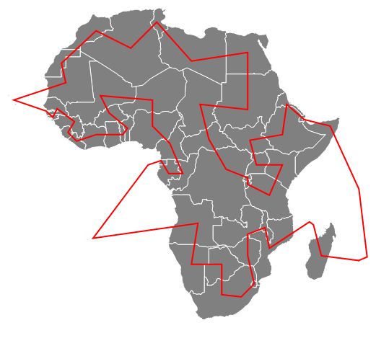
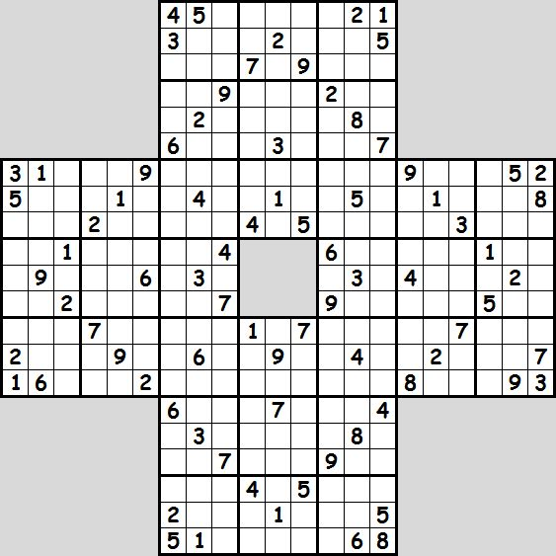

Phase transitions in random satisfiability problems
Eli Chertkov
Algorithms Interest Group 9/5/2017

Slide 2
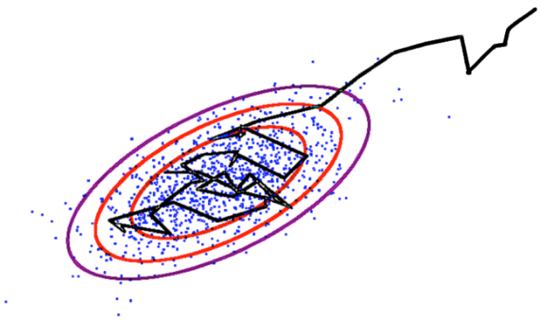
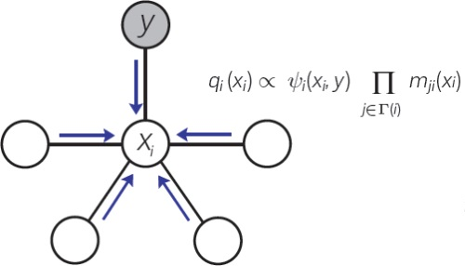
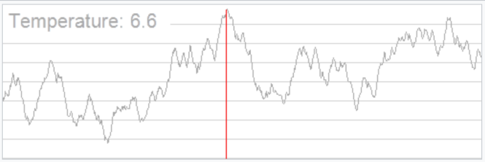
Statistical physics and computation
Markov chain Monte Carlo (1953)
Method to integrate high-dimensional probability distributions.
Originally developed to study deviations from the ideal gas law.
Belief propagation (1982)
Method to perform statistical inference on a network. Used often with error-correcting codes.
Based on methods from spin glass theory.
Simulated Annealing (1983)
General purpose optimization algorithm.
Based on thermal annealing of materials.

Slide 3
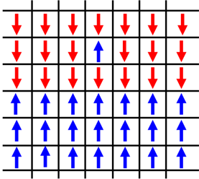
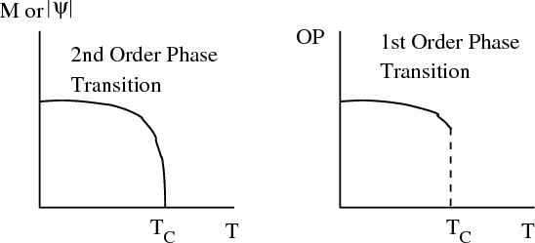
Phase transitions
Example: Ising model
Order parameter
continuous
discontinuous
Scaling for continuous PT
Notes:
Ising model
First-order (discontinuous) and second-order (continuous) phase transitions
Scaling analysis

Slide 4
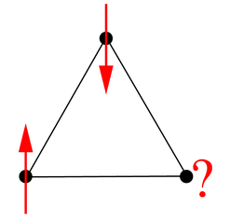
Spin glasses
Magnetic disorder induces frustration
Geometrical frustration
Spin glass, quenched disorder
Interaction strengths drawn from random distributions.
There are a variety of analytic techniques that have been developed to study the thermodynamic properties of simple models of spin glasses.
Notes:
Spin glasses are physical systems with magnetic disorder
Spin glass models people have studied have the interaction parameters drawn from random distributions. These represent quenched disorder and induce frustration between spin degrees of freedom.

Slide 5
Complexity in computer science
Computer scientists often classify algorithms based on their worst-case performance:
Quicksort O(n log(n))
Selection sort O(n²)
They categorize algorithms based on their worst case behavior into classes, such as NP-complete:
Boolean satisfiability (SAT)
Travelling salesman problem
Hamiltonian path problem
…
which, intuitively, are problems that are easy to check, but hard to solve.
Practical instances of NP-complete problems can actually be easy to solve.
We can use some phase transition analysis to see this.

Slide 6
Boolean Satisfiability (k-SAT)
Determine whether a boolean formula made of binary variables can be evaluated to TRUE, or “satisfied.”
k-SAT is an NP-complete decision problem that is used as a test bed for the development of heuristic algorithms.
Example k-SAT problem instance:
N=4 boolean variables
M=6 clauses
k=3 size clauses
Conjunctive normal form (CNF)
Answer: Yes! The logical assignment
evaluates the expression to 1.
We call this k-SAT instance
satisfiable.
Question: Can we pick boolean variables so that this evaluates to TRUE?
Notes:
One of the first problems proven to be NP-complete.

Slide 7
The relation of random k-SAT to spin glasses
The k-SAT problem instances can be generated randomly, with the variables participating in clauses chosen at random from all N boolean variables.
For each problem instance, the boolean variables can be mapped to spin variables
Then, we can define a Hamiltonian for the k-SAT problem that looks exactly like a spin glass Hamiltonian, with the randomly generated clauses acting as the random interaction strengths.
Finding whether or not the problem is satisfiable is the same as finding whether the ground state energy is positive.

Slide 8
Solving a SAT problem
Example k-SAT problem instance with k=3,N=5, M=5:
Naïve binary search
Note that always shows up with the same “sign” in clauses.
…
is called a pure literal.
evaluates to TRUE.

Slide 9
Davis-Putnam-Logemann-Loveland (DPLL) algorithm
DPLL
Pure literal evaluation (PLE)
Find pure literals in the unassigned clauses and set them to 1 or 0 as needed.
Unit-propagation (UP)
…
If there is only one unassigned variable left in a clause, set it to 1 or 0 as needed.

Slide 10
Davis-Putnam-Logemann-Loveland (DPLL) algorithm
1
2
DPLL
1
PLE
2
Pure literal evaluation (PLE)
Find pure literals in the unassigned clauses and set them to 1 or 0 as needed.
Unit-propagation (UP)
If there is only one unassigned variable left in a clause, set it to 1 or 0 as needed.

Slide 11
Davis-Putnam-Logemann-Loveland (DPLL) algorithm
2
3
DPLL
1
PLE
2
Pure literal evaluation (PLE)
3
Find pure literals in the unassigned clauses and set them to 1 or 0 as needed.
Unit-propagation (UP)
If there is only one unassigned variable left in a clause, set it to 1 or 0 as needed.

Slide 12
Davis-Putnam-Logemann-Loveland (DPLL) algorithm
3
4
DPLL
1
PLE
2
Pure literal evaluation (PLE)
3
Find pure literals in the unassigned clauses and set them to 1 or 0 as needed.
PLE
4
Unit-propagation (UP)
If there is only one unassigned variable left in a clause, set it to 1 or 0 as needed.
We found two examples of vectors of binary variables that satisfy the k-SAT problem instance.

Slide 13
Analyzing random k-SAT problem instances
In the following analysis, I generated 10,000 random problem instances of k-SAT. The main property I looked at was
This is presented as a function of clause density

Slide 14
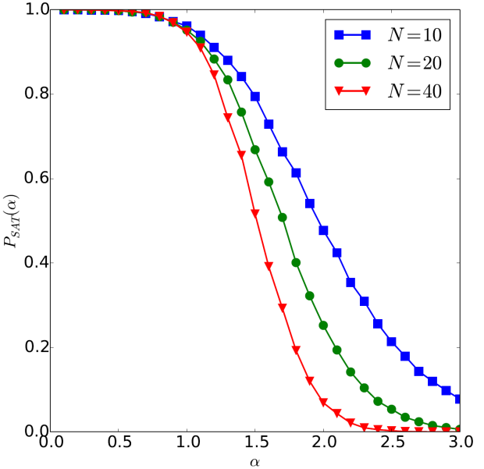
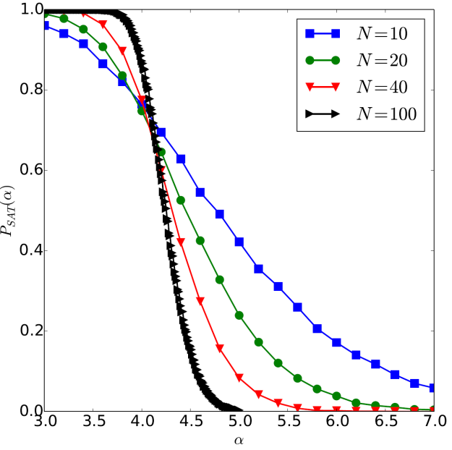
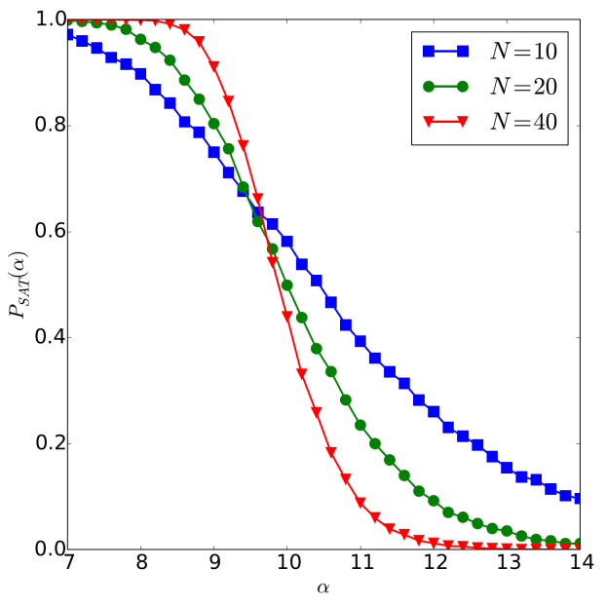
Satisfiability of random k-SAT problem instances
(Generated using Zchaff SAT solver)
k=2
k=3
k=4
Continuous change in P_{SAT}
Discontinuous change in P_{SAT}
Problem instances are P
Problem instances are NP-complete

Slide 15
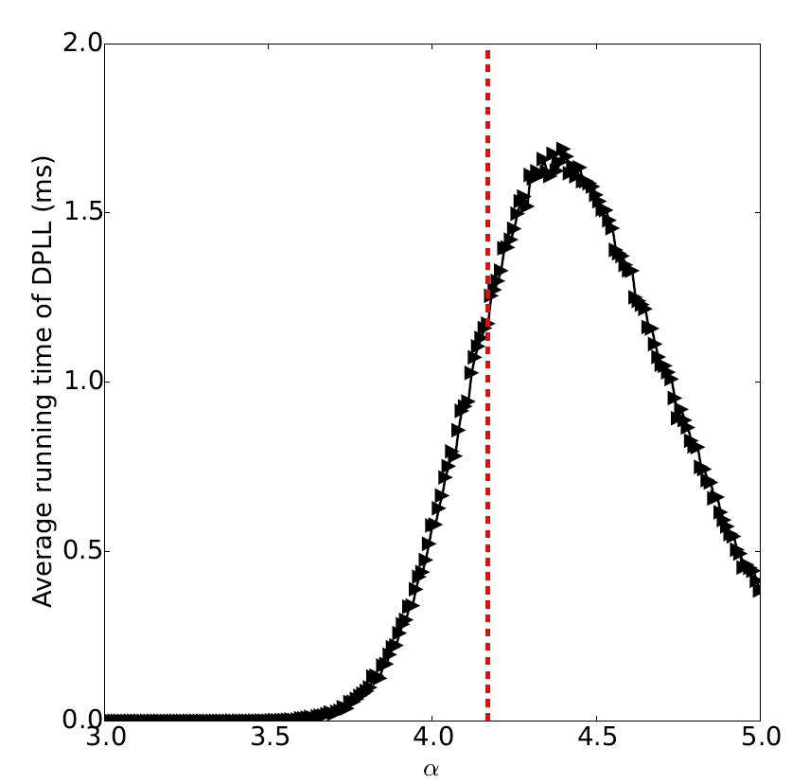
Running time of DPLL on random k-SAT
N=100, k=3
The hardest problem instances are the ones near the transition!

Slide 16
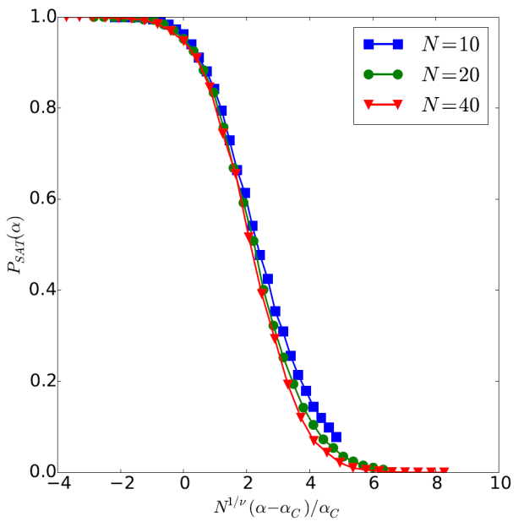
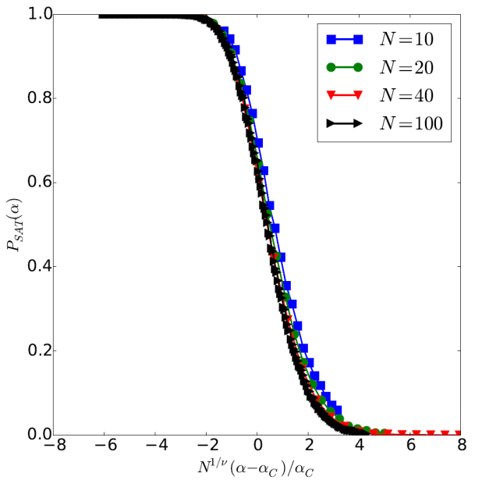
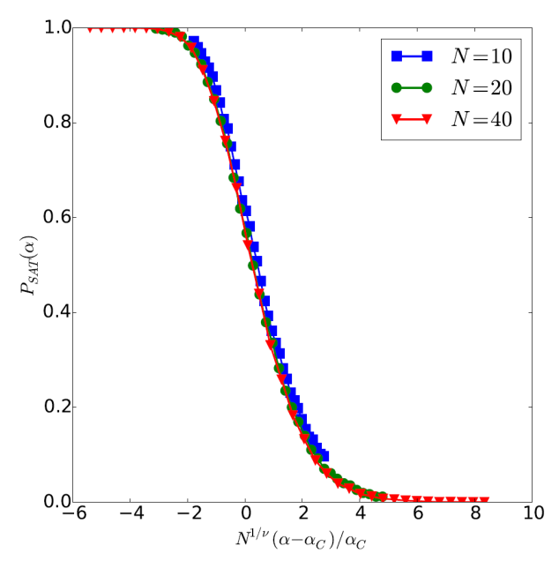
Finite size scaling
You can even perform “finite size scaling” to determine the critical exponents of the k-SAT transition.
k=2
k=3
k=4

Slide 17
References
My term paper for Prof. Nigel Goldenfeld’s Phase transitions and the Renormalization Group class has all of the material from this presentation, as well as references:
http://guava.physics.uiuc.edu/~nigel/courses/563/Essays_2017/PDF/chertkov.pdf

