Slide 1
Relaxation Methods in the Solution of Partial Differential Equations
Kiel Williams
Algorithms Group
University of Illinois, Dept. of Physics
05/09/2017

Slide 2
Solving Partial Differential Equations
Stereotypical problem: solve for a potential given some source function:
(Poisson's Equation)
Electric/Gravitational Potential
Mass/Charge Distribution
This is an inhomogeneous elliptic differential equation → some simple ways to handle the problem numerically?
Start by exploiting some properties of Laplace's equation in free space:
(Laplace's Equation)
Electric/Gravitational Potential
Free Space

Slide 3
Harmonic Function Theorem
A solution V to Laplace's equation:
(Laplace's Equation)
is called harmonic
Interesting harmonic properties:
1.) No extrema in interior of region, away from boundaries:
2.) Value of solution at any given point equals average of points in surrounding sphere:

Slide 4
Harmonic Function Theorem
V(x, y)
Y
X
Average of Solution Along Circle = Solution Value at Center

Slide 5
Relaxation Algorithm
Second derivative in 1D can be discretized as:
Approximate (2D) Laplacian in same way
If Poisson's equation is true:

Slide 6
Relaxation Algorithm
If Poisson's equation is true:
For f = 0:
Simply the average over adjacent grid points! Discretized form of mean-value theorem for harmonic functions
Basic strategy: starting from initial guess, demand that this condition be satisfied
Generalization to d > 2 easy to see from context

Slide 7
Relaxation Algorithm
Make initial guess at solution in interior region (guess doesn't need to be very good)
Compute averaged value at each point
Update solution
No – perform another relaxation iteration step
Solution obtained
Check for convergence
Yes – you're done

Slide 8
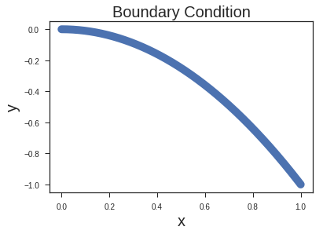
Relaxation Algorithm - Example
To run relaxation, just need the boundary conditions and some initial guess
Example: consider parabolic boundary condition along each edge on 2D grid, arranged to be continuous:
These boundary conditions stay fixed in time, while the interior region of the 2D grid relaxes

Slide 9
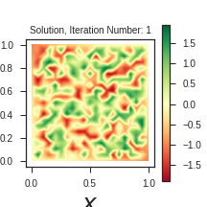

Relaxation Algorithm - Example
To run relaxation, just need the boundary conditions and some initial guess
Example: consider parabolic boundary condition along each edge on 2D grid, arranged to be continuous:
These boundary conditions stay fixed in time, while the interior region of the 2D grid relaxes
Even with a terrible initial guess, solution still converges within 10's of iterations!
Initial Guess
Solution Relaxation
(Note that you can always imagine this as an electrostatic potential, for intuition purposes)

Slide 10
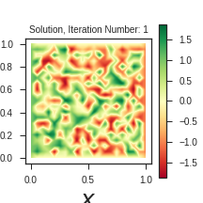
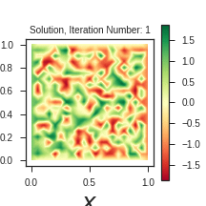
Relaxation Algorithm - Example
To run relaxation, just need the boundary conditions and some initial guess
Example: consider opposite edges held at V = +1 and V = -1
This is like finite parallel plate capacitor, and we can see the edge fields
These boundary conditions stay fixed in time, while the interior region of the 2D grid relaxes
Even with a terrible initial guess, solution still converges within 10's of iterations!
Initial Guess
Solution Relaxation
(Note that you can always imagine this as an electrostatic potential, for intuition purposes)

Slide 11
Relaxation Algorithm, for Poisson's Equation
Make initial guess at solution in interior region (guess doesn't need to be very good)
Compute averaged value at each point
Update solution
For electrostatics:
No – perform another relaxation iteration step
Solution obtained
Check for convergence
Yes – you're done

Slide 12
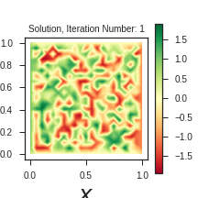
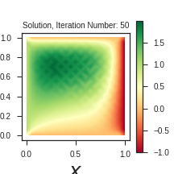
Relaxation Algorithm - Example, for Poisson's Equation
To run relaxation, just need the boundary conditions and some initial guess
Example: consider opposite edges held at V = +1 and V = -1, with
Charge distribution given by:
Now there are local extrema that occur away from the boundaries due to the charge distribution:
Solution Relaxation
Final Potential
(Note that you can always imagine this as an electrostatic potential, for intuition purposes)

Slide 13
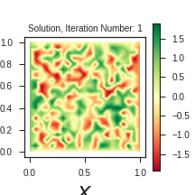
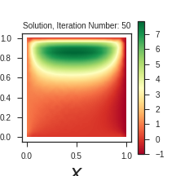
Relaxation Algorithm - Example, for Poisson's Equation
To run relaxation, just need the boundary conditions and some initial guess
Example: consider opposite edges held at V = +1 and V = -1, with
Charge distribution given by:
If we dump a lot of charge into the interior, boundary conditions become less significant:
Solution Relaxation
Final Potential
(Note that you can always imagine this as an electrostatic potential, for intuition purposes)

Slide 14
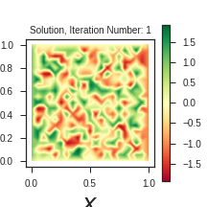
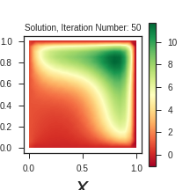
Relaxation Algorithm - Example, for Poisson's Equation
To run relaxation, just need the boundary conditions and some initial guess
Example: consider opposite edges held at V = +1 and V = -1, with
Charge distribution given by:
If we dump a lot of charge into the interior, boundary conditions become less significant:
Solution Relaxation
Final Potential
(Note that you can always imagine this as an electrostatic potential, for intuition purposes)

Slide 15
Summary
Relaxation method → rely on properties of harmonic functions to solve Laplace's equation from an initial guess + boundary conditions
Simple modification allows for solutions to Poisson's equation for arbitrary charge distribution
Concepts easily extended to higher number of dimensions
Multigrid methods exist to accelerate convergence for harder problems

