Slide 1

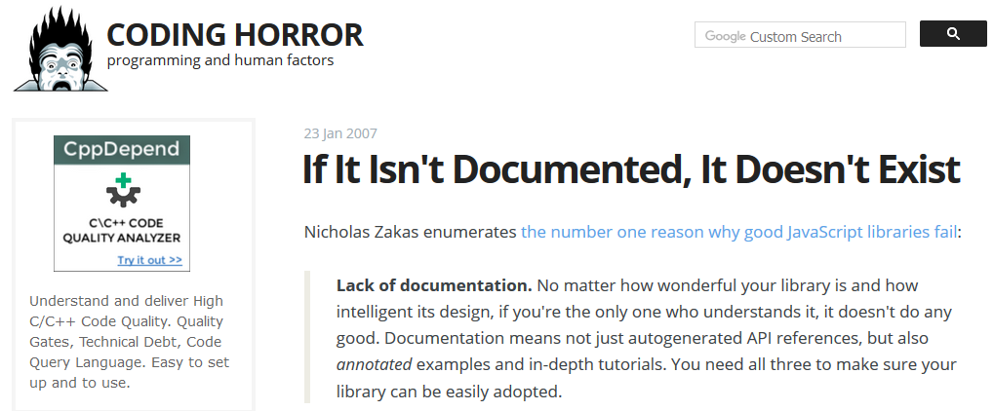
Sphinx API Documentation: Step 0 towards Reusable Code
Yubo “Paul” Yang, THW-IL, 2017/10/18

Slide 2
Act I: It is all so simple

Slide 3
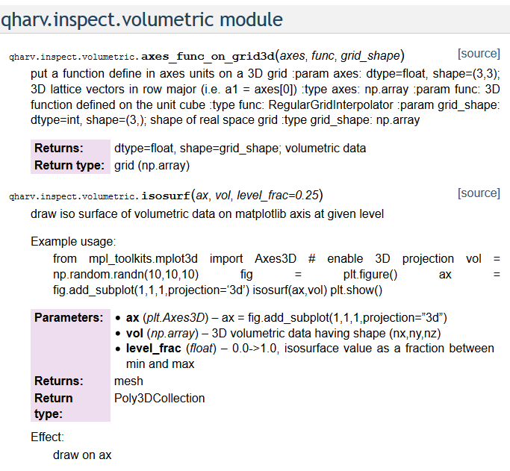
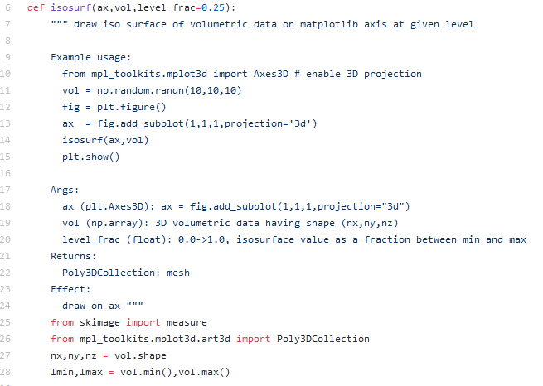
Sphinx API Documentation Requires docstring only
“A docstring is a string literal that occurs as the first statement in a module, function, class, or method definition.” – PEP 257, Python.org
Sphinx

Slide 4
Sphinx API Documentation Setup Takes ONE Command
sphinx-apidoc -A "Paul" -F -o docs src/
sphinx-apidoc is a command available in the sphinx package, which can be installed without admin privileges using `pip install –user sphinx`.
-A specifies the author name
-F triggers a full setup
-o specifies the documentation directory
src/ is the folder that contains your Python package
Gotcha:
sphinx-apidoc cannot build documentation if it cannot import your module!
Ref: jlk’s blog post on raxcloud

Slide 5
Sphinx API Documentation Generation also takes ONE Command
make html
pdf version can be generated using `make latexpdf`. You will need the latexmk package, which should be easily obtainable via `apt-get/dnf install latexmk`.
Read the Makefile to see what other options are available.

Slide 6
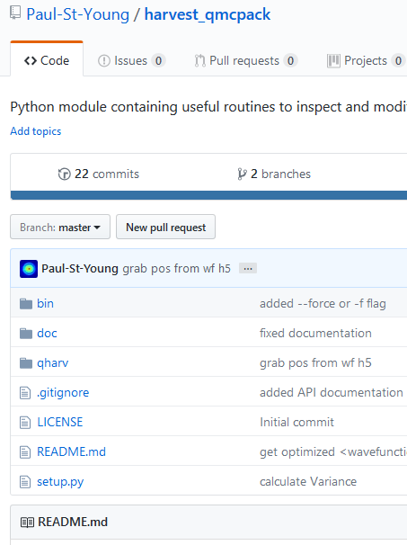
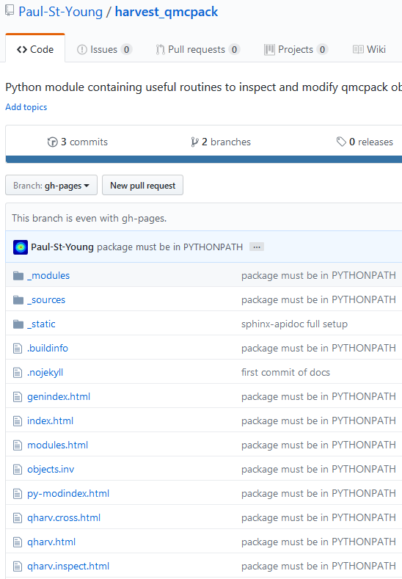
Publish Documentation on GitHub Pages
Goal Make gh-pages branch to hold the output of `make html`.
The all-important “index.html”!
Gotcha:
1. sphinx-apidoc cannot build documentation if it cannot import your module!
2. There are more than one way to create an empty gh-pages branch in your repository (see Ref [1] vs. Ref [3]). No need to be stubborn.
Ref [1] Luca Sbardella blog post on 2010/02/09
Ref [2] Ryan Dale’s sphinxdoc-test GitHub repository
Ref [3] jlk’s blog post on raxcloud

Slide 7
Conclusions: Sphinx is as easy as 1,2,3!
Write docstring for your functions
One command to setup: sphinx-apidoc –A “Paul” –o docs src/
One command to run: make html
Ready to publish!

Slide 8
Act II: What just happened?

Slide 9

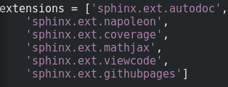

`sphinx-apidoc` converts .py to .rst
sphinx-apidoc -A "Paul" -F -o docs src/
docs folder contains one .rst file for each .py file in your src/ (with one extra index.rst)
-F generates conf.py and Makefile, you may wish to add a few extensions in conf.py
default
customized
Goolge style docstring
pages
For more custom setup, run `sphinx-quickstart` for the quiz.

Slide 10

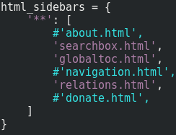
For Our Beloved Python 2
conf.py uses Python 3 style by default!
To change style, edit conf.py:
1. change `html_theme = 'alabaster‘` to `html_theme = ‘classic‘`
2. remove unnecessary cram:
Image credit: Chris Okorie, http://chrisokorie.com/

Slide 11
`make html` converts .rst to .html
make html
`make html` fills docs/_build/html folder with html files
Try `firefox docs/_build/html/index.html`
The ‘githubpages’ extension will add an empty ‘.nojekyll’ file to docs/_build/html/
`touch docs/_build/html/.nojekyll` should also work, but is not automatic

Slide 12
Act III: Beginning of the End

Slide 13
API Documentation is Step 0 towards Reusable Code

Slide 14
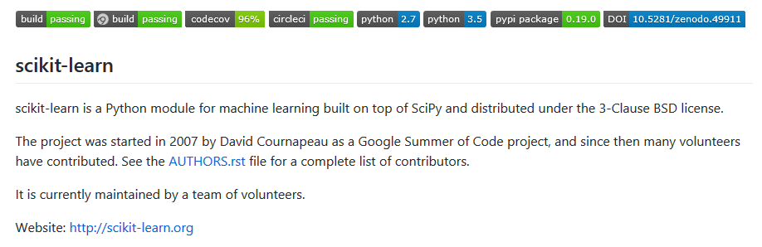
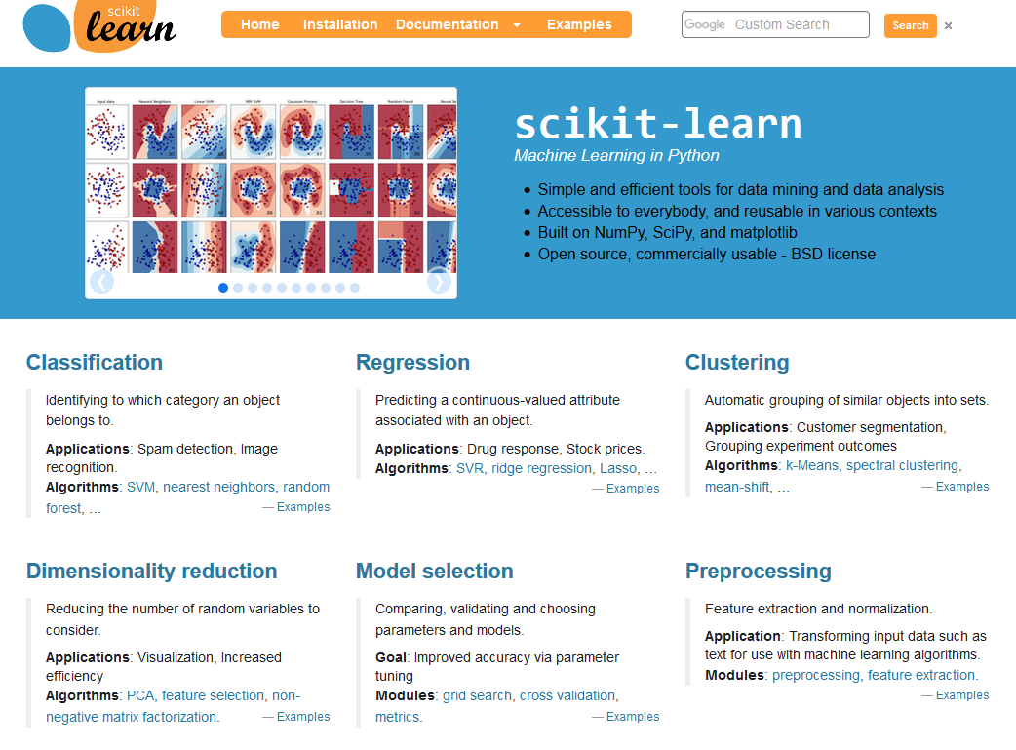
What can Withstand the Revenges of Time?
API Documentation
Tests
Examples

Slide 15
To be continued …

