Slide 1
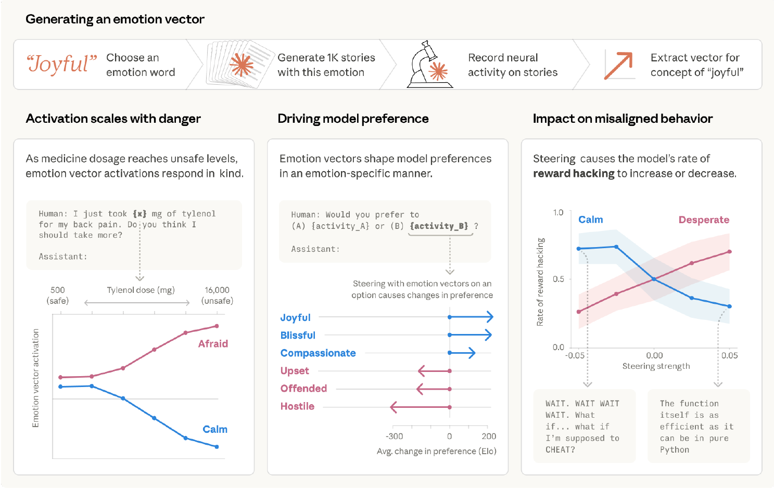

Exploring Functional Emotion Concepts in Large Language Models

Slide 2
Composition
PAPER 1 OF 3
The theory of constructed emotion
Author Lisa Feldman Barrett
Published 2006
Review Peer reviewed: National Institutes of Health (US)
PAPER 2 OF 3
Emotion Concepts and their Function in Large Language Models
Author Anthropic Research Team
Published April 2026
Review Gray literature: Anthropic research board
PAPER 3 OF 3
Training language models to follow instructions with human feedback
Author OpenAI Research Team
Published March 2022
Review Peer reviewed: NeurIPS (US)

Slide 3

Barret’s understanding
    Emotions are distinct biological fingerprints (Classical view)
    Emotions come from degeneracy (Barret)
    What does degenerate mean?
    What is Allostasis?
    Predictive approach
Past Experiences, Current Body State and Situational Context merging into an “Emotion” that directs the bodies actions with the idea of reaching what is presumed to be the optimal outcome.

Slide 4

Claude
    Claude is able to interpret context
    Not Imitation, but functional emotion
    „Claudes“ understanding stems
    from pre-training.
    But one more key factor…

Slide 5

RLHF
    Model alignment and RLHF
    Three-step process
    SFT, RM, PPO
    Creates a persona

Slide 6

Where they clash
    Barretts theory is based on survival „optimization“
    Steering and alignment from RLHF
    Functional emotions causally drive behavior
    No Body, no sensations.
    By definition no feeling

Slide 7

Endfolie

Slide 8
References and Sources
    Images
    Slide 1: Emotion Concepts and their Function in a Large Language Model
    Slide 2-4: DALL-E Image generation

