Slide 1
Grocery Bill
How to boost it?

Slide 2
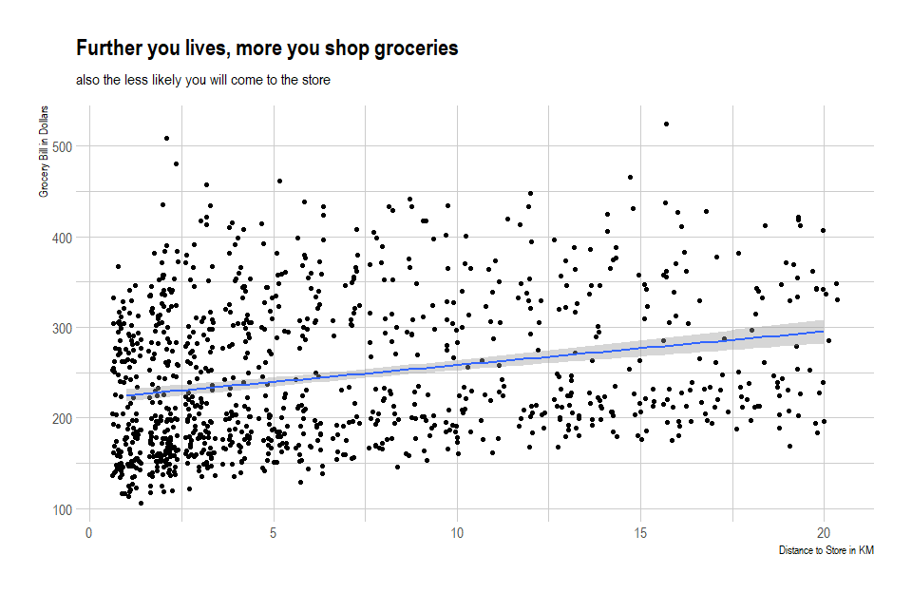
Store only serves a limited region

Slide 3
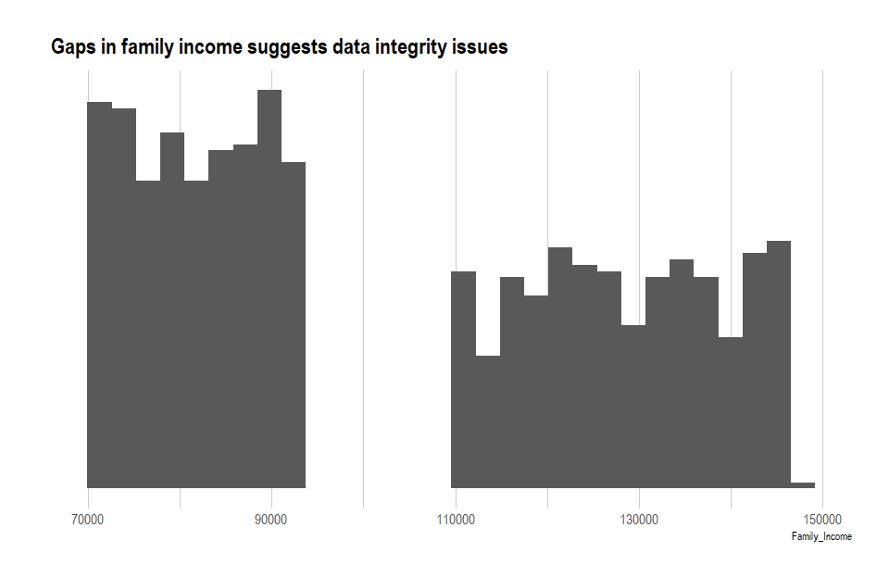
Dataset have issues

Slide 4
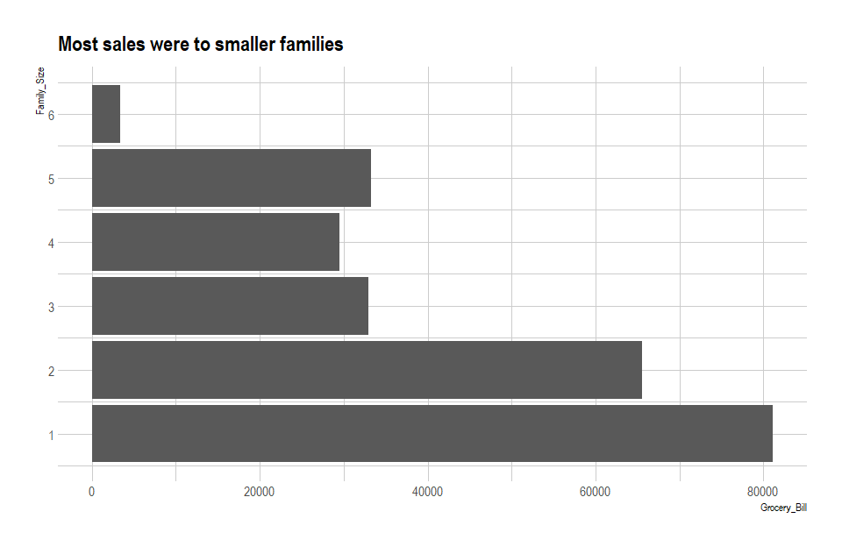
Serve shoppers with smaller family size

