Slide 1
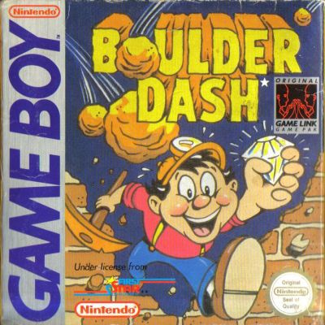
UML/OOP/JAVA PROJECT
BOULDER DASH
Group 3
NGANKAM Paul-henry
BALOG Georges Arthur
TANKWA Prince Jordan
TEMA Gregori

Slide 2
INTRODUCTION

Slide 3
CONTEXT
We have to recreate an abandonware called Boulder Dash.
The goal of the game is to dig the ground to pick a certain number of diamonds in order to access the next level. The player has to avoid enemies. Rocks and diamonds may fall on him.

Slide 4
PROBLEMATIC
How will we recreate the game and store the levels in a database while respecting all the constraints given to us?

Slide 5
ACTION PLAN
1- ORGANIZATION AND SETUP
II- ANALYSIS
II- CONCEPTION AND DESIGN
III- IMPLEMENTATION

Slide 6
Human resource
We are a team of four members made up of:
Analysis manager: TANKWA Prince
Organization manager: TEMA Gregori
Design manager: BALOG Phil
Implementation manager (Group leader): NGANKAM Paul-Henry

Slide 7
sOFTWARE
Visual Paradigm CE 16.0
Eclipse IDE
MS Word
Java
Maven
MS PowerPoint

Slide 8



ORGANIZATION AND SETUP

Slide 9
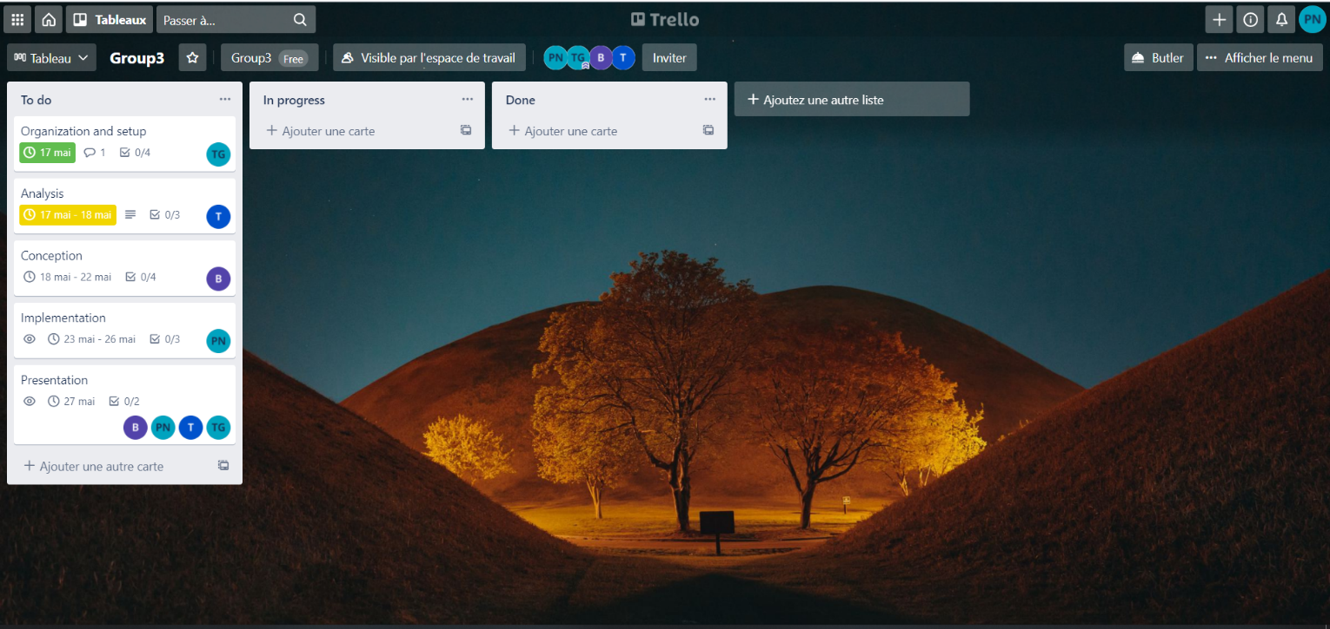
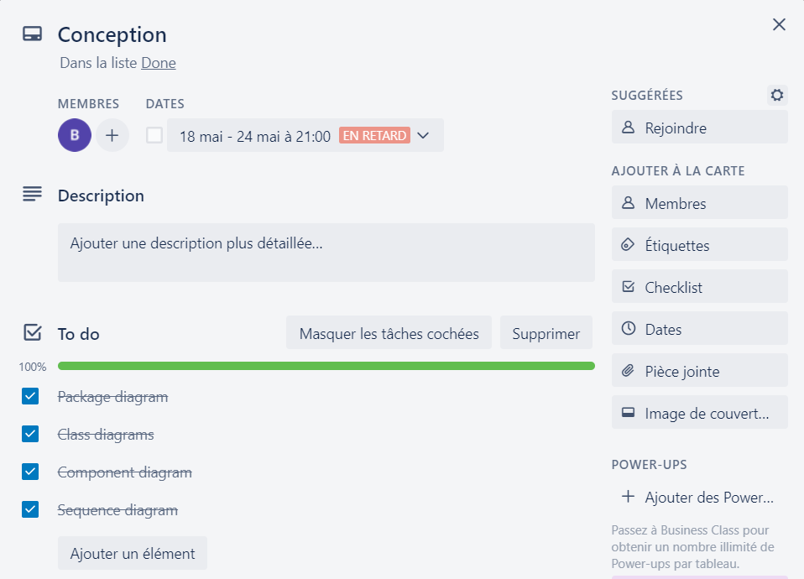
TRELLO

Slide 10
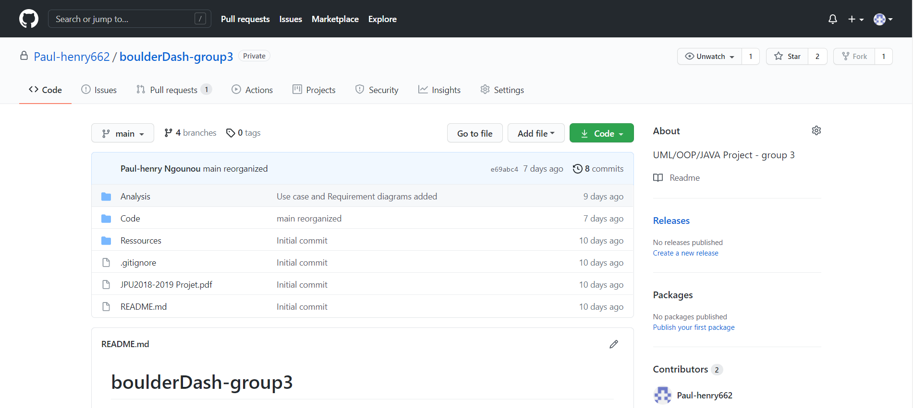
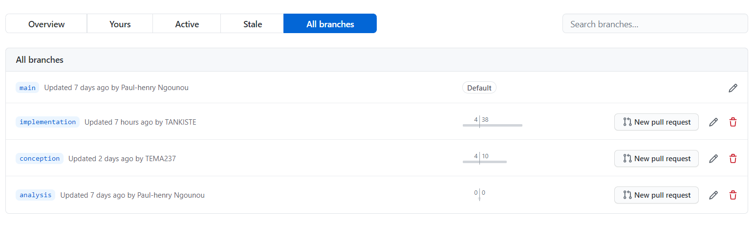
GITHUB

Slide 11

ANALYSIS

Slide 12
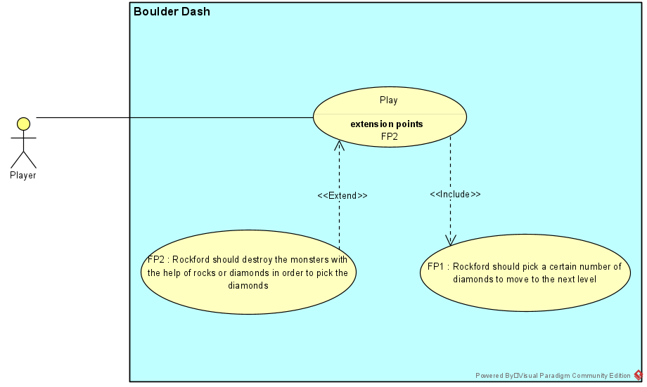
USE case diagram

Slide 13
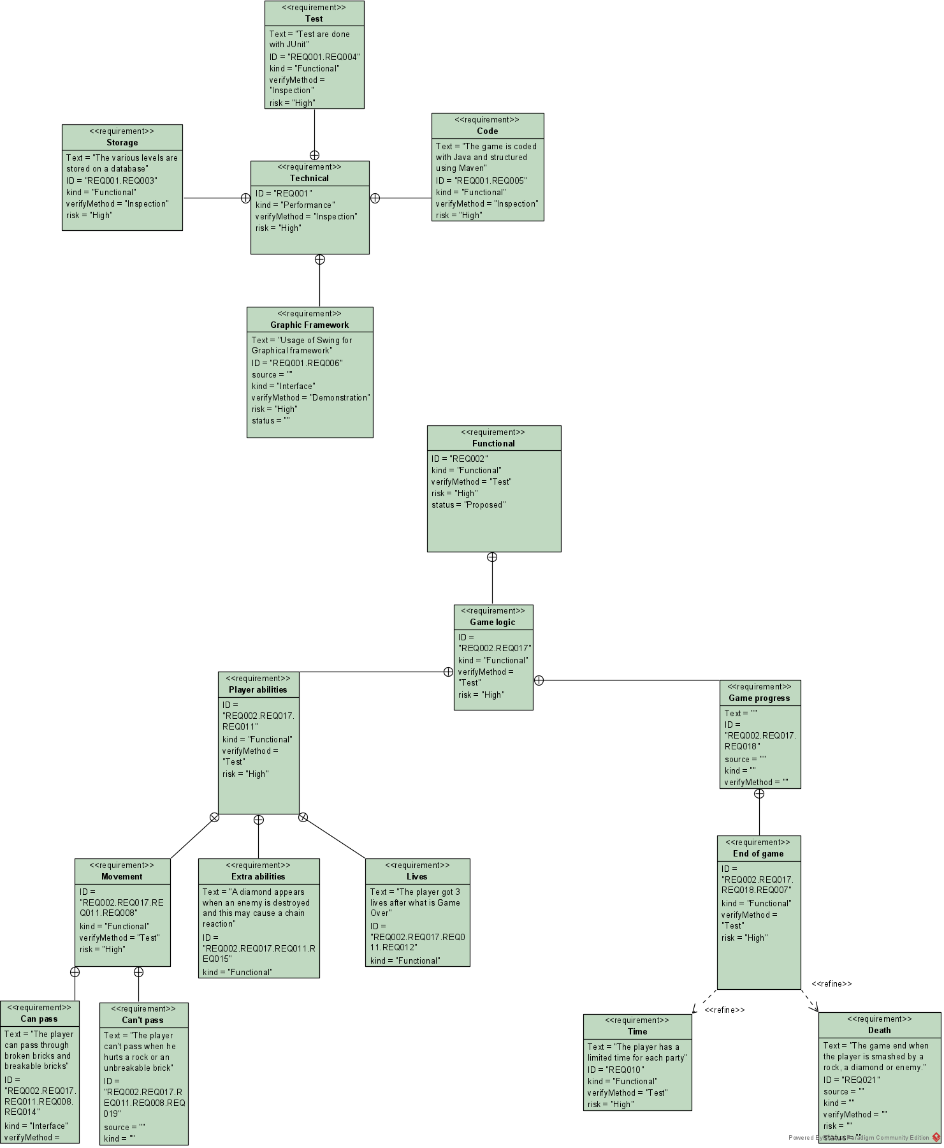
REQUIREMENT DIAGRAM

Slide 14
cONCEPTION and implementation
(DEMONSTRATION)

Slide 15





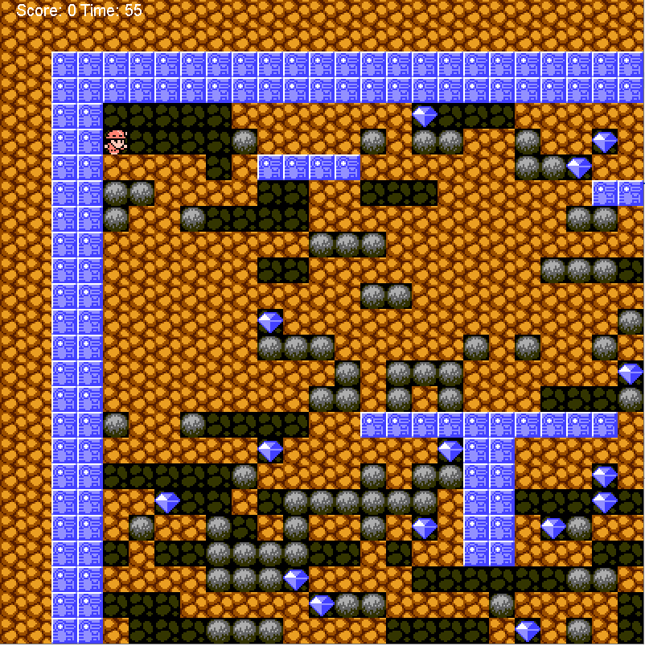
Factory method

Slide 16
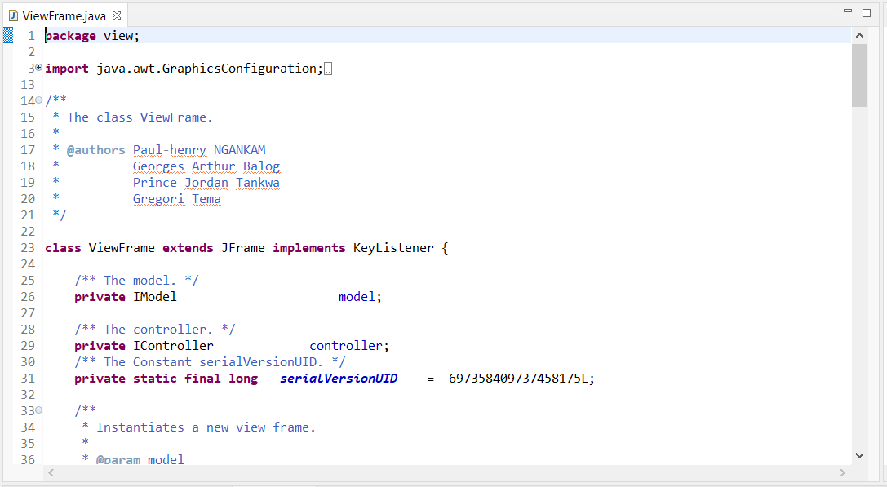
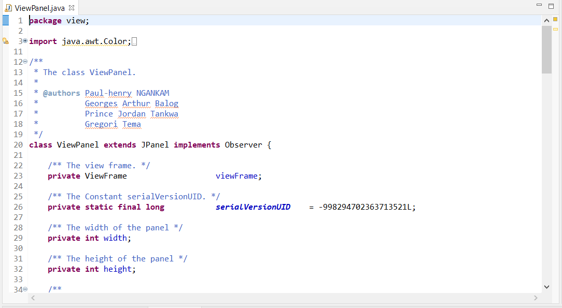
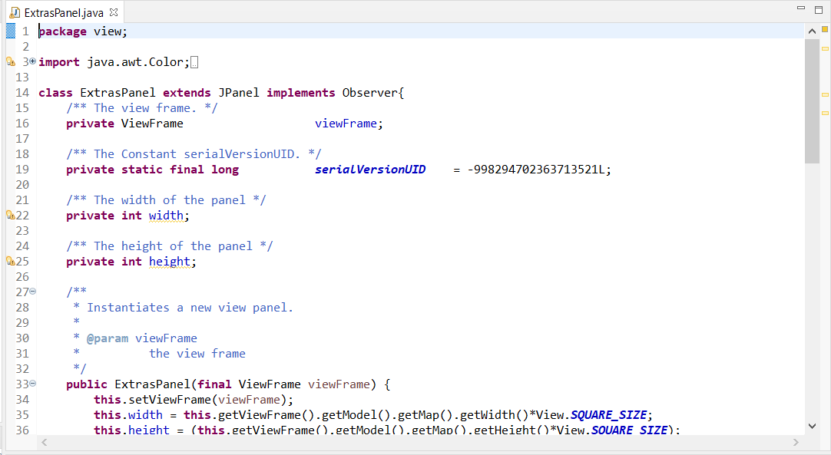
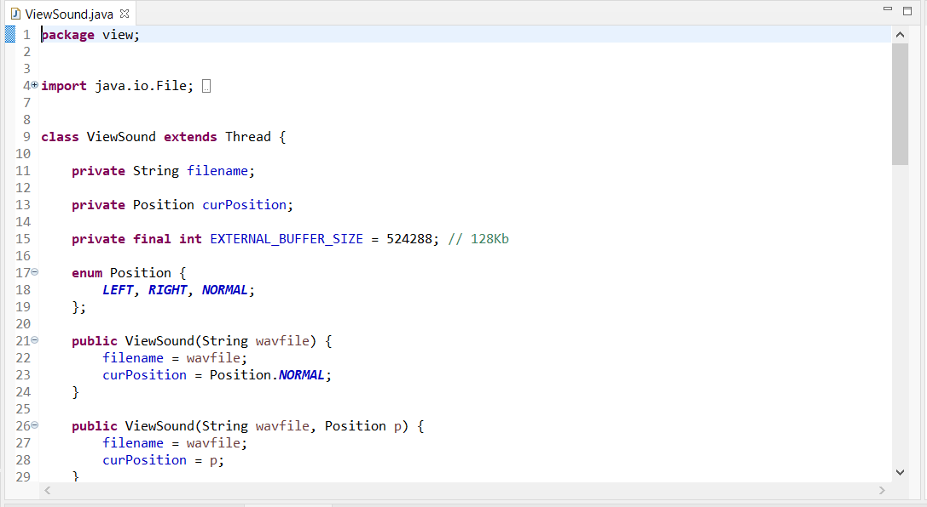
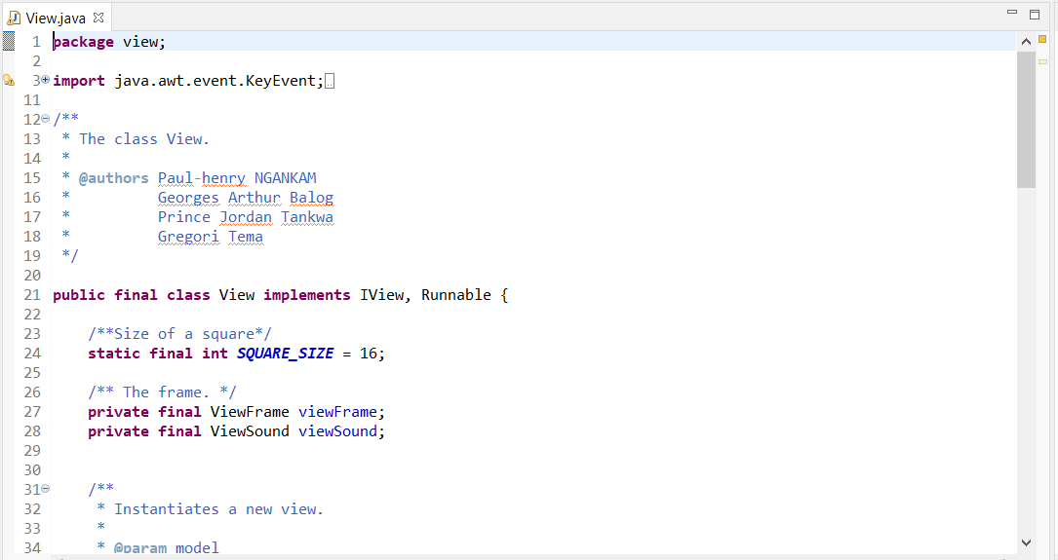
Façade DP

Slide 17
MUltithreading
Checking gravity
Playing animations
Refreshing the view
Counting time

Slide 18
Sound

Slide 19
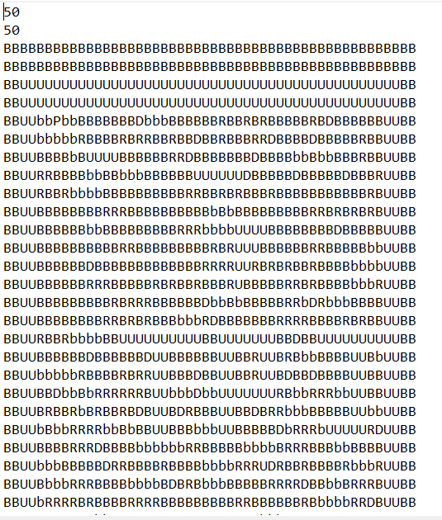
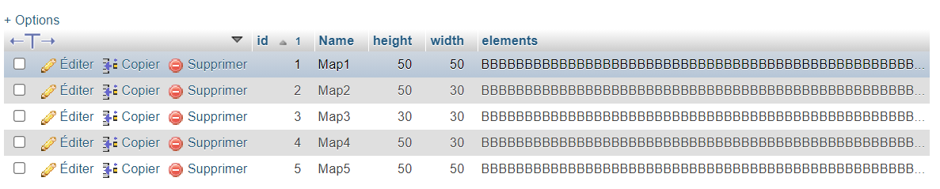
Level management

Slide 20
THANKS

