Slide 1
How Multitasking Benefits QA Retrieval
F74096043 王駿杰
F74091035 黃念暉
指導教授 高宏宇

Slide 2
Wendy Lehnert [1] :
“ The ability to answer questions about a text is the strongest possible demonstration of text comprehension.”
---- The QA is a benchmark for Machine Comprehension.

Slide 3
Introduction

Slide 4
1.1 Outline and history
Decades ago, machine reading comprehension posed a significant challenge. However, in 2018, BERT[2] was introduced and revolutionized the field, becoming the state-of-the-art model in various tasks, including QA-retrieval.
Prior to the emergence of BERT, there were already several models designed for QA-retrieval, such as BiDAF[3], which was a significant milestone in the development of QA systems introduced in 2016.
In our approach, we refer to the paper "Question Answering on SQuAD 2.0 Dataset"[4], which proposes three model structures based on BERT embeddings and compares their performance with BiDAF. We adopt this reference to design our Multi-Task Learning structure, aiming to enhance the model's ability to classify whether the context contains the answer to a given question.

Slide 5
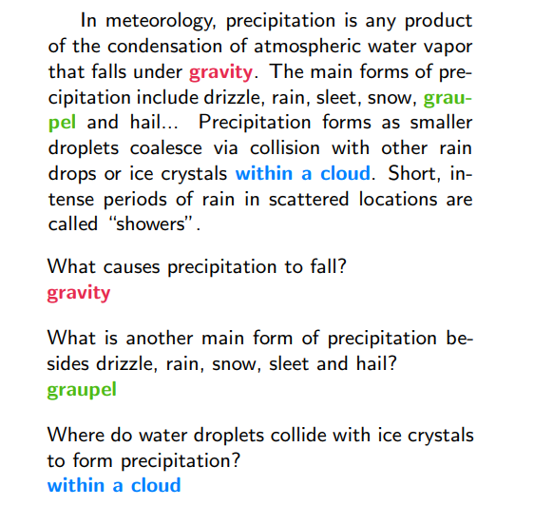
1.2 Question answering retrieval
Given the context and question,
retrieve the relevant answer for the question from the context.
Fig1, the example of QA-retrieval [7]

Slide 6
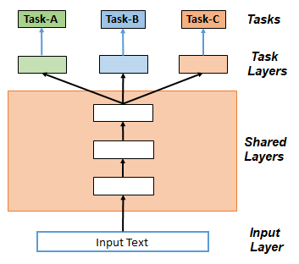
1.3 Multi-Task Learning (MTL)
Leverage useful information from support tasks to achieve performance improvements on target tasks.
In MTL, there are shared layers as well as task-specific layers.
Fig2, the concept of hard parameter sharing MTL

Slide 7
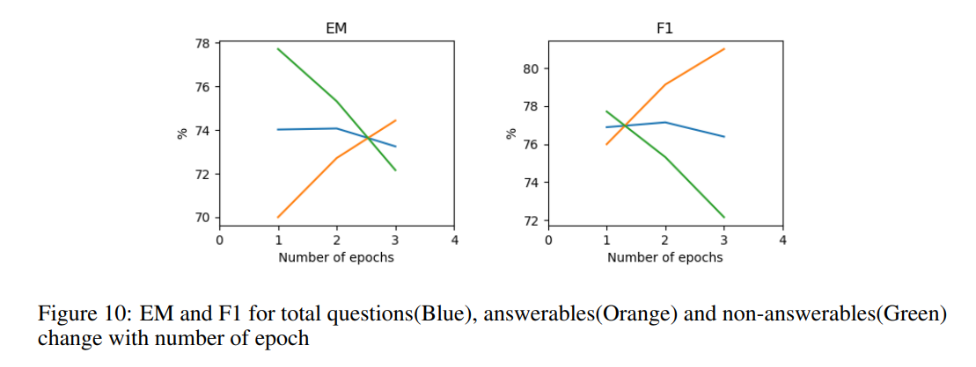
Improving Classifying (Un)answerable Q.
Fig3, Analysis in Question Answering on SQuAD 2.0 Dataset[4]
Goal: Increase the performance of classification in Squad 2.0
Answerable vs non-answerable questions[4], the analysis showed that the performance of the answerable question is improved while the performance for the unanswerable question dropped hugely. The research thought that it’s not an overfitting problem but a problem with weak [CLS] token to classify the unanswerable ones.
In the above, we tried some multitasking mechanism to help the model get more weight on the [CLS] token, also make sure that answerable questions work properly.

Slide 8
Improving Classifying (Un)answerable Q.
Main Method :
Inspired by BERT and the architecture in Multi-Task Learning in Natural Language Processing: An Overview[8], we tried to use self-attention to focus on [CLS] token
Self-attention allows the model to attend to relevant information and make accurate predictions for no-answer scenarios
Sub. Method (Abandoned) :
Refer to Question Answering on SQuAD 2.0 Dataset[4] ,we built modeling layers for QA and supporting data while the classification of the answerable/unanswerable question was supported by the supporting data’s modeling layers.

Slide 9
1.4 Dataset
Squad 2.0
In SQuAD 1.0, all questions are answerable, meaning there is a definite answer provided in the context passage. However, in SQuAD 2.0, the dataset includes both answerable and unanswerable questions. Unanswerable questions are accompanied by a placeholder answer, "no-answer," indicating that the answer is not present in the provided context passage.
GLUE Dataset
The text in the GLUE dataset is unprocessed and reflects real-world language use. It contains nuances, variations, and complexities that are representative of natural language. This realism helps models trained on GLUE to better generalize to real-world applications and perform well on unseen data.

Slide 10
Approach

Slide 11
All architecture
Bert Embedding (bert-base-uncased)
Bert Encoder (bert-base-uncased)
CLF Modeling layer (Modeling layer for classification)
Original pooler output + Linear(the concatenation last 4 hidden states of BERT)
Retrieval Modeling layer (Highway Network with Bi-LSTM)
Captures contextual information and relationships between words
Allows bidirectional information flow
Inspired by Stanford research[4]
Self-Attention Structure
Addresses the defect in classifying no-answer data

Slide 12
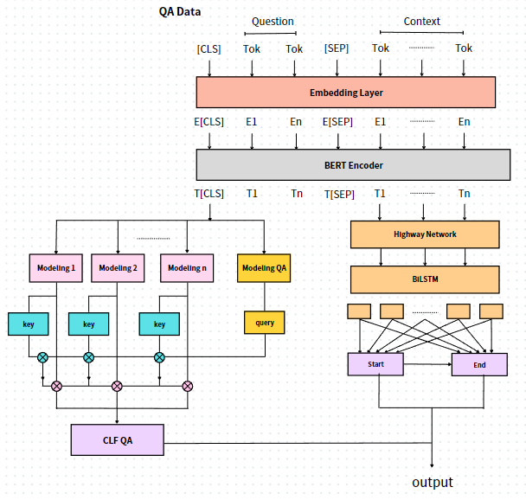
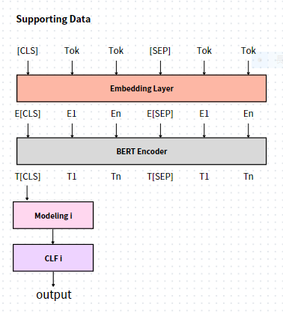
2.1 Training Framework
Two frameworks in Multi-Task learning process[5].
1: training supporting data
2: training target data
Fig4, training structure for supporting data
Fig5, training structure for target data

Slide 13
2.2 Supporting Data
Shared layer: Embedding, BERT Encoder
Specific layer: Modeling(clf), Classifier
Input format : [CLS] sentence1 [SEP] sentence2
With the self-attention mechanism [6] in the BERT Encoder, the model is able to identify the relationship between two sentences.
The representation of the [CLS] token is extracted and then combined with additional layers for further fine-tuning.
Fig4, training structure for supporting data

Slide 14
2.3 Target Data
Shared layer:
Embedding, BERT Encoder, Supporting Data Modeling
Specific layer: other
Input format: [CLS] question [SEP] context
Part1(left): identify if the context has the answer
Part2(right): determine the start and end position
Fig5, training structure for target data

Slide 15
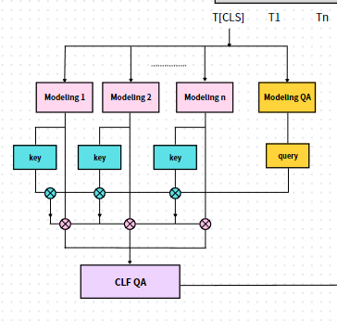
2.3.1 Target data Part1
N supporting data => N Modeling layers
=> N pairs of “key” and “value”
Utilizing modeling QA to obtain the key, then applying single-head self-attention to the N modeling results. Ultimately, using CLF QA to determine if the context contains the answer.
2.3.2 Modeling Layer
Linear(Concatenate the last 4 hidden states in BERT Encoder)
+
BERT Pooler(T[CLS])
To get more information
Fig6, the part classify if the context has answer

Slide 16
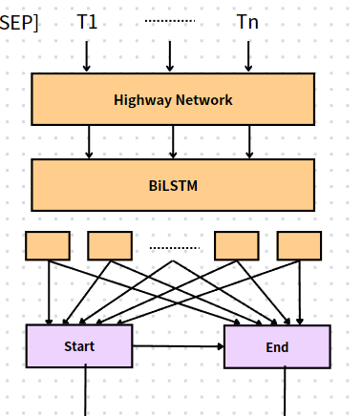
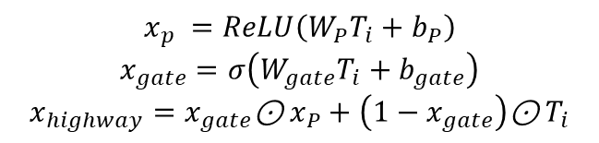

2.3.3 Target data Part2
Extract the representation of context $T_{i}$, fed into the Highway layer to refine the BERT-embedded representation, and pass it through the LSTM layer to obtain the new $T_{i}$.
$P_{i,start}=\frac{e^{ST_{i}}}{\sum_{j}{e^{ST_{j}}}}$ , $P_{i,end}=\frac{e^{ET_{i}}}{\sum_{j}{e^{ET_{j}}}}$
2.3.4 Highway Network + BiLSTM
Highway network :
$$x_{p} =ReLU\left(W_{P}T_{i}+b_{P}\right)$$
$$x_{gate}=σ\left(W_{gate}T_{i}+b_{gate}\right)$$
$$x_{highway}=x_{gate}\text{⊙}{ x}_{P}+\left(1−x_{gate}\right)\text{⊙}{ T}_{i}$$
BiLSTM :
Fig7, the part determines the answer’s start and end in context
{$b_{1}$, $b_{2}, ……,b_{L}$}$=BiLSTM(\{x_{1},x_{2}, ……x_{L}\})$

Slide 17
Experiment

Slide 18
3.1 Result of 70k SQuAD2.0 data training :
 | Has answer F1 score | No answer F1 score | Has answer accuracy | No answer accuracy
Vanilla | 0.6990 | 0.7695 | 0.8712 | 0.7610
MTL | 0.7031 | 0.7958 | 0.8818 | 0.7897
In our research, we have made multiple changes to the model structure and hyperparameters, and the table presented here is the results obtained under the final conditions.
Among all the experimental conditions we have tested, the performance of the Multi-Task Learning (MTL) approach consistently outperforms the Vanilla approach. However, it's important to note that we have only utilized 100,000 data and trained 70,000 from the SQuAD dataset. The performance with larger training data is yet to be determined.

Slide 19
3.2 Result of 7k SQuAD2.0 data training :
 | Has answer F1 score | No answer F1 score | Has answer accuracy | No answer accuracy
Vanilla | 0.5502 | 0.9772 | 0.8361 | 0.9715
MTL | 0.6980 | 0.7692 | 0.9229 | 0.7550
No answer recall
0.5581
0.6760
In this table, the results obtained using MTL are comparable to the results obtained from training with 70,000 data. This indicates that MTL enhances the model's understanding of the mutual relationship between two sentences, even though the support data only do the classification, it helps the model to retrieve text and get a higher f1 score.
On the other hand, the Vanilla model shows a significantly high score in No answer accuracy; however, its recall is considerably low. This is inconvenient if we expect the model to output relevant information in response to a question.

Slide 20
3.3 example question comparison (70K training) :
3.3.1 multi-hop question
context = "Sam walks into the kitchen. Sam picks up an apple.
Sam walks into the bedroom. Sam drops the apple."
question = "Where is the apple?"
MTL: bedroom (has answer probabiliy: 0.9120)
Vanilla: sam picks up an apple. sam walks into the bedroom
(has answer probabiliy: 0.7799)

Slide 21
3.3.2 the punctuation effect
context = "After the 1980s, the use of the "Canadian Armed Forces" name gave way to "Canadian Forces";[citation needed] The "Canadian Armed Forces" name returned in 2013."
question = "What is the old name of the Canadian Forces?"
MTL: NO ANSWER (has answer probabiliy: 0.4855)
Vanilla: NO ANSWER (has answer probabiliy: 0.2459)
context = "After the 1980s, the use of the "Canadian Armed Forces" name gave way to "Canadian Forces“,[citation needed] The "Canadian Armed Forces" name returned in 2013."
question = "What is the old name of the Canadian Forces?"
MTL: “canadian armed forces” (has answer probabiliy: 0.5331)
Vanilla: NO ANSWER (has answer probabiliy: 0.2716)

Slide 22
The accurate response is "Canadian Armed Forces," while both models incorrectly output "NO ANSWER." However, the MTL model is closer to being correct since it has a higher probability of having an answer ("HA probability").
In addition to this example, we observe that when misclassifying questions that have an answer (meaning they are classified as having no answer), the MTL model typically has a higher probability of predicting HA. Conversely, when misclassifying questions that have no answer (meaning they are classified as having an answer), the MTL model usually has a lower probability of predicting HA. As a result, the MTL model performs the classification more accurately.
And in the above and below case, the below transfers the punctuation “;” to “,”, then the MTL predicts the question has the answer and outputs the answer correctly, implies punctuation can influence the prediction to some extent, but we cannot just replace all the “;” to “,” in data, in some condition, it may destroy the semantics.

Slide 23
3.3.3 hard question
context = "Snapshots usually become available more than six months after they are archived or, in some cases, even later; it can take twenty-four months or longer. The frequency of snapshots is variable, so not all tracked website updates are recorded. Sometimes there are intervals of several weeks or years between snapshots."
question = "What are the saved versions of a site called?"
MTL: NO ANSWER (has answer probabiliy: 0.2980)
Vanilla: NO ANSWER (has answer probabiliy: 0.2100)
This is too hard for the model to be comprehensive and classify, if we want to improve the model’s ability to output the correct answer, we can consider employing a more powerful pre-trained model or training MTL utilizing a larger dataset.

Slide 24
3.3.4 no relationship questions
context = "Sam walks into the kitchen. Sam picks up an apple.
Sam walks into the bedroom. Sam drops the apple."
question = "Where is the lion?“
question = "Where is the banana?“
question = "Where are the fruits?“
question = "Where are the apples?"
question = "Where is the apple?"
question = "Where is the apple Sam dropped?“
question = "Where is the apple Sam picked?“

Slide 25
has answer probabiliy : 0.048812 (lion)
NO ANSWER
has answer probabiliy : 0.200875 (banana)
NO ANSWER
has answer probabiliy : 0.538285 (fruits)
the kitchen
has answer probabiliy : 0.658558 (apples)
the kitchen
has answer probabiliy : 0.857128 (apple)
bedroom
has answer probabiliy : 0.988505 (apple Sam dropped)
bedroom
has answer probabiliy : 0.982020 (apple Sam picked)
the kitchen

Slide 26
Conclusion
In comparing the use of self-attention for multitasking in Squad 2.0 tasks with the absence of self-attention and multitasking, we observed a notable difference.
Specifically, the accuracy of the answerable and unanswerable questions in Squad 2.0 showed an increasing trend with each epoch in the former method, while the latter method exhibited a decrease or fluctuation in the accuracy of unanswerable questions.
This suggests that the inclusion of self-attention and multitasking in the model enhances the performance of Squad 2.0 tasks, specifically in the classification of answerable and unanswerable questions, and also enables the model to comprehend the relationship between the context better.

Slide 27
Reference
[1] WENDY LEHNER. Human and Computational Question Answering*. Yale University. 1977
[2] Jacob Devlin, Ming-Wei Chang, Kenton Lee, and Kristina Toutanova. Bert: Pre-training of deep bidirectional transformers for language understanding. 2018
[3] Minjoon Seo1∗ Aniruddha Kembhavi2 Ali Farhadi1,2 Hananneh Hajishirzi1 University of Washington1 , Allen Institute for Artificial Intelligence2. BI-DIRECTIONAL ATTENTION FLOW FOR MACHINE COMPREHENSION, 2016
[4] Yuanjun Li, Yuzhu Zhang. Question Answering on SQuAD 2.0 Dataset.
[5] Orion Weller*, Kevin Seppi, Matt Gardner. When to Use Multi-Task Learning vs Intermediate Fine-Tuning for Pre-Trained Encoder Transfer Learning. 2022
[6] Ashish Vaswani, Noam Shazeer, Niki Parmar, Jakob Uszkoreit, Llion Jones, Aidan N. Gomez, Lukasz Kaiser, Illia Polosukhin. Attention Is All You Need. 2017
[7] Pranav Rajpurkar, Jian Zhang, Konstantin Lopyrev, Percy Liang. SQuAD: 100,000+ Questions for Machine Comprehension of Text
[8] Shijie Chen, Yu Zhang, Qiang Yang. Multi-Task Learning in Natural Language Processing: An Overview. 2021

