Slide 1
Predicting Loan Grades from Lending Club Data
Noah Wong, Bipasha Kundu, Sudipta Paul

Slide 2
Outline
Introduction
Related Works
Proposed Work
Dataset
Exploratory Data Analysis
Problems
Data Preprocessing
Experimental Evaluation
K Nearest Neighbors (KNN)
Decision Tree (DCT)
Deep Neural Network (DNN)
Random Forest (RF)
Logistic Regression (LR)
Compare Models
Notes:
Noah

Slide 3
Introduction
Peer to peer (P2P) lending is a non-traditional way to lend and borrow loans
Lending Club is a company that connects borrowers to lenders, doesn’t fund any loans themselves
Lending Club accepts loan requests and then grades the loans for risk based on financial history
Notes:
Noah

Slide 4
Loan Grades
Loan grades range from A to G
A: 8 - 11%
G: 30 - 31%
A higher loan grade is associated with a lower interest rate
Our goal is predict the loan grade of a loan given the borrower’s financial history
Notes:
Noah

Slide 5
Related Work
Lending Club dataset is quite popular in research done on loans
P2P lending became popular after the financial crisis in 2008
Mistrust of banks, the internet platform and lower interest rates impacted their growth
Lending Club is one of many P2P companies have issued $56 billion loans
Much research has been done in predicting whether borrowers will default on loans
Research was done on predicting default focusing on the class imbalance of the dataset
Research has been done on small business applying for loans, but that only makes up about 2% of the full dataset
Notes:
Noah

Slide 6
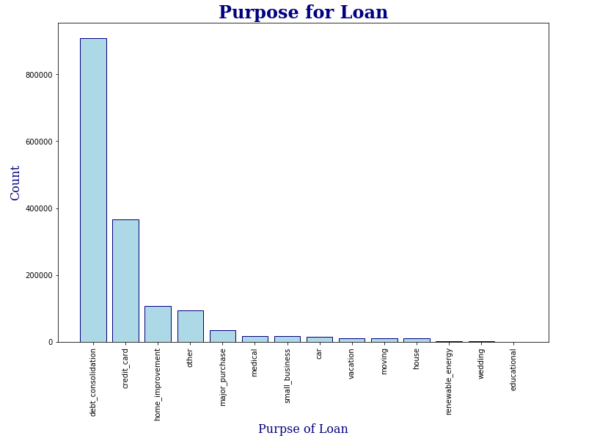
Application
80% of borrowers listed ‘debt consolidation’ or ‘credit card’ as the purpose of the loan
It is our hope this research could benefit people struggling with debt
These models could be used to determine the interest rate available to them through LC
Notes:
Noah

Slide 7
Dataset
Data is from Kaggle, includes accepted loan from 2007 to 2018
Loans are up to $40,000 with either 3 or 5 year payment plans
Started with around 2 million rows and 151 variables
Variables include
Fico Score
Debt to Income Ratio
Number of delinquent accounts
Total annual income
Home ownership
Average current balance
Notes:
Noah

Slide 8
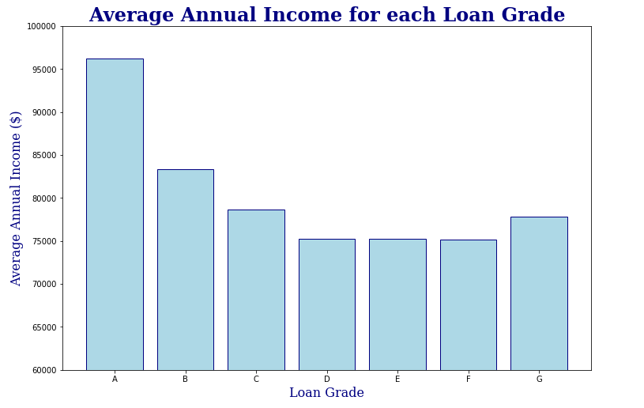
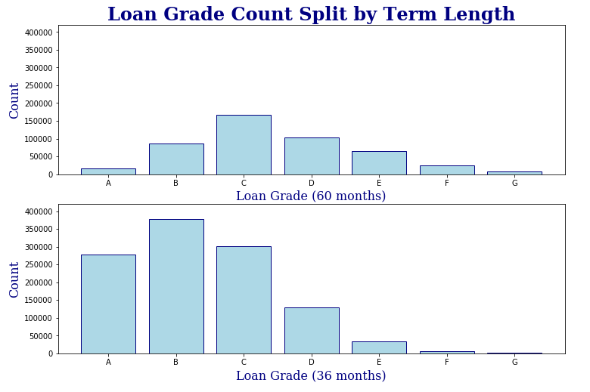
Exploratory Data Analysis
Notes:
Noah

Slide 9
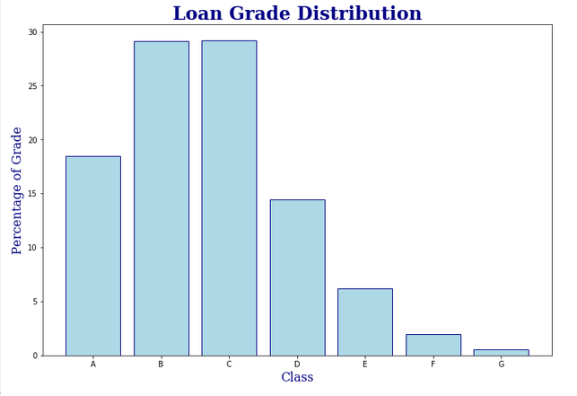
Problems
High Dimensionality dataset
Class imbalance
Poor computing power
Notes:
Noah

Slide 10
Implementation Platform
Used Ipython notebooks
Data Processing
Pandas, Numpy
Machine Learning Libraries
Keras, Tensorflow, Scikit-learn
Data Visualization
Matplotlib, Seaborn
Notes:
Noah

Slide 11
Data Preprocessing
Threw out all joint accounts and associated variables
Dropped features unrelated to loan grade
Address State, Employee Title, Zip code etc.
Threw out all variables with more than 80% missing
Left us with 1.6 million rows and 83 features
Removed all the column strongly correlated with loan grades
Notes:
Bipasha

Slide 12
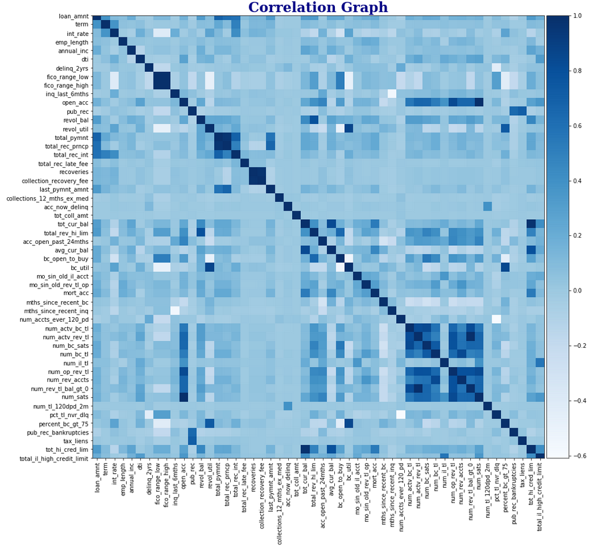
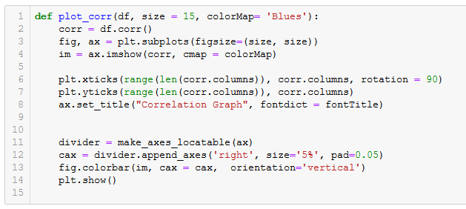
Correlation Testing-(Before)
Compared correlations of continuous features
Dropped features that were strongly correlated to reduce redundancies
Notes:
Bipasha

Slide 13
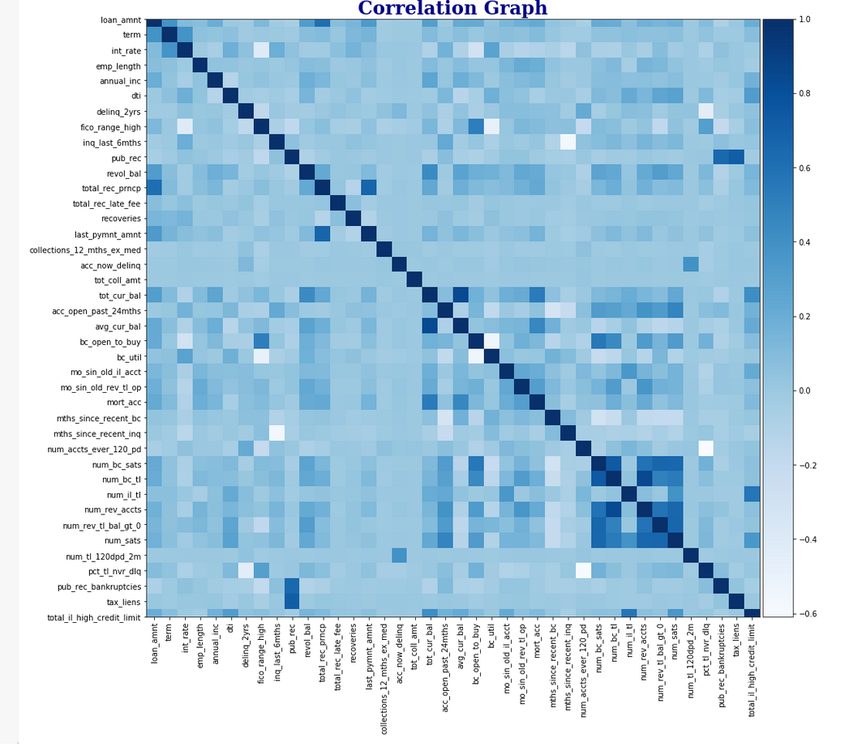
Correlation(After)
Dropped features like Fico range low and open accounts
Reduce the total number of features to 49
Notes:
Bipasha

Slide 14
Categorical Features
Created dummy variables from the categorical features
Home_ownership,verification_status, loan_status etc
Normalized the dataset using Min Max Scaler
Used stratify to maintain the same proportion as the input data
Due to the limitation of using huge dataset used 10% of full dataset i.e 159587 rows and 49 features .
Notes:
Bipasha

Slide 15
Combatting Imbalance Dataset
There are several methods to help with the imbalance of loan grades
Upsampling
Downsampling
Generate synthetic samples
Penalize models
Apply different algorithm
First priority: Find the best algorithm
Applied upsampling to ONE of the algorithm (Logistic Regression)
Notes:
Bipasha

Slide 16
Experimental Evaluation
Developed 5 different algorithms
K-Nearest Neighbors (KNN)
Decision Tree (DCT)
Random Forest (RF)
Deep Neural Network (DNN)
Logistic Regression (from Scratch)
Notes:
Bipasha

Slide 17
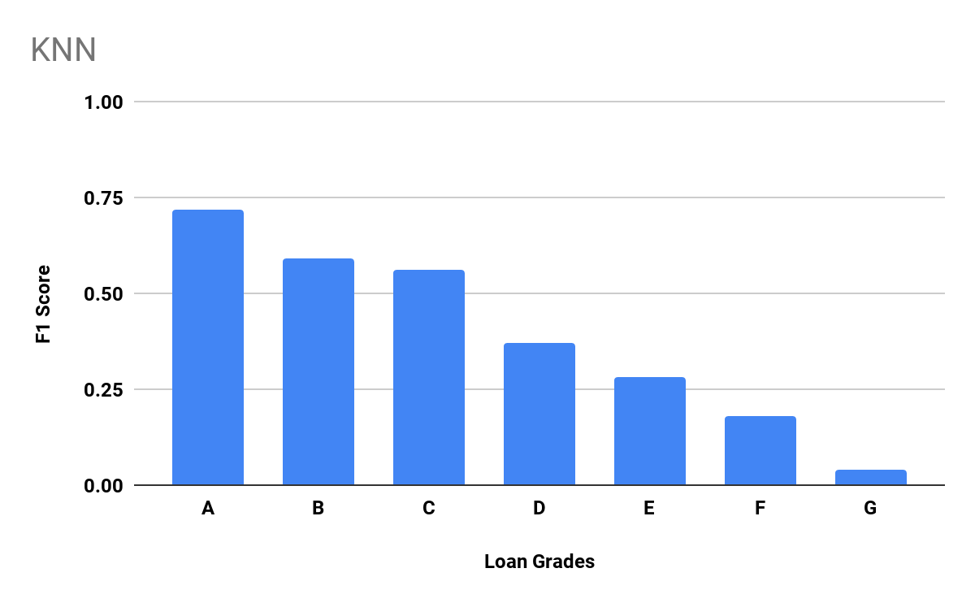
K Nearest Neighbors
Grid Search(CV=5) | Best Param(Neighbor=10)
Accuracy | 56%
Computational Time | 100 minutes
F1-Scores
A | 0.72
B | 0.59
C | 0.56
D | 0.37
E | 0.28
F | 0.18
G | 0.04
Notes:
Bipasha

Slide 18
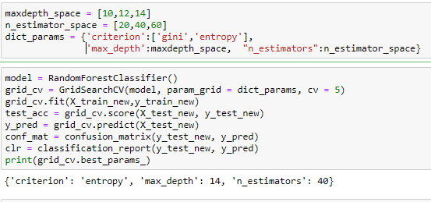
Random Forest -1/2
GridSearchCV (cv = 5)
Best Parameters:
Criterion : ‘entropy’,
Max_depth : 14
N_estimator : 40
Notes:
Bipasha

Slide 19
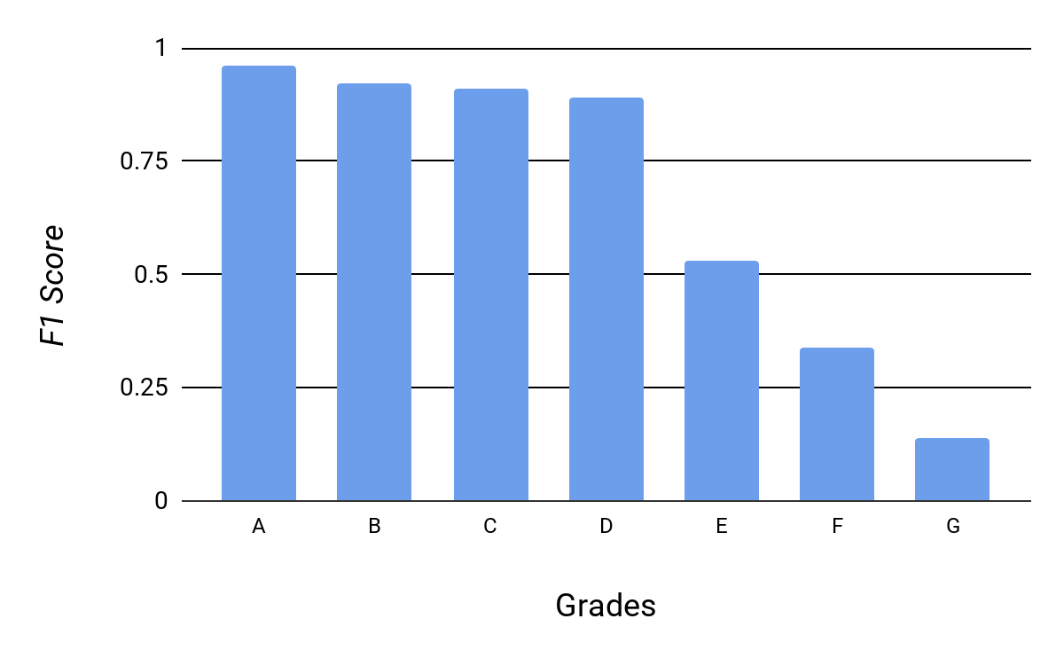
Random Forest -2/2
Accuracy | 0.87
Computation Time | 40 minutes
F1-Scores
A | 0.96
B | 0.92
C | 0.91
D | 0.89
E | 0.53
F | 0.34
G | 0.14
Notes:
Bipasha

Slide 20
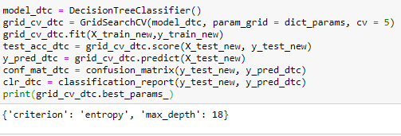
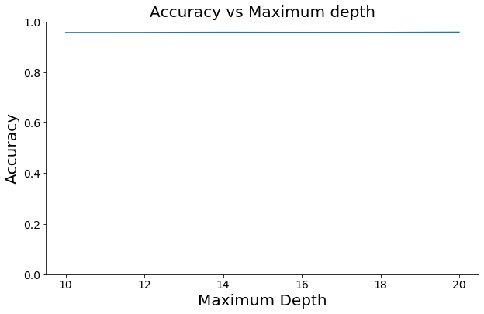
Decision Tree - 1/2
GridSearchCV (cv = 5)
Best Parameters:
Criterion : ‘entropy’,
Max_depth : 18
Notes:
Sudipta

Slide 21
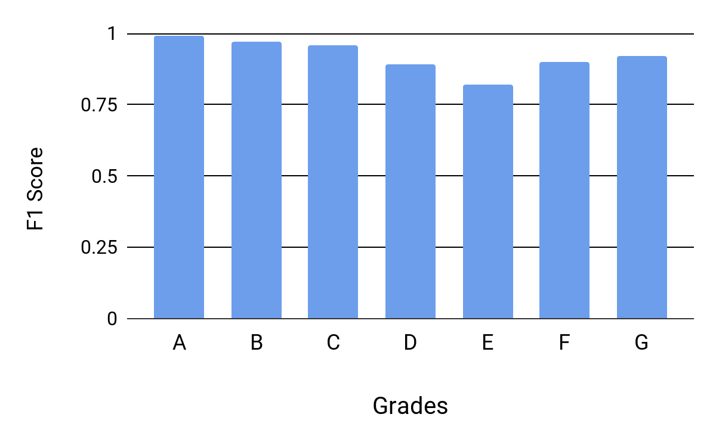
Decision Tree - 2/2
Accuracy | 0.96
Computation Time | 5 minutes
F1-Scores
A | 0.99
B | 0.97
C | 0.96
D | 0.89
E | 0.82
F | 0.90
G | 0.92
Notes:
Sudipta

Slide 22
Deep Neural Net -1/4
Input Layer
(55 Neurons)
Layer - 2
Neurons = 5
Activation = ’relu’
Layer - 3
Neurons = 5
Activation = ’relu’
Layer - 4
Neurons = 7
Activation = ’softmax’
4 layer Neural Network architecture
Notes:
Sudipta

Slide 23
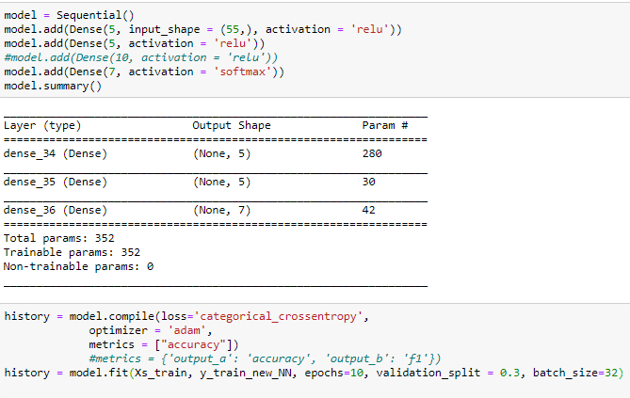
Deep Neural Net -2/4
Loss = categorical Cross entropy
Optimizer = adam
Metrics = accuracy
Epochs = 10
Validation split = 0.3
Batch size = 32
Notes:
Sudipta

Slide 24
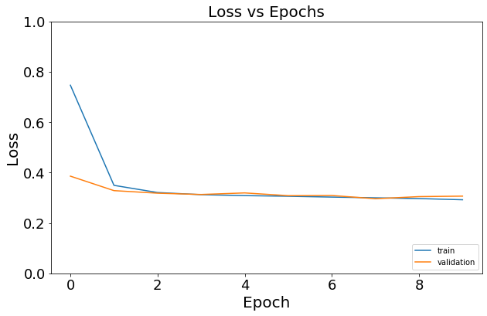
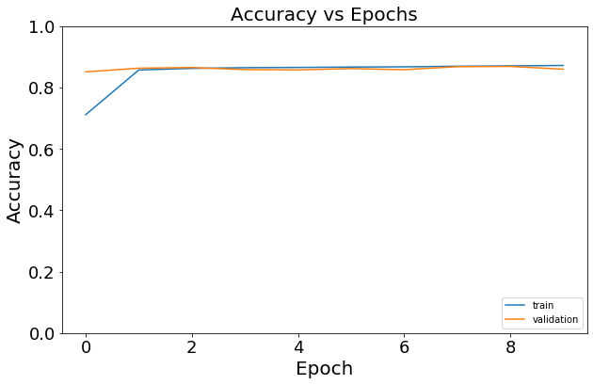
Deep Neural Net - 3/4
Notes:
Sudipta

Slide 25
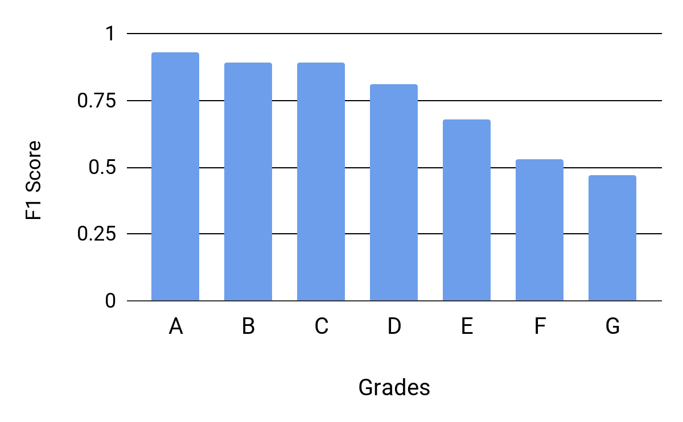
Deep Neural Net - 4/4
Accuracy | 0.87
Computation Time | 6 minutes
F1-Scores
A | 0.93
B | 0.89
C | 0.89
D | 0.81
E | 0.68
F | 0.53
G | 0.47
Notes:
Sudipta

Slide 26
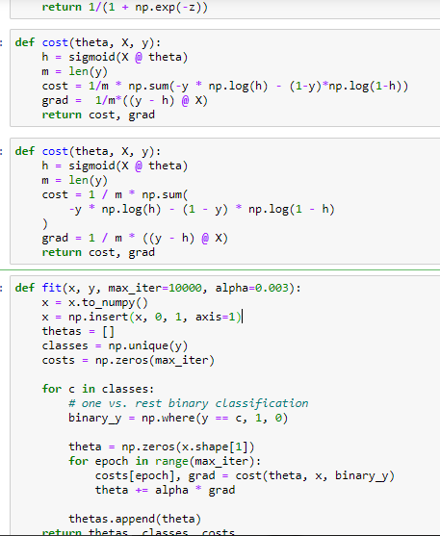
Logistic Regression (Scratch) -1/4
Sigmoid
Input: hypothesis
Output: sigmoid
cost
Input: theta, X, y
Output: cost, gradient
Fit
Input: X, y, max_iter, alpha
Output: thetas, classes, costs
Predict
Input: thetas, classes, X
Output: predicted class
Score
Input: predicted class, y
Output: accuracy
Notes:
Sudipta

Slide 27
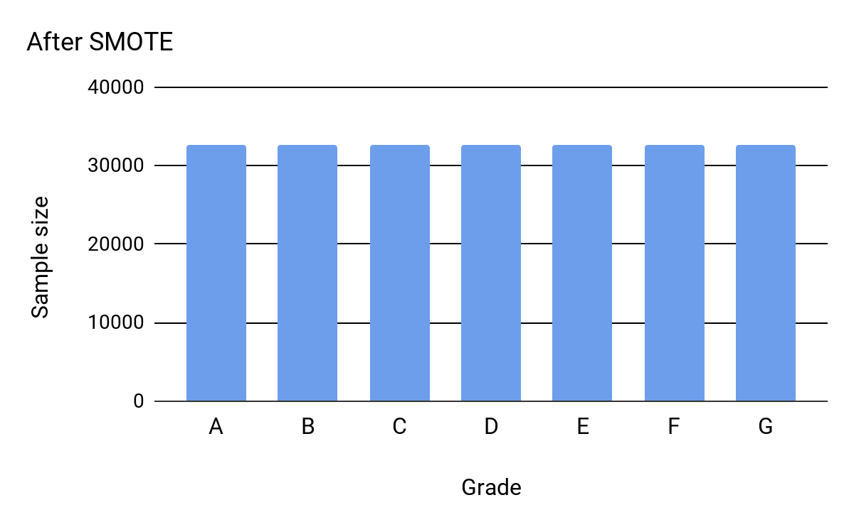
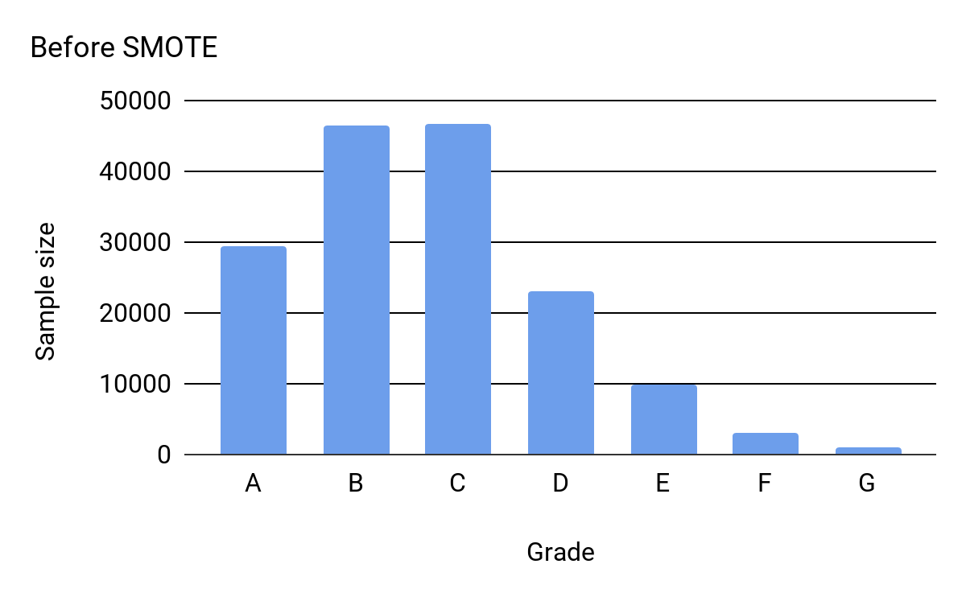
Logistic Regression (Scratch) -2/4
Applied Oversampling
SMOTE (Synthetic minority oversampling technique)
Notes:
Sudipta

Slide 28
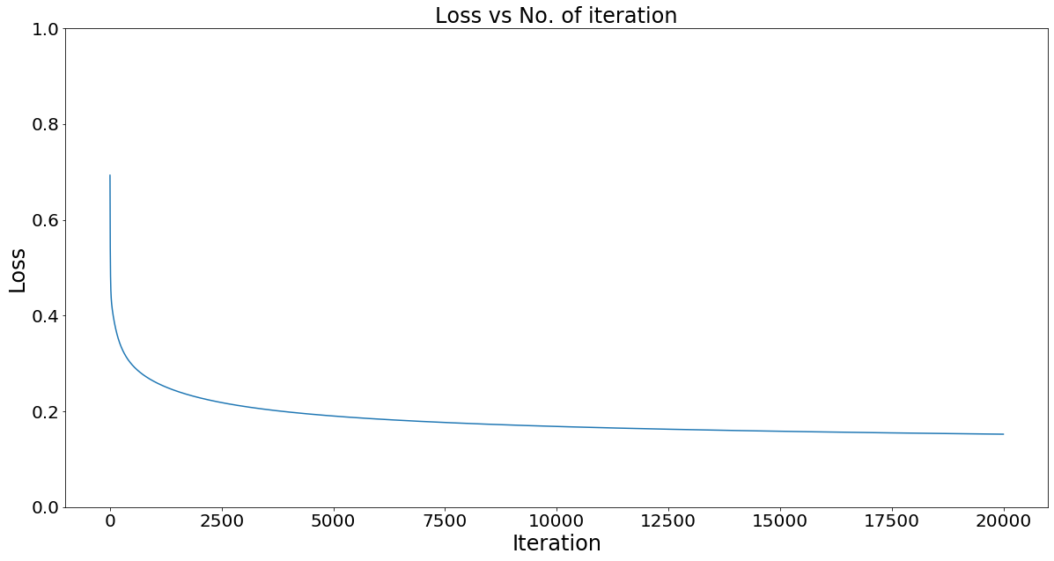
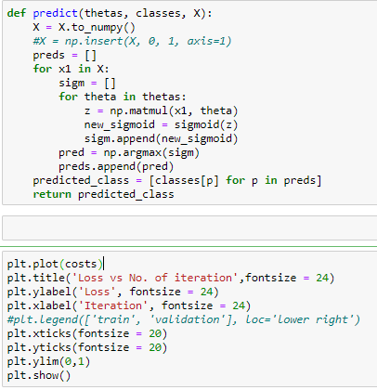
Logistic Regression (Scratch) -3/4

Slide 29
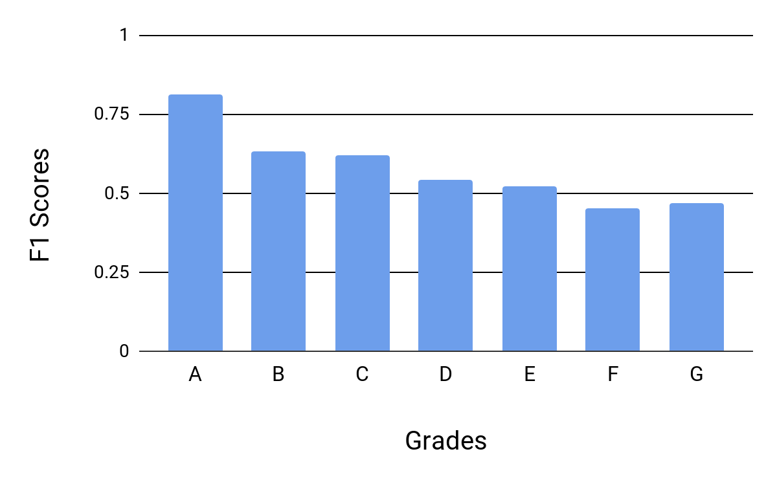
Logistic Regression (Scratch) -4/4
Accuracy | 0.68
Computation Time | 170 minutes
F1-Scores
A | 0.81
B | 0.63
C | 0.62
D | 0.54
E | 0.52
F | 0.45
G | 0.47
Notes:
Sudipta

Slide 30
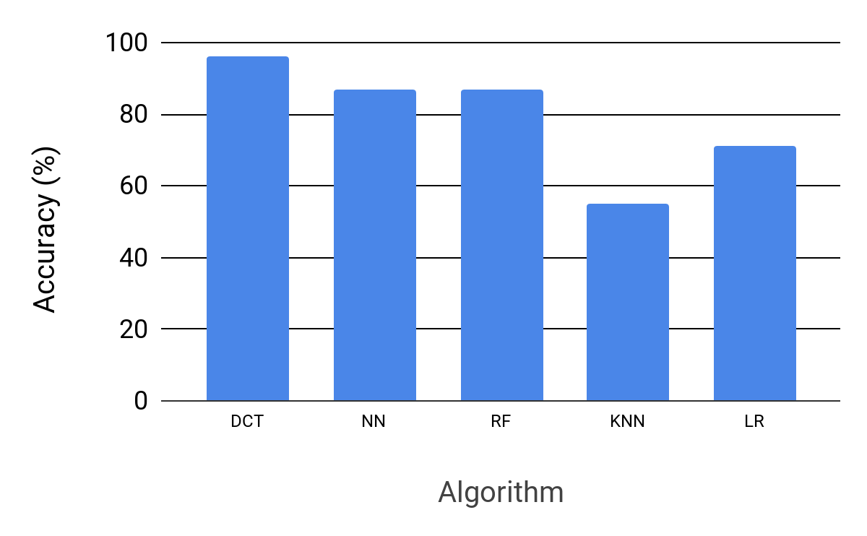
Comparison - Accuracy
Accuracy (%)
DCT | 96
NN | 87
RF | 87
LR | 68
KNN | 55
Notes:
Sudipta

Slide 31
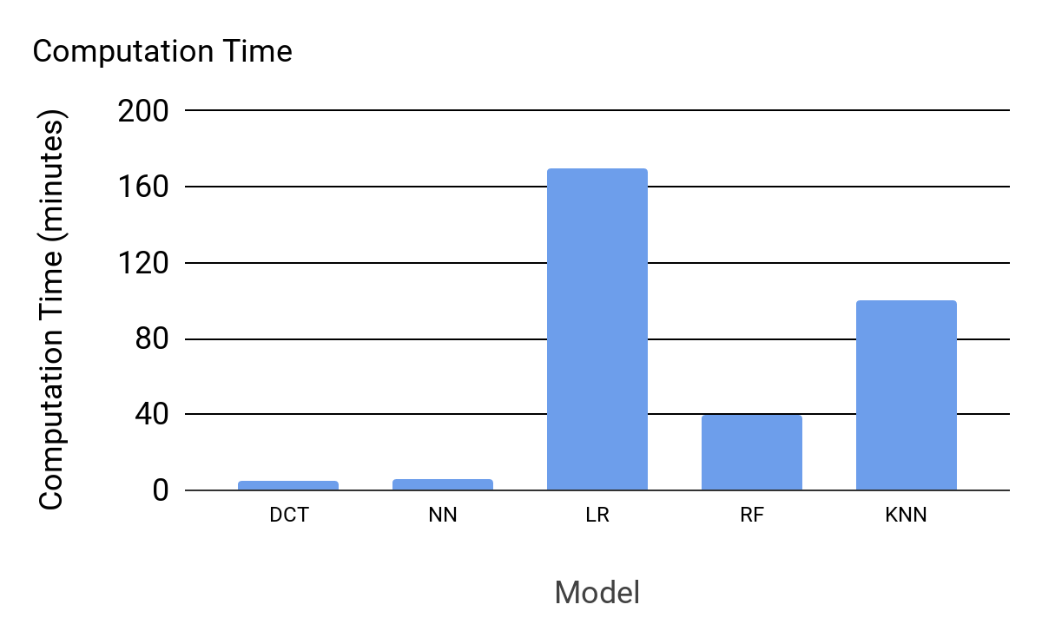
Comparison - Computation Time
Computation Time (minutes)
DCT | 5
NN | 6
LR | 170
RF | 40
KNN | 100
Notes:
Sudipta

Slide 32
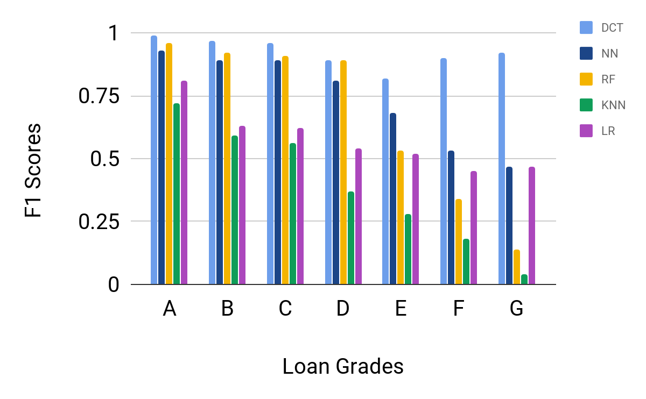
Comparison - F1 Scores
Notes:
Sudipta

Slide 33
Conclusion
Decision Tree has the highest accuracy, 9% higher than the next best algorithm Deep Neural Network.
Decision Tree is able to predict the classes with fewer data, high F1 scores
Decision Tree had the fastest runtime, 1 minute faster than the next fastest algorithm Deep Neural Network.
KNN and Logistic Regression had the worst performance for this dataset
Very high computation time.
Had poor accuracy and F1 scores
Notes:
Noah

Slide 34
Future Work
Try different class imbalance techniques
Predict Fico score from dataset
Notes:
Noah

Slide 35
Thank You
Questions?

