Slide 1
A Simplified SDRE Technique for Finite Horizon Tracking Problem in Optimal Control Systems
D. Subbaram Naidu, Life Fellow IEEE
Minnesota Power Jack F. Rowe Endowed Chair
University of Minnesota Duluth (UMD)
Sudipta Paul
University of Minnesota Duluth (UMD)
Ahmed Khamis
Military Technical College, Egypt
Craig R. Rieger, Senior Member IEEE
Idaho National Laboratory (INL), Idaho Falls, Idaho
SIXTH INDIAN CONTROL CONFERENCE (ICC-6)
Indian Institute of Technology, Hyderabad, India

Slide 2
Outline
Overview of infinite-horizon regulation via SDRE
Overview of infinite-horizon tracking via SDRE
Overview of finite-horizon regulation via SDRE
Existing SDRE Approach
Simplified SDRE Approach
Overview of finite-horizon tracking via SDRE
Existing SDRE Approach
Simplified SDRE Approach
Nonlinear modeling of PMSG based WECS
Simulation Results
Conclusions
Sixth Indian Control Conference (ICC-6), IIT Hyderabad, 18-20 Dec, 2019

Slide 3
Paper Goal and Contribution
Discusses nonlinear, closed-loop finite-horizon tracking via existing state dependent Riccati equation (SDRE) technique.
Proposes a simplified SDRE approach for closed-loop finite-horizon tracking for nonlinear systems.
Presents a fifth order nonlinear model of a permanent magnet synchronous generator based wind energy conversion system (PMSG-WECS).
Validity of the proposed simplified SDRE technique is illustrated with finite-time optimal tracking of a nonlinear, fifth order model of a PMSG-WECS and compared with the existing SDRE technique.
Sixth Indian Control Conference (ICC-6), IIT Hyderabad, 18-20 Dec, 2019

Slide 4
Overview of Nonlinear and Linearized Systems
Linearized System
Optimal Linear Tech.
(LQR, LQT,..)
Linearization
around O.P.
Nonlinear System
Optimal Nonlinear Tech.
(SDRE,..)
LQR: Linear Quadratic Regulation; LQT: Linear Quadratic Tracking;
SDRE: State-Dependent Riccati Equation
Sixth Indian Control Conference (ICC-6), IIT Hyderabad, 18-20 Dec, 2019

Slide 5
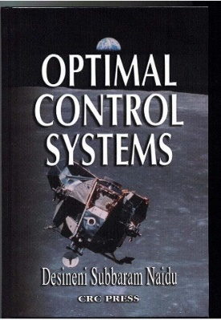
Finite-Horizon Regulation & Tracking: Analytical Solution of DRE
Analytical Solution to Matrix DRE (Ref: Lewis, F., Optimal Control, 1986 and Vaughan, D.R., IEEE TAC, 1970)
The solution of the matrix DRE is not available in MATLAB
A MATLAB-based program was developed by Craig Rieger (INL), PhD (2008) for solving the matrix DRE based on the analytical solution of the DRE.
MATLAB Command [x,u,K]=lqrnss(A,B,F,Q,R,x₀,tspan)
For tracking, the command is : [x,y,u,trkerr]=lqtnss(A,B,C,F,Q,R,x₀,z,tspan)
lqrnss stands for lqr for non-steady state condition.
lqtnss stands for lqt for non-steady state condition.
D.S. Naidu, Optimal Control Systems,
CRC Press of Taylor & Francis, 2003
Sixth Indian Control Conference (ICC-6), IIT Hyderabad, 18-20 Dec, 2019

Slide 6
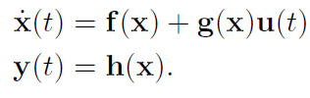



Overview of Infinite-Horizon SDRE Regulator
Given a nonlinear system
SDC representation
Infinite-horizon cost
State feedback control law
State-Dependent Algebraic Riccati Equation (SD-ARE)
Sixth Indian Control Conference (ICC-6), IIT Hyderabad, 18-20 Dec, 2019

Slide 7
Overview of Infinite-Horizon SDRE Regulator
At time step q =1
X=X0
x
Calculate A(x), B(x)
Solve ARE for P
Calculate Gain K
Calculate control u
u
q = q + 1
The system
Sixth Indian Control Conference (ICC-6), IIT Hyderabad, 18-20 Dec, 2019

Slide 8
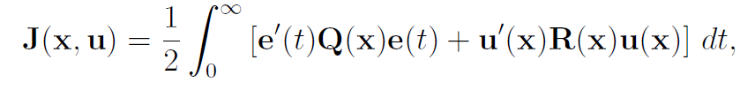

Overview of Infinite-Horizon SDRE Tracking
Given a nonlinear system
SDC representation
Infinite-horizon cost
State feedback control law
Algebraic Riccati Equation (ARE) and Vector Algebraic Equation
Sixth Indian Control Conference (ICC-6), IIT Hyderabad, 18-20 Dec, 2019

Slide 9
Overview of Infinite-Horizon SDRE Tracking
At time step q =1
X=X0
Z(t)
x
Calculate
A(x), B(x), C(x)
Solve ARE for P
Solve AE for g
Calculate control u
u
q = q + 1
The system
x
Sixth Indian Control Conference (ICC-6), IIT Hyderabad, 18-20 Dec, 2019

Slide 10
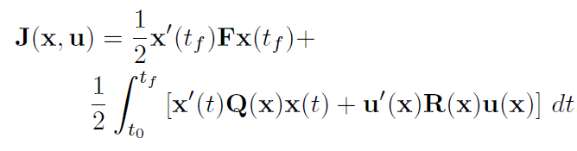
Nonlinear Finite-Horizon Regulation via SDRE
Given a nonlinear system
SDC representation
Finite- horizon cost
Sixth Indian Control Conference (ICC-6), IIT Hyderabad, 18-20 Dec, 2019

Slide 11
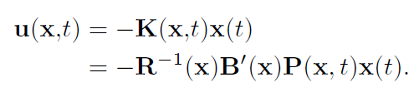
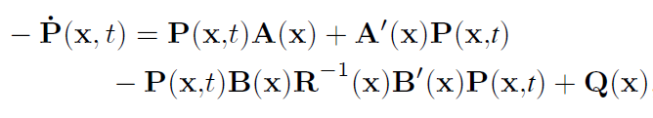


General Solution: Finite-Horizon SDRE Regulation
State feedback control law
State-Dependent Differential Riccati Equation (SD-DRE)
with final condition,
The Closed-Loop State Trajectory
Sixth Indian Control Conference (ICC-6), IIT Hyderabad, 18-20 Dec, 2019

Slide 12
Existing SDRE Approach: Finite Horizon Regulation
At time step t=t₀,
X=X₀
Solve ARE
P_{SS}(x)
The System
A(x), B(x)
Apply change of variable
K(x,t)
Solve DRE for P(x,t)
Solve ALE
Next time step
t=t+∆t
A_{cl} , D
Calculate gain K
Solve DLE
Solve K(x,t)
Calculate control u
Find P(x,t)
t<t_{f}
Stop

Slide 13
Simplified SDRE Approach – One Step Process
At time step t=t₀, x=x₀
SDC form: A(x), B(x)
Set timespan, tspan=[t₀ t₁]
MATLAB Command:
[x,u,K]=lqrnss(A,B,F,Q,R,x₀,tspan)
lqrnss
Find optimized x
Find control u
Set next timespan: [t₁ t₂]
Set next initial condition x₁
t₂<t_{f}
Stop

Slide 14
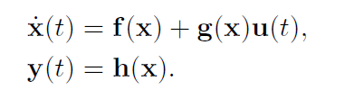
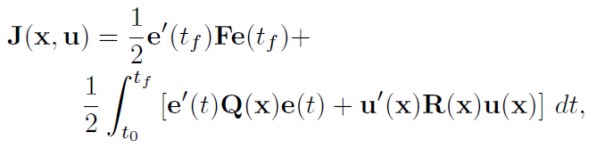
Finite-Horizon Tracking via SDRE
Given a nonlinear system
State-Dependent Coefficient (SDC) Form
Finite horizon cost function
Sixth Indian Control Conference (ICC-6), IIT Hyderabad, 18-20 Dec, 2019

Slide 15


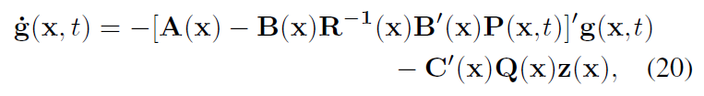


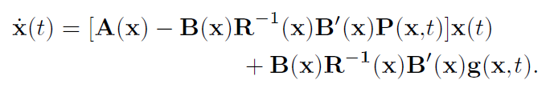
General Solution: Finite-Horizon SDRE Tracking
State feedback control law
Differential Riccati Equation (DRE)
with final condition,
Vector differential equation (VDE)
with final condition,
SD-DRE controlled trajectory
Sixth Indian Control Conference (ICC-6), IIT Hyderabad, 18-20 Dec, 2019

Slide 16




Existing SDRE Approach: Finite Horizon Tracking
Algorithmic steps for solving P(x,t)
Step-1: Solve ARE to find P_{SS}(x)
Step-2: Use change of variable to get
Step-3: Calculate A_{cl}(x)
Step-4: Solve algebraic Lyapunov equation for D
Sixth Indian Control Conference (ICC-6), IIT Hyderabad, 18-20 Dec, 2019

Slide 17
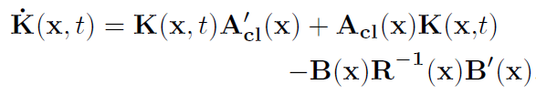

Existing SDRE Approach: Finite Horizon Tracking
Algorithmic steps for solving P(x,t)
Step-5: Solve DLE
The solution is found as
Step-6: Obtain P(x,t) as
Sixth Indian Control Conference (ICC-6), IIT Hyderabad, 18-20 Dec, 2019

Slide 18
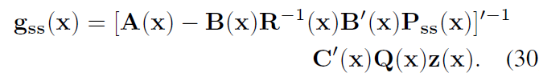

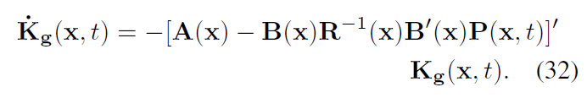
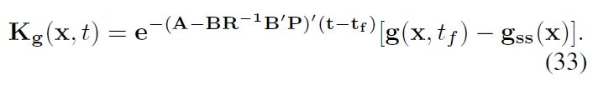
Existing SDRE Approach: Finite Horizon Tracking
Algorithmic steps for solving g(x,t)
Step-1: Solve VAE to find g_{SS}(x)
Step-2: Use change of variable to get
Step-3: Solve differential equation
The solution is found as
Sixth Indian Control Conference (ICC-6), IIT Hyderabad, 18-20 Dec, 2019

Slide 19

Existing SDRE Approach: Finite Horizon Tracking
Step-4: Obtain g(x,t) as
State feedback optimal control law
Sixth Indian Control Conference (ICC-6), IIT Hyderabad, 18-20 Dec, 2019

Slide 20
Existing SDRE Approach: Finite Horizon Tracking
At t=t₀ , X = X₀
Solve VAE
The system A(x), B(x), C(x)
Solve ARE
g_{SS}(x)
P_{SS}(x)
Apply change of variable
Apply change of variable
Solve VDE
g(x,t)
Solve DRE
P(x,t)
K_{g}(x,t)
t = t + ∆t
K(x,t)
Solve ALE
Solve DE
A_{cl} , D
Solve K_{g}(x,t)
Find optimal control, u(x,t)
Solve DLE
Find g(x,t)
Solve K(x,t)
t<t_{f}
Find P(x,t)
Stop

Slide 21
Finite-Horizon Tracking via SDRE: Simplified Approach
At t=t₀ , X = X₀
Z(t)
A(x), B(x), C(x)
Set timespan, tspan = [t₁ t₂]
lqtnss
(lqt for non-steady state)
Analytic solution of Matrix DRE
Analytic solution of VDE
Find optimal u and optimal x
New timespan, tspan = [t₁+∆t t₂+ ∆t]
Initial condition for new tspan
t₂<t_{f}
Stop

Slide 22
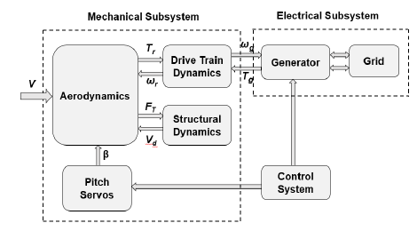
Nonlinear Modeling of PMSG-WECS – 1/6
WECS can be divided into two groups in terms of physical nature (electrical and mechanical) and four groups in terms of dynamics (aerodynamics, drive train dynamics, generator dynamics and structural dynamics)
WECS block diagram
PMSG: Permanent Magnet Synchronous Gnerator; WECS: Wind Energy Conversion System
v - wind speed; T_{r} – Aerodynamic torque; ω_{r} – Reference wind rotor speed; ω_{g} – generator speed; T_{g} – Generator torque; F_{T} – thrust force (For control design, we will neglect structural dynamics.)

Slide 23
Nonlinear Modeling of PMSG-WECS – 2/6
ω_{r} – wind rotor speed
ω_{g} – generator speed
T_{g} – Generator torque
T_{H} – Internal torque
i – Gearbox ratio
η – Gearbox efficiency
J_{r} – Wind rotor inertia
T_{r} – Aerodynamic torque
J_{g} – Generator inertia
K_{g} – High speed shaft stiffness coefficient
B_{g} – High speed shaft damping coefficient
β – Pitch angle of the blade
β_{d} – Desired pitch angle
i_{d}, u_{d} – d axis current and voltage
i_{q}, u_{q}– q axis current and voltage
R_{s} – Resistance of the stator
L_{d}, Lq – d and q axis inductance
p – number of poles
Ф_{m} – PMSG flux linkage
R – wind rotor plane radius
C₀–C₇ – Polynomial coefficients
Sixth Indian Control Conference (ICC-6), IIT Hyderabad, 18-20 Dec, 2019

Slide 24
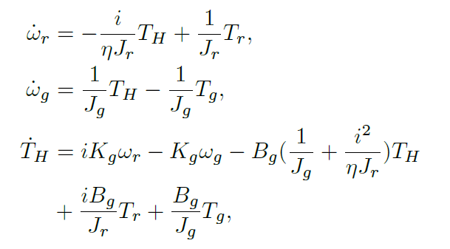
Nonlinear Modeling of PMSG-WECS – 3/6
Flexible Drive-train Dynamic Model
ω_{r} – wind rotor speed; ω_{g} – generator speed; T_{g} – Generator torque; T_{H} – Internal torque;
Sixth Indian Control Conference (ICC-6), IIT Hyderabad, 18-20 Dec, 2019

Slide 25
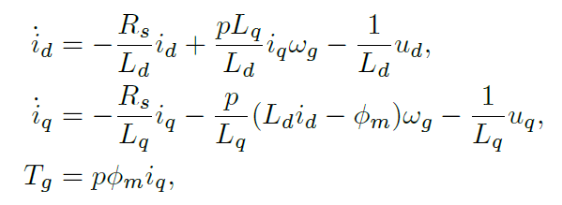

Nonlinear Modeling of PMSG-WECS – 4/6
PMSG Generator Dynamic Model in (d,q) Axes
State Vector of PMSG-WECS
Control Vector
PMSG: Permanent Magnet Squirrel Cage; i_{d}, u_{d} – d axis current and voltage; i_{q}, u_{q}– q axis current and voltage
Sixth Indian Control Conference (ICC-6), IIT Hyderabad, 18-20 Dec, 2019

Slide 26
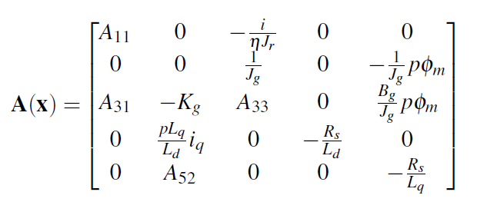
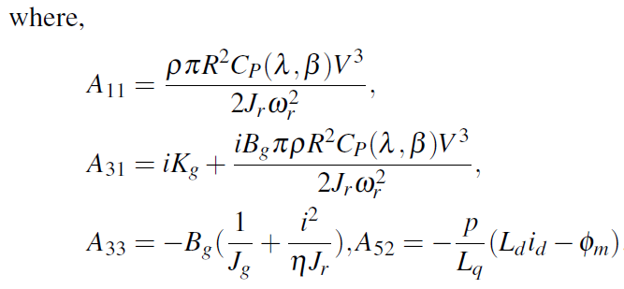
Nonlinear Modeling of PMSG-WECS – 5/6
After transforming into SDC form, A(x) and B(x) matrices are found as
Sixth Indian Control Conference (ICC-6), IIT Hyderabad, 18-20 Dec, 2019

Slide 27
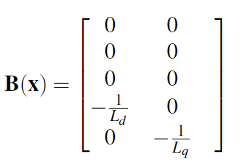
Nonlinear Modeling of PMSG-WECS – 6/6
and B(x) matrix will be
Sixth Indian Control Conference (ICC-6), IIT Hyderabad, 18-20 Dec, 2019

Slide 28
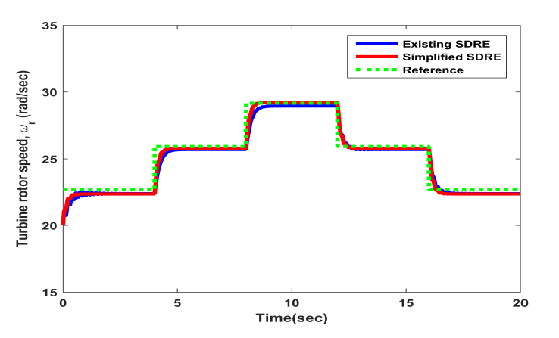
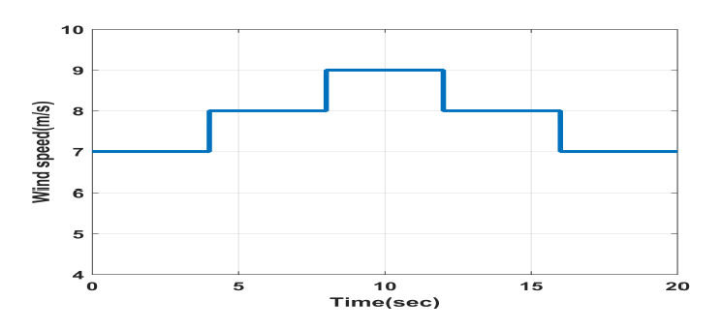
Simulation and Comparison of Results Existing and Simplified SDRE – 1/4
Wind speed profile
Tracking performance via existing SDRE and simplified SDRE
Sixth Indian Control Conference (ICC-6), IIT Hyderabad, 18-20 Dec, 2019

Slide 29
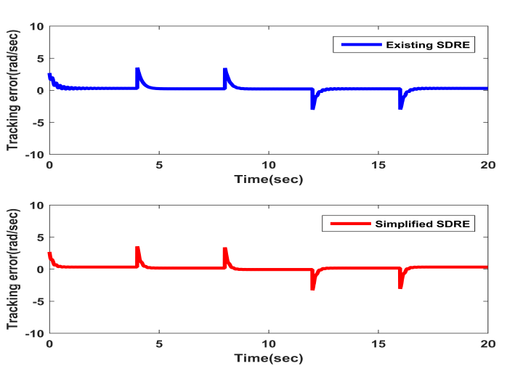
Simulation and Comparison of Results Existing and Simplified SDRE – 2/4
Tracking error via existing SDRE and simplified SDRE
Sixth Indian Control Conference (ICC-6), IIT Hyderabad, 18-20 Dec, 2019

Slide 30
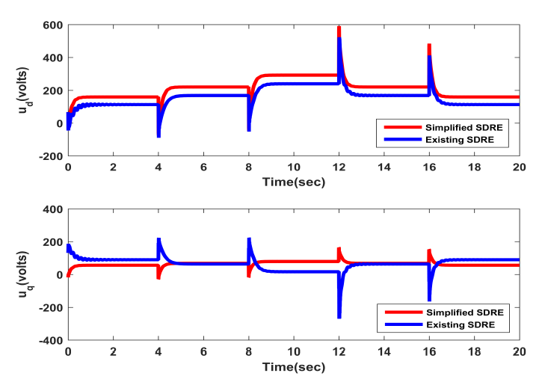
Simulation and Comparison of Results Existing and Simplified SDRE – 3/4
Nonlinear finite horizon tracking controller via existing SDRE and
simplified SDRE
Sixth Indian Control Conference (ICC-6), IIT Hyderabad, 18-20 Dec, 2019

Slide 31
Conclusions
This paper proposed a simplified SDRE technique for finite- horizon optimal tracking of nonlinear systems.
The main idea is to use the analytical solution of DRE and VDE and the associated MATLAB program lqtnss at each time step developed by the authors instead of using approximate steady-state ARE and VAE with the existing SDRE.
This method eliminates approximate nature of the solution resulting from existing SDRE and reduces the computational complexities.
The proposed simplified technique is implemented with a nonlinear fifth- order PMSG-WECS and compared with the existing approach.
Simulation results validate the effectiveness of the simplified SDRE technique.

Slide 32
Thank You & Any Questions ?
Sixth Indian Control Conference (ICC-6), IIT Hyderabad, 18-20 Dec, 2019

