Slide 1
A Simplified SDRE Technique for Regulation in Optimal Control Systems
D. Subbaram Naidu, Fellow IEEE
Minnesota Power Jack F. Rowe Endowed Chair
University of Minnesota Duluth
Sudipta Paul
University of Minnesota Duluth
Craig R. Rieger, SMIEEE
Idaho National Laboratory
19th Annual IEEE INTERNATIONAL CONFERENCE ON ELECTRO INFORMATION TECHNOLOGY (eit2019)
May 20-22, 2019 Brookings, South Dakota, USA

Slide 2
Outlines
Overview of infinite horizon LQR
Overview of finite Horizon LQR
Overview of infinite horizon SDRE
Nonlinear finite horizon regulation via SDRE
Existing SDRE Approach
Simplified SDRE Approach
Nonlinear modeling of PMSG based VSVP-WECS
Simulation results
Conclusions
19th Annual IEEE INTERNATIONAL CONFERENCE ON ELECTRO INFORMATION TECHNOLOGY

Slide 3
Paper Goal and Contribution
Discusses nonlinear closed loop finite horizon regulation via existing state dependent Riccati equation (SDRE) technique.
Proposes a simplified SDRE approach for closed loop finite horizon regulation for nonlinear systems.
Presents a complete sixth order nonlinear model of a PMSG based variable speed variable pitch wind energy conversion system (VSVP-WECS).
Validity of the proposed simplified SDRE technique is illustrated with finite time optimal regulation of a nonlinear, sixth order model of a VSVP-WECS and compared with the existing SDRE technique.
19th Annual IEEE INTERNATIONAL CONFERENCE ON ELECTRO INFORMATION TECHNOLOGY

Slide 4
Overview
Optimal Linear Tech.
(LQR, LQT,..)
Linearization
around O.P.
Linearized System
Nonlinear System
Optimal Nonlinear Tech.
(SDRE, ASRE,..)
19th Annual IEEE INTERNATIONAL CONFERENCE ON ELECTRO INFORMATION TECHNOLOGY

Slide 5




Overview of Infinite Horizon LQR
Given a linear time varying system
Quadratic performance index
State feedback control law
Matrix differential Riccati equation (MDRE)
with final condition,

Slide 6
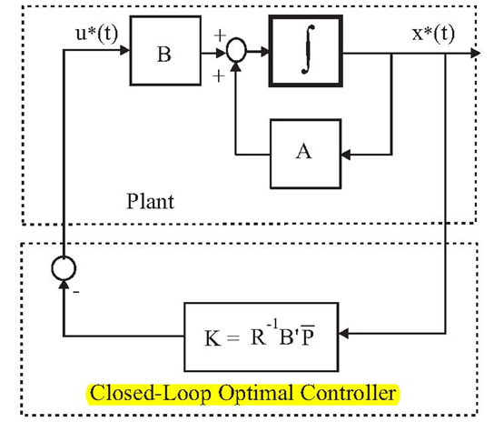
Infinite Horizon LQR-Implementation
Closed-Loop Optimal Control Implementation: Infinite Final Time
MATLAB Command
[K,P,EV]=lqr(A,B,Q,R)
19th Annual IEEE INTERNATIONAL CONFERENCE ON ELECTRO INFORMATION TECHNOLOGY

Slide 7

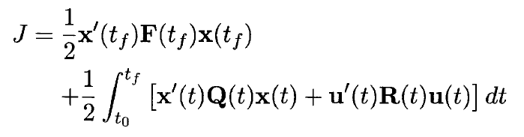
Overview of Finite Horizon LQR
Given a linear time varying system
Quadratic performance index
State feedback control law
Matrix differential Riccati equation (MDRE)
with final condition, P(t_{f}) = F(t_{f})
19th Annual IEEE INTERNATIONAL CONFERENCE ON ELECTRO INFORMATION TECHNOLOGY

Slide 8
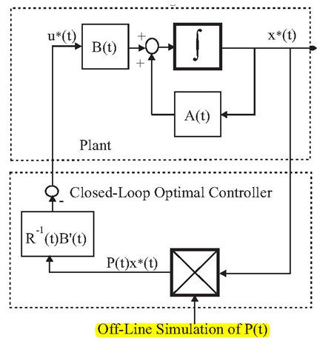
Finite Horizon LQR-Implementation
Closed-Loop Optimal Control Implementation:
19th Annual IEEE INTERNATIONAL CONFERENCE ON ELECTRO INFORMATION TECHNOLOGY

Slide 9
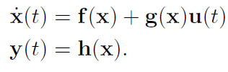



Overview of Infinite Horizon-SDRE Regulator
Given a nonlinear system
SDC representation
Infinite horizon cost function
State feedback control law
Algebraic SDRE (SDARE)

Slide 10
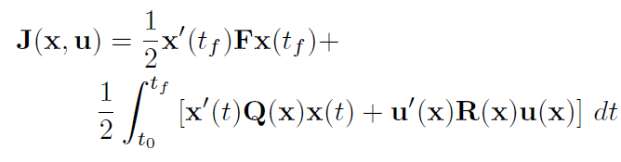
Nonlinear Finite Horizon Regulation via SDRE
Given a nonlinear system
SDC representation
Finite horizon cost function
19th Annual IEEE INTERNATIONAL CONFERENCE ON ELECTRO INFORMATION TECHNOLOGY

Slide 11
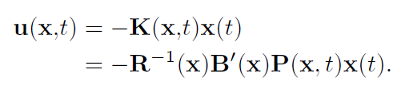
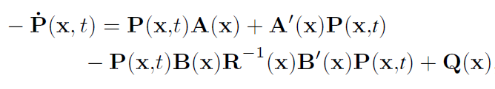


General Solution-Finite Horizon SDRE
State feedback control law
Differential Riccati Equation
with final condition,
SD-DRE controlled trajectory
19th Annual IEEE INTERNATIONAL CONFERENCE ON ELECTRO INFORMATION TECHNOLOGY

Slide 12
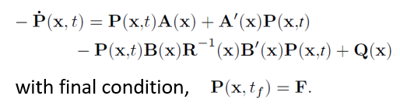
Existing SDRE Approach
At time step t=t₀,
X=X₀
The System
A(x), B(x)
Solve DRE for P(x,t)
Next time step
t=t+∆t
Calculate gain K
Calculate control u
t<t_{f}
Stop
19th Annual IEEE INTERNATIONAL CONFERENCE ON ELECTRO INFORMATION TECHNOLOGY

Slide 13




Existing SDRE Approach
Algorithmic steps for solving P(x,t)
Step-1: Solve ARE to find P_{SS}(x)
Step-2: Use change of variable to get
Step-3: Calculate A_{cl}(x)
Step-4: Solve algebraic Lyapunov equation
19th Annual IEEE INTERNATIONAL CONFERENCE ON ELECTRO INFORMATION TECHNOLOGY

Slide 14
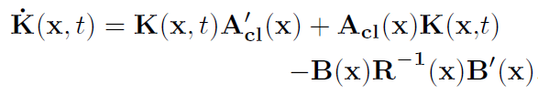

Existing SDRE Approach
Algorithmic steps for solving P(x,t)
Step-5: Solve DLE
The solution is found as
Step-6: Obtain P(x,t) as
Step-7: Calculate optimal control u(x,t)
19th Annual IEEE INTERNATIONAL CONFERENCE ON ELECTRO INFORMATION TECHNOLOGY

Slide 15
Simplified SDRE Approach
Eliminates approximate nature of the solution resulting from existing SDRE.
MATLAB Implementation of Analytical Solution to Matrix DRE.
The solution of the matrix DRE is not readily available with MATLAB and hence a MATLAB-based program lqrnss was developed by the authors of this paper for solving the matrix DRE based on analytical solution.
MATLAB Command: [x,u,K]=lqrnss(A,B,F,Q,R,x0,tspan)
lqrnss stands for lqr for non-steady state condition.
19th Annual IEEE INTERNATIONAL CONFERENCE ON ELECTRO INFORMATION TECHNOLOGY

Slide 16
Simplified SDRE Approach
The MATLAB program lqrnss for analytic solution of MDRE is used at each time step instead of using steady-state Riccati coefficient.
The solution of the finite time non-steady-state LQR problem requires a backward integration of the MDRE.
Common method of solution: rewrite the matrix equation into a set of scalar equations, then perform the required numerical backward integration. This method is complex and time consuming also does not lend itself to the development of a generic LQR controller for online implementation.
That’s why as a better and easier method, the analytical solution of MDRE is utilized which is found in various texts.
19th Annual IEEE INTERNATIONAL CONFERENCE ON ELECTRO INFORMATION TECHNOLOGY

Slide 17
Simplified SDRE Approach
At time step t=t₀, X=X₀
SDC form: A(x), B(x)
Set timespan, tspan=[t₁ t₂]
MATLAB Command:
[x,u,K]=lqrnss(A,B,F,Q,R,x0,tspan)
lqrnss
Find optimized X
Find control u
Define new timespan
Define new initial condition
t₂<t₁
Stop

Slide 18
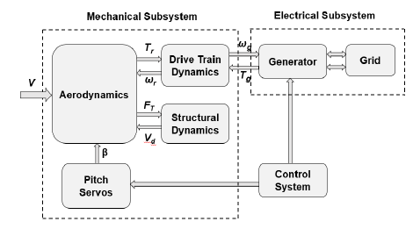
Nonlinear Modeling of VSVP-WECS
WECS can be divided into two groups in terms of physical nature (electrical and mechanical) and four groups in terms of dynamics (aerodynamics, drive train dynamics, generator dynamics and structural dynamics)
WECS block diagram
19th Annual IEEE INTERNATIONAL CONFERENCE ON ELECTRO INFORMATION TECHNOLOGY

Slide 19
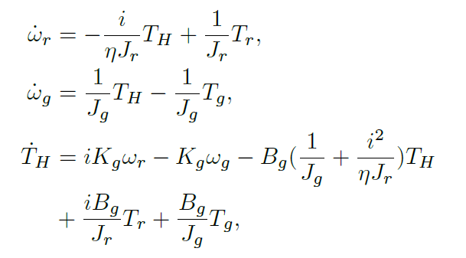

Nonlinear Modeling of VSVP-WECS
Flexible Drive train dynamic model
Pitch actuator dynamics
19th Annual IEEE INTERNATIONAL CONFERENCE ON ELECTRO INFORMATION TECHNOLOGY

Slide 20
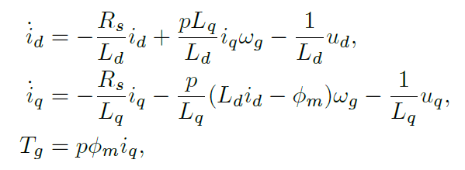


Nonlinear Modeling of VSVP-WECS
PMSG dynamic model in (d,q) axes
State vector of VSVP-WECS
And, control vector
19th Annual IEEE INTERNATIONAL CONFERENCE ON ELECTRO INFORMATION TECHNOLOGY

Slide 21
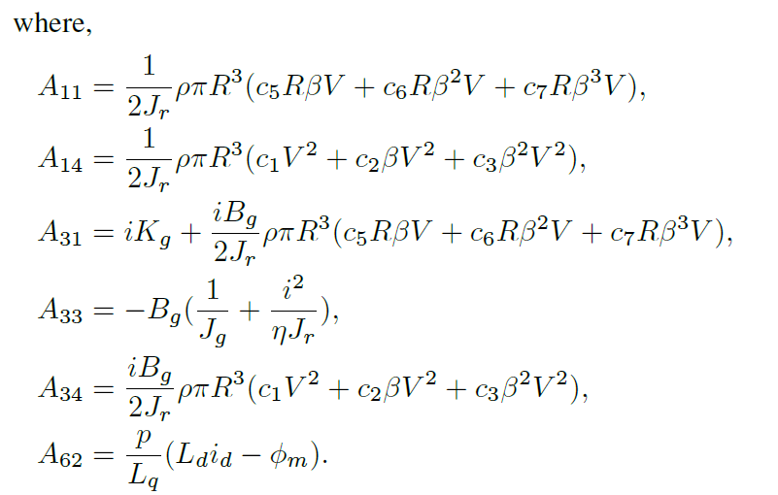
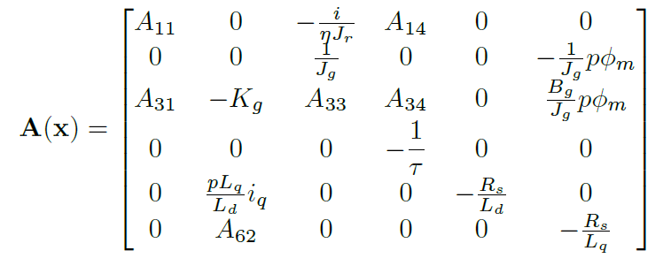
Nonlinear Modeling of VSVP-WECS
Nonlinear VSVP-WECS after transforming into SDC form, A(x) and B(x) matrices are found.
19th Annual IEEE INTERNATIONAL CONFERENCE ON ELECTRO INFORMATION TECHNOLOGY

Slide 22
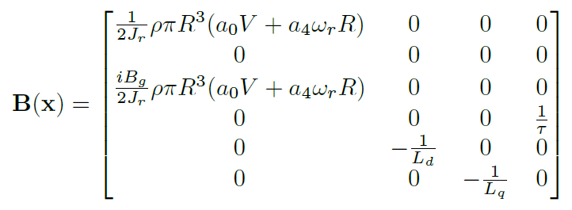
Nonlinear Modeling of VSVP-WECS
and B(x) matrix will be
19th Annual IEEE INTERNATIONAL CONFERENCE ON ELECTRO INFORMATION TECHNOLOGY

Slide 23
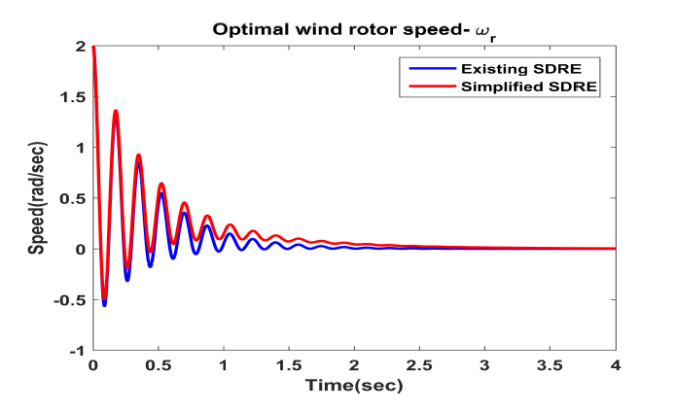
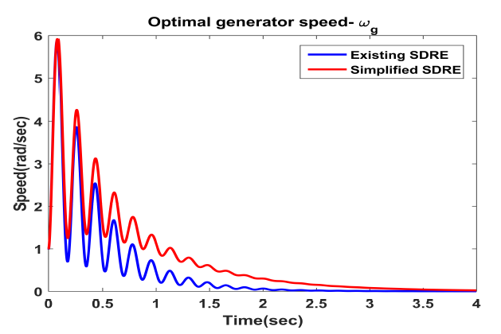
Simulation Results
State ω_{r} response with existing SDRE and simplified SDRE
State ω_{g} response with existing SDRE and simplified SDRE

Slide 24
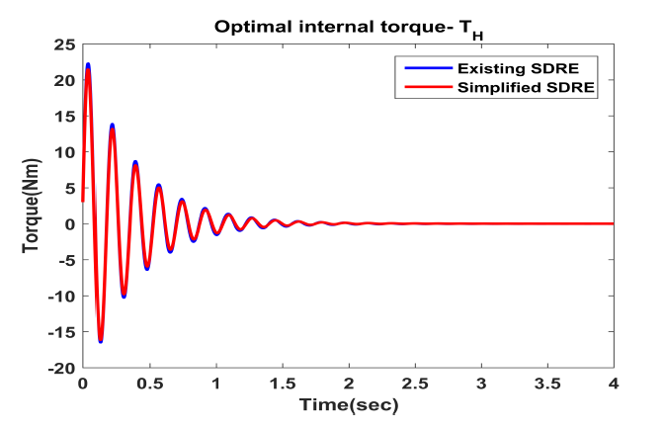
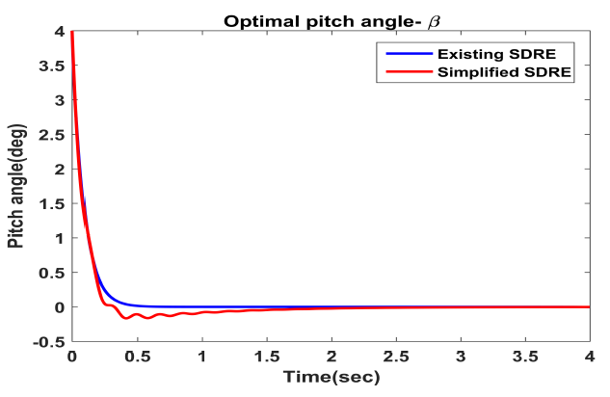
Simulation Results
State T_{H} response with existing SDRE and simplified SDRE
State β response with existing SDRE and simplified SDRE

Slide 25
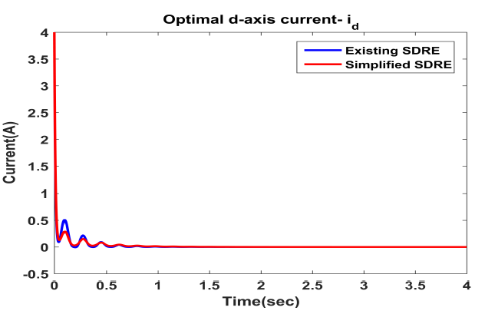
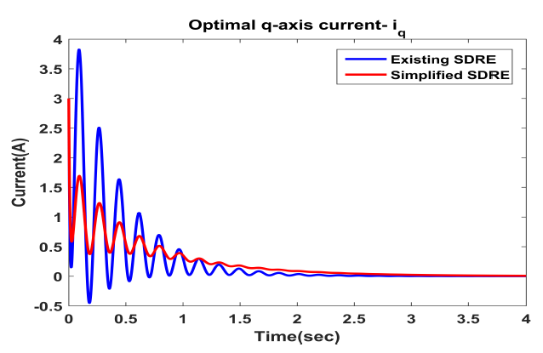
Simulation Results
State i_{d} response with existing SDRE and simplified SDRE
State i_{q} response with existing SDRE and simplified SDRE

Slide 26
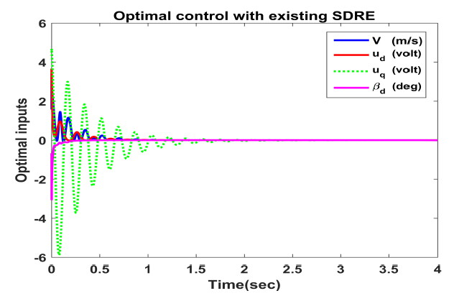
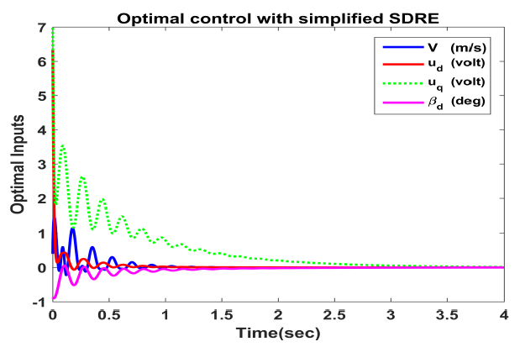
Simulation Results
Nonlinear optimal controller with existing SDRE
Nonlinear optimal controller with simplified SDRE

Slide 27
Conclusions
This paper proposed a simplified SDRE technique for finite horizon optimal regulation of nonlinear systems.
The main idea is to use the analytical solution of MDRE and associated MATLAB program lqrnss at each time step instead of using steady-state Riccati coefficient.
This method eliminates approximate nature of the solution resulting from existing SDRE and reduces the computational complexities.
The proposed simplified technique is implemented on a nonlinear sixth order VSVP-WECS and compared with the existing approach.
Simulation results validates the effectiveness of the simplified SDRE technique.
19th Annual IEEE INTERNATIONAL CONFERENCE ON ELECTRO INFORMATION TECHNOLOGY

Slide 28
Thank You & Any Questions ?
19th Annual IEEE INTERNATIONAL CONFERENCE ON ELECTRO INFORMATION TECHNOLOGY

